Slide 1
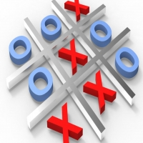
Tic Tac Toe Game
SHIVAM BATHAM
Supervised By: MR. Subhash Maurya

Slide 2
Topics to be discussed!???
introduction
Tic Tac Toe(Description)
Why this project?
Project Features
Problems
Project implementation
Recommendations and Future work
Demo

Slide 3
introduction
Games provide a real source of enjoyment in daily life.
Games also are helpful in improving the physical and mental health of human. Apart from daily life physical games, people also play computer games. These games are different than those of physical games in a sense that they do not involve much physical activity rather mental and emotional activities.

Slide 4
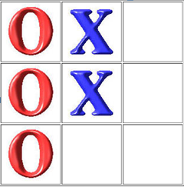
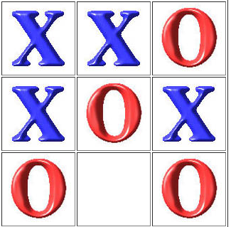
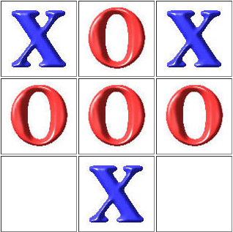
introduction
Our project name is Tic-Tac-Toe. This game is very popular and is fairly simple by itself. It is actually a two player game, zero-sum game (gain equals the loss of other).
In this game, there is a board with n x n squares. In our game, it is 3 x 3 squares. The goal of Tic-Tac-Toe is to be one of the players to get three same symbols in a row - horizontally, vertically or diagonally - on a 3 x 3 grid.

Slide 5
Tic Tac Toe(Description)
Our project is a Tic Tac Toe game that play by two human player depend on the picture that a human take it his chance and analysis the image using it’s own brain then send turn to Another human move it to one of the nine positions depend on which player was play, when the game finished and if the you win than bear will start dancing.

Slide 6
Why this project?
So we try to employee human intelligence to play Tic Tac Toe in more interesting way.
As Artificial intelligence technology occupies the world, it becomes an essential part of all the fields around us; it aims to become more interactive and interesting.
Notes:
اصبح الذكاء الاصطناعي موجود في كل مكان وحتى تكون الالعاب اكثر ذكاءا اصبحت تحتوي بشكل كبير على الذكاء الاصطناعي وهنا اليوم نقوم باستخدام الدكاء الاصطناعي لعمل روبوت يلعب الاكس او مع شخص عادي .

Slide 7
Project Features
The game can start by any one of the two player.
The main features of our project that we can play any level of tic tac toe with the human brain (Simple, Medium, Hard).its on you.
The result after the game finish will see on the website.
After the game finished we put Bear dance in the website page or off depending on the result of the game.

Slide 8
Project implementation
We divided the project into two parts.
Software part.
Hardware implementation.

Slide 9
Software part
We build application by using VS code program to deal with the hardware part. This application consist of three parts (html ,css ,js) these are communicate with each other to play a Tic Tac Toe game between human and human player using the image processing to analyze the picture and take a effective move to win the game.

Slide 10
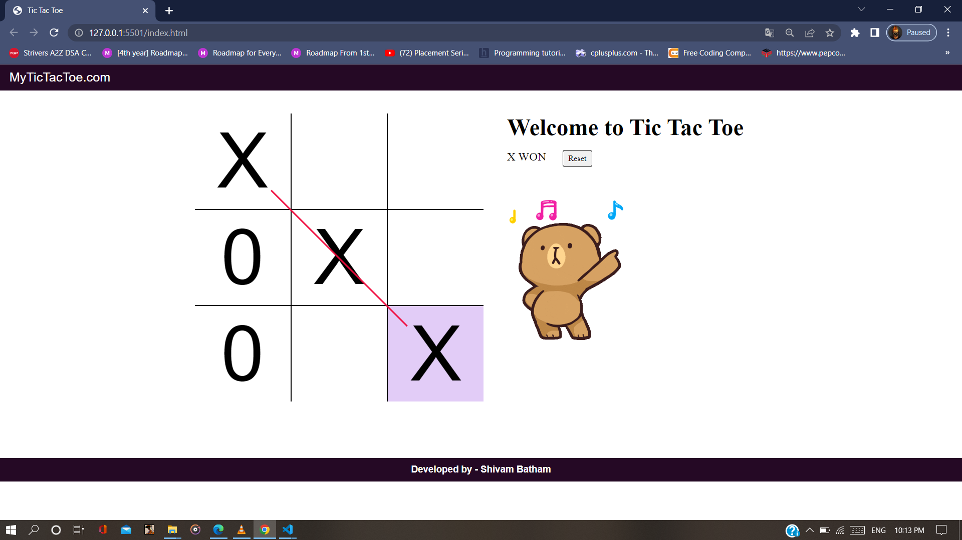
Software part
This picture show the application to interacts with the hardware part.

Slide 11
Software part
First part is a TicTacToe class this class control the board in the project the class consist off 3*3 array and function to set the current player may be player X or player O in the specifid position in the array, the psistion in the array speciefied by the players O, and when any position in the array is set by any player there is the function to detect the win or the eqality(draw).

Slide 12
Software part
The this part in the program is the frame window that shown to the user, this frame consist of web page with box size of 3*3 small boxes to open the web page connected to internet.

Slide 13
Hardware part
Firstly we have the Phone or Computer to play the game.
Then in this part we determine the values on each position for the nine positions and store the values in different functions, then depend on the command received by serial we control the flow.
Lastly and the most important was the development of code to translate move of the tic-tac-toe program into actions of the physical system.

Slide 14
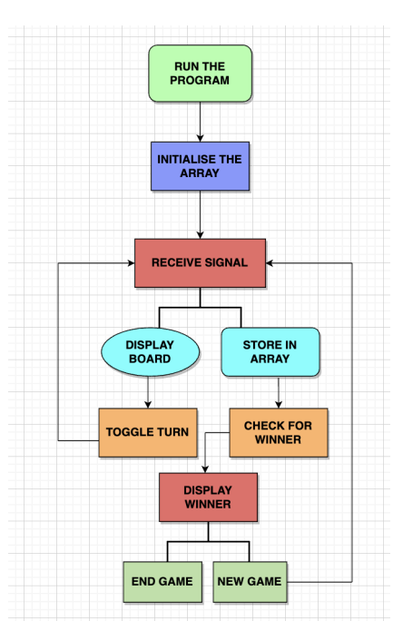
Analysis System Design

Slide 15
Components
A Laptop
VS code studio IDE
VS live server for Local hostiong
Board of 3 x 3 squares
Red and white pieces
OS windows
Hyper Text Markup Language
Cast Cadding Style sheet
JavaScript

Slide 16
Problems
The problem was not familiar with the Tech Stack.
One month to get the basic syntax.
In this project Javascript was the most compleacted part of this.
Connecting to the Html code With JavaScript

Slide 17
Recommendations and Future work
Before using any component make sure you have suitable Knowledge of tech stack for your project.
Firstly, Get familiar with the tech stack.
Choose a tech stack who can help you in your skills.

Slide 18
Demo

