Slide 1
Network Diagram
Design a 4G/5G Telecom Network Diagram from Integration Matrix
(This experiment is morphed with Dummy data to explain phenomenon and keeping Organization’s data secure)
Purpose: Designing Network Diagram for a customer by various employees leads to different diagram structure by every individual, increases challenge in understanding diagrams generated by other employees. Also, due to limited visibility on complex network structure, humans are more prone to errors/missing interfaces/integration points. With Network Diagram solution, a standard snip is created considering all integration points and interfaces, reduce human errors and enhances understanding network design based on standard network diagram.

Slide 2
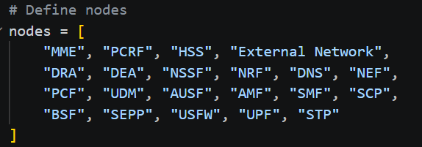
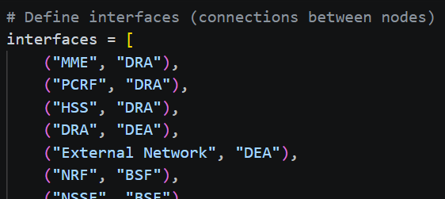
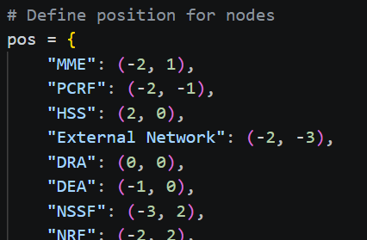
Input: Define Nodes, Interfaces, Position
FYI: Due to more control of position, it’s asked by peers to define it manually, else automatic position can also be determined based on popularity of interfaces with other nodes.

Slide 3
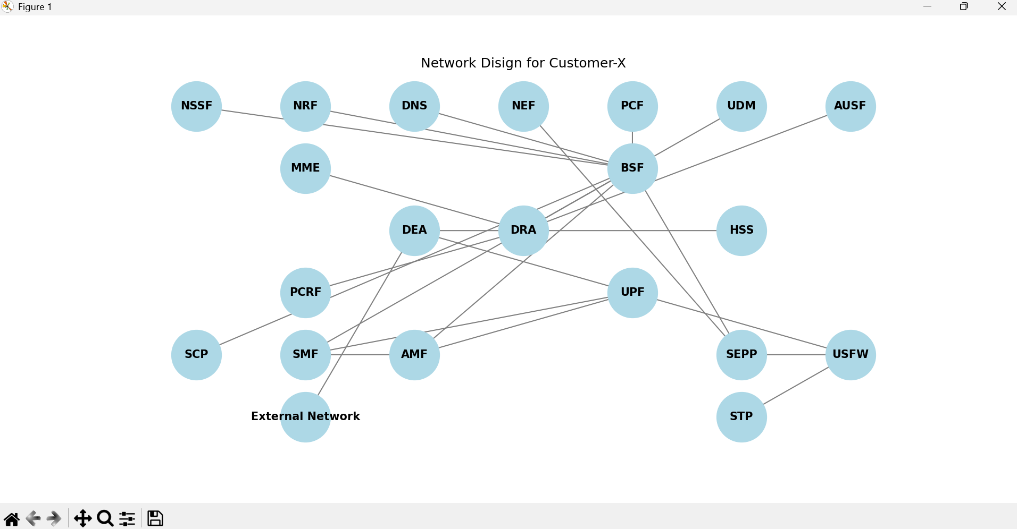
Graphs for Visualization

