Slide 1


Hotel Guest Experience Mind the Gap
Shivam Rajeshkumar Modi
| (857)230-4270 |

Slide 2
Introduction
Hotel Survey Method
Check-in: "What persuaded you to choose our hotel for your stay?"
Check-out: "What impressed you the most during your stay?"
11 identical options available at both touchpoints
47 guest responses analyzed
Analysis Approach
Compared attraction factors vs. impression factors
Calculated fulfillment rates for each feature
Identified guest experience patterns
Developed targeted recommendations

Slide 3
Findings

Slide 4
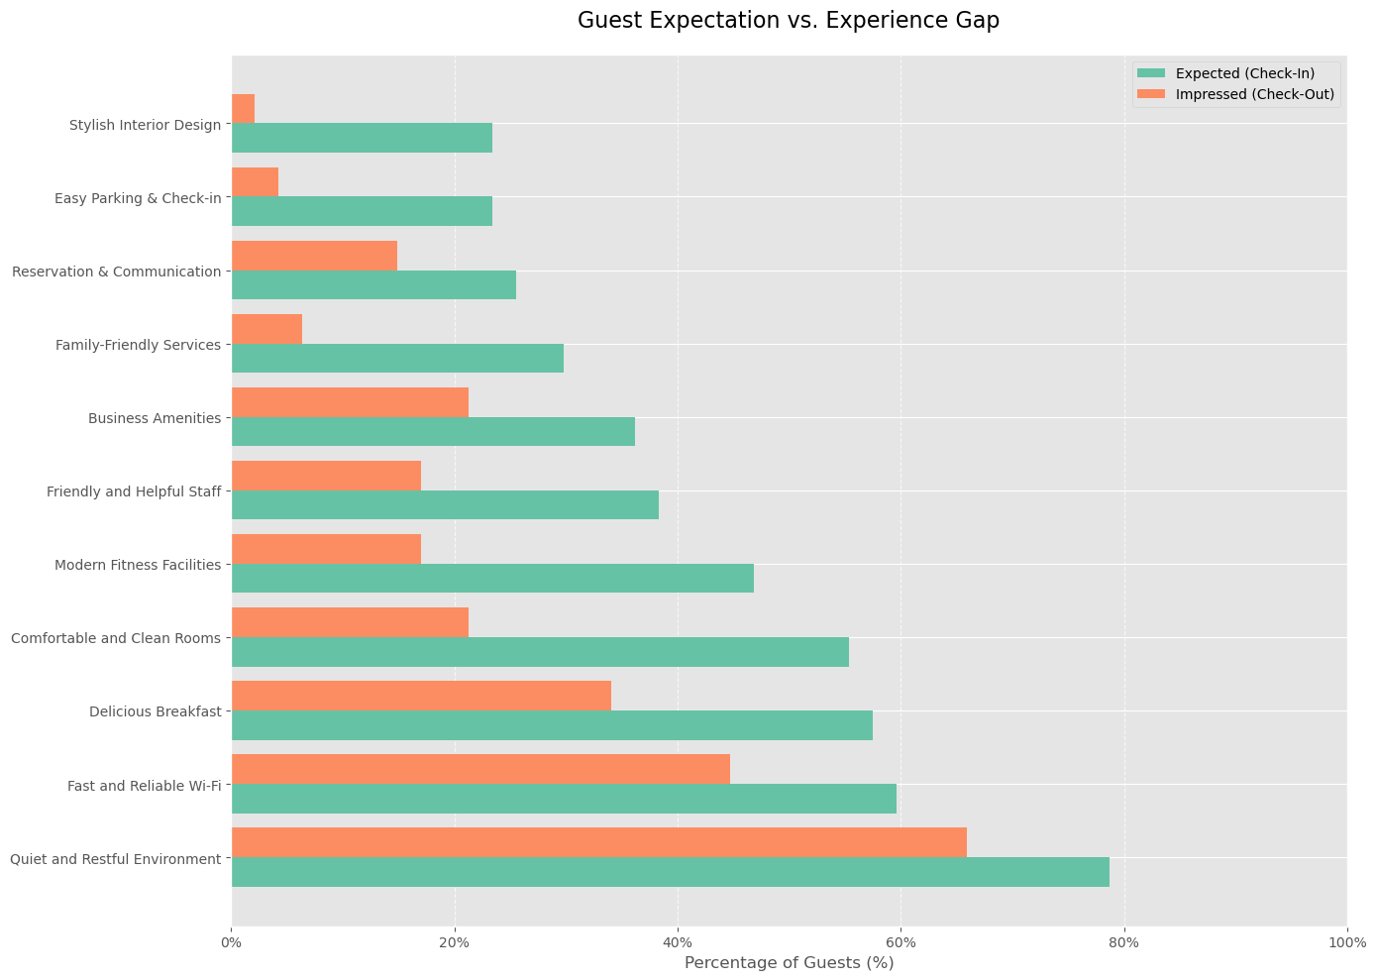
Expectation vs. Reality Gap
Feature | Check-In % | Check-Out % | Gap (% points)
Quiet and Restful Environment | 78.7% | 66.0% | -12.7%
Fast and Reliable Wi-Fi | 59.6% | 44.7% | -14.9%
Delicious Breakfast | 57.4% | 34.0% | -23.4%
Comfortable and Clean Rooms | 55.3% | 21.3% | -34.0%
Modern Fitness Facilities | 46.8% | 17.0% | -29.8%
Friendly and Helpful Staff | 38.3% | 17.0% | -21.3%
Business Amenities | 36.2% | 21.3% | -14.9%
Family-Friendly Services | 29.8% | 6.4% | -23.4%
Reservation & Communication | 25.5% | 14.9% | -10.6%
Easy Parking & Check-in | 23.4% | 4.3% | -19.1%
Stylish Interior Design | 23.4% | 2.1% | -21.3%
All features show negative gaps
Top 5 disconnects:
Comfortable Rooms (-34.0%)
Fitness Facilities (-29.8%)
Breakfast & Family Services (-23.4%)
Friendly Staff (-21.3%)
Even best performers disappoint

Slide 5
Reliable Strengths
Feature | Continuation Rate | Interpretation
Quiet and Restful Environment | 86.1% | Strong performer
Fast and Reliable Wi-Fi | 80.8% | Strong performer
Business Amenities | 58.8% | Moderate performer
Reservation & Communication | 58.3% | Moderate performer
Delicious Breakfast | 57.7% | Moderate performer
Friendly and Helpful Staff | 44.4% | Underperformer
Comfortable and Clean Rooms | 38.5% | Underperformer
Modern Fitness Facilities | 36.4% | Underperformer
Family-Friendly Services | 21.4% | Poor performer
Easy Parking & Check-in | 18.2% | Poor performer
Stylish Interior Design | 9.1% | Poor performer
Two consistent strengths:
Quiet Environment (86.1% fulfillment)
Fast Wi-Fi (80.8% fulfillment)
Critical failures in basic expectations:
Comfortable Rooms (38.5% fulfillment)
Friendly Staff (44.4% fulfillment)

Slide 6
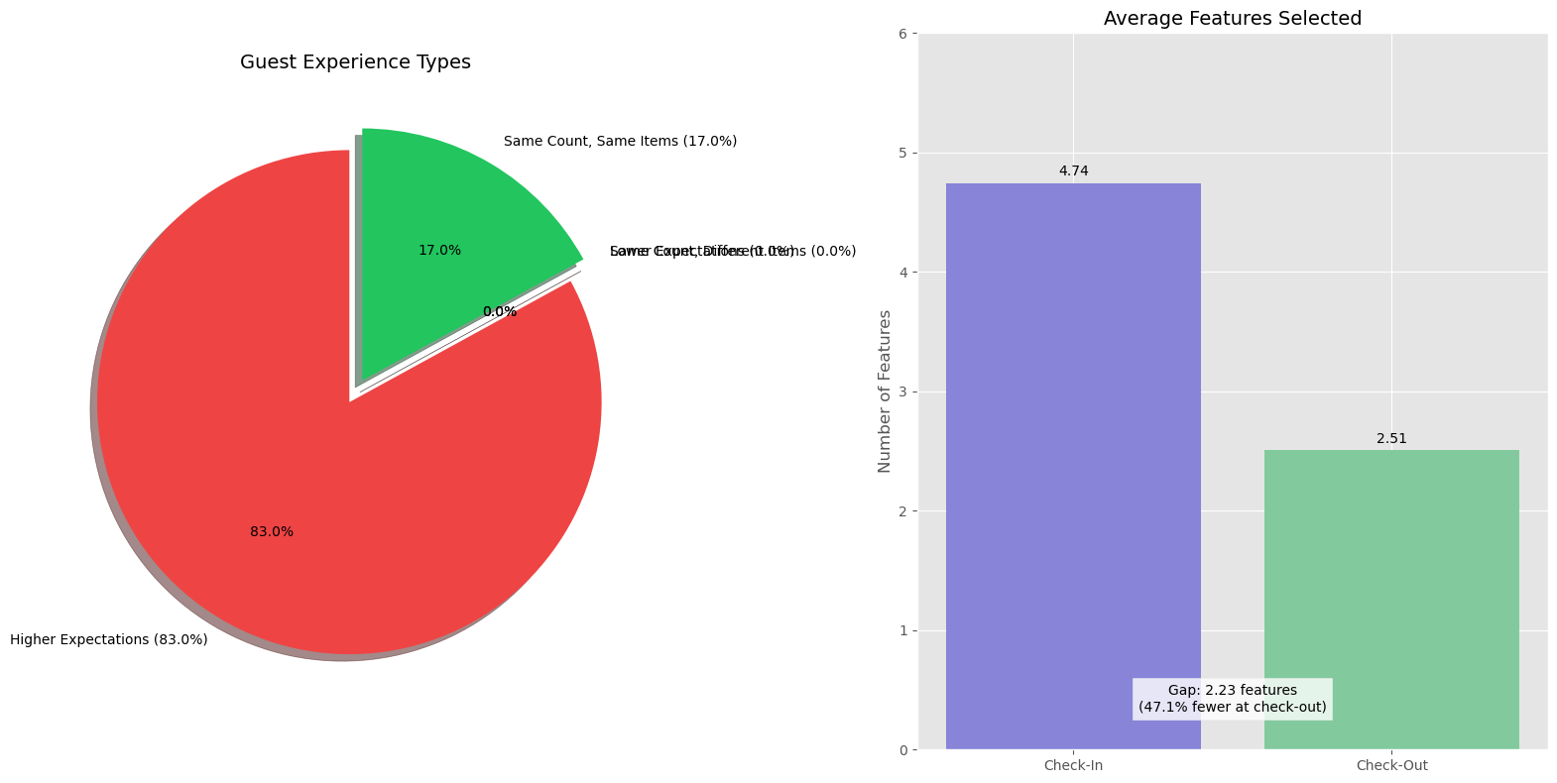
Systematic Disappointment
83% of guests experienced disappointment
47.6% drop in feature mentions from check-in to check-out
Average guest mentions:
4.74 features at check-in
2.49 features at check-out

Slide 7
Recommendations

Slide 8
1: Marketing Realignment
Focus on Proven Strengths
Emphasize "Quiet Environment" and "Fast Wi-Fi" in all marketing
De-emphasize weakest performers until improved
Implement authentic content strategy with genuine guest photos
Implementation:
Update website homepage within 2 weeks
Revise all digital ads within 1 month
Redesign brochures and print materials within 2 months

Slide 9
2: Operational Priorities
Urgent Focus Areas:
Room quality: Enhanced cleaning protocols and quality checks
Staff service: Comprehensive customer service training
Breakfast quality: Menu review and service improvements
Fitness facilities: Equipment upgrade or marketing adjustment
Timeline:
Room & staff improvements: 30 days
Breakfast & fitness improvements: 90 days
Weekly operational reviews of progress

Slide 10
3: Guest Experience System
Expectation Management:
Pre-arrival communications highlighting true strengths
Website "Expectations vs. Reality" section with authentic content
Staff training on consistent delivery of core promises
Continuous Improvement:
Real-time guest feedback system during stays
Ongoing check-in/check-out surveys to measure progress
90-day targets for reducing expectation-experience gap

Slide 11
Next Steps & Implementation
Immediate
(1-2 weeks)
Update marketing content to reflect true strengths
Implement enhanced room cleaning protocols
Begin detailed tracking of guest feedback
Short-term
(30 days)
Complete staff customer service training
Launch real-time guest feedback system
Redesign pre-arrival communications
Medium-term
(90 days)
Measure reduction in expectation-experience gap
Complete secondary operational improvements
Develop loyalty strategy based on authentic strengths

Slide 12

Thank You!!!
Shivam Rajeshkumar Modi
Business Analyst
Northeastern University, Boston, MA
Email: shivam.rajeshkumar.modi@gmail.com
Mob.: +1 (857) 230-4270

