Slide 1
Object Oriented Programming In Java
Saurabh Pandey
Associate Professor
Sitare University

Slide 2
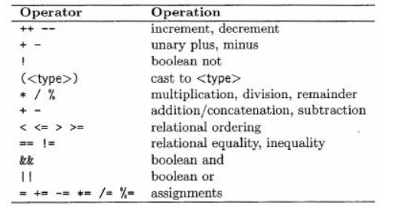
Java Operators
Post and pre increment

Slide 3
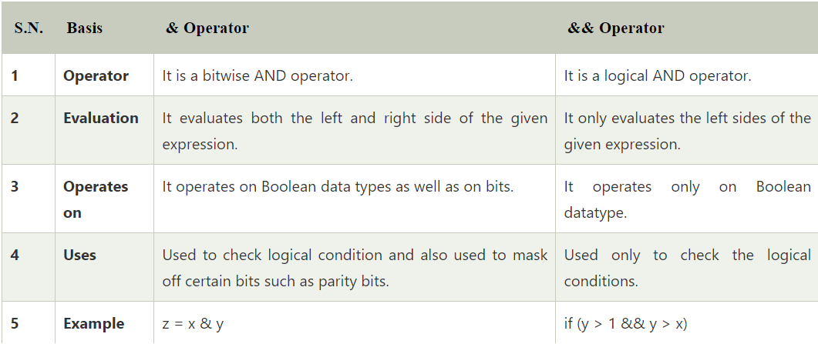
Java Operators
Difference between (&&, ||) and (&,|)
&&, || : These are called Logical AND and Logical OR operator
&, | : These are called bitwise AND and bitwise OR operator

Slide 4
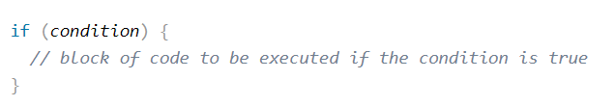
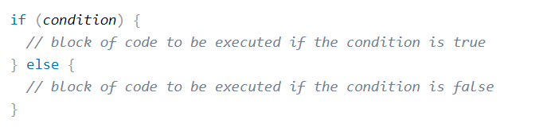
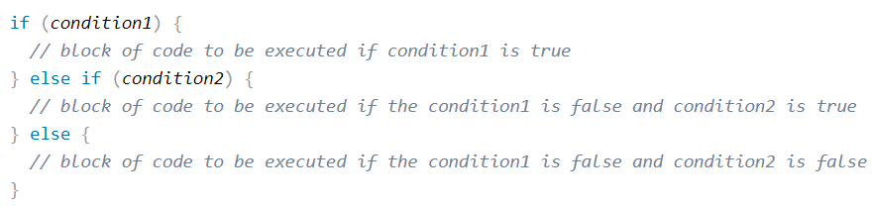
Conditional Statements
Java has the following conditional statements:
Use if to specify a block of code to be executed, if a specified condition is true
Use else to specify a block of code to be executed, if the same condition is false
Use else if to specify a new condition to test, if the first condition is false
Use switch to specify many alternative blocks of code to be executed
if syntax
else syntax
else if syntax

Slide 5
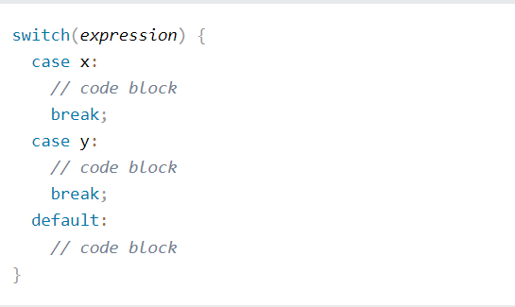
Conditional Statements
Ternary operator(short hand if else) syntax
There could be nested if else statements also.
Switch statement

Slide 6
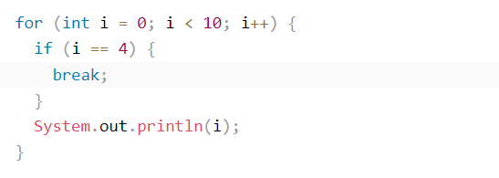
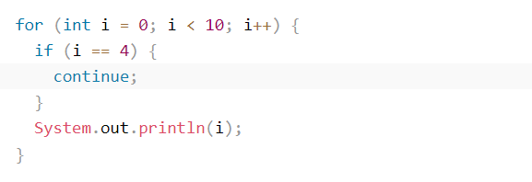
break and continue keywords
You have already seen the break statement used in an earlier chapter of this tutorial. It was used to "jump out" of a switch statement.
The break statement can also be used to jump out of a loop.
The continue statement breaks one iteration (in the loop), if a specified condition occurs, and continues with the next iteration in the loop.

Slide 7
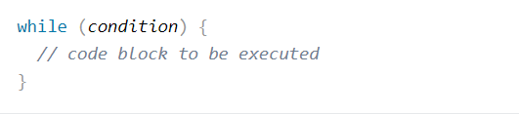
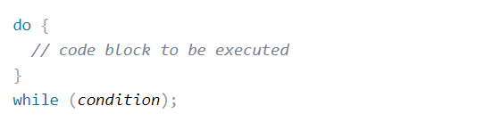
Loops in java
While loop
Do/While loop

Slide 8
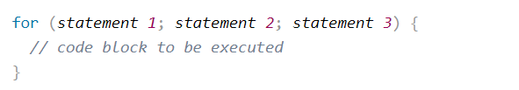
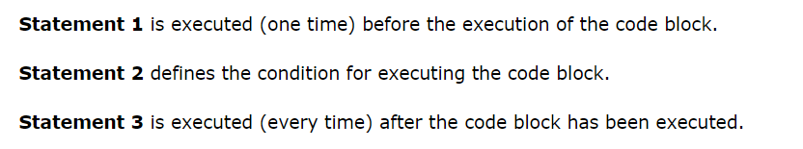
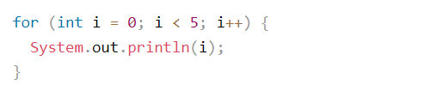
Loops in java
For loop
There could be nested loops in your code.

Slide 9
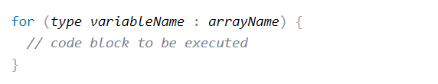
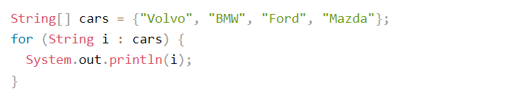
Loops in java
For Each loop
It is used exclusively to loop through elements in an standard data structure as array or arraylist.

Slide 10
Packages
In the Java API, classes are grouped into packages. To use a class in the API, you have to know which package the class is in.
Packages are important for three main reasons.
First, they help the overall organization of a project or library. Rather than just having one horrendously large pile of classes, they’re all grouped into packages for specific kinds of functionality (like GUI, or data structures, or database stuff, etc.)
Second, packages give you a name scoping, to help prevent collisions. If you and 12 other programmers in your company all decide to make a class with the same name. If you have a class named Set and someone else (including the Java API) has a class named Set, you need some way to tell the JVM which Set class you’re trying to use.
Third, packages provide a level of security, because you can restrict the code you write so that only other classes in the same package can access it.
import the package or type class with full package name

Slide 11
Object Equality
When we compare primitives with == operator, it compares values of the primitives.
When you compare two object references, it checks only reference values not the objects.
If you want to check two objects equality, use equals() method which is method of Object class. Object class is mother of all classes in java.

