Slide 1
Object Oriented Programming In Java
Saurabh Pandey
Associate Professor
Sitare University

Slide 2
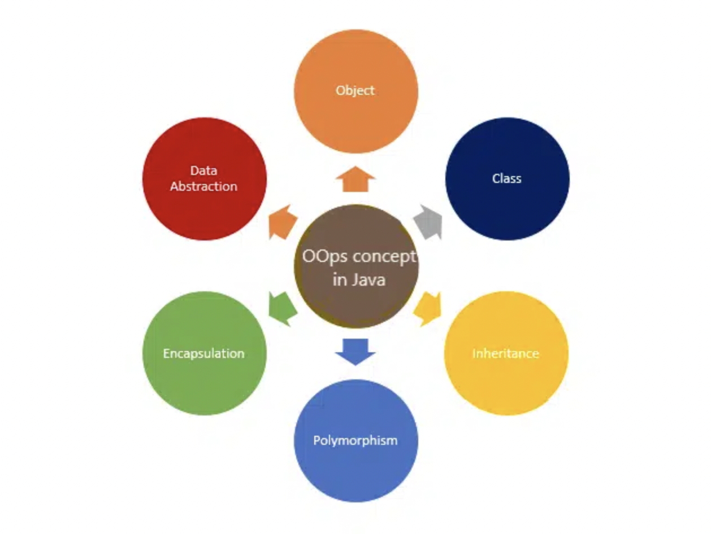
OOPS Core Concepts
Class
Object
Data Abstraction
Encapsulation
Inheritance
Polymorphism

Slide 3
Inheritance
Inheritance is the process of one class inheriting properties and methods from another class in Java. Inheritance is used when we have is-a relationship between objects. Inheritance in Java is implemented using extends keyword. It avoids the duplicate code.
What is has-a relationship?
There are 5 different types of inheritance as follows:
Single Inheritance: Class B inherits Class A using extends keyword
Multilevel Inheritance: Class C inherits class B and B inherits class A using extends keyword
Hierarchy Inheritance: Class B and C inherits class A in hierarchy order using extends keyword
Multiple Inheritance: Class C inherits Class A and B. Here A and B both are superclass and C is only one child class. Java is not supporting Multiple Inheritance, but we can implement using Interfaces.
Hybrid Inheritance: Class D inherits class B and class C. Class B and C inherits A. Here same again Class D inherits two superclass, so Java is not supporting Hybrid Inheritance as well.
Notes:
Inheritance example : Human, our forefathers, us. Describe it in the form of super class and sub classes.

Slide 4
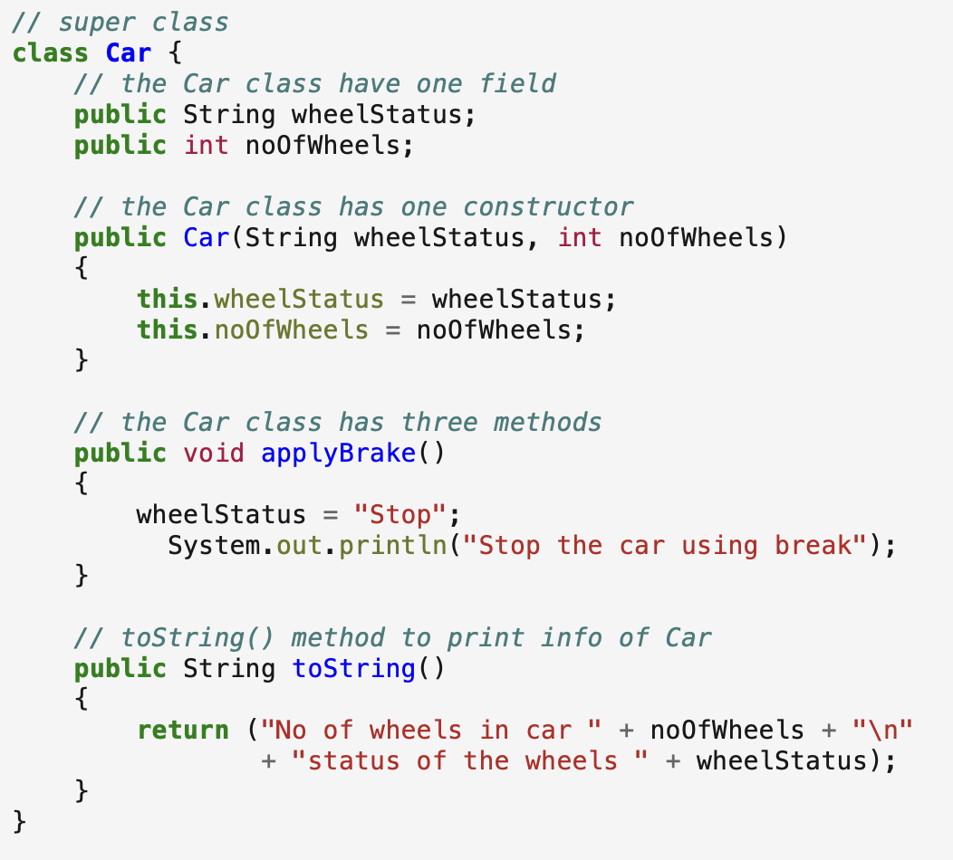
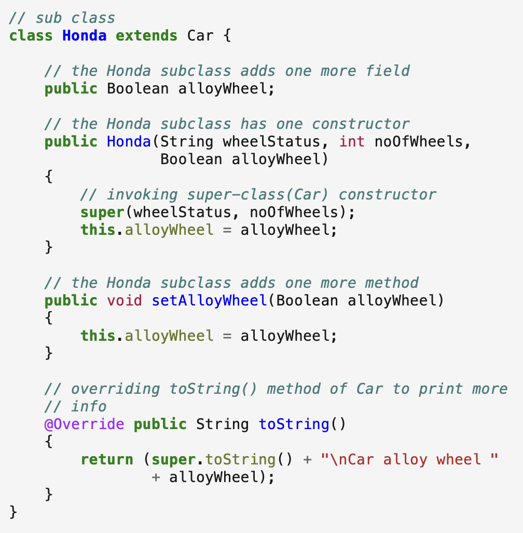
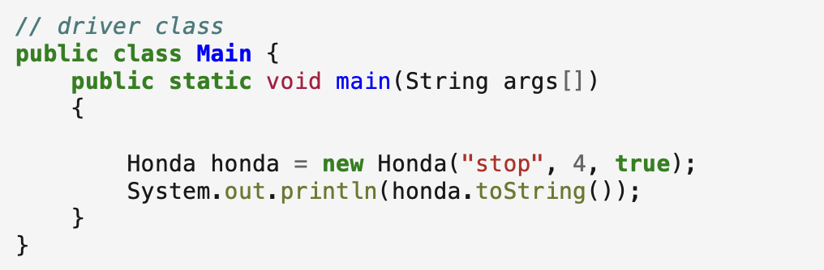
Example
Output :
No of wheels in car 4
Status of the wheels stop
Car alloy wheel true

Slide 5
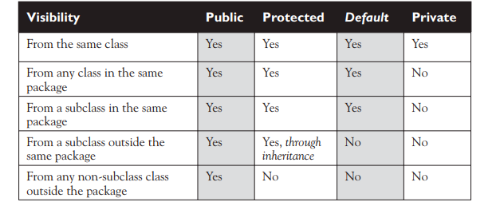
Inheritance and Access modifiers
Public members are inherited.
Private members are not inherited.
default members are inherited in the same package subclass but not in different package subclass.
Protected members are inherited in the different package subclass too.
Overriding:
Only super class methods can be overridden not the instance variables. Only those methods should be overridden whose behaviors may change in subclasses.
If subclass wants to use super class method, use super.methodname() in the subclass method.

Slide 6
Restrict Inheritance
If you declare a class as final, no other class can extend it. Java APIs has many classes as final. Example : String Class
If you declare an instance variable as final, you can’t change it’s value.
If you declare a method as final, subclass can’t override it.
Rules for Overriding:
Arguments must be the same and return type must be compatible.
The method can’t be less accessible.

Slide 7
Overloading a method
Method overloading is nothing more than having two methods with the same name but different argument lists. It has nothing to do with inheritance and polymorphism. An overloaded method is NOT the same as an overridden method.
Rules of Overloading:
The return types can be different.
You can’t change ONLY the return type.
You can vary the access levels in any direction.

Slide 8
Abstraction
Abstraction is a process of hiding implementation details and exposing only the functionality to the user. In abstraction, we deal with ideas and not events. This means the user will only know “what it does” rather than “how it does”.
There are two ways to achieve abstraction in Java:
Abstract class (0 to 100%)
Interface (100%)
Certain key points should be remembered regarding this pillar of OOPS as follows:
The class should be marked as abstract if a class has one or many abstract methods.
An abstract class can have constructors, concrete methods, static method, and final method
Abstract class can’t be instantiated directly with the new operator. It can be possible as shown in pre tag below:
A obj = new B();
//Here A is abstract class and B is the concrete sub class of A.
The child class should override all the abstract methods of parent else the child class should be declared with abstract keyword.
Notes:
Bridge or house architecture example.

Slide 9
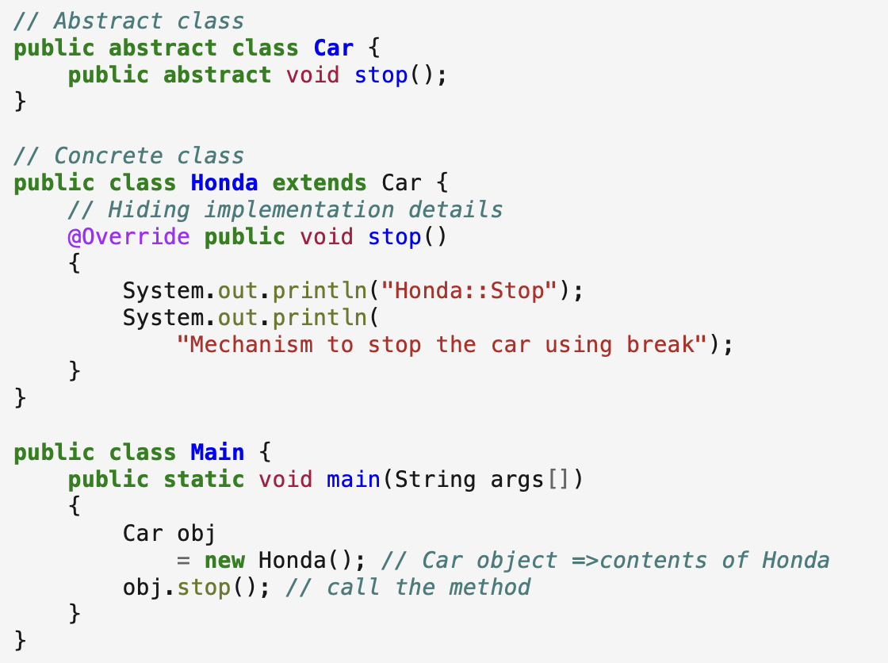
Example:
Output:
Honda::Stop
Mechanism to stop the car using break

Slide 10
Abstract Class
The compiler won’t let you instantiate an abstract class
An abstract class has virtually* no use, no value, no purpose in life, unless it is extended
An abstract method has no body!
If you declare an abstract method, you MUST mark the class abstract as well. You can’t have an abstract method in a non-abstract class.
You MUST implement all abstract methods in the first concrete class. Implementing an abstract method is just like overriding a method.

Slide 11
Interface
A Java interface is like a 100% pure abstract class.
Define an interface
Implement an interface
Classes from different inheritance trees can implement the same interface.
A class that implements an interface must implement all the methods of the interface, since all interface methods are implicitly public and abstract
Default methods
Static methods
Private methods

Slide 12
Object Class important methods
equals(Object o)
getClass()
hashCode()
toString()

Slide 13
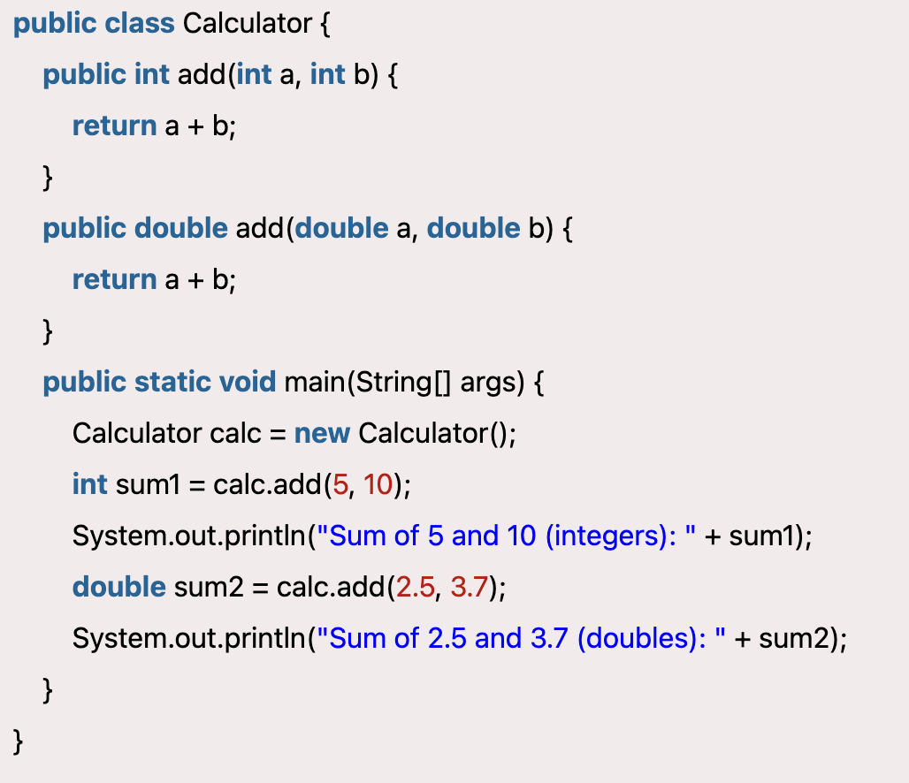

Polymorphism
Polymorphism refers to many forms, or it is a process that performs a single action in different ways. It occurs when we have many classes related to each other by inheritance.
There are two types of polymorphism as listed below:
Static or Compile-time Polymorphism
Dynamic or Run-time Polymorphism
Static or Compile-time Polymorphism when the compiler is able to determine the actual function, it’s called compile-time polymorphism. Compile-time polymorphism can be achieved by method overloading in java. When different functions in a class have the same name but different signatures, it’s called method overloading. A method signature contains the name and method arguments. So, overloaded methods have different arguments. The arguments might differ in the numbers or the type of arguments.
Compile Time or Static Polymorphism
Notes:
Many forms

Slide 14
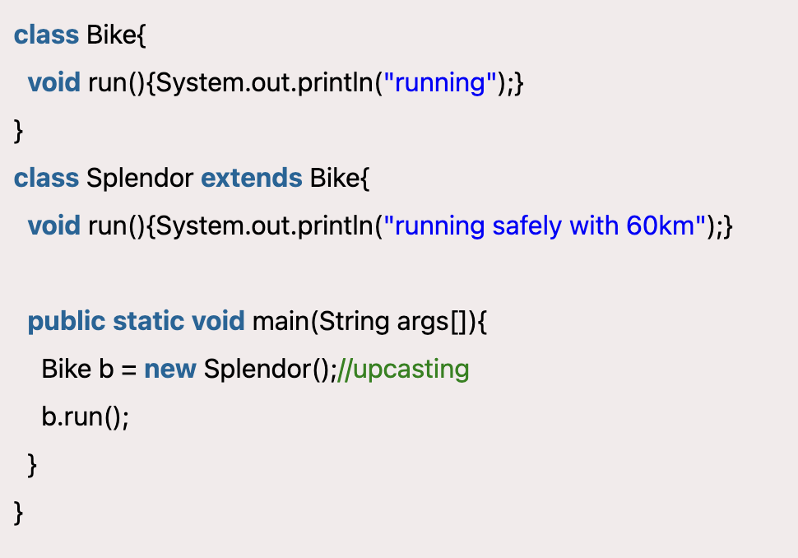

Polymorphism
Dynamic or Run-time Polymorphism occurs when the compiler is not able to determine whether it’s superclass method or sub-class method it’s called run-time polymorphism. The run-time polymorphism is achieved by method overriding. When the superclass method is overridden in the subclass, it’s called method overriding.

