Slide 1
A Convolutional Neural Network Based Skin Disease Diagnosis
Aju K Toly(6)
Akhilnath G(9)
Akshay T K(10)
Arjun R(17)

Slide 2
Introduction
Composed of epidermis, dermis, and subcutaneous tissues, skin is the largest organ of human body, containing blood vessels, lymphatic vessels, nerves, and muscles, which can perspire, perceive the external temperature, and protect the body.
Currently, there are three main types of skin diseases appearing in human body, including viral skin diseases, fungal skin diseases, and allergic skin disease.
Despite the fact that these types of skin diseases can be cured at present, these diseases indeed have brought trouble to patient's life. Nowadays, the majority of conclusions on the patient's’ existing symptoms are drawn mainly based on doctors’ years of experience or their own subjective judgments, which may lead to misjudgments and consequently delay the treatment of these.
Therefore, it is of great theoretical significance and practical value to study how to extract symptoms of diverse skin diseases on the basis of modern science and technology. Under this circumstance, effective and accurate identification of the types of skin diseases can be achieved to prescribe treatment according to patient’s symptoms

Slide 3
Problem Statement
The early detection of skin diseases are very important as skin is one of the largest organ in the human body. Prevention of diseases and early diagnosis is of prime importance in today’s scenario as the lifestyle have changed. Today’s lifestyle has paved way to new diseases. Without proper care and safety, it may result in leading to chronic diseases. There is a need of system that can diagnose the skin diseases without any extensive tests being conducted.

Slide 4
Objective
The objective of the project is two-fold; to develop a convolutional neural network to diagnose various skin diseases like melanoma psoriasis, ringworm etc. that overcomes the cons of existing methods and provide better results and accuracy and to develop an efficient and dependable system for dermatological disease detection that can be used as a reliable real time tool for dermatological disease diagnosis

Slide 5
Literature Survey

Slide 6
SL NO | PAPER NAME | PAPER AUTHORS | METHODS USED | DISADVANTAGES
1 | Analysis and classification of human skin diseases | P.B. Manoorkar Prof. D.K. Kamat | Measurement of impedance of skin | Can only be used at an early stages. Can’t detect multiple diseases at a time.
2 | Detection of vitiligo skin disease using LVQ neural network | Anish Gupta, Anand Upadhyay | LVQ NN | Only detect affected area,Cannot measure the intensity of the disease.
3 | Image analysis model for skin disease detection framework | Shihab A.Hameed, Alaa Haddad | Image Processing | Large no: of data is needed,High configuration systems required.
4 | Dermatological disease detection using Image processing and ANN | Nova Ahmed, Rahat Yasir | Image Processing, ANN,CV | Large no: of datasets is needed,High configuration systems required.
5 | Dermatological Disease Detection Using Image Processing and Machine Learning | V B Kumar, Varun Saboo | CV,ML,ANN | Only 6 diseases can be detected,Inaccuracy with varying skin colours.
6 | Skin Disease Recognition Using Texture Analysis | Masyitah Abu, Md. Nazrul Islam | Classification using ANN | Shape accuracy comparatively low,Pattern similarity between diseases lead to less accuracy.
7 | An Automated Computer Aided Diagnosis of Skin Lesions Detection and Classification for Dermoscopy Images | R Suganya | SVM | Fails when two regions overlap,Segmentation of the skin in Dermis layer of the skin is not possible.
8 | Dermatological Disease Detection using Image Processing and CV | Ashiqur Rahman | CV,ML,Image Processing | Applicable only to diseases that has low elevation in the infected area,ineffective for acne and tinea corporis

Slide 7
System Design
The proposed system uses a convolutional neural network architecture called MobileNet. This architecture is based on depthwise separable convolution thus helping us to create a faster and lighter model that can be easily used on embedded and mobile devices. The user gives input of the skin disease which the system processes, does feature extraction and training using Mobile net architecture and use softmax classifier to detect the disease. For MobileNets the depthwise convolution applies filters to each input channel. The pointwise convolution then applies a 1×1 convolution to combine the outputs the depthwise convolution. A standard convolution both filters and combines inputs into a new set of outputs in one step thus increases the number of parameters. The depthwise separable convolution splits this into two layers, a separate layer for filtering and a separate layer for combining. This factorization has the effect of drastically reducing computation and model size. The main steps performed in each layers are:
Depthwise convolution
Batch norm
ReLU
Pointwise convolution
Batch norm
ReLU

Slide 8
Convolution
Convolution is the process of moving a filter mask over the image. There are 4 steps in convolution:
Line up the feature and the image.
Multiply each image pixel by corresponding feature pixel
Add the values and find the sum
Divide the sum by the total number of pixels in the feature

Slide 9
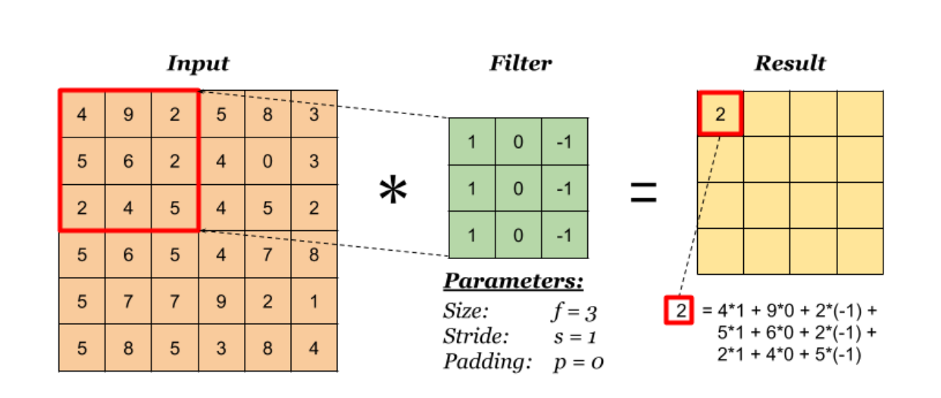

Slide 10
Depthwise separable convolution
Unlike normal convolution operations, here the different input channels are processed separately and then combined together. This helps in reducing the number of arithmetic calculations needed and thus makes the model faster and lighter. This is done by using two steps namely,
Depthwise convolution
Pointwise convolution

Slide 11
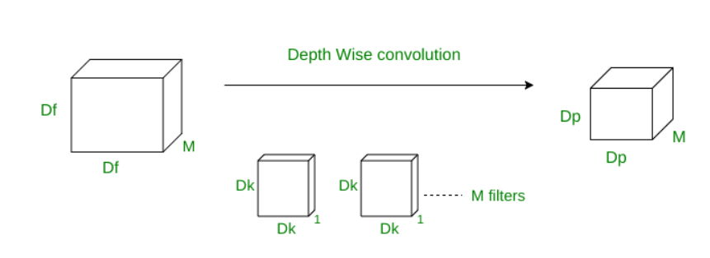
Depthwise convolution
In depth-wise operation, convolution is applied to a single channel at a time unlike standard CNN’s in which it is done for all the M channels. So here the filters/kernels will be of size Dk x Dk x 1. Given there are M channels in the input data, then M such filters are required. Output will be of size Dp x Dp x M.

Slide 12
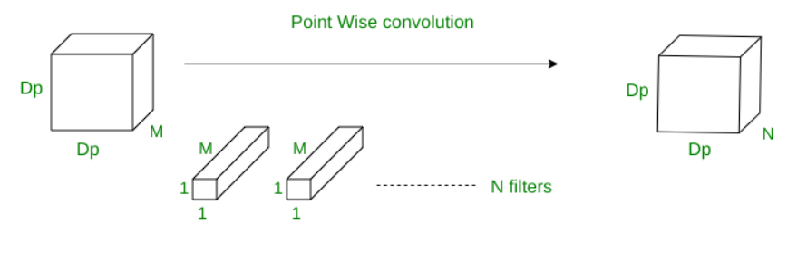
Pointwise convolution
In point-wise operation, a 1×1 convolution operation is applied on the M channels. So the filter size for this operation will be 1 x 1 x M. Say we use N such filters, the output size becomes Dp x Dp x N.

Slide 13
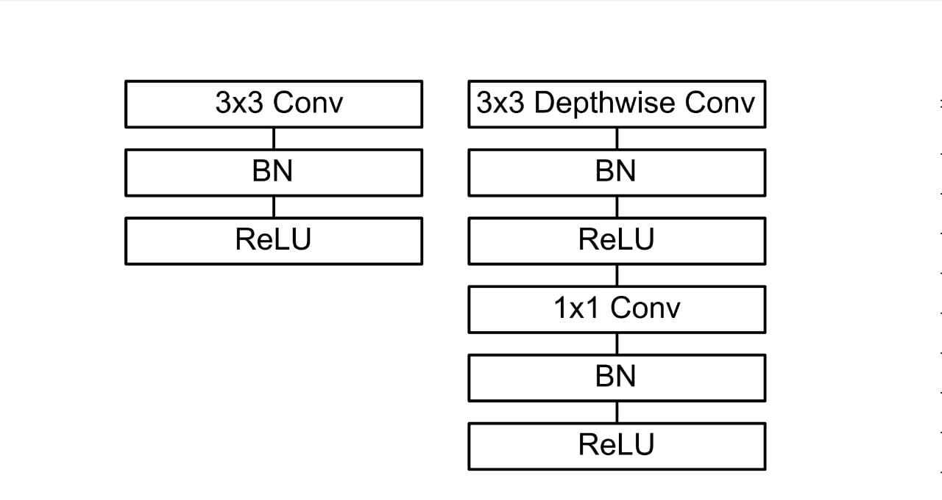
Normal convolution and depth wise separable convolutions
Fig: Normal convolution
Fig: Depthwise separable convolution

Slide 14
Batch Normalization
Batch normalization is a technique for training very deep neural networks that standardizes the inputs to a layer for each mini-batch. This has the effect of stabilizing the learning process and dramatically reducing the number of training epochs required to train deep networks.

Slide 15
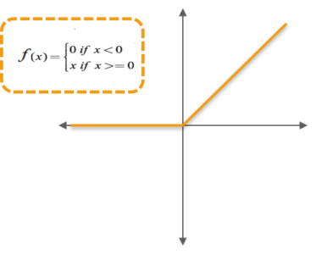
ReLU
Rectified Linear Unit (ReLU) transform function only activates a node if the input is above a certain quantity, while the input is below zero, the output is zero, but when the input rises above a certain threshold, it has a linear relationship with the dependent variable.

Slide 16
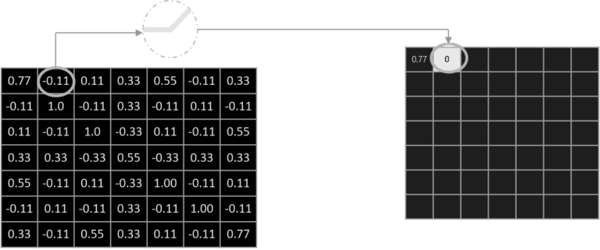

Slide 17
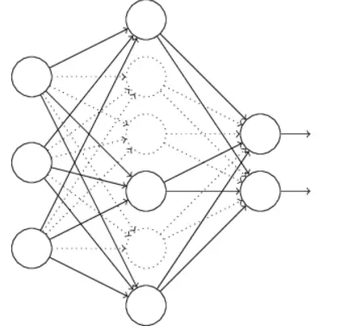
Dropout
Dropout is a a technique used to tackle Overfitting.The Dropout method in keras.layers module takes in a float between 0 and 1, which is the fraction of the neurons to drop.Dropout consists in randomly setting a fraction rate of input units to 0 at each update during training time, which helps prevent overfitting.

Slide 18
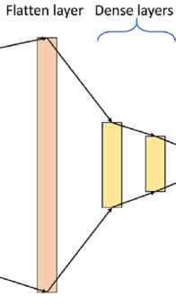
Dense layer
A Dense layer is just a regular layer of neurons in a neural network. Each neuron receives input from all the neurons in the previous layer, thus densely connected. The layer has a weight matrix W, a bias vector b, and the activations of previous layer. The dense layer takes in parameters the number of input neurons and the activation function.

Slide 19
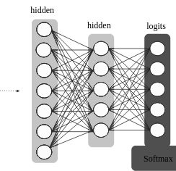
Softmax Classifier
The purpose of the softmax classification layer is simply to transform all the net activations in your final output layer to a series of values that can be interpreted as probabilities. The last layer takes in parameters like number of output labels and the activation called softmax.
It is further used to predict the class label.
CLASS LABELS

Slide 20
The dataset
Various sources were used to collect the required images
Bing API
500 images for each of the classes
We are using 4 classes of diseases in this classification namely,
Psoriasis
Melanoma
Ringworm
measles

Slide 21
Modules and functions
The following modules are used from tensorflow.keras
MobileNet
Model
ImageDataGenerator
Dense
Dropout
Adam optimizer
ReduceLROnPlateau
ModelCheckpoint
Categorical_accuracy
top_k_categorical_accuracy

Slide 22
Splitting the dataset
We used split_folders() for splitting the data set into train, test and validation sets
Import split_folders
split_folders.ratio(“phase2”,output=’ttv’,seed=1337,ratio=( .8, .1 , .1 ))

Slide 23
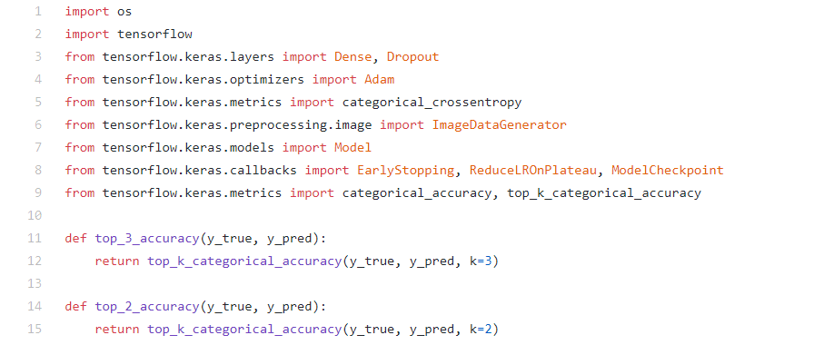

Slide 24
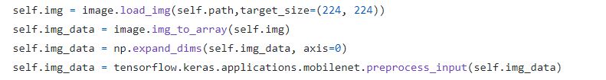
Pre processing
The resolution of the input images are changed to 224 x 224 using image module.
The loaded image is transformed into an array using img_to_array().
The rest of the preprocessing is done by MobileNet.preprocess_input().
Augmentation is done using ImageDataGenerator()

Slide 25
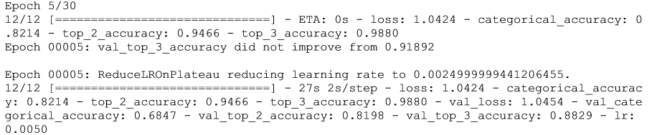
Steps in training
The pretrained MobileNet model is initialised.
This model have 28 layers in total. Of these layers the last 6 layers are removed so that it can be trained according to our required classes.
Dense and dropout are specified.
Class weights are initialised.
Function fit_generator() is called to begin training.
The number of epochs are set to be 30.
After each epoch the top 3 accuracy is checked ad the value of learning rate is adjusted if accuracy is not improving. This helps in converging faster
Adam optimizer is used to control the learning rate accordingly

Slide 26
mobile = tensorflow.keras.applications.mobilenet.MobileNet()
# MODIFY THE MOBILENET
#--EXCLUDE LAST 6 LAYERS
x = mobile.layers[-6].output
#--CREATE A DENSE LAYER FOR PREDICTION OF 4 CLASSES
x = Dropout(0.25)(x)
predictions = Dense(4, activation='softmax')(x)
model = Model(inputs=mobile.input, outputs=predictions)
#--LAST 23 LAYERS WILL BE TRAINED AND FREEZING THE WEIGHTS OF REST
for layer in model.layers[:-23]:
layer.trainable = False
model.compile(Adam(lr=0.01), loss='categorical_crossentropy',
metrics=[categorical_accuracy, top_2_accuracy, top_3_accuracy])
# CLASS SENSITIVITY , HERE PSORIASIS CLASS IS THE MOST SENSITIVE
class_weights={
0: 3.0, # PSORIASIS
1: 1.5, # MEASLES
2: 2.0, # MELANOMA
3: 2.4, # RINGWORM
}

Slide 27
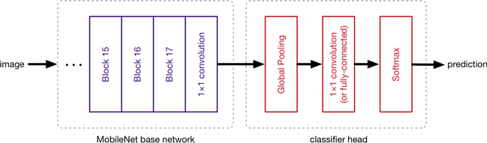
Image
MobileNet base Network
Classifier Head
Prediction class_labels = ["psoriasis","measles","melanoma","ringworm"]

Slide 28
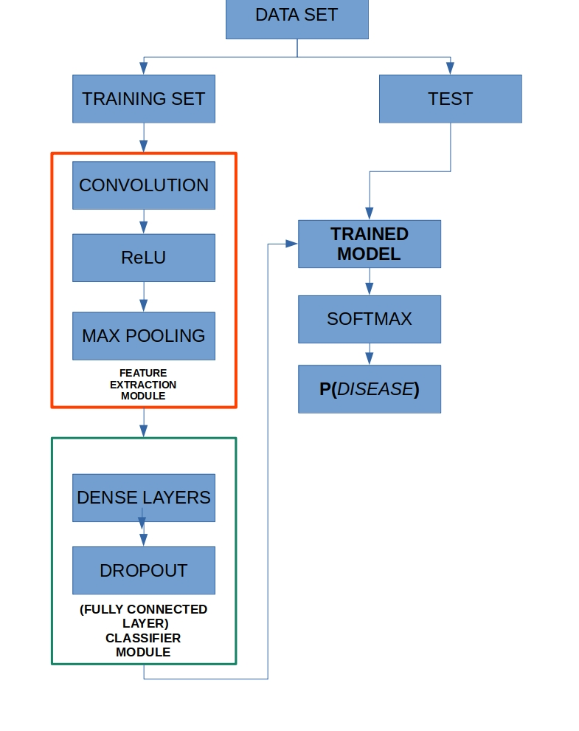
DFD

Slide 29
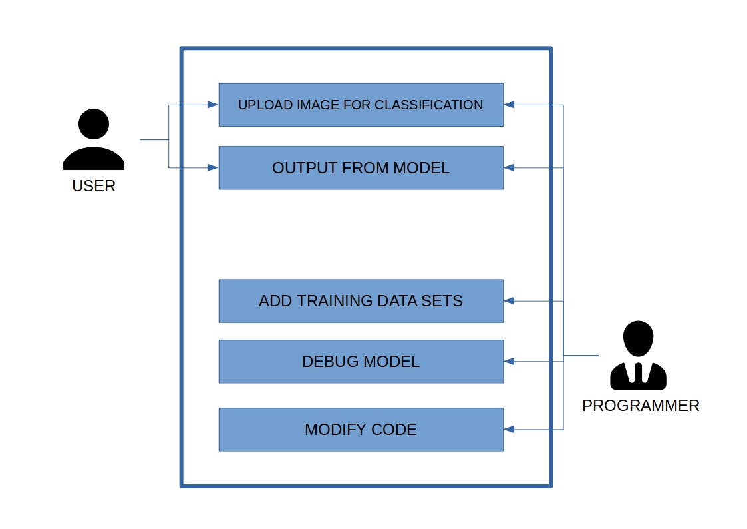
USE CASE DIAGRAM

Slide 30
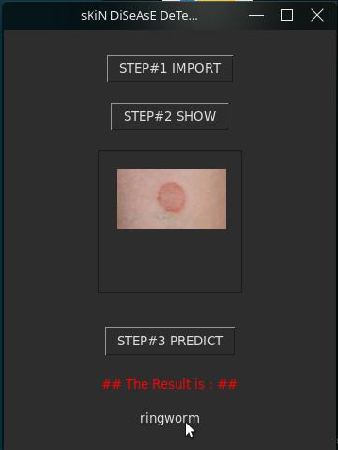
Graphical User Interface

Slide 31
Result
The system utilizes the MobileNet architecture. The neural network learns and extracts the features by itself.Hence unlike image processing techniques used in the related works, feature extraction is done using depthwise separable convolution. Based on the training and validation data an accuracy of 98.38 is obtained. Initially with 2000 data samples, the system recognizes 4 diseases like ringworm, measles, psoriasis, and melanoma . The advantages of CNN include extracting features and classifying skin diseases much more efficiently. The model itself identifies the features from the deepest layer i.e deep learning technique. The limitations include limited datasets. To increase the efficiency each time, different image size must be given. The value changes at each time of training. For large datasets the time taken to train is considerably high. The use of MobileNet architecture has enabled us to create a light weight model which can be easily used on devices with even lower specs. We hope that our model is useful in the field of skin disease detection.

Slide 32
THANK YOU

