Slide 1


SQL PROJECT ON PIZZA SALES.

Slide 2

Introduction
Hello, my name is Shivam Bhardwaj. In this project, I utilized SQL queries to analyze pizza sales data, providing valuable insights into customer preferences and sales trends. By examining order details, pizza types, and pricing information, I identified key patterns and peak sales periods. This analysis helps in optimizing inventory, improving customer satisfaction, and boosting overall sales. Dive in to discover the impactful insights derived from our pizza sales data!

Slide 3

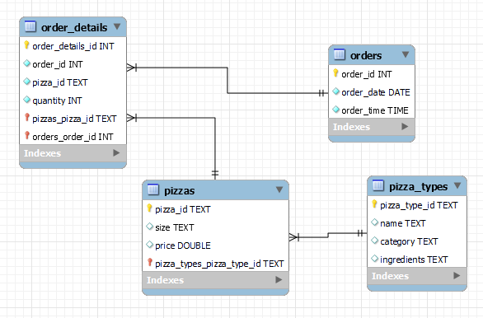
ER Diagram:

Slide 4

Questions
Basic:
Retrieve the total number of orders placed.
Calculate the total revenue generated from pizza sales.
Identify the highest-priced pizza.
Identify the most common pizza size ordered.
List the top 5 most ordered pizza types along with their quantities.
Intermediate:
Join the necessary tables to find the total quantity of each pizza category ordered.
Determine the distribution of orders by hour of the day.
Join relevant tables to find the category-wise distribution of pizzas.
Group the orders by date and calculate the average number of pizzas ordered per day.
Determine the top 3 most ordered pizza types based on revenue.
Advanced:
Calculate the percentage contribution of each pizza type to total revenue.
Analyze the cumulative revenue generated over time.
Determine the top 3 most ordered pizza types based on revenue for each pizza category.

Slide 5


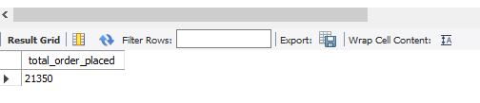
Q1> Retrieve the total number of orders placed.

Slide 6

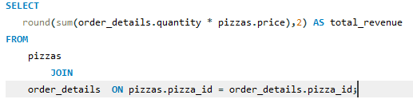
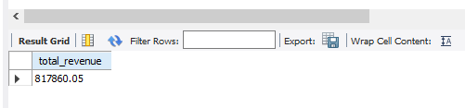
Q2> Calculate the total revenue generated from pizza sales

Slide 7

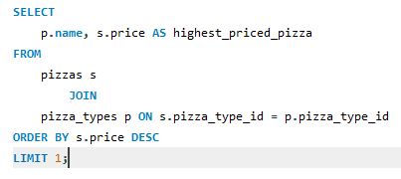
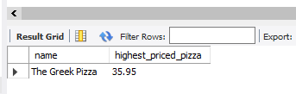
Q3> Identify the highest-priced pizza.

Slide 8
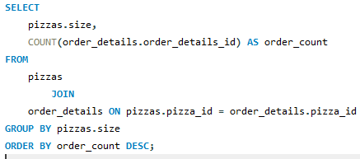
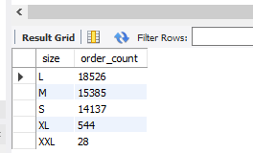
Q4> Identify the most common pizza size ordered.

Slide 9
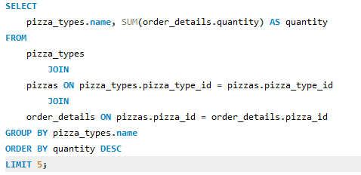
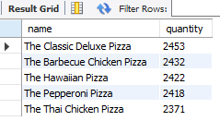
Q5> List the top 5 most ordered pizza types along with their quantities.

Slide 10
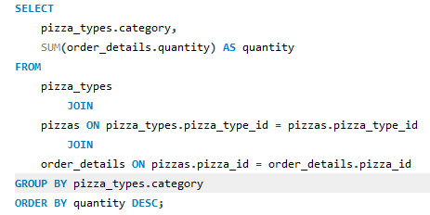
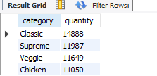
Q6> Join the necessary tables to find the total quantity of each pizza category ordered.

Slide 11
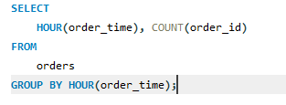
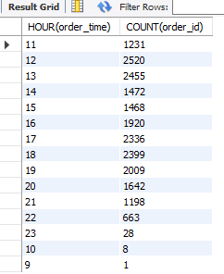
Q7> Determine the distribution of orders by hour of the day.

Slide 12
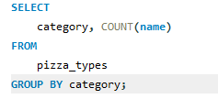
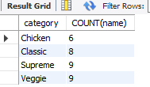
Q8> Join relevant tables to find the category-wise distribution of pizzas.

Slide 13
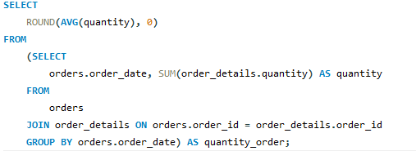

Q9> Group the orders by date and calculate the average number of pizzas ordered per day.

Slide 14
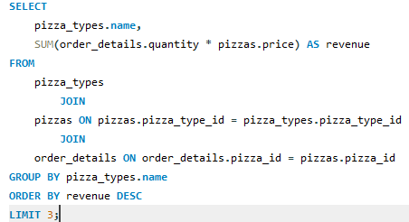
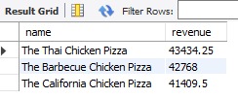
Q10> Determine the top 3 most ordered pizza types based on revenue.

Slide 15
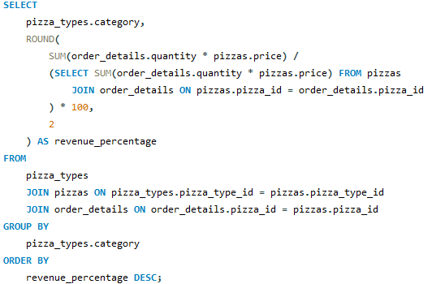
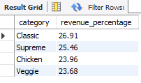
Q11> Calculate the percentage contribution of each pizza type to total revenue.

Slide 16
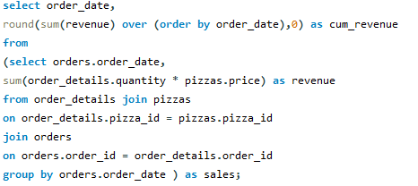
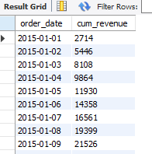
Q12> Analyze the cumulative revenue generated over time.
A long list

Slide 17
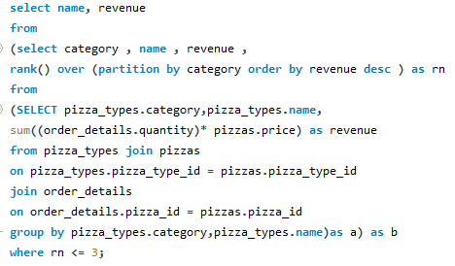
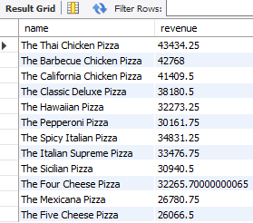
Q13> Determine the top 3 most ordered pizza types based on revenue for each pizza category.

Slide 18
THANK YOU

