Slide 1
Semantic Segmentation using CNN's
​
Team 20​
H S Jayanth (231IT034)​
Shivam Kumar A (231IT068)
Dept of IT, NITK

Slide 2
Table of Content
Introduction
Literature Survey
Problem Statement and Objectives
Methodology
Experimental Setup
Results and Analysis
Conclusion and Future Work
References

Slide 3
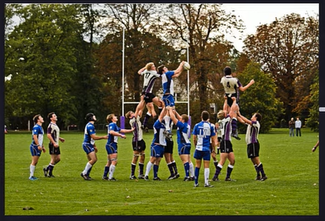
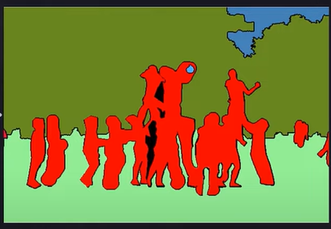
Introduction
Semantic segmentation is a computer vision technique that classifies and labels each pixel in an image using a deep learning algorithm.
The goal of semantic segmentation is to help computer systems understand the relationships between objects in an image.
It plays a crucial role in several fields such as:​​
Object recognition using semantic details.​ ​
Pattern classification & Facial recognition.

Slide 4
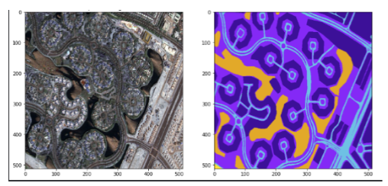
Introduction
There is a high demand for high-precision image processing and segmentation in computer vision.
The evolving field requires more efficient and robust algorithms for image segmentation.
The need is to develop an algorithm that performs the task well and does it fast.

Slide 5
Literature Survey
No. | Title, Author, Year of Publication | Key Observations
1 | U-Net: Convolutional Networks for Biomedical Image Segmentation by Olaf Ronneberger, Philipp Fischer, Thomas Brox (2015) | - Introduced U-Net architecture for pixel-level segmentation. - Effective for biomedical image segmentation. - Achieves high accuracy with limited training data.
2 | Fully Convolutional Networks for Semantic Segmentation by Jonathan Long, Evan Shelhamer, Trevor Darrell (2015) | - Pioneering work in semantic segmentation using deep learning. - Introduced fully convolutional networks (FCNs) for pixel-wise labeling. - Demonstrated FCN's success on a range of datasets.
3 | Deep Residual Learning for Image Recognition by Kaiming He, Xiangyu Zhang, Shaoqing Ren, Jian Sun (2016) | - Introduced deep residual networks (ResNets) which improved segmentation performance. - Helped in reducing the vanishing gradient problem in deep networks.
3

Slide 6
​
​
Problem Statement and Objectives​
PROBLEM STATEMENT:​ The project focuses on designing and implementing an efficient algorithm using U-Net architecture for semantic
image segmentation, using custom loss functions and metrics.
​ Objective 1: Design a preprocessing algorithm for the data, and try out a variety of models on a small dataset and record the outcomes.​
Objective 2: Design a final model that is trained on the full dataset, and is designed to optimize accuracy while also constraining the model size. ​
4

Slide 7
Methodology
Objective 1 Methodology
Dataset Familiarization & Preprocessing
Understand dataset characteristics.
Apply preprocessing techniques:
Patchifying
Color masking
Model Research & Experimentation
Explore different architectures and hyperparameters.
Run initial models on a small toy dataset.
Record and analyze outcomes.

Slide 8
Methodology
Objective 2 Methodology
Model Selection & Scaling
Finalize model based on observed results.
Prepare for implementation on a larger dataset.
Preprocess and train on the bigger dataset.
Result Analysis & Documentation
Record model performance and key results.
Focus on accuracy improvement.
Document the process and analyze final outcomes.
6

Slide 9
Experimental Setup
Implementation:
Framework: TensorFlow-Keras
Training Platform: Kaggle GPUs
Loss Functions:
Dice Loss
Focal Loss
Optimizer: ADAM Optimizer
Dataset:​
Aerial Imagery Semantic Segmentation Dataset​
Source: Kaggle (Humans in the Loop)
7

Slide 10
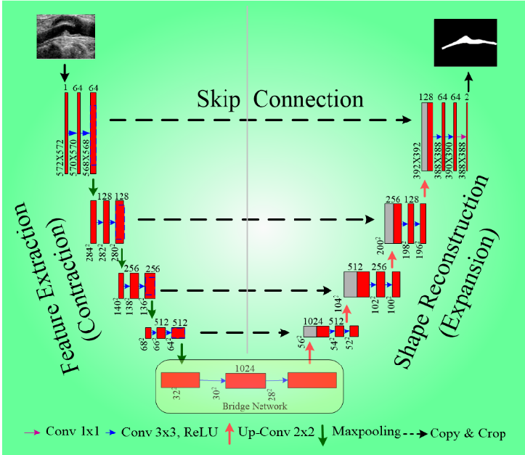
U-NET Architecture
8

Slide 11
Model Architecture
Conv2D (16 filters, 3x3), Conv2D (16 filters, 3x3), MaxPooling2D (2x2)
Conv2D (32 filters, 3x3), Conv2D (32 filters, 3x3), MaxPooling2D (2x2)
Conv2D (64 filters, 3x3), Conv2D (64 filters, 3x3), MaxPooling2D (2x2)
Conv2D (128 filters, 3x3), Conv2D (128 filters, 3x3), MaxPooling2D (2x2)
Conv2D (256 filters, 3x3), Conv2D (256 filters, 3x3)
Conv2DTranspose (128 filters, 2x2, strides 2), Concatenate
Conv2D (128 filters, 3x3), Conv2D (128 filters, 3x3)
Conv2DTranspose (64 filters, 2x2, strides 2), Concatenate
Conv2D (64 filters, 3x3), Conv2D (64 filters, 3x3)
Conv2DTranspose (32 filters, 2x2, strides 2), Concatenate
Conv2D (32 filters, 3x3), Conv2D (32 filters, 3x3)
Conv2DTranspose (16 filters, 2x2, strides 2), Concatenate
Conv2D (16 filters, 3x3), Conv2D (16 filters, 3x3), Conv2D (nClasses filters, 1x1, softmax activation)
9

Slide 12
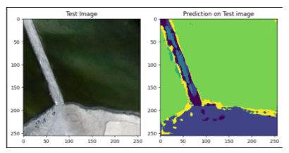
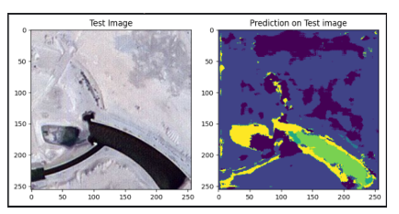
Result and Analysis
The final model achieved an accuracy of 80-85%, during multiple trials.
10

Slide 13
Result and Analysis
The final model demonstrates that optimized configurations can significantly enhance performance in pixel-wise semantic segmentation of aerial imagery using U-Net architectures.
Key improvements included selecting a suitable pooling method, fine-tuning the activation function, and adjusting hyperparameters.
These modifications enable the model to excel in high-precision tasks like urban planning, land cover mapping, and disaster management, showcasing the practical potential of deep learning for critical image segmentation applications.
11

Slide 14
📌
Conclusion
This project provided insights into semantic segmentation, including its implementation, architectures (notably U-Net), loss functions, limitations, and recent advancements. Key takeaways include:
U-Net architecture: Optimal for semantic segmentation
Leaky ReLU activation: Enhanced model performance
Preprocessing techniques: Essential for effective model learning
Future goals involve refining and optimizing the model further.
12

Slide 15
References
B. U. Mahmud and G. Y. Hong, "Semantic Image Segmentation using CNN (Convolutional Neural Network) based Technique," 2022 IEEE World Conference on Applied Intelligence and Computing (AIC), Sonbhadra, India, 2022, pp. 210-214.
O. Ronneberger, P. Fischer, and T. Brox, "U-Net: Convolutional Networks for Biomedical Image Segmentation," in Medical Image Computing and Computer-Assisted Intervention (MICCAI), 2015.
M. Ansari, S. Bhosale, and A. Choudhary, "Semantic Segmentation using Convolutional Neural Networks," International Journal of Engineering Research & Technology, 2023.
13

Slide 16
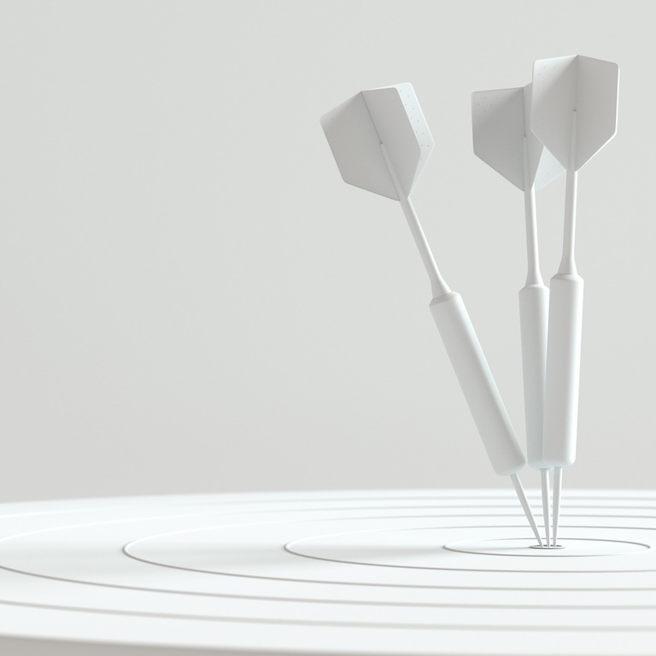
Thank you

