Slide 1
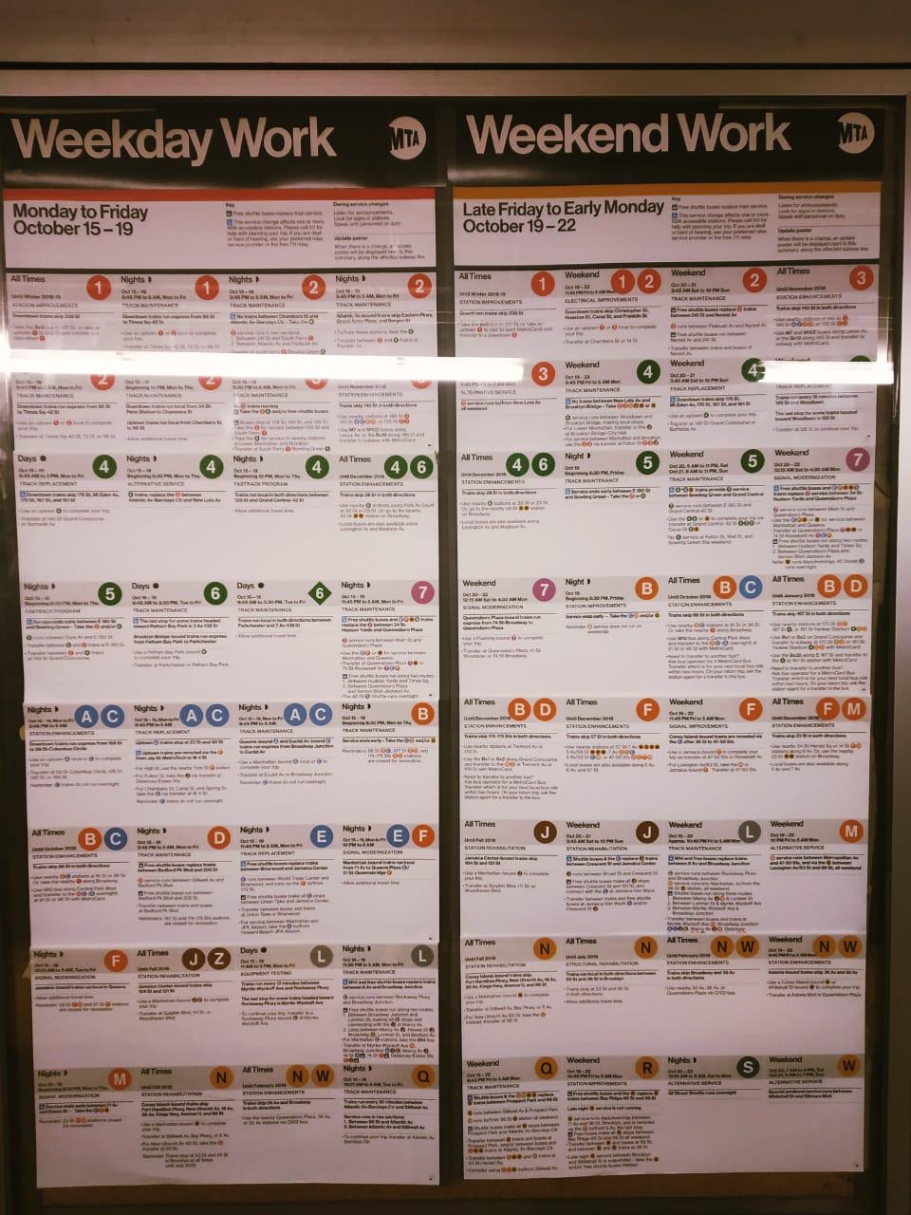
Impact of MTA Maintenance Activities on Subway and Taxi Riderships in NYC

Slide 2
Introduction:
New York City MTA Subway system is more than 100 years old.
System breakdown lead to significant delays in system; the cost of subway delays in lost work time translates to $1.23 million daily.
Tracks and Signals are old and need constant maintenance.
2500+ Scheduled Maintenance activity takes place every year to keep system healthy.
Maintenance causes a complete or partial shutdown of the subway services at various stations.
Due to these frequent maintenance, commuters face inconvenience, and they have to switch to other modes for transportation.

Slide 3
Research Objectives:
Research Outcomes:
To examine whether maintenance leads to loss in subway ridership or not?
What are the leading causes for loss in ridership due to maintenance on different subway lines?
To examine whether taxi ridership experience surge in taxi zones where maintenance was present?
How can we quantify this surge in taxi ridership?
The outcomes of this research can benefit majorly two clients:
MTA: To understand about the quantum of loss in ridership due to maintenance, and identify key focus areas to reduce this loss.
Taxi Companies: To learn about a new potential way to gather demand, and methods to integrate this demand with the existing supply chain.

Slide 4
Methodology:
All the datasets used are available through online open-sources :
MTA Turnstile Data.
MTA Real-Time GTFS Feed Data.
NYC Taxi Data.
MTA subway Ridership can be quantified using the equation:
Ridership = f(trend,periodicity) + f(maintenance features) + f(normal features)
Ridership from MTA Turnstile Data
Parse MTA Real-Time GTFS Feed Data for Maintenance Features
Remove trend, periodicity by rolling mean and standard deviation standardization. Model ridership with maintenance features as input using tree based decision models.

Slide 5
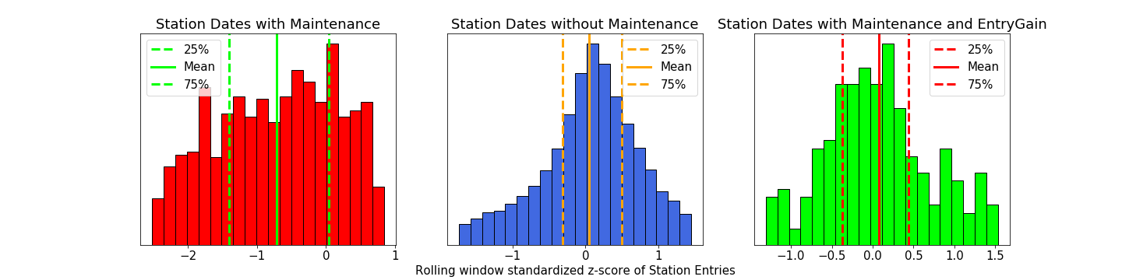
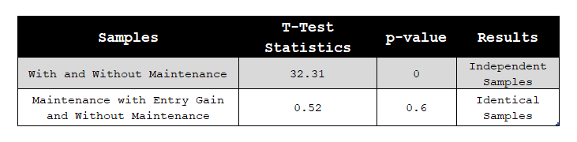
POC Analysis on F, N and R Lines
Data used: 106 Stations x 45 weeks x 2 days ~ 9340 data points( Station+Date Combination)

Slide 6
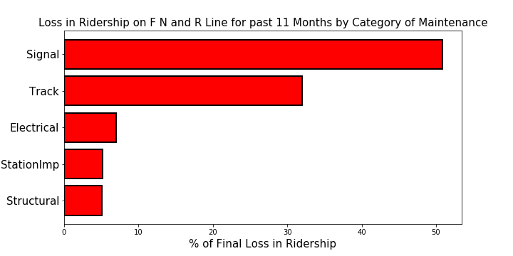
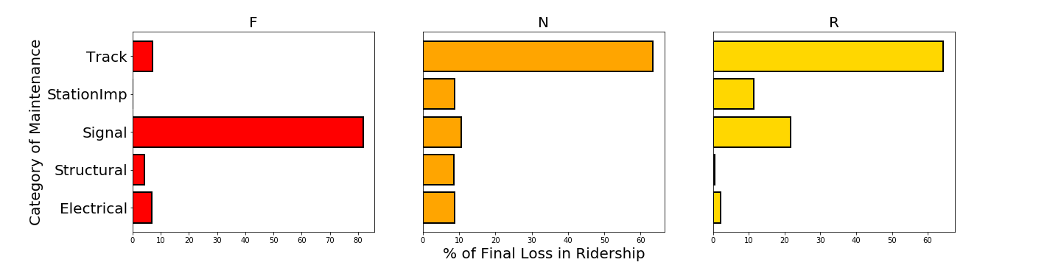
Results
Total loss in ridership due to maintenance on F, N & R line from October 2017 to October 2018 is 1.45 Million riders.

Slide 7

Next Steps:
Scale the analysis: Include all the stations in NYC Subway System and evaluate impact on all the 23 lines.
Include weekday maintenance and system delays in the analysis.
Understand the impact on taxi ridership
Quantify the impact on taxi ridership.

Slide 8
Thank You

