Slide 1
Finility: News Sentiment, VIX, and S&P 500 Returns (2017–2020)
Goal: Test whether financial news sentiment predicts daily S&P 500 returns.
Approach: VADER labeling → Linear SVC sentiment model → daily sentiment index.
Then merged with S&P 500 returns and VIX to analyze relationships.

Slide 2
Data Sources (Aligned to 2017–2020)
1) Financial News Headlines (CNBC, Guardian, Reuters) — Kaggle CSV (~50k rows)
2) S&P 500 Index (^GSPC) — Yahoo Finance API (daily OHLCV)
3) VIX Index (^VIX) — Yahoo Finance API (daily close)
All datasets merged by date; analysis uses window with sentiment available.

Slide 3
Summary Statistics
 | return | daily_sentiment | vix
count | 647.0 | 647.0 | 647.0
mean | 0.0 | 0.036 | 19.412
std | 0.015 | 0.159 | 10.542
min | -0.12 | -1.0 | 9.15
25% | -0.004 | -0.063 | 13.16
50% | 0.001 | 0.045 | 15.8
75% | 0.007 | 0.137 | 20.555
max | 0.094 | 1.0 | 82.69

Slide 4
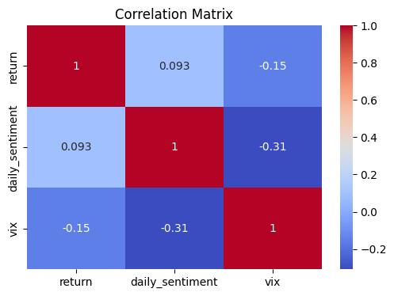
Correlation Matrix

Slide 5
Correlation Insights
Sentiment vs Return: r = 0.09 → weak positive relationship.
VIX vs Return: r = -0.15 → weak negative relationship.
Sentiment vs VIX: r = -0.31 → moderate negative relationship.
Interpretation: Negative news coincides with higher volatility; sentiment alone has limited daily predictive power.

Slide 6
Regression Results (OLS)
Model: return ~ daily_sentiment + sentiment_lag1 + vix
• daily_sentiment: coef +0.0053, p=0.175 (not significant)
• sentiment_lag1: coef -0.0048, p=0.220 (not significant)
• vix: coef -0.0002, p=0.001 (significant)
R² = 0.027
Takeaway: VIX significantly explains returns; sentiment does not at daily frequency.

Slide 7
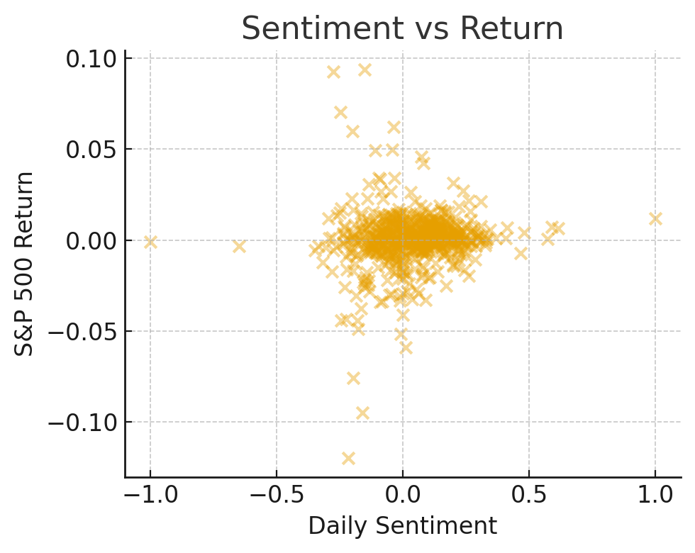
Sentiment vs Return (Scatter)

Slide 8
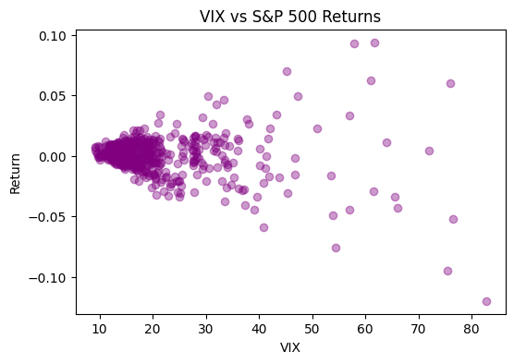
VIX vs S&P 500 Returns

Slide 9
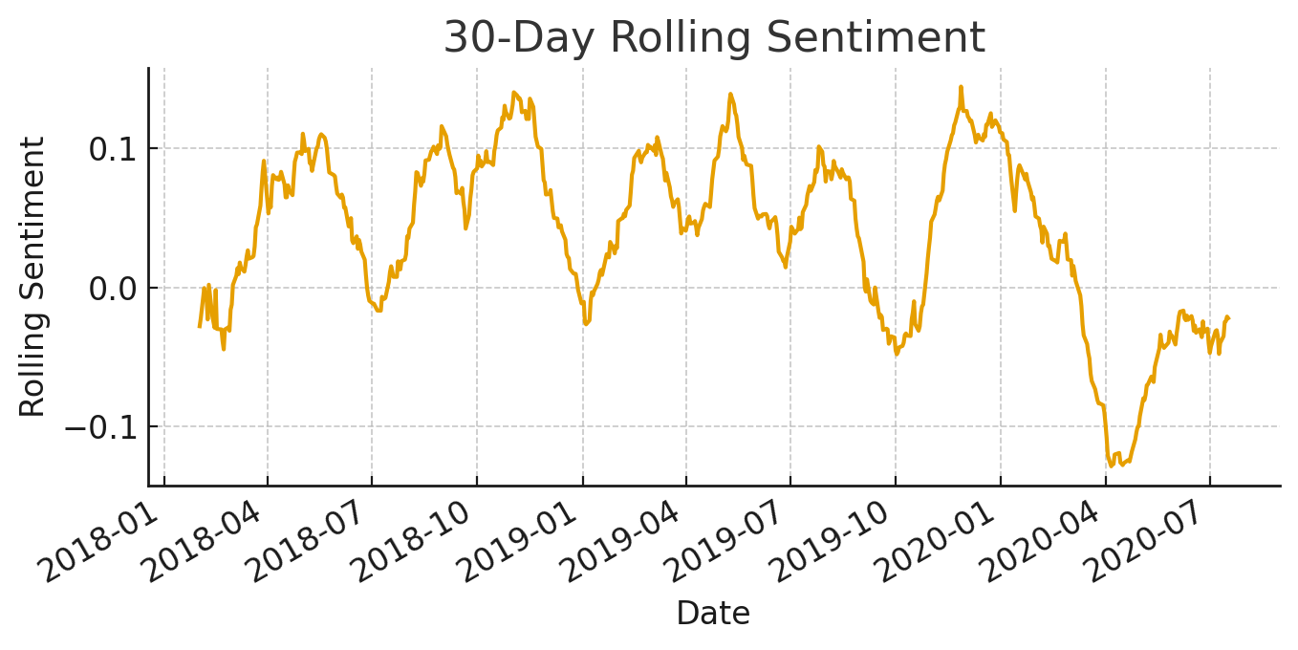
Rolling Sentiment Trend (30-day)

Slide 10
Challenges
Aligning three news sources and two market series by date.
Cleaning Yahoo Finance CSV exports (extra header rows).
Handling missing sentiment days and creating lag features.
Low signal-to-noise ratio in daily market returns.

