Slide 1


Data Analysis Project for Call Centre Operations by United Airlines

Slide 2


Today's agenda
Project recap
Problem
The Analytics team
Process
Insights
Summary

Slide 3

Helping reduce resolution times and providing faster, more efficient service to our customers. You are required to analyze our existing call center data to identify inefficiencies, determine the drivers of long AHT and AST, and suggest strategies to enhance customer satisfaction, reduce escalations, and improve overall operational efficiency.
An justification of their big data practice
Recommendations for the insights
An analysis of their content categories with respect to the timeline.
Project Recap

Slide 4

Over 70,000 calls per month
Management of the large Data of the users
Analysis of finding most optimum results of the content
Problem

Slide 5
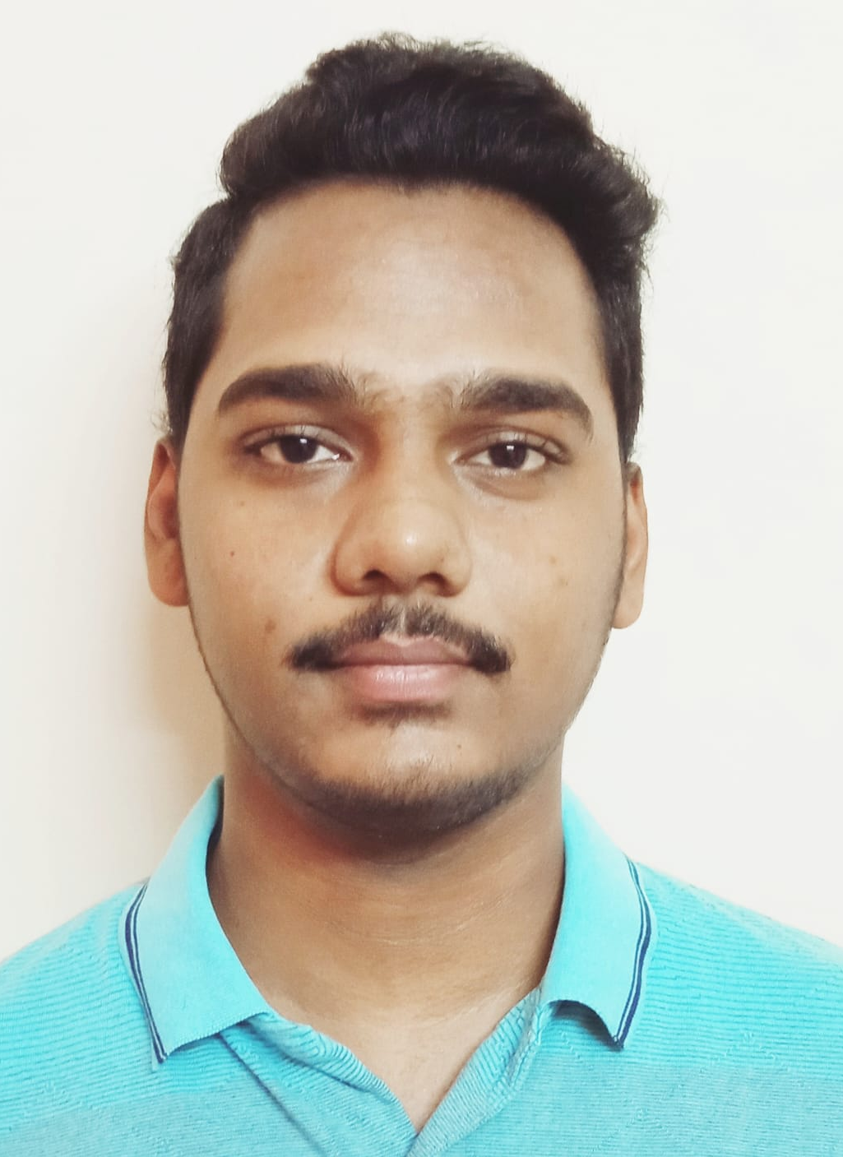

Shivam Shankerwal
Delhi Technological University(DTU)
Engineering Physics
2K21/EP/91
The Analytics team
Shivam Garg
Delhi Technological University(DTU)
Engineering Physics
2K21/EP/88

Slide 6
Process
1 Data Understanding
2 Data Cleaning
3 Data Modelling
4 Data Analysis
5 Uncover Insights

Slide 7

Insights
Data Cleaning: -
Null value processing and jumping
Data Processing:-
Compilation of all the .CSV files into one format .CSV file
Data Validation: -
Process of maintaining the data to a usable form for the analysis of the data sets

Slide 8
Usage of Excel and Jupyter Notebook to the Data Analysis working and Processing
import pandas as pd
from datetime import datetime
from sklearn.model_selection import train_test_split
from sklearn.ensemble import RandomForestRegressorfrom sklearn.metrics import mean_squared_error, r2_score
df = pd.read_csv('united_airlines_actual.csv’)
Df.head(10)
By the usage of above codes we have imported the important libraries abd collected the information from the .CSV file compiled earlier

Slide 9
df['AHT'] = pd.to_datetime(df['AHT’])
df['AST'] = pd.to_datetime(df['AST’])
X = df[[ 'agent_tone', 'customer_tone', 'average_sentiment', 'silence_percent_average’]]
y_aht = df['AHT'] # Target for AHT
y_ast = df['AST'] # Target for AST
X = pd.get_dummies(X, drop_first=True)
X_train_aht, X_test_aht, y_train_aht, y_test_aht = train_test_split(X, y_aht, test_size=0.2, random_state=42)
X_train_ast, X_test_ast, y_train_ast, y_test_ast = train_test_split(X, y_ast, test_size=0.2, random_state=42)
rf_aht = RandomForestRegressor(n_estimators=100, random_state=42)
rf_ast = RandomForestRegressor(n_estimators=100, random_state=42)
rf_aht.fit(X_train_aht, y_train_aht)
rf_ast.fit(X_train_ast, y_train_ast)
y_pred_aht = rf_aht.predict(X_test_aht)
y_pred_ast = rf_ast.predict(X_test_ast)
feature_importance_aht = pd.Series(rf_aht.feature_importances_, index=X.columns)
feature_importance_ast = pd.Series(rf_ast.feature_importances_, index=X.columns)
print("Feature Importance for AHT:")
print(feature_importance_aht.sort_values(ascending=False))
print("Feature Importance for AST:")print(feature_importance_ast.sort_values(ascending=False))
import matplotlib.pyplot as plt
feature_importance_aht.sort_values(ascending=False).plot(kind='barh', title="Feature Importance for AHT")plt.show()feature_importance_ast.sort_values(ascending=False).plot(kind='barh', title="Feature Importance for AST")
plt.show()
df.plot.scatter(x,y)

Slide 10
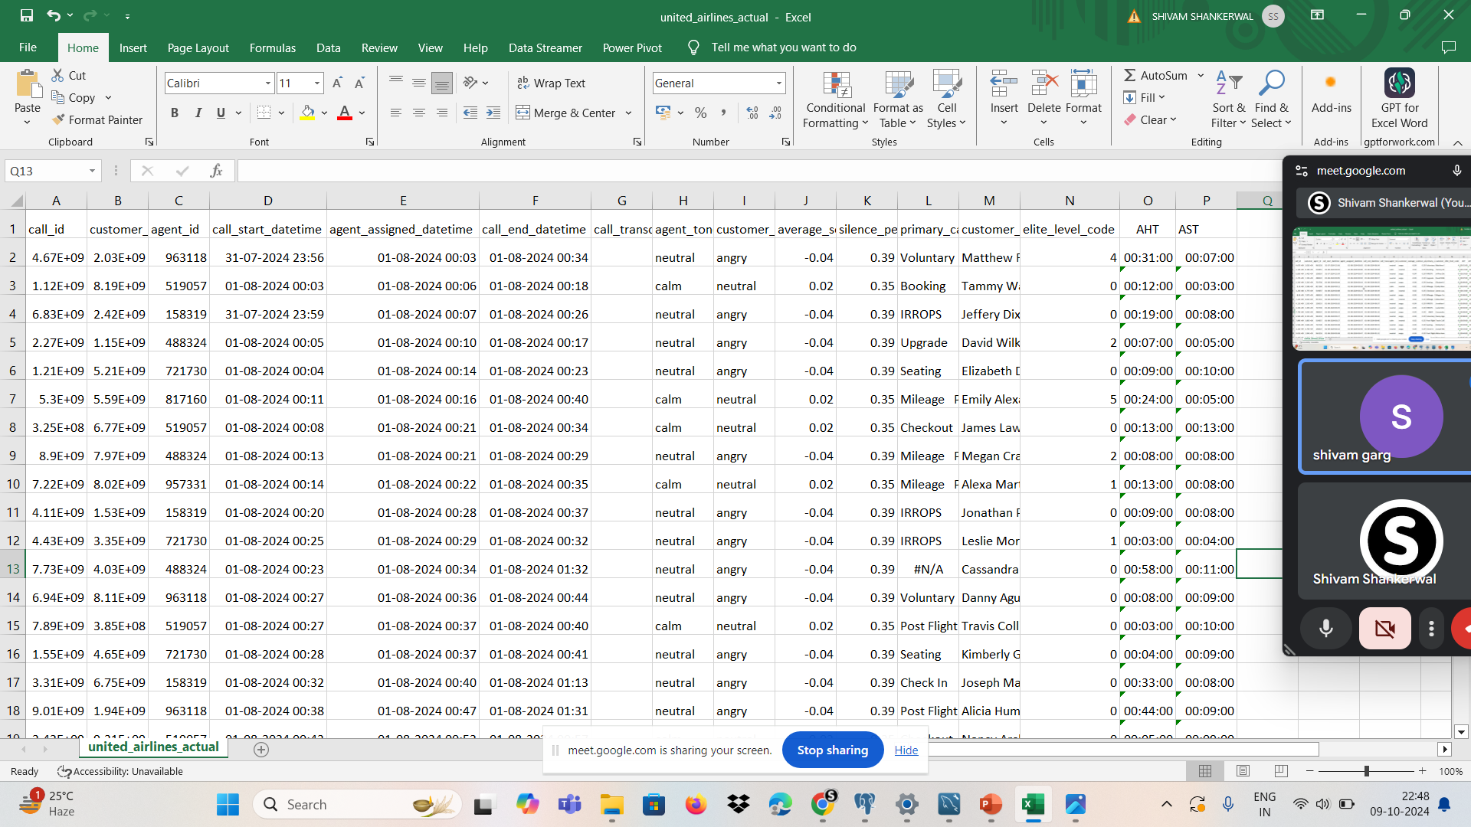
Here as we can see that we have compiled all the files provided to a single extension for a more compatible approach

Slide 11

Analysis
AHT and AST of the Call Services are founded easily with the help of graphs
Insights
Here we get to know about the workings of call services operations. By this we can say that by predicting the traffic of calls in a month we can justify the AST and AHT compilations to predict a more work Friendly Outcome
Summary
Next Step
Providing efficient and reliable customer service is crucial for customer retention and loyalty. Our call center, which handles customer inquiries, complaints, and service requests, is an essential touchpoint for many of our passengers, Ultimately supporting a more efficient and customer-friendly operation.

Slide 12
Thank you!
ANY QUESTIONS?

