Slide 1


Enterprise Parcel Management System
Courier & Parcel Services | B.Tech DBMS Project
Student Name
Roll Number
SHIVAM TIWARI
V.AKHIL
BALAJI PATIL
2520080026
2520080029
2520080065
Department
AI&DS

Slide 2


Introduction
Critical to Modern Logistics
Courier and parcel management underpins the global supply chain, connecting businesses and consumers at every level.
Manual Systems Fall Short
Paper-based and phone-driven operations lead to inefficiencies, delays, and significant customer dissatisfaction.
Automation is the Answer
Digitization enables real-time tracking, streamlined workflows, and true operational excellence for courier enterprises.

Slide 3


PROBLEM STATEMENT
The Challenges We Face
Manual Handling
Tracking Issues
Paper-based records are prone to errors, misplacement, and irreversible data loss.
Customers lack real-time visibility into parcel location and delivery status.
Data Redundancy
Delayed Deliveries
Duplicate information scattered across multiple disconnected systems.
Inefficient routing and poor resource allocation cause persistent delivery delays.

Slide 4
Project Objectives
Automate Operations
Real-Time Tracking
End-to-end parcel operations and booking fully digitized and automated.
Live status updates and location visibility for every parcel in the system.
Minimize Errors
Enhance Satisfaction
Eliminate data inconsistencies through centralized, validated database management.
Boost customer experience and overall operational efficiency across all branches.

Slide 5

Existing vs. Proposed System
Feature
Existing System
Proposed System
Booking
Manual
Automated
Tracking
Phone-based
Real-time Digital
Records
Paper
Database
Errors
High
Minimal
Speed
Slow
Fast
The proposed system addresses every critical failure point of the legacy manual approach.

Slide 6

System Architecture
Customer Interface
Admin Dashboard
Manage orders and monitor system-wide activity.
Place orders and view status in real time.
Courier Mobile App
MySQL Database
Central store ensuring synchronized, role-based data.
Receive assignments and update delivery progress.
A modular, centralized architecture connects customers, administrators, and delivery personnel through a single MySQL database — ensuring real-time data synchronization, role-based access, and consistent operational visibility across all touchpoints.

Slide 7
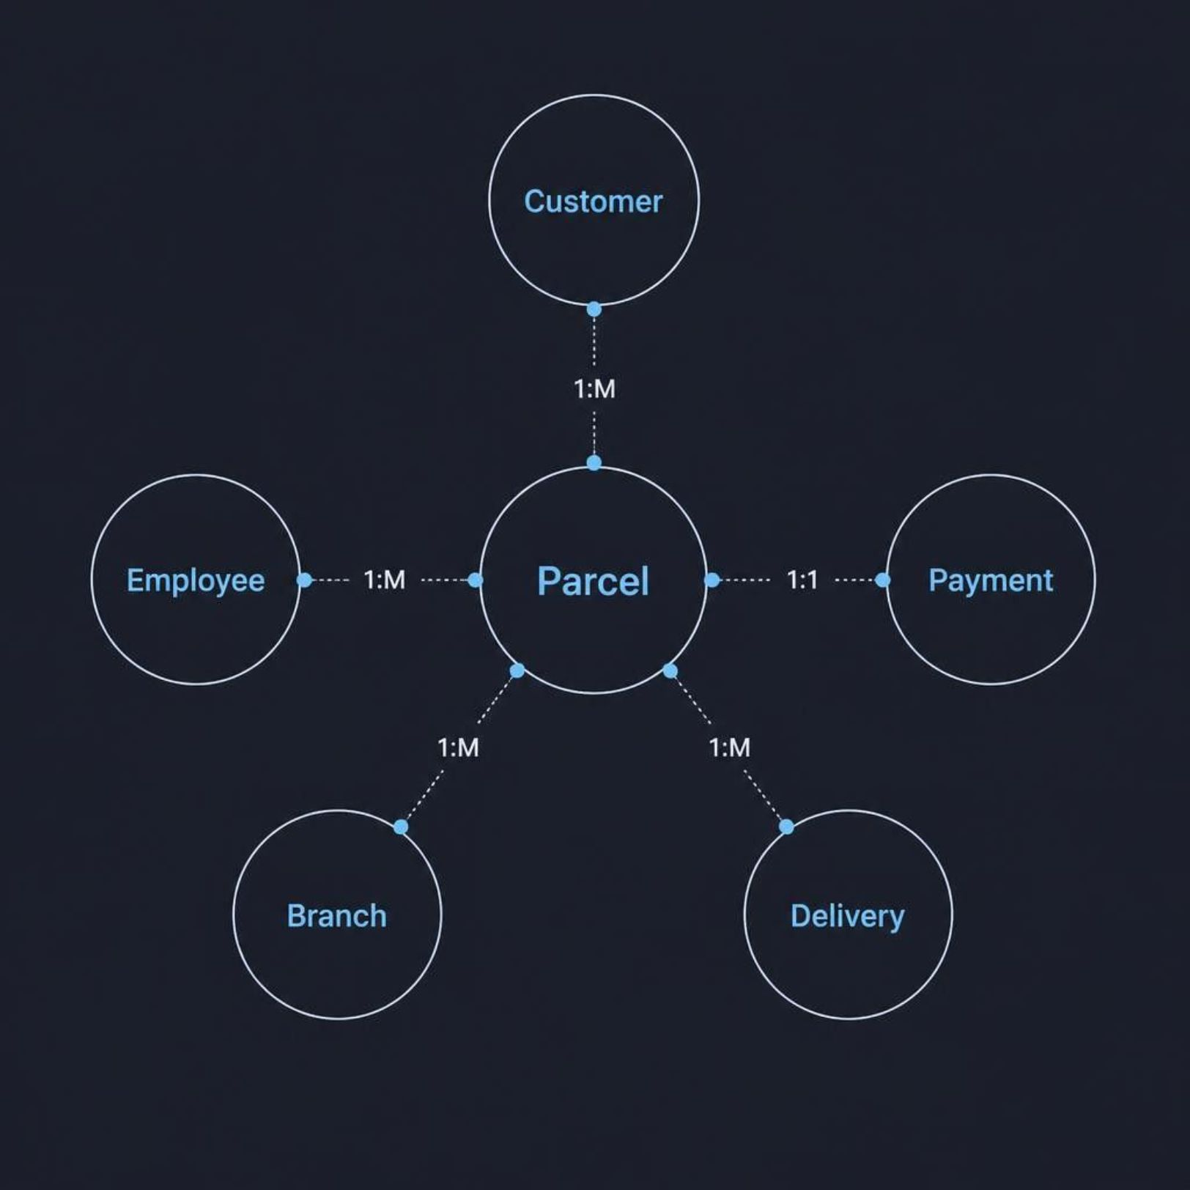
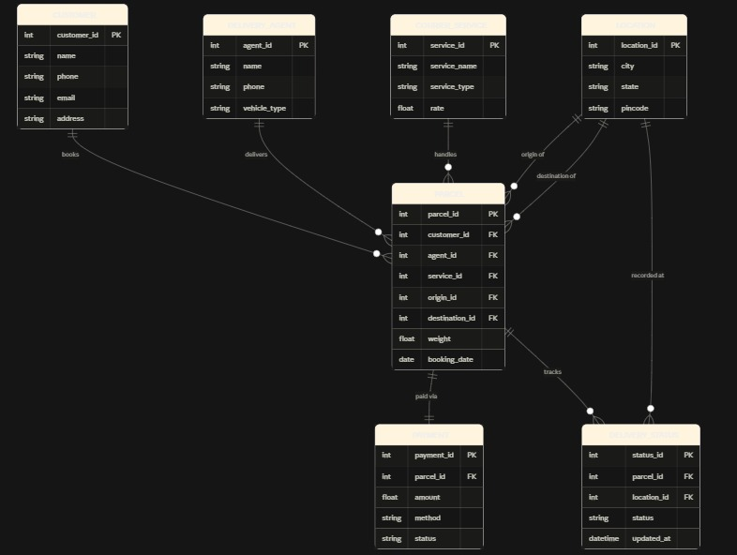
DATABASE DESIGN
ER Diagram
The normalized relational schema captures all core entities and their relationships:
Customer (1:M) → Parcel
Employee (1:M) → Delivery
Branch (1:M) → Employee
Parcel (1:1) → Payment
Parcel (1:M) → Delivery
A fully normalized schema eliminates redundancy and guarantees data integrity across the entire parcel lifecycle.

Slide 8
System Modules
Customer Management
Parcel Booking
Registration, profiles & address management
Shipment creation, service selection & cost calculation
Parcel Tracking
Employee Management
Real-time status, location updates & delivery confirmation
Staff profiles, assignments & performance tracking
Payment Management
Report Generation
Invoice generation, payment processing & receipts
Analytics, delivery statistics & revenue reports

Slide 9

TECH STACK
Technology Stack
Frontend
Backend
HTML5, CSS3, JavaScript — responsive UI for all devices
Java / PHP for server-side logic and API handling
Database
Dev Tools
MySQL (or) Prisma SQL — relational data management & normalization
XAMPP, VS Code, Git for development & version control

Slide 10
Key Advantages & Future Enhancements
ADVANTAGES
FUTURE ENHANCEMENTS
Real-Time Tracking
GPS Tracking
Customers monitor parcels from pickup to final delivery.
Real-time location mapping for all delivery vehicles.
Data Security
Mobile Application
Encrypted database with role-based access control.
Native iOS & Android apps for customers and couriers.
80% Efficiency Gain
AI Route Optimization
Automated workflows dramatically reduce manual effort.
Machine learning for smarter, faster delivery routes.
Cost Reduction
Cloud Integration
Paperless operations and optimized delivery routing.
Scalable cloud deployment for multi-branch operations.

Slide 11

Conclusion
🚀 Transforms Operations
📦 Measurable Benefits
Faster delivery, reduced errors, and a significantly improved customer experience.
Enterprise Parcel Management System automates courier operations end-to-end.
🌐 Enterprise-Ready
Scalable, normalized, and ready for deployment across multiple branches.
Thank You — Enterprise Parcel Management System | B.Tech DBMS Project

