Slide 1
Organ Transplant Monitoring

Slide 2
Agenda
Problem Statement
Solution
Model
Roles
Key Features
Extra Features

Slide 3
Problem Statement
Scarcity of Required Organ
Unavailability of Organ during emergency
Less awareness of potential donors around area

Slide 4
Solution
To develop an application through which we can meet modern day Organ requirement during the emergency time and can track availability of potential donors in nearby area

Slide 5
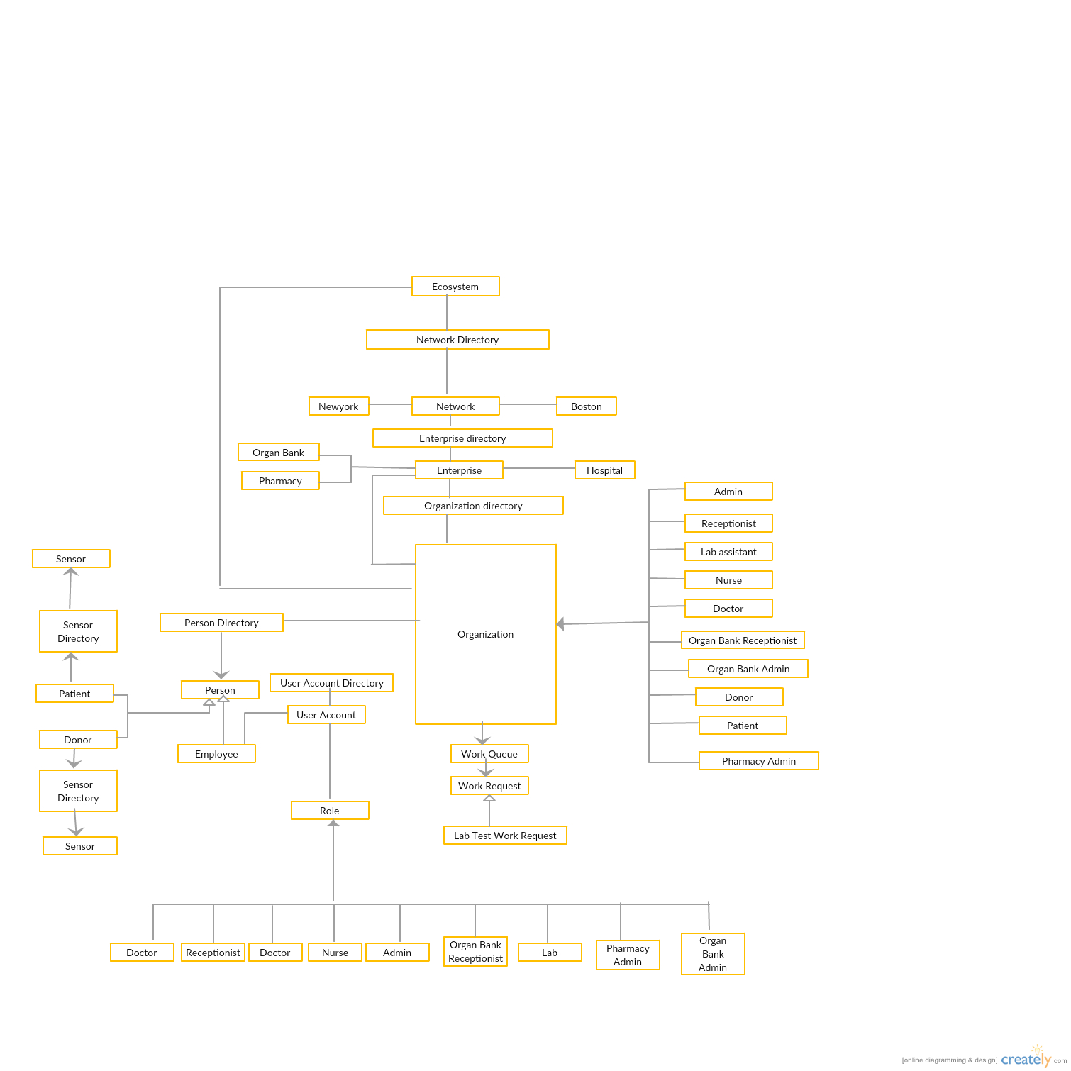
Object Model

Slide 6
Roles
System admin
Admin
Receptionist
Doctor
Nurse
Organ Bank Admin
Organ Bank Receptionist
Lab Assistant
Pharmacy Admin

Slide 7
Roles
System admin-Add All network their enterprises and will create their user account
Admin-Add all Organization for hospital and will create user account
Receptionist-Add Patient and will assign to doctor for checkup, in case of emergency or significant drop of vital sign reported by sensor a request will immediately send to receptionist which will call ambulance
Doctor-Will check the patient and can give him medicine and will assign to nurse for test, also will see available donors and can match them
Nurse- will record vital sign
Organ Bank Admin-Add all Organization for hospital and will create user account
Organ Bank Receptionist-
Lab Assistant-- will record vital sign
Pharmacy Admin-Will add supplier and drugs

Slide 8
Key Features
Matching Algorithm
Distance Tracking
Patient /Donor Report
Graphs (Line/Pie/Bar)

Slide 9
Extra Features
Email
Alert Message
Google Map
Calling
Pdf
Splash

