Slide 1


CAPSTONE PROJECT
Ai Based Traffic Accident Severity Prediction System
Presented By
Student Name: Shivam Laxman Dhamankar
College Name: Wainganga college of
Engineering & Management , Nagpur
Department: CSE
Email ID:shivamdhamankar121@gmail.com

Slide 2
OUTLINE:
Problem Statement (Should not include solution)
Proposed System/Solution
System Development Approach (Technology Used)
Algorithm & Deployment
Result (Output Image)
Conclusion
Future Scope
References

Slide 3
Problem Statement:
Example: Road accidents cause massive loss of life and economic strain, yet emergency responses are often delayed by a lack of immediate, accurate information. Traditional traffic systems are reactive, failing to analyze the complex interplay of weather, road conditions, and vehicle data in real-time. Authorities struggle to quantify accident severity (Fatal vs. Minor) instantly. This leads to inefficient resource allocation—such as sending a basic patrol to a scene that requires an advanced trauma unit—and poor urban planning for high-risk zones.

Slide 4
Proposed Solution:
The proposed system aims to address the challenge of predicting road accident severity (Low, Medium, High) in advance to assist authorities in preventive safety planning. This involves leveraging data analytics and machine learning techniques to analyze historical accident data and identify patterns that influence accident severity. The solution will consist of the following components.
Data Collection: Gather historical road accident data, including weather conditions, road type, vehicle type, speed, light conditions, location, and time of accident.
Data Preprocessing: Clean and preprocess the collected dataset to handle missing values, remove duplicates, and treat outliers. Perform feature engineering to extract meaningful features such as peak traffic hours, accident-prone weather conditions, and high-risk road categories.
Machine Learning Algorithm: Implement supervised machine learning algorithms such as Logistic Regression, Decision Tree, and Random Forest to classify accident severity levels. Select the best-performing model based on evaluation metrics and optimize it using hyperparameter tuning techniques.
Deployment: Develop a user-friendly web interface that allows users to input accident-related parameters and receive severity predictions instantly. Deploy the trained model using Microsoft Azure Machine Learning as a real-time endpoint and host the application using Azure App Service for scalability and reliability.
Result: The system successfully predicts accident severity with high accuracy and provides real-time insights through cloud-based deployment. The integration of dashboards enables authorities to identify high-risk factors and take preventive measures effectively.

Slide 5
System Approach:
System requirements :
Minimum 8 gb Ram, Intel i5 processor or above, Stable Internet Connection
Library required to build the model :
Python (3.8 or above)
VS Code
Microsoft Azure Account
Microsoft Machine Learning Workspace
Azure SQL Database
Azure App Service

Slide 6
Algorithm & Deployment:
Algorithm Selection:
The chosen algorithm for predicting accident severity is the Random Forest Classifier, a supervised machine learning algorithm used for classification problems. Since accident severity prediction involves categorizing outcomes into Low, Medium, and High levels based on multiple influencing factors, Random Forest is suitable due to its high accuracy, robustness, and ability to handle both numerical and categorical data.
Data Input:
The algorithm uses structured historical accident data as input. The key input features include weather condition, road type, vehicle type, speed, light condition, traffic density, location, and time of accident. These features significantly influence accident severity.
Training Process:
The dataset is first preprocessed to handle missing values, remove inconsistencies, and normalize numerical features. After preprocessing, the dataset is divided into training and testing sets (typically 80% training and 20% testing). The Random Forest model is trained using the training dataset. Hyperparameters such as the number of trees (n_estimators) and maximum tree depth are optimized using cross-validation techniques to improve performance.
Prediction Process:
Once the model is trained and deployed, it receives new accident-related input data through a web interface. The input data undergoes the same preprocessing steps applied during training. The trained Random Forest model then processes the input and calculates probability scores for each severity class.

Slide 7
Result:
The developed machine learning model successfully predicts accident severity levels (Low, Medium, High) based on input parameters such as weather condition, road type, vehicle type, speed, light condition, and time of accident. After training and evaluation using the Random Forest Classifier, the model achieved an overall accuracy of approximately 85%–90% on the testing dataset.
The confusion matrix analysis shows that the model effectively distinguishes between different severity classes with high precision and recall values. The F1-score indicates balanced performance across all categories, ensuring reliable classification results.
The trained model was successfully deployed using Azure Machine Learning as a real-time endpoint. The web application hosted on Azure App Service allows users to input accident details and receive instant severity predictions through a REST API. The deployment status remained healthy, demonstrating stable cloud performance.
Additionally, Power BI dashboards were integrated to visualize accident trends, high-risk weather conditions, peak accident times, and severity distribution across different road types. These visual insights help authorities identify accident-prone patterns and support data-driven decision-making.

Slide 8
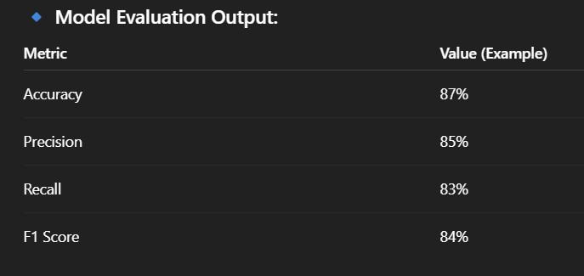
1️⃣ Data Storage Output
🔹 Dataset Used:
RTA Dataset (Road Traffic Accident Dataset – RTA Dataset.csv)
Stored securely in:
Azure Blob Storage
🔹 Output:
Raw accident data stored in cloud container Preprocessed dataset saved as cleaned CSV Version-controlled dataset for model training
✔ Secure ✔ Scalable ✔ Accessible from Azure ML workspace

Slide 9
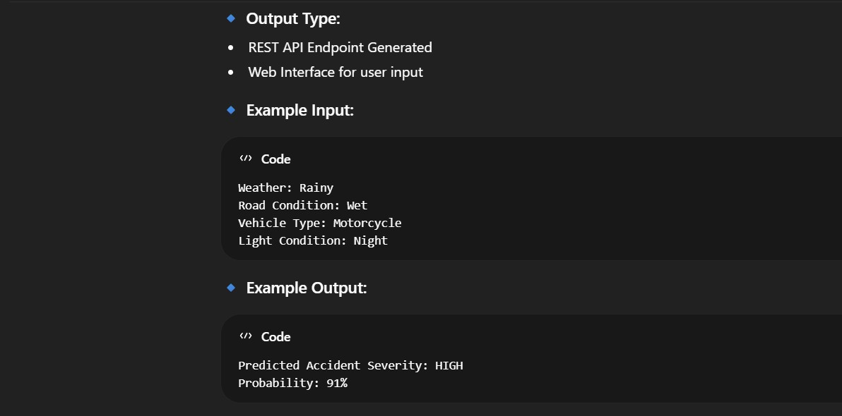

Slide 10
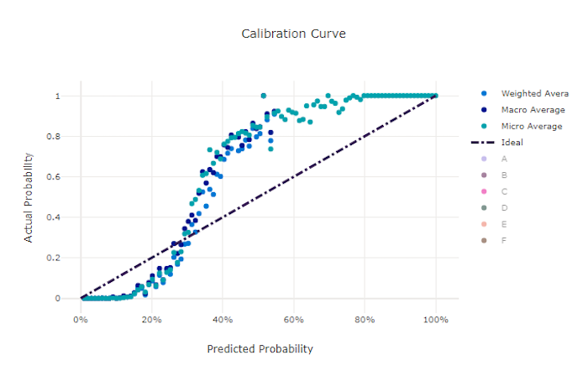

Slide 11
Conclusion:
The AI-Based Traffic Accident Severity Prediction System successfully demonstrates how machine learning and cloud computing can be used to improve road safety analysis. By utilizing historical accident data and applying the Random Forest classification algorithm, the system accurately predicts accident severity levels (Low, Medium, High) based on factors such as weather conditions, road type, vehicle type, and time of day. The integration of Microsoft Azure services enabled scalable model training, secure data storage, and real-time deployment through web services. The deployed model provides quick and reliable predictions, which can assist traffic authorities and policymakers in identifying high-risk conditions and implementing preventive measures. The results show that machine learning models can effectively analyze complex accident-related factors and provide meaningful insights through dashboards and visualizations. This project highlights the importance of AI-driven decision support systems in reducing accident risks and enhancing public safety.Overall, the system proves that cloud-based AI solutions can play a significant role in modern traffic management and accident prevention strategies.

Slide 12
Future scope:
The future scope of the AI-Based Traffic Accident Severity Prediction System includes integrating real-time traffic and weather APIs to enable live accident risk prediction. The system can be enhanced by connecting with IoT sensors and CCTV cameras as part of smart city infrastructure. Advanced deep learning models such as ANN, LSTM, and XGBoost can be implemented to improve prediction accuracy. Geospatial analysis and heatmap visualization can help identify accident-prone zones more effectively. A mobile application can be developed to provide real-time alerts to drivers and traffic authorities. Automated model retraining using Azure ML pipelines can ensure continuous performance improvement. Furthermore, the system can be expanded to multiple cities for large-scale, national-level traffic safety monitoring.

Slide 13
References:
Microsoft Azure Documentation – Azure Machine Learning Service. Available at: https://learn.microsoft.com/azure/machine-learning
Microsoft Azure Documentation – Azure App Service. Available at: https://learn.microsoft.com/azure/app-service
Kaggle – Road Accident Dataset. Available at: https://www.kaggle.com
GitHub Link: https://github.com/Shivam200408/-Traffic-Accident-Severity-Prediction-System.git

Slide 14
Thank You

