Slide 1

Encrypted Client–Server
Communication Framework (ECCP)
Mini-project presentation
Computer Networks Laboratory (CSE20110)
Department of Computer Engineering and Technology
Vallabh Deshpande – 1262240331 Aditya Sarode – 1262240481
Shivam Shirsat – 1262242312
Panel: J | Batch: J1
Faculty: Dr. Uma Pujeri
Academic Year: 2026–2027
Computer Networks Laboratory CSE20110
15 seconds
Notes:
Suggested time: 15 seconds. Replace all bracketed placeholders and prompts with your own project details. Keep explanations brief. Total time across slides 1–7 is 5 minutes, including the demonstration. Slide 8 is for reference during questions. Logo source: https://mitwpu.edu.in/uploads/images/MIT-WPU-logo-1.webp. Introduce only the title and team; do not read every PRN.

Slide 2
Problem and Objectives
Problem
Plain TCP provides reliable delivery, but it does not encrypt application data or establish user identity. Credentials, chat messages and files can be exposed if an application lacks additional security. ECCP addresses this with TLS-protected transport, user authentication, message-integrity checks and file verification.
Scope: a learning prototype for secure messaging and file exchange, with command-line and Tkinter GUI clients.
Objectives
1. Establish a TCP connection protected by TLS and validate the server certificate.
2. Register users, authenticate credentials and validate session tokens.
3. Detect altered, malformed or incomplete frames using framing checks and HMAC-SHA256.
4. Transfer files and compare SHA-256 digests to verify content integrity.
5. Exercise multiple clients and common network failures using tests and packet inspection.
Computer Networks Laboratory CSE20110
40 seconds
Notes:
Suggested time: 40 seconds. Replace all bracketed placeholders and prompts with your own project details. Keep explanations brief. Total time across slides 1–7 is 5 minutes, including the demonstration. Slide 8 is for reference during questions.

Slide 3
Proposed Design and Tools
ECCP Protocol Layer
Framing • JSON • HMAC
Client A
CLI / Tkinter GUI
TCP + TLS 1.2/1.3
X.509 certificate
Authentication & Sessions
bcrypt • session token
Client B
CLI / Tkinter GUI
SQLite database
users / offline messages
TOOLS • Python 3.13 (documented) • SQLite • Tkinter CLI/GUI • pytest • Wireshark / PCAP
PROTOCOLS • TCP: reliable, ordered delivery • TLS 1.2/1.3: encrypted transport • X.509: server identity • JSON framing: message boundaries • HMAC-SHA256: frame integrity • bcrypt: password hashing • SHA-256: file checksum
ADDRESSING • Default host: localhost / 127.0.0.1 • Configured port: 5050.
Computer Networks Laboratory CSE20110
45 seconds
Notes:
Suggested time: 45 seconds. Replace all bracketed placeholders and prompts with your own project details. Keep explanations brief. Total time across slides 1–7 is 5 minutes, including the demonstration. Slide 8 is for reference during questions. Explain the diagram and only the most relevant design decisions. Use an actual project diagram with readable labels.

Slide 4
Implementation and Working
1. Connect
TCP + TLS
2. Authenticate
password check
3. Create session
token issued
4. Exchange ECCP
frames + HMAC
5. Transfer file
SHA-256 check
IMPLEMENTATION MODULES
• server.py — listener, worker threads and message routing
• auth.py / user_db.py — credential checks, sessions and SQLite persistence
• client.py / client_gui.py — CLI and Tkinter interfaces
• protocol.py / crypto_utils.py — JSON framing, HMAC and file digests
WORKING FLOW
1. TCP connects; TLS establishes a protected channel. 2. User authenticates; server issues a session token.
3. ECCP frames carry typed, length-aware JSON payloads. 4. Server validates structure, integrity and authorization before routing.
5. Receiver checks the file’s SHA-256 digest.
Computer Networks Laboratory CSE20110
55 seconds
Notes:
Suggested time: 55 seconds. Replace all bracketed placeholders and prompts with your own project details. Keep explanations brief. Total time across slides 1–7 is 5 minutes, including the demonstration. Slide 8 is for reference during questions.

Slide 5
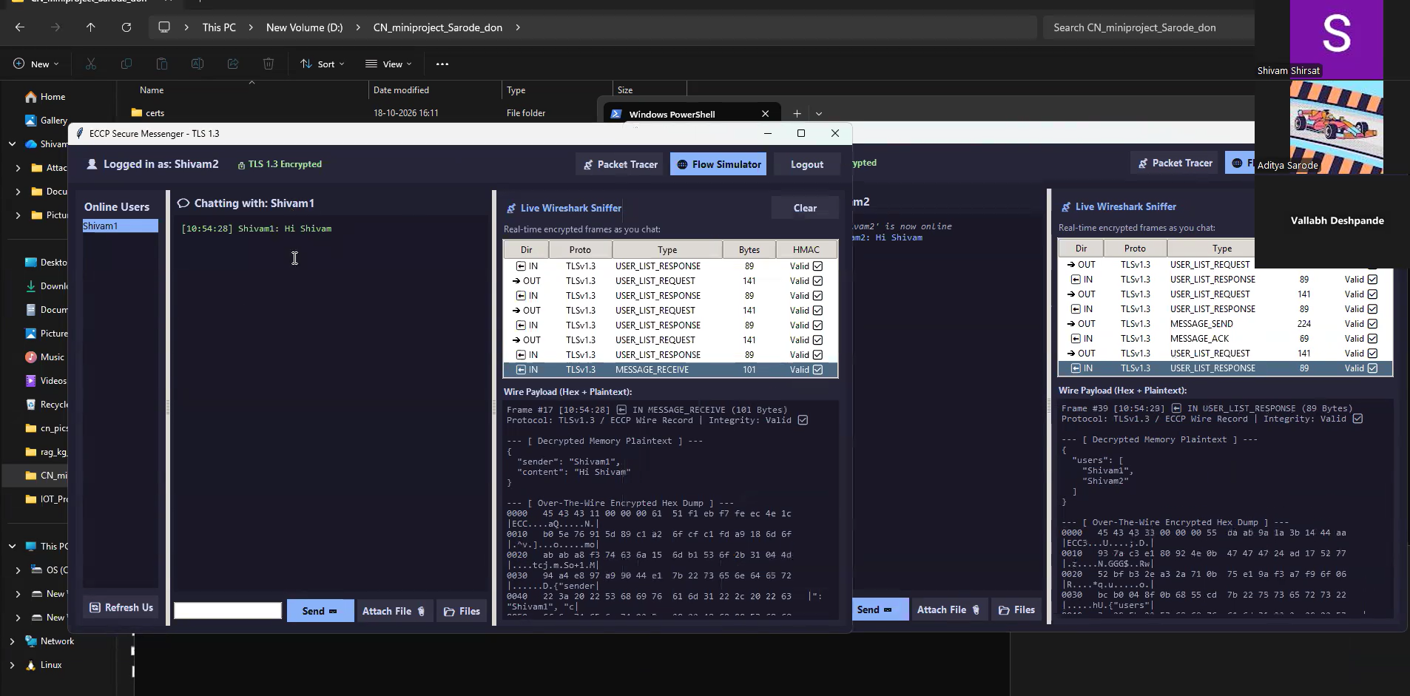

Slide 6
Testing and Results
AUTHENTICATION
10 cases reported
TAMPERING / FRAMES
10 cases reported
NETWORK FAILURES
10 cases reported
FILE TRANSFER
4 cases reported
Evidence included in project archive: five Wireshark-compatible PCAPs for TLS handshake, authentication, encrypted chat, file transfer and tampering.
TESTS TO SHOW
• Authentication — valid/invalid login; failed login must not create a valid session.
• Frame integrity — altered payloads/tags and truncated or oversized frames should be rejected.
• Network resilience — disconnects and concurrent clients should not freeze the server.
• File integrity — changing a byte should cause a SHA-256 mismatch.
• Wireshark — supplied PCAPs cover TLS handshake, authentication, encrypted chat, file transfer and tampering.
Computer Networks Laboratory CSE20110
50 seconds
Notes:
Suggested time: 50 seconds. Replace all bracketed placeholders and prompts with your own project details. Keep explanations brief. Total time across slides 1–7 is 5 minutes, including the demonstration. Slide 8 is for reference during questions. Show actual evidence. Explain the output and mention any failed or partial tests. Do not invent performance figures.

Slide 7
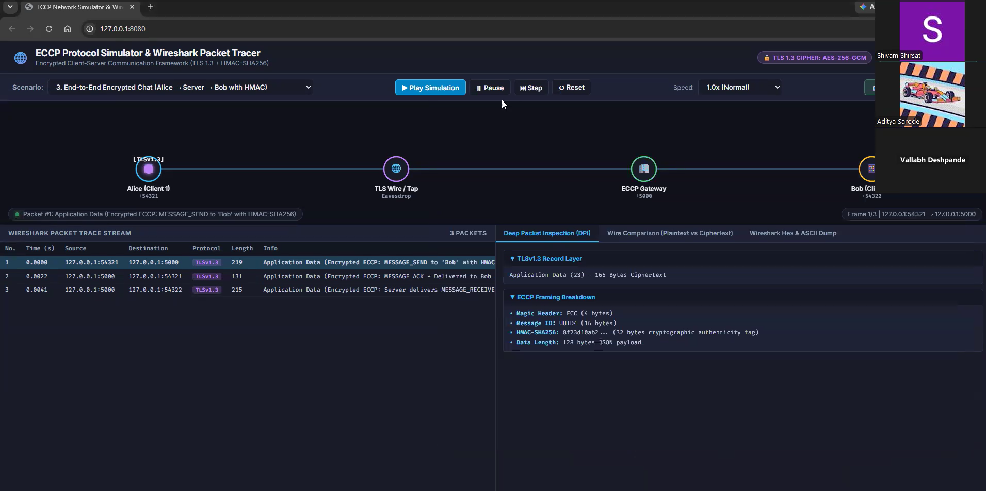

Slide 8
Working Demonstration
Function to demonstrate
Demonstrate the core security workflow: user authentication, TLS-protected messaging between two clients, and file-integrity verification.
1. Start the server; confirm its actual listening address and port in the terminal.
2. Launch two CLI or Tkinter clients and register/log in with test accounts.
3. Send a message from Client A to Client B; explain that application traffic travels inside the TLS channel.
4. Transfer a small test file and compare the sender/receiver SHA-256 values.
5. If time permits, attempt an invalid login or inspect a supplied PCAP in Wireshark to show TLS Application Data.
SUCCESS CRITERIA • Valid users can establish sessions and exchange messages. • Invalid credentials or modified frames are rejected. • The received file checksum matches the sender’s checksum. • Wireshark shows TLS records rather than readable application payloads.
Computer Networks Laboratory CSE20110
65 seconds
Notes:
Suggested time: 65 seconds. Replace all bracketed placeholders and prompts with your own project details. Keep explanations brief. Total time across slides 1–7 is 5 minutes, including the demonstration. Slide 8 is for reference during questions. Prepare the project before the timer starts. Keep the demo to about one minute. Keep a screenshot or short recording ready as a backup, and identify it as recorded evidence if used.

Slide 9
Conclusion and Contributions
OUTCOME
ECCP combines TCP/TLS, certificate-based server identity, user authentication, session tokens, framed messages, HMAC-SHA256 and SHA-256 file verification. CLI and Tkinter clients, modular server code, test scripts and PCAPs make network behavior observable.
APPLICATIONS
Secure-chat learning prototype • Protected file exchange • TLS and packet-analysis demonstrations
LIMITATIONS
Localhost-first setup • Development certificates • Port/test-count inconsistencies • Benchmarks not independently reproduced. This is a lab prototype, not a production security certification.
FUTURE SCOPE
LAN deployment profiles, certificate lifecycle hardening, key rotation, rate limits, dependency lockfile, CI regression tests and repeatable benchmarks.
TEAM CONTRIBUTIONS -
Vallabh Deshpande — Network architecture and protocol analysis
Aditya Sarode — Implementation review and functional testing; run setup, authentication, messaging, file-transfer and failure tests
Shivam Shirsat — Security evaluation, benchmark review and report integration
Computer Networks Laboratory CSE20110
30 seconds
Notes:
Suggested time: 30 seconds. Replace all bracketed placeholders and prompts with your own project details. Keep explanations brief. Total time across slides 1–7 is 5 minutes, including the demonstration. Slide 8 is for reference during questions.

Slide 10
References
[1] E. Rescorla, “The Transport Layer Security (TLS) Protocol Version 1.3,” RFC 8446, Aug. 2018. https://www.rfc-editor.org/rfc/rfc8446
[2] H. Krawczyk, M. Bellare, and R. Canetti, “HMAC: Keyed-Hashing for Message Authentication,” RFC 2104, Feb. 1997. https://www.rfc-editor.org/rfc/rfc2104
[3] Python Software Foundation, “Python 3 Documentation.” https://docs.python.org/3/
[4] Python Cryptographic Authority, “cryptography documentation.” https://cryptography.io/
[5] Wireshark Foundation, “Wireshark User’s Guide.” https://www.wireshark.org/docs/wsug_html_chunked/
[6] “ECCP Project README, Architecture, Protocol Specification, and Final Laboratory Report,” supplied project files, accessed Oct. 21, 2026.
Computer Networks Laboratory CSE20110
Notes:
Suggested time: Backup slide. Replace all bracketed placeholders and prompts with your own project details. Keep explanations brief. Total time across slides 1–7 is 5 minutes, including the demonstration. Slide 8 is for reference during questions.

