Slide 1
WELCOME
“BASKET BAZZAR ”

Slide 2

A PROJECT PRESENTATION ON
“BASKET BAZZAR ”
SUBMITTED IN PARTIAL FULFILLMENT OF THE REQUIRMENT FOR THE AWARD OF THE DEGREE MASTER OF COMPUETER APPLICATIONS
SESSION - 2021-2023
PROJECT GUID NAME PRESENTATION BY:
Internal Guide: Name of Student : VAIBHAV MAHDOLE
Shri. NITIN GUPTA SIR Enrolment no. : AX1020999012
Roll No. : 102034
Study Institute code no. : 999
Name of Student : SHIVAM KUMAR
Enrolment no. : AX1020999009
Roll No. :102032
Study Institute code no. : 999
SUBMITTED TO
MAKHANLAL CHATURVEDI NATIONAL UNIVERSITY OF JOURNALISM AND COMMUNICATION, BHOPAL (M.P.)

Slide 3
INTRODUCTION
Project E-Commerce Site For Online Shopping (BASKET BAZZAR) is a web based project The E-commerce is fast gaining ground as an accepted and used business paradigm. More and more business houses are implementing web sites providing functionality for performing commercial transactions over the web. It is reasonable to say that the process of shopping on the web is becoming commonplace. The objective of this project is to develop a general purpose e-commerce store where any product (such as Dress, toys, books, computers, mobile phones, electronic items, and home appliances) can be bought from the comfort of home through the Internet.

Slide 4
Abstract
The business-to-consumer aspect of electronic commerce (e-commerce) is the most visible business use of the World Wide Web. The primary goal of an e-commerce site is to sell goods and services online.
This project deals with developing an e-commerce website for Online Shooping. It provides the user with a catalog of different products available for purchase in the store. In order to facilitate online purchase a shopping cart is provided to the user. The system is implemented using a 3-tier approach, with a backend database, a middle tier DJANGO and SQLITE, and a web browser as the front end client.
In order to develop an e-commerce website, a number of Technologies must be studied and understood. These include multi-tiered architecture, server and client side scripting techniques, implementation technologies such as Python, programming language (such as JavaScript, django), relational databases (such as SQLITE,).
This is a project with the objective to develop a basic website where a consumer is provided with a shopping cart application and also to know about the technologies used to develop such an application.

Slide 5
Objective
Today the internet and its sound have created a new economic scenario that not only
stresses on the classical concept of the“ product” but also on the modern concept of “service”. It is this level of service that dictates whether a commercial venture will succeed or not in the market. To provide a high accessibility of service we will design the online shopping website, so that potential customers need not go to a physical shop to buy products or services. There are several objective of this websites are following given bellows.
• This site gives all the information about the e-shopping to provide better service for
the customer.
• It provides the facility to the customers who want to shop on-line due to lots of time.
• It provides facility to the customer to payment by the cash and online and UPI also.
• It’s providing the full details about the product and related information about the
Product like cost, size etc.
• With the help of it we can save the time and money also.

Slide 6
Scope
• The current system can be extended to allow the users to create accounts and save products in to wish list.
• The current system is confined only to the shopping cart process. It can be extended to have a easy to use check out process.
It satisfy the user requirement
Be easy to understand by the user.
Be easy to operate.
Have a good user interface.
Be expandable.
Delivered the information in a short time .

Slide 7
Project Design
In order to design a web site, the relational database must be designed first. Conceptual design can be divided into two parts: The data model and the process model. The data model focuses on what data should be stored in the database while the process model deals with how the data is processed. To put this in the context of the relational database, the data model is used to design the relational tables. The process model is used to design the queries that will access and perform operations on those tables.

Slide 8
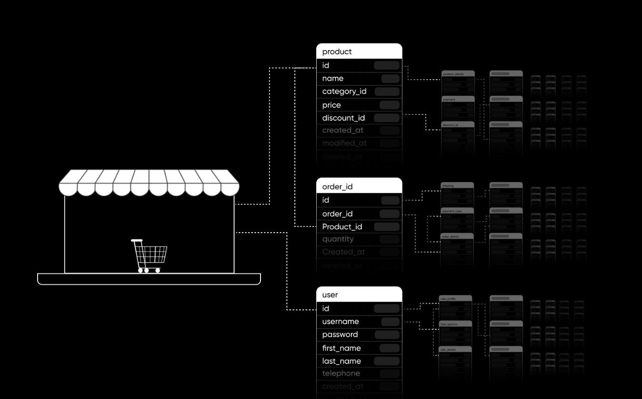
Data Model
A data model is a conceptual representation of the data structures that are required by a database. The first step in designing a database is to develop an Entity-Relation Diagram (ERD). The ERD serves as a blue print from which a relational database maybe deduced. Figure 1 shows the ERD for the project and later we will show the transformation from ERD to the Relational model.

Slide 9
Functional Decomposition Diagram
A decomposition diagram shows a top-down functional decomposition of a system and exposes the system's structure. The objective of the Functional Decomposition is to break down a system step by step, beginning with the main function of a system and continuing with the interim levels down to the level of elementary functions. The diagram is the starting point for more detailed process diagrams, such as data flow diagrams (DFD). Figure 2 shows the Functional Decomposition Diagram for this project.

Slide 10
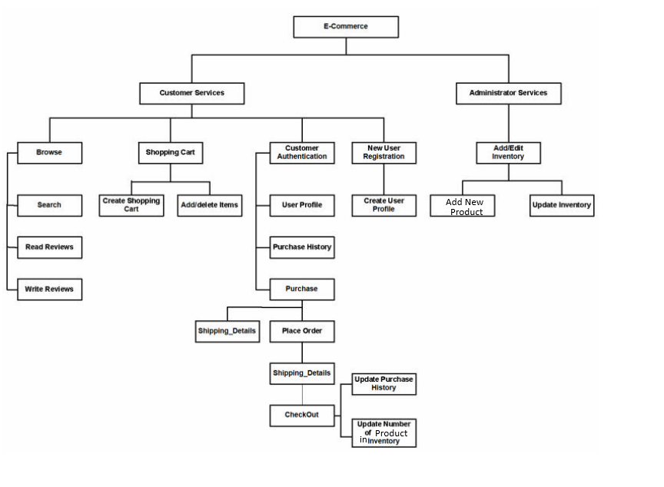

Slide 11
The Shopping Cart Application:
The objective of this application is to provide the user an online website where they can buy Products from the comfort of their home. A shopping cart is used for the purpose. The user can select the desired Products, place them in the shopping cart and purchase them. The user’s order will be shipped according to the type of shipping selected at the time of placing the order.
Website consists of the following things :

Slide 12
User Dashboard
Product Category Details
Add Product to Card
New user Sign up page
User Login
User Log Out
Card Details
User check out form
User order
User Order Status
User Final Order
Website Footer
Admin Login
Admin Dashboard
Admin Manage User
Admin Store Category/ manage Category
Admin Store User/ manage user
Admin Store Order/ manage Order
Admin Store Product/manage product
Admin Manage password

Slide 13
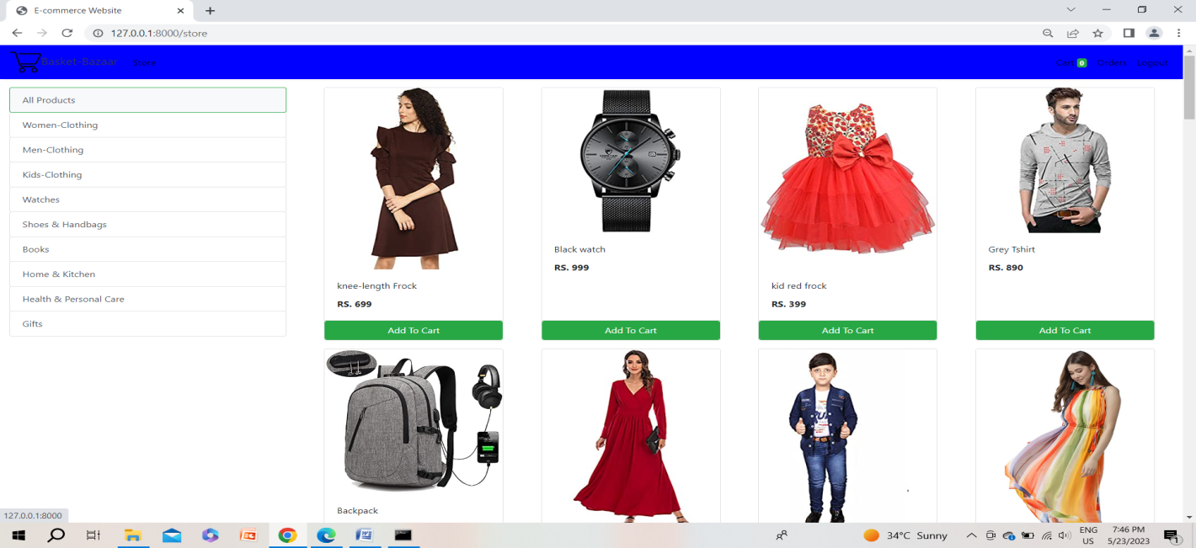
User Dashboard :-
When the user types the web address in the browser, the main page of the application is displayed which has the list of the top 8 popular Products available in the store, as shown in Figure.

Slide 14

Product Category Details :
When the user types the web address in the browser, the main page of the application is displayed which has the list of the product category sections available in the store, as shown in Figure .
Figure : Product Category Details

Slide 15
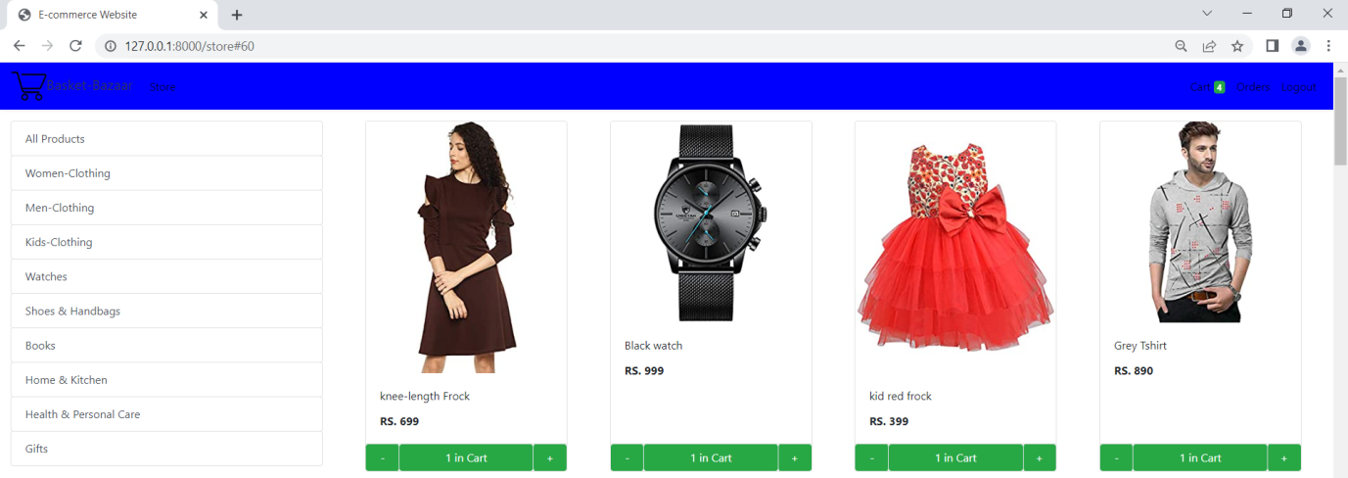
Add Product to Card :
The information about Product is stored in “Product” . The user can know the product in the store, product title, price of the product, number of product available at the store A link to add the product to the shopping cart The user have to login to add a Product to the cart or to process the order.
Figure 24: Add Product to Card

Slide 16
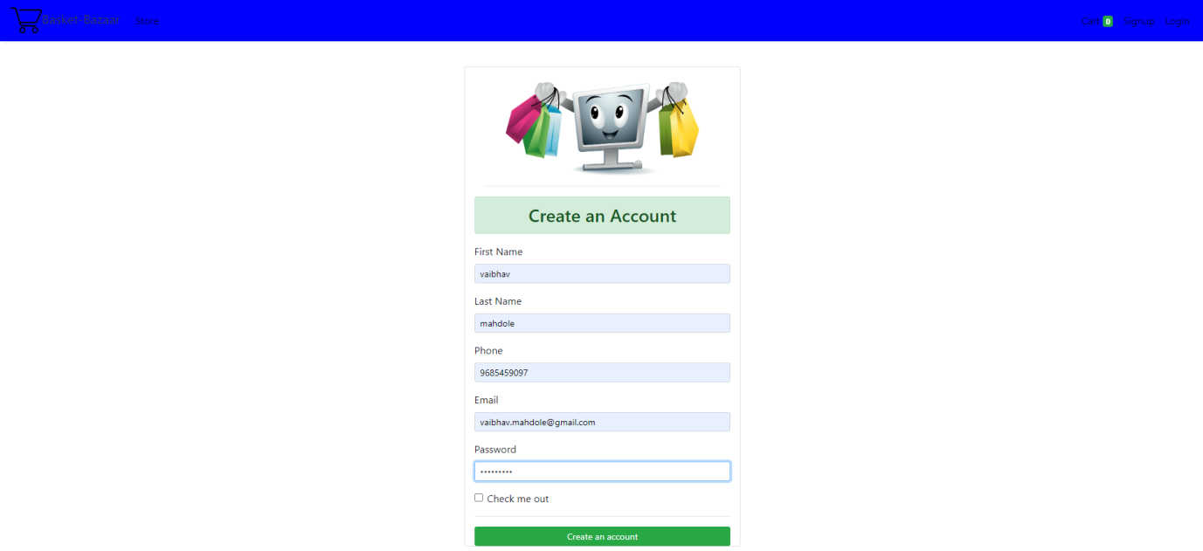
New user Sign up page:
This is the user signup page . where the user have to fill the basic information to signup process. The user have to Sign up and then have to login and add a Product to the cart or to process the order.
Figure : New user Sign up page

Slide 17
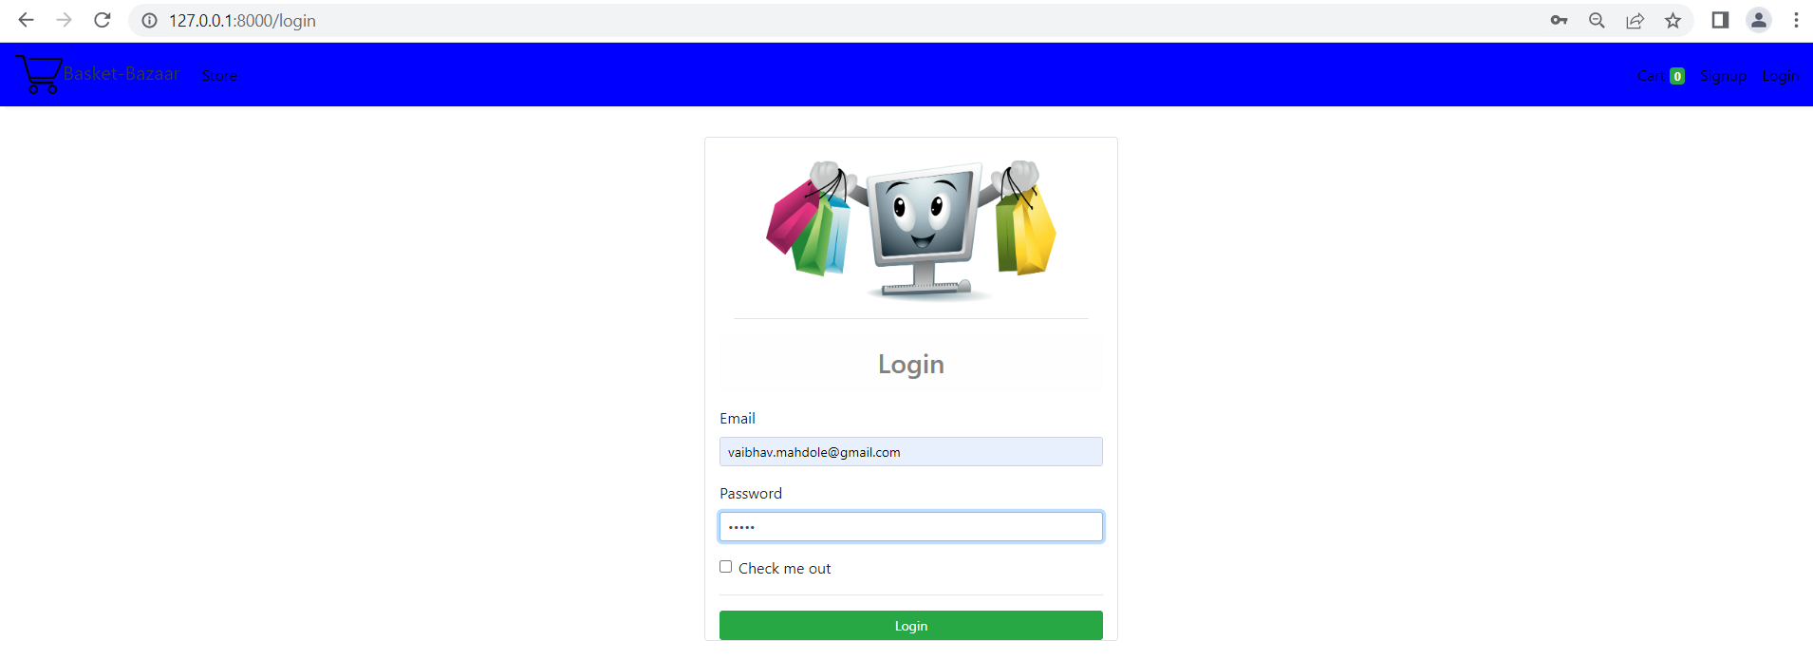
User Login :-
This is the user login page. The user have to login to add a Product to the cart or to process the order.
Figure : User Login page

Slide 18
User Log Out :
The logout Button is there in menu bar at right side of the corner of a website.
Figure : User Logout

Slide 19
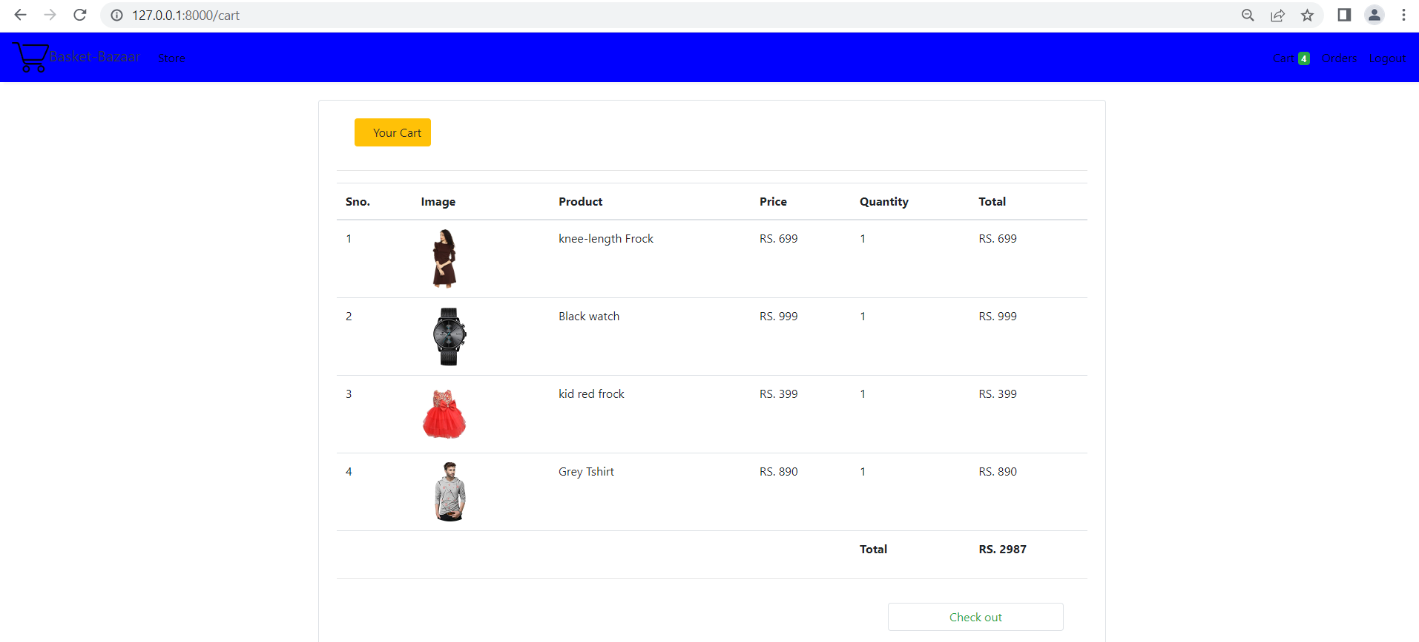
Card Details :
When “Add to Cart” is clicked for any Product, it is added to the shopping cart illustrated in Figure . If that particular Product is already present in the shopping cart, the quantity is increased by 1 and the price is changed accordingly; if not, a new entry is made into the table. All the information in the shopping cart is stored in “shopping_cart_items” table. Adding a product into the shopping cart does not decrease the quantity of product in the Product table. It is decreased only after an order is placed for the Product. So, placing the product in the shopping cart does not guarantee the availability of the product at the time of placing the order.
Figure : Card Details

Slide 20
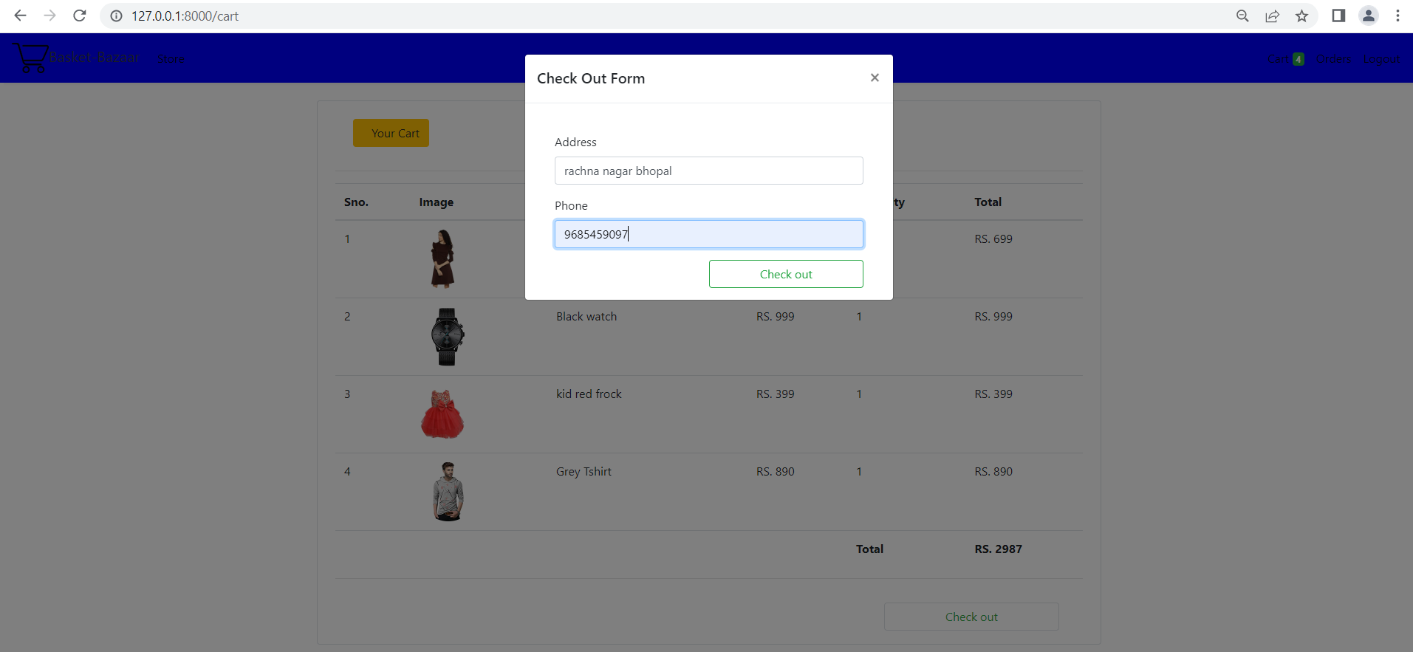
User check out form:
This is the user check out form, to fill the basic information.
Figure : User check out form

Slide 21
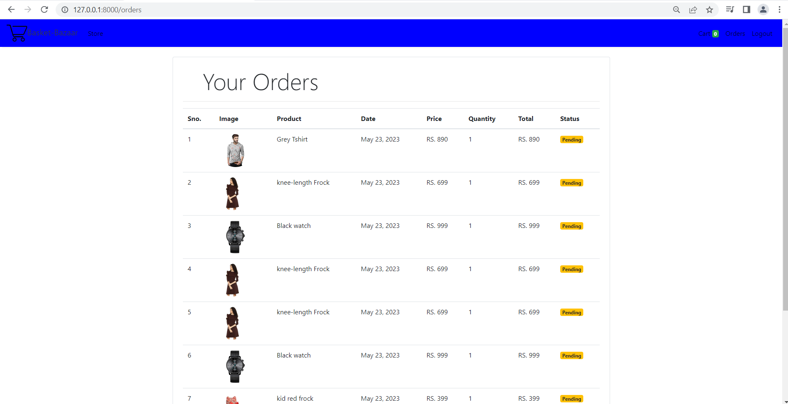
User order:
When “ Order” button is clicked which is located on the Top right side of the shopping website.
Figure : User order

Slide 22
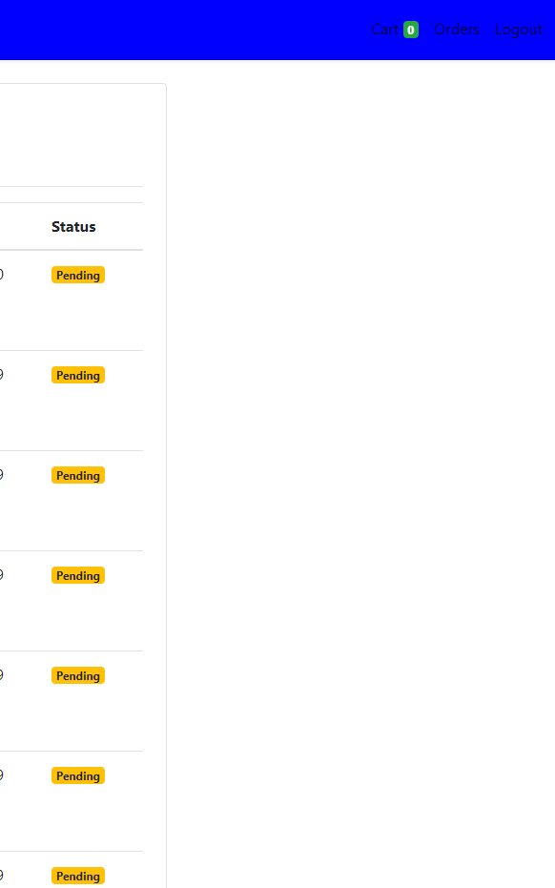
User order status:
When the order is done by the user . the user can see the status of their order by the status section.
Figure : User order status

Slide 23
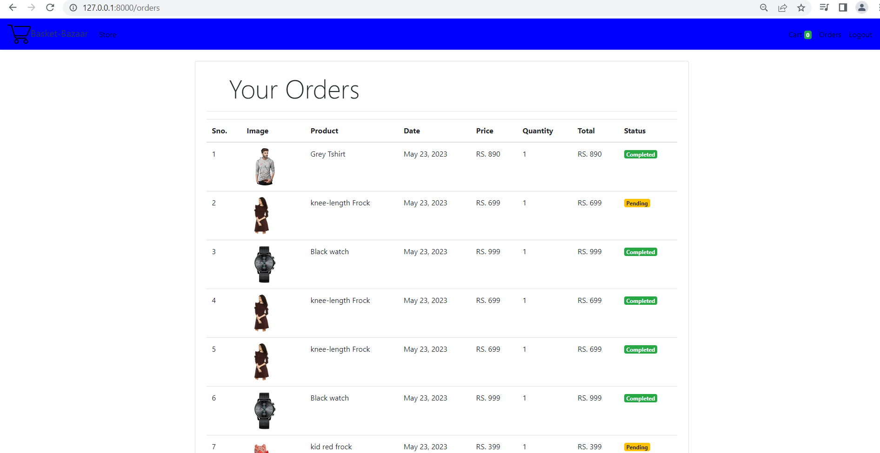
User Final Order status :
When the dealer accept the order the order status has been changed. From pending to completed user can check their product status.
Figure : User Final Order status

Slide 24
Website Footer:
The footer is at bottom of the website. The information in footers may include copyrights on all pages.
Figure : Website Footer

Slide 25
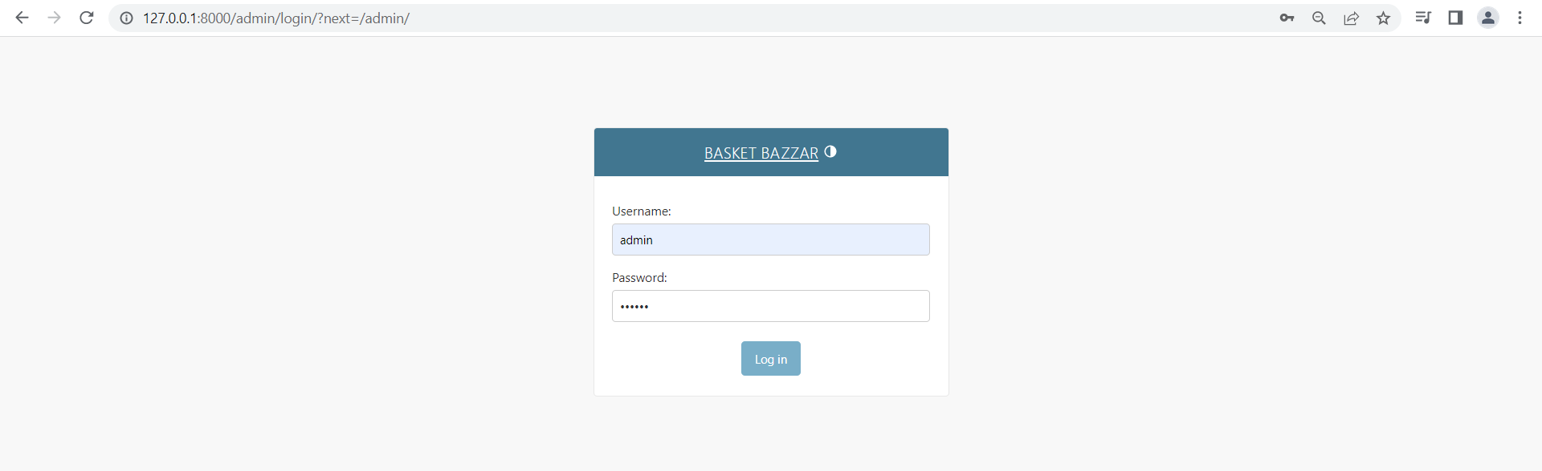
Admin Login : This is admin login panel.
Figure : Admin Login

Slide 26
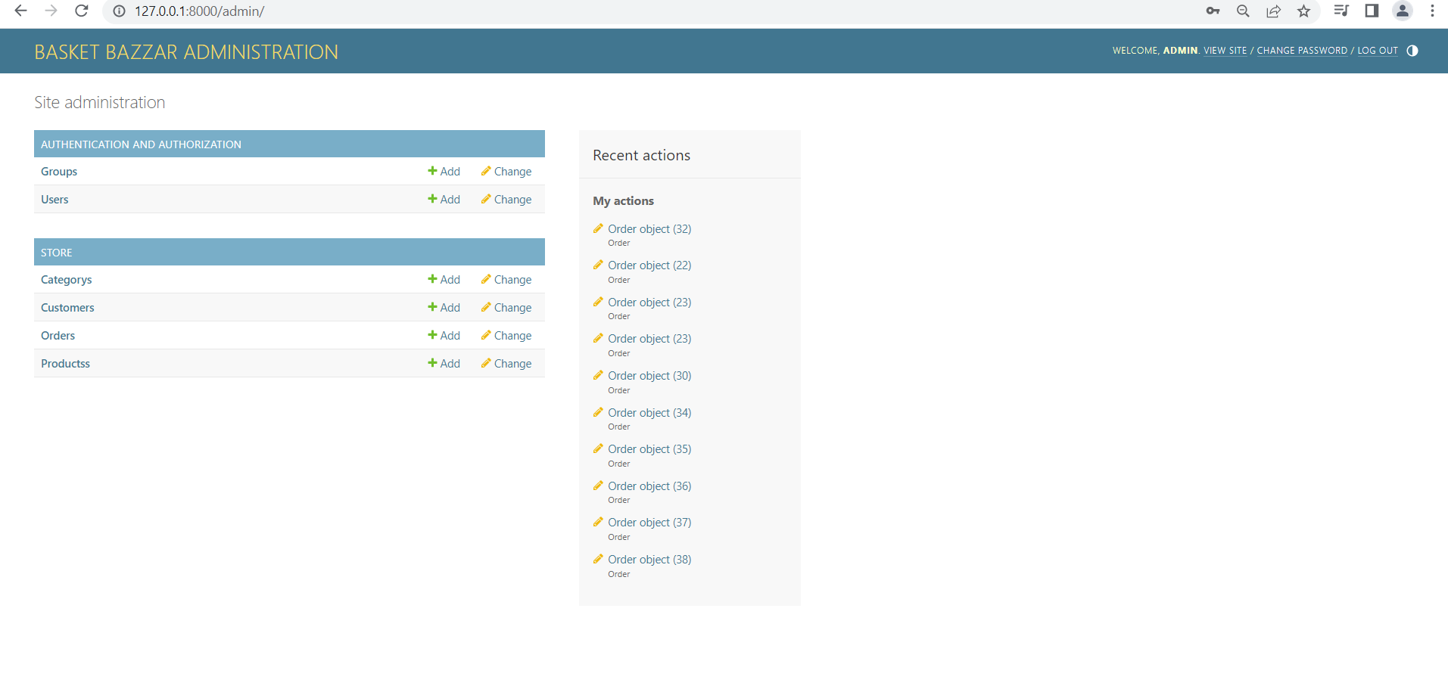
Admin Dashboard: This is admin dashboard.
Figure : Admin Dashboard

Slide 27
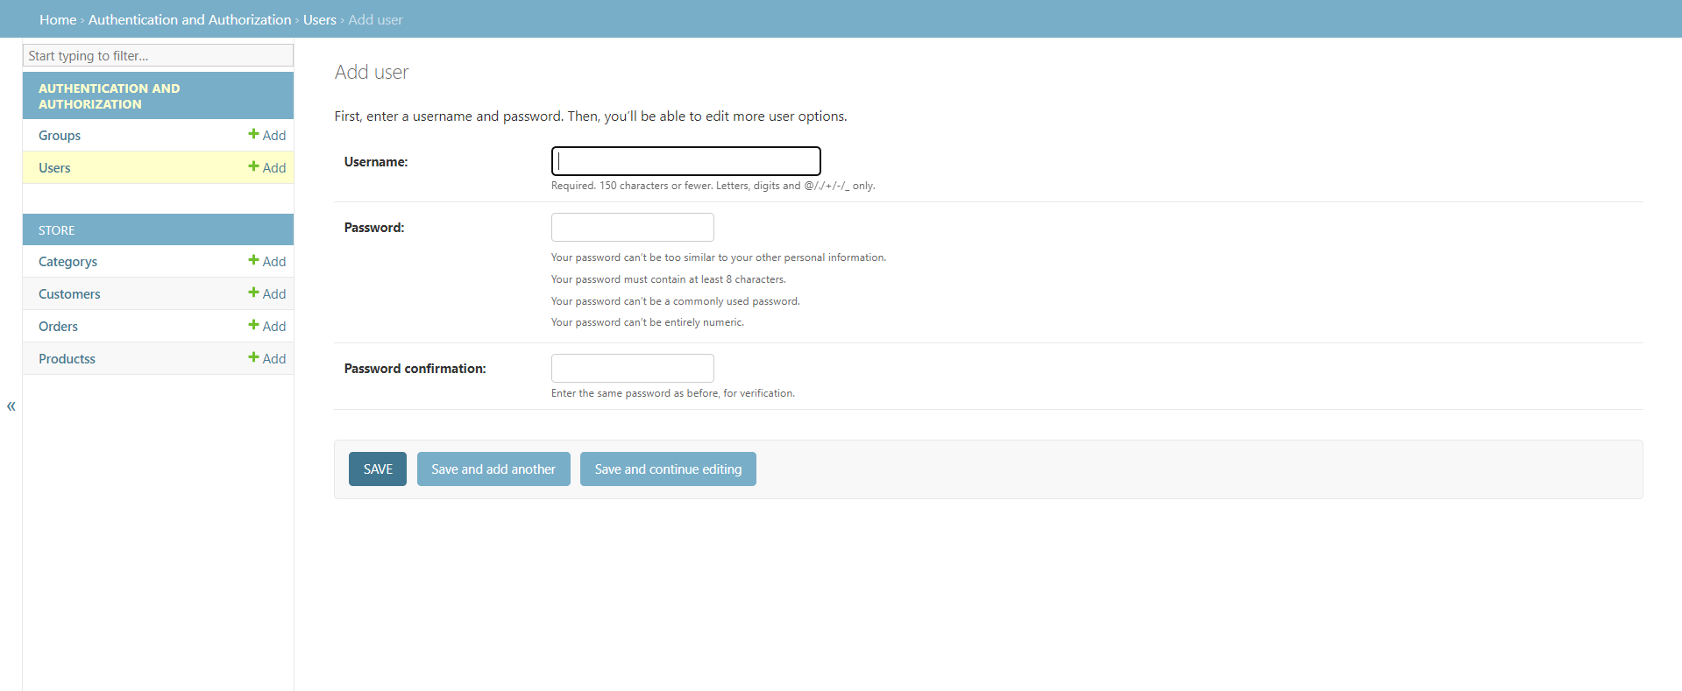
Admin Manage User :
Here the admin can manage user and perform many activity related to the user.
Figure : Admin Manage User

Slide 28
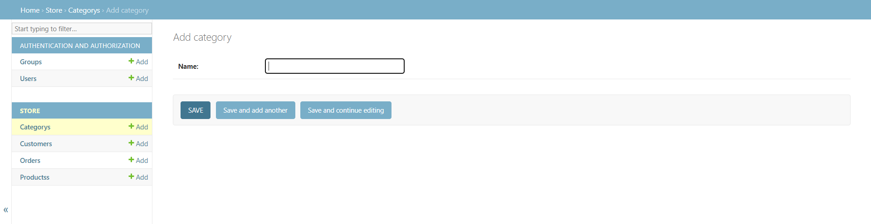
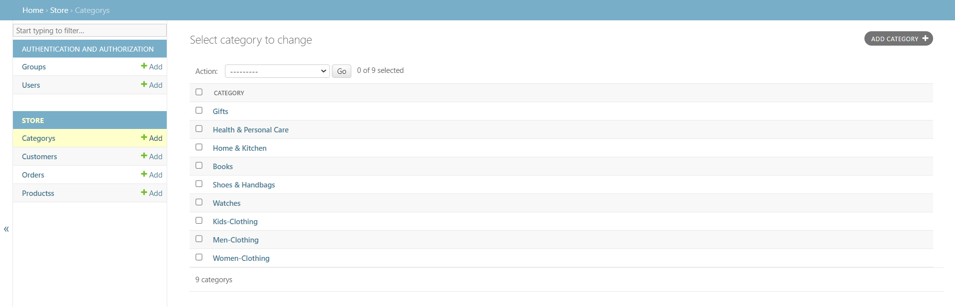
Admin Store Category/ manage Category:
In this admin can manage the store category add the category or remove the
Category or may edit on it.
Figure : Admin Store Category/ manage Category

Slide 29
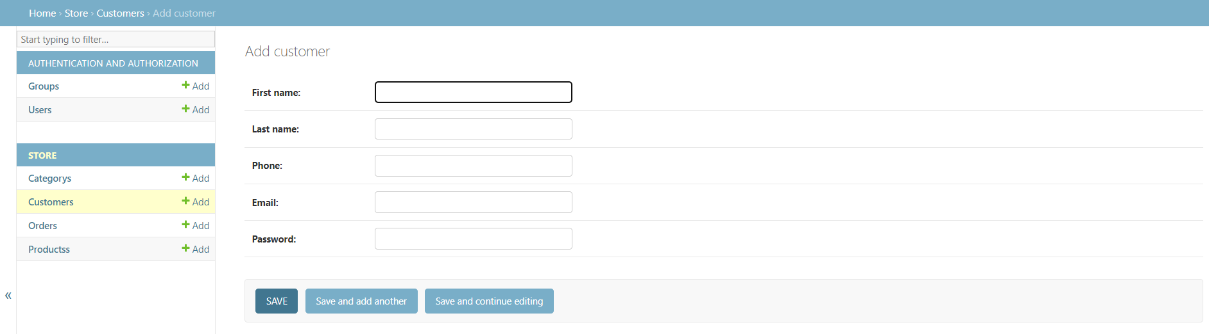
Admin Add Customer: Admin can also add custom directly.
Figure : Admin Add Customer

Slide 30
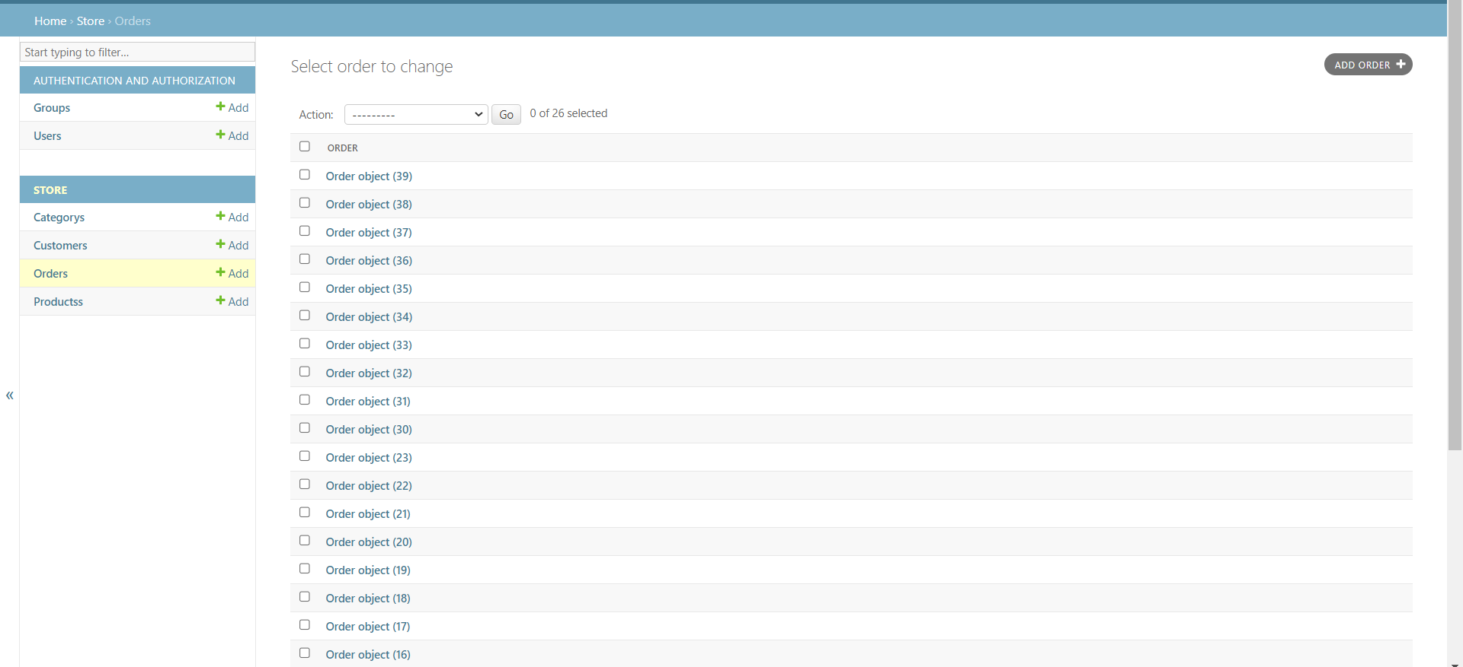
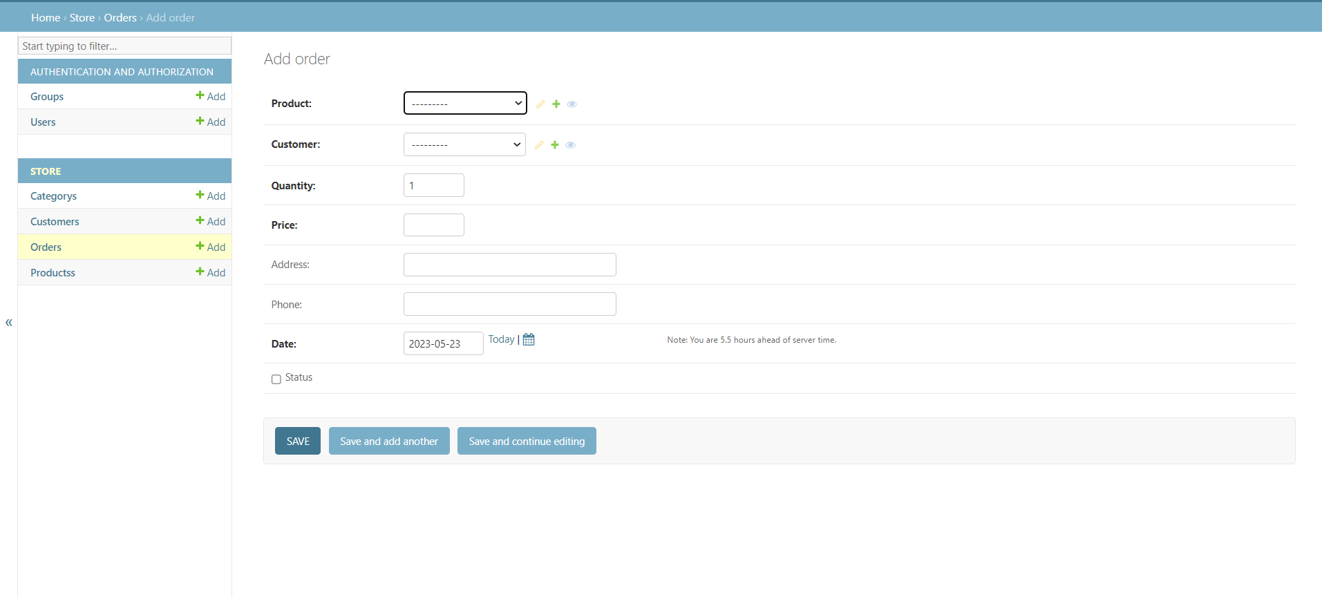
Admin Store Order/ manage Order:
In this panel admin can accept the order or change the order status or may decline
the order. And also add new order
.
Figure : Admin Store Order/ manage Order

Slide 31
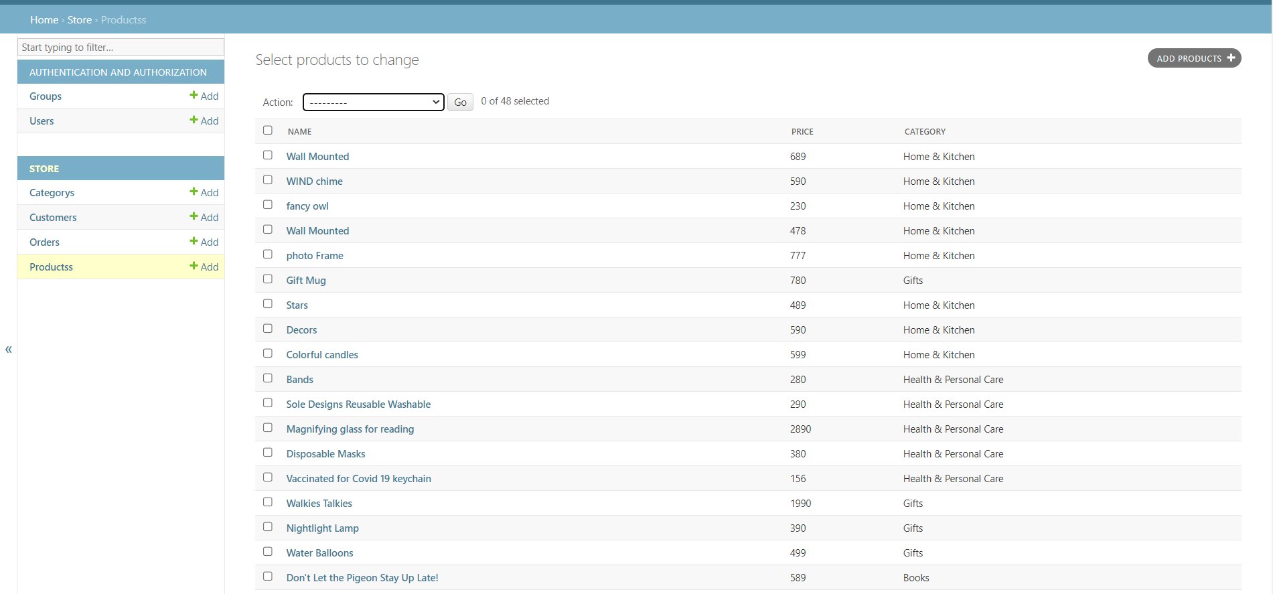
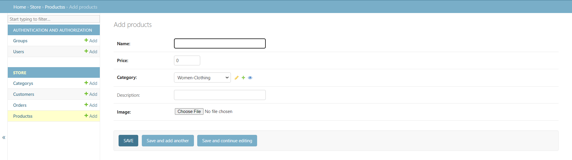
Admin Store Product/manage product:
In this store section the product can add and remove and manage all data related to Product are upload on a product section.
Figure : Admin Store Product/manage product

Slide 32
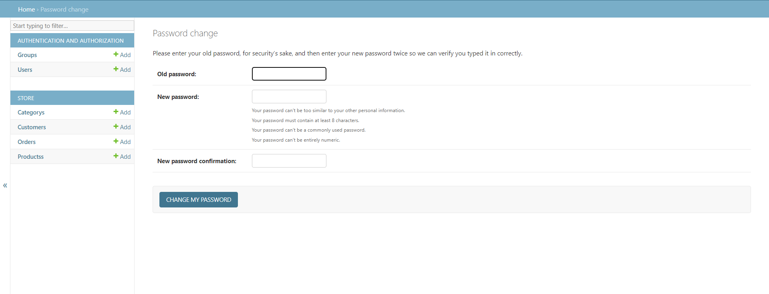
Admin Manage password:
In this section the admin can change their password. In a very simple way they just have to put the old password and new password and click on change password.
Figure : Admin Manage password

Slide 33
Limitations and Future Development
There are some limitations for the current system to which solutions can be
provided as a future development:-
1. This application does not have features by which user can set price ranges for
products and receive alerts once the price reaches the particular range. This
application does not have features by which user can set price ranges for
products and receive alerts once the price reaches the particular range.
2. The Website is not accessible to everyone. It can be deployed on a web server so
that everybody who is connected to the Internet can use it.
As for other future developments, the following can be done.
The Administrator of the web site can be given more functionalities.
3. Payment method can be Added.
4. The users could subscribe for price alerts which would enable them to receive
messages when price for products fall below a particular level.
5. Users can have multiple shipping and billing information saved. During checkout
they can use the drag and drop feature to select shipping and billing information.

Slide 34
Conclusions
The “E-Commerce Site For Online Shopping (BASKET BAZZAR)” is designed to provide a web based application that would make searching, viewing and selection of a product easier. The search engine provides an easy and convenient way to search for products where a user can Search for a product interactively and the search engine would refine the products available based on the user’s input. The user can then view the complete specification of each product. They can also view the product category wise and also add the product to a card.
A good shopping cart design must be accompanied with user-friendly shopping cart application logic. It should be convenient for the customer to view the contents of their cart and to be able to remove or add items to their cart. The shopping cart application described in this project provides a number of features that are designed to make the customer more comfortable.
This project helps in understanding the creation of an interactive web page and the technologies used to implement it. The design of the project which includes Data Model and Process Model illustrates how the database is built with different tables, how the data is accessed and processed from the tables. The building of the project has given me a precise knowledge about Django is used and how it connects to the database to access the data and how the data and web pages are modified to provide the user with a shopping cart application.

Slide 35
THANK YOU

