Slide 1
ADBMS MINI PROJECT
Farmer-to-Market Crop Yield
& Pricing Database
A polyglot ADBMS connecting field, mandi, and weather data to help farmers sell smarter
FARM
MANDI
CONSUMER
Shivam Chaudhari E213
Bhavya Sharma E223
Akshat Jain E257

Slide 2
Introduction & Motivation
Crop yield records, mandi (market) prices, and weather data today live in disconnected registers, spreadsheets, and paper ledgers.
Farmers decide where and when to sell largely on word-of-mouth, without a consolidated view of price trends across nearby markets.
An Advanced DBMS can unify structured farm/market records with fast-changing, semi-structured weather feeds — and still answer real-time "best market to sell today" queries.
This project models that system end-to-end: EER design, relational schema, PL/SQL business logic, and a polyglot (RDBMS + NoSQL + distributed) implementation.
Price Volatility
Mandi prices swing daily; farmers rarely see trends before selling.
Scattered Yield Data
Sowing, harvest and yield figures are kept per-field, never aggregated.
No Weather Linkage
Rainfall/temperature history is never connected to yield or price analysis.
Farmer-to-Market Crop Yield & Pricing Database
2

Slide 3
Objectives & Scope
1
Centralize farm data
Store farmer, field, and crop details in one normalized schema.
KEY OUTCOME
Farm → Market
Connected.
2
Track yield lifecycle
Log sowing, harvest, expected vs. actual yield per field per season.
3
Aggregate mandi prices
One query surface spanning structured records and fast-changing feeds:
Capture daily min/max/modal price feeds from multiple markets.
Farmer, field & crop master data
Yield records across seasons
Multi-mandi price history
Weather log correlation
Role-based access (farmer / officer / admin)
4
Recommend best market
Rank markets for a crop using recent price trend queries.
5
Fuse weather signals
Join rainfall/temperature history against yield outcomes.
Farmer-to-Market Crop Yield & Pricing Database
3

Slide 4
System Architecture Overview
District
Node A
District
Node B
District
Node C
Market & Price Service
(daily min / max / modal price)
Distributed mandi nodes (fragmented by district)
Sale Transaction Records
Central RDBMS
(Oracle / PostgreSQL)
Federated Query &
Management Layer
(polyglot API middleware)
Dashboards & Reports
(farmers, market officials, admin)
Weather Log Store
(MongoDB — NoSQL, JSON docs)
External Weather API
Solid = structured RDBMS flow · Dashed = NoSQL / external feed · Boxes on the left replicate into the central RDBMS nightly
Farmer-to-Market Crop Yield & Pricing Database
4

Slide 5
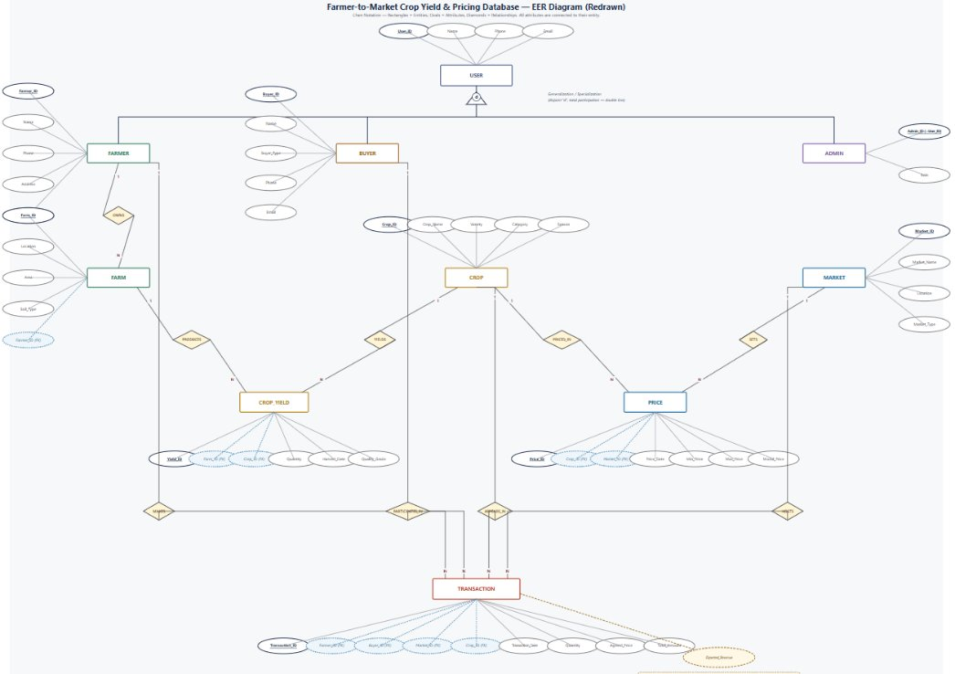
1
N
Farmer-to-Market Crop Yield & Pricing Database
5

Slide 6
Relational Schema — Core Tables
FARMER
FIELD
CROP
MARKET
PK farmer_id
PK field_id
PK crop_id
PK market_id
name
FK farmer_id
crop_name
market_name
phone
location
category
district
village
soil_type
season
state
district
area_acres
land_area_acres
YIELD_RECORD
CEREAL_CROP
VEGETABLE_CROP
FRUIT_CROP
PK yield_id
PK,FK crop_id
PK,FK crop_id
PK,FK crop_id
FK field_id
avg_duration_days
perishability_days
harvest_cycle_years
FK crop_id
sowing_date
harvest_date
expected_yield_qtl
actual_yield_qtl
PK = primary key · FK = foreign key · Cereal / Vegetable / Fruit tables implement the CROP specialization (1:1 with CROP)
Farmer-to-Market Crop Yield & Pricing Database
6

Slide 7
Relational Schema — Market & Transaction Tables
PRICE_RECORD
SALE_TRANSACTION
PRICE_ALERT (trigger-generated)
PK price_id
PK sale_id
PK alert_id
FK market_id
FK farmer_id
FK crop_id
FK crop_id
FK market_id
FK market_id
price_date
FK crop_id
alert_date
min_price
quantity_qtl
deviation_pct
max_price
sale_date
modal_price
price_per_qtl
WEATHER_LOG — stored outside the RDBMS (MongoDB document)
Why keep tables normalized to 3NF?
{ "district": "Nashik", "log_date": "2026-09-10",
"temperature_c": 29.4, "rainfall_mm": 12.5,
"humidity_pct": 68 }
No repeating price/yield groups inside FARMER or CROP
Every non-key attribute depends only on its table's key
Farmer-to-Market Crop Yield & Pricing Database
7

Slide 8
PL/SQL Constructs — Triggers
1. Validate harvest date on entry
CREATE OR REPLACE TRIGGER trg_validate_harvest
BEFORE INSERT OR UPDATE ON YIELD_RECORD
FOR EACH ROW
BEGIN
IF :NEW.harvest_date <= :NEW.sowing_date THEN
RAISE_APPLICATION_ERROR(-20001,
'Harvest date must be after sowing date');
END IF;
END;
Row-level BEFORE trigger
Blocks impossible date entries before they reach storage
Keeps YIELD_RECORD trustworthy for later trend queries
2. Flag sudden price swings
CREATE OR REPLACE TRIGGER trg_price_alert
AFTER INSERT ON PRICE_RECORD
FOR EACH ROW
DECLARE
v_avg NUMBER;
BEGIN
SELECT AVG(modal_price) INTO v_avg FROM PRICE_RECORD
WHERE crop_id = :NEW.crop_id
AND price_date >= :NEW.price_date - 7;
IF ABS(:NEW.modal_price - v_avg) > 0.2 * v_avg THEN
INSERT INTO PRICE_ALERT(crop_id, market_id, alert_date, deviation_pct)
VALUES (:NEW.crop_id, :NEW.market_id, :NEW.price_date,
ROUND((:NEW.modal_price - v_avg) / v_avg * 100, 2));
END IF;
END;
AFTER INSERT trigger with an embedded query
Compares new price to the 7-day rolling average
>20% deviation auto-logs a PRICE_ALERT row
Powers the "best time to sell" recommendation
Farmer-to-Market Crop Yield & Pricing Database
8

Slide 9
PL/SQL Constructs — Procedures & Functions
Stored procedure — best market for a crop (cursor loop)
CREATE OR REPLACE PROCEDURE proc_best_market(
p_crop_id IN NUMBER, p_result OUT VARCHAR2) IS
CURSOR c_prices IS
SELECT m.market_name, AVG(p.modal_price) avg_price
FROM PRICE_RECORD p JOIN MARKET m ON m.market_id = p.market_id
WHERE p.crop_id = p_crop_id
AND p.price_date >= SYSDATE - 30
GROUP BY m.market_name
ORDER BY AVG(p.modal_price) DESC;
v_top c_prices%ROWTYPE;
BEGIN
OPEN c_prices;
FETCH c_prices INTO v_top;
p_result := v_top.market_name || ' @ Rs.' || v_top.avg_price;
CLOSE c_prices;
END;
Procedure returns an OUT parameter, so the calling app (or a report) receives the ranked result directly.
Explicit cursor demonstrates row-by-row processing — a core PL/SQL skill beyond plain SQL.
Function is reusable inside SELECT statements and dashboard views.
Both encapsulate business rules inside the database, so every client (web, mobile, SMS gateway) gets consistent answers.
Exception handling (NO_DATA_FOUND) is added in the full implementation to keep calls safe when a farmer has no records yet.
Function — expected revenue for a farmer's crop
CREATE OR REPLACE FUNCTION fn_expected_revenue(
p_farmer_id NUMBER, p_crop_id NUMBER) RETURN NUMBER IS
v_yield NUMBER; v_price NUMBER;
BEGIN
SELECT actual_yield_qtl INTO v_yield FROM YIELD_RECORD y
JOIN FIELD f ON f.field_id = y.field_id
WHERE f.farmer_id = p_farmer_id AND y.crop_id = p_crop_id
AND ROWNUM = 1 ORDER BY harvest_date DESC;
SELECT MAX(modal_price) INTO v_price FROM PRICE_RECORD
WHERE crop_id = p_crop_id;
RETURN v_yield * v_price;
END;
Farmer-to-Market Crop Yield & Pricing Database
9

Slide 10
Implementation — Polyglot Persistence
Relational DBMS
NoSQL Store
Distributed System
Oracle 19c / PostgreSQL
MongoDB (document store)
District-level mandi nodes
FARMER, FIELD, CROP, YIELD_RECORD
MARKET, PRICE_RECORD, SALE_TRANSACTION
ACID transactions for sales & payments
Triggers, procedures, functions (Slides 8–9)
WEATHER_LOG as flexible JSON docs
High-frequency API ingestion (per hour)
Schema varies by sensor/region
Queried by district + date range, joined at the app layer
Horizontal fragmentation of PRICE_RECORD by district
Local writes at each mandi node
Nightly replication to the central RDBMS
Central node serves state-wide read queries
Management layer that ties it together
A federated API (e.g. Node.js / Django) accepts one request such as "best market for wheat near Nashik this week", fans it out to the RDBMS (price + yield) and MongoDB (weather), and merges the results before responding.
Farmer-to-Market Crop Yield & Pricing Database
10

Slide 11
Sample Query & Dashboard Report
Query — top 3 markets for Wheat, last 30 days
Farmer dashboard (conceptual)
SELECT m.market_name,
ROUND(AVG(p.modal_price),2) AS avg_price
FROM PRICE_RECORD p
JOIN MARKET m ON m.market_id = p.market_id
JOIN CROP c ON c.crop_id = p.crop_id
WHERE c.crop_name = 'Wheat'
AND p.price_date >= SYSDATE - 30
GROUP BY m.market_name
ORDER BY avg_price DESC
FETCH FIRST 3 ROWS ONLY;
Best Market Today: Lasalgaon — Rs. 2,340/qtl
MARKET
AVG PRICE (Rs/qtl)
Lasalgaon
2,340
Nashik APMC
2,275
Weather note: Nashik district recorded 12.5mm rainfall yesterday — no yield risk flagged
Alert: Pune Mandi price dropped 8% from last week (see PRICE_ALERT)
Pune Mandi
2,190
Farmer-to-Market Crop Yield & Pricing Database
11

Slide 12
Conclusion & Future Scope
What this project demonstrates
Future scope
An Extended EER model with a weak entity and crop specialization
A normalized (3NF) relational schema mapped from that EER design
PL/SQL triggers, a cursor-based procedure, and a reusable function
A realistic polyglot architecture: RDBMS + NoSQL + distributed mandi nodes under one query layer
ML-based price forecasting layered on historical PRICE_RECORD data
Mobile / SMS alerts driven directly by PRICE_ALERT triggers
Blockchain-backed sale ledger for tamper-proof transaction history
IoT soil-moisture sensors feeding a new field-level NoSQL stream

