Slide 1
EIGEN DECOMPOSITION

Slide 2
WHAT ARE WE GOING TO LEARN(OUTCOMES)
1. EIGEN DECOMPOSITION INTRODUCTION
WHY IS EIGEN DECOMPOSITION USEFUL?
APPLICATION OF EIGEN DECOMPOSITION

Slide 3
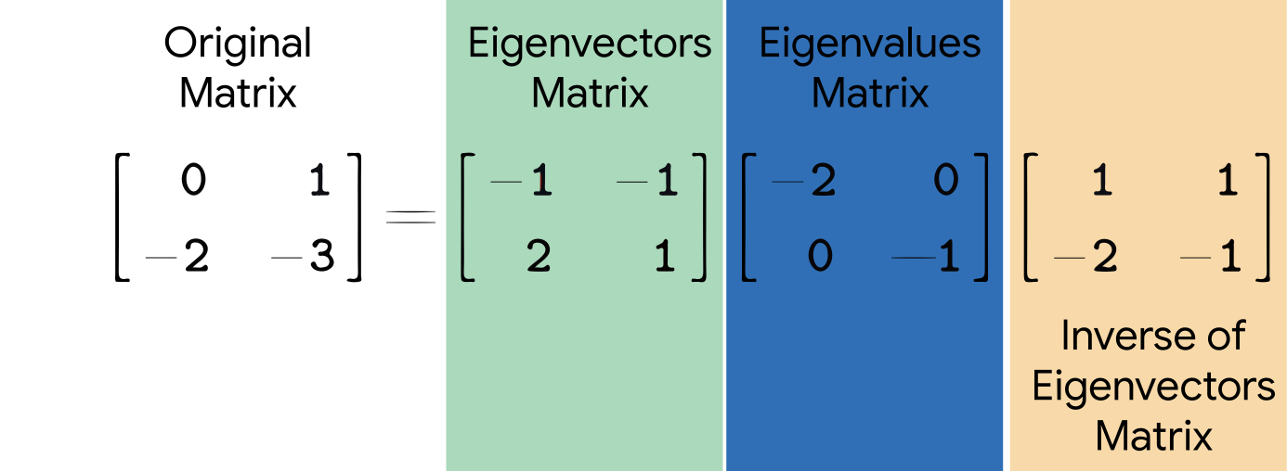
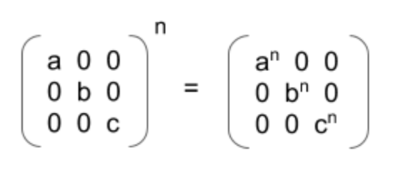
INTRODUCTION
Let A be a square n × n matrix with n linearly independent eigenvectors p_{i} (where i = 1, ..., n).
Then A can be factorized as : A=PDP⁻¹
where P is the square n × n matrix whose i th column is the eigenvector p_{i} of A, and D is the diagonal matrix whose diagonal elements are the corresponding eigenvalues, D_{ii} = λ_{i}.
Note that only diagonalizable matrices can be factorized in this way.
(1)
The decomposition can be derived from the fundamental property of eigenvectors:
v is the eigen vector and λ is eigen value
Av = λv
AP = PD
A = PDP⁻¹
(A)
Squaring both sides of eqn (1) ,we get
A² = (PDP⁻¹)(PDP⁻¹)
= PD(PP⁻¹)DP⁻¹
= PD²P
P
D
P⁻¹
Diagonal Matrix
By induction, it follows that for general positive integer powers,
A^{n}=PD^{n}P⁻¹
Diagonal matrix raised to power n (D^{n})
Inverse of a matrix can also be calculated
A⁻¹ = PD⁻¹P⁻¹

Slide 4
Why is the eigendecomposition useful ?
Matrix operations such as transformations or multiplications are computationally expensive. In applications such as machine learning, we often have thousands or millions of dimensions. Imagine we have to perform matrix transformations repeatedly on matrices in millions of dimensions. Even the best computers quickly reach their limits.
If we need to calculate the matrix A raised to power n (A^{n}) then it is quite difficult as we have to multiply matrix A n times.
But with the help of eigen decomposition this can be done in few steps :
A=PDP⁻¹
Now if we try to calculate A^{n} using eigen decomposition
A^{n} = (PDP⁻¹) (PDP⁻¹) (PDP⁻¹)…….. (PDP⁻¹) [n-times]
= (PD)(PP⁻¹)D(PP⁻¹)….(P⁻¹) (PP⁻¹ = I (Identity matrix )) [I when multiplied with D gives D i.e DI=D]
= (PD^{n}P⁻¹)
Eigendecomposition provides us with a tool to decompose a matrix by discovering the eigenvalues and the eigenvectors.
This operation can prove useful since it allows certain matrix operations to be easier to perform and it also tells us important facts about the matrix itself.
For example, a matrix is only singular if any eigenvalues are zero.

Slide 5
It turns out when performing eigendecomposition, we are looking for a vector, whose direction will not be changed by a matrix-vector multiplication — only its magnitude will either be scaled up or down.
Therefore, the effect of the matrix on the vector is the same as the effect of a scalar on the vector.
This effect can be described, more formally, by the fundamental eigenvalue equation:
Application of eigen decomposition
The most important application Eigen decomposition is that it can be used in the reduction of the dimensionality of your data.

