Slide 1

Multiple Disease Prediction system...
Using mACHINE LEARNING

Slide 2
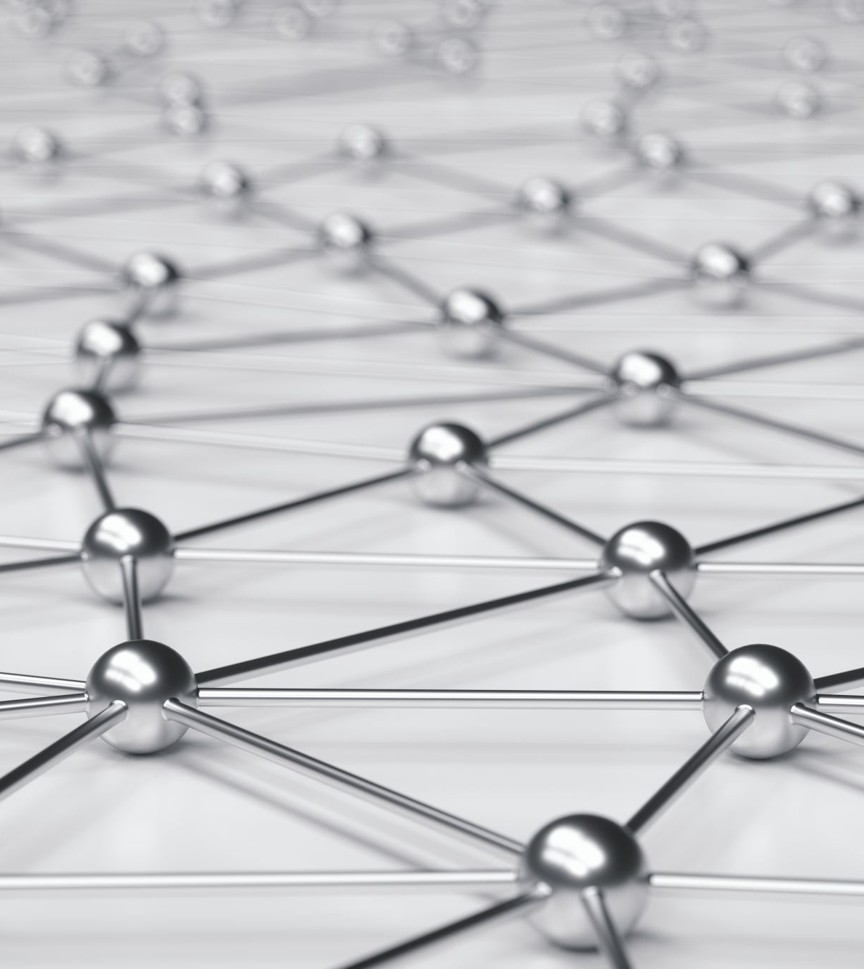
What is Machine Learning ?
Machine Learning is the field of study that gives computers the capability to learn without being explicitly programmed. ML is one of the most exciting technologies that one would have ever come across. As it is evident from the name, it gives the computer that makes it more similar to humans: The ability to learn. Machine learning is actively being used today, perhaps in many more places than one would expect.

Slide 3
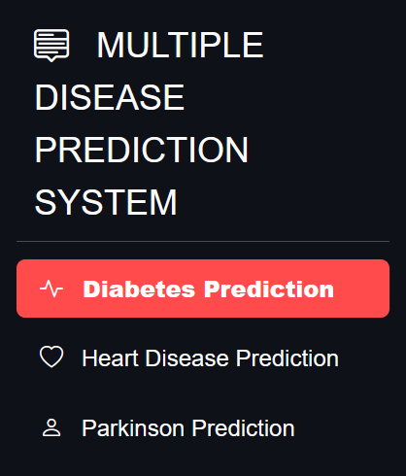
Multiple Disease Prediction system

Slide 4
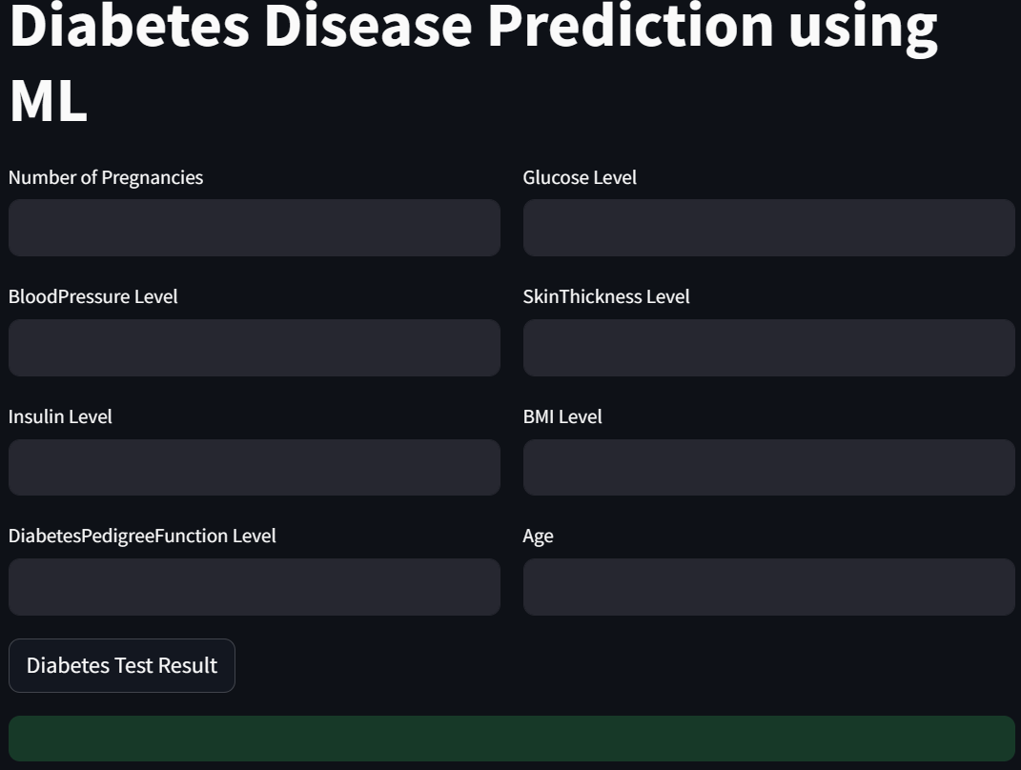
Diabetes Disease Prediction using ML
Diabetes mellitus refers to a group of diseases that affect how the body uses blood sugar (glucose). Glucose is an important source of energy for the cells that make up the muscles and tissues. It's also the brain's main source of fuel.
The main cause of diabetes varies by type. But no matter what type of diabetes you have, it can lead to excess sugar in the blood. Too much sugar in the blood can lead to serious health problems.

Slide 5
SUPPORT VECTOR MACHINE
Support Vector Machine (SVM) is a powerful machine learning algorithm used for linear or nonlinear classification, regression, and even outlier detection tasks. SVMs can be used for a variety of tasks, such as text classification, image classification, spam detection, handwriting identification, gene expression analysis, face detection, and anomaly detection. SVMs are adaptable and efficient in a variety of applications because they can manage high-dimensional data and nonlinear relationships.Support Vector Machine (SVM) is a powerful machine learning algorithm used for linear or nonlinear classification, regression, and even outlier detection tasks. SVMs can be used for a variety of tasks, such as text classification, image classification, spam detection, handwriting identification, gene expression analysis, face detection, and anomaly detection. SVMs are adaptable and efficient in a variety of applications because they can manage high-dimensional data and nonlinear relationships.pport Vector Machine (SVM) is a powerful machine learning algorithm used for linear or nonlinear classification, regression, and even outlier detection tasks. SVMs can be used for a variety of tasks, such as text classification, image classification, spam detection, handwriting identification, gene expression analysis, face detection, and anomaly detection.

Slide 6
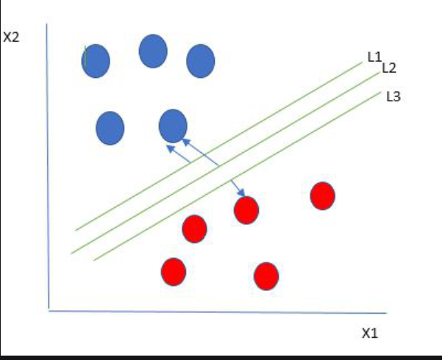
SUPPORT VECTOR MACHINE

Slide 7
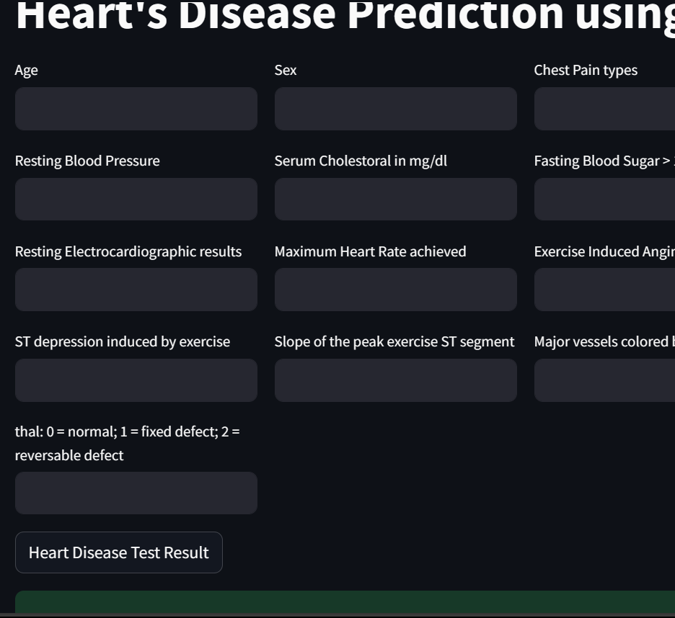
Heart's Disease Prediction using ML
Heart disease describes a range of conditions that affect the heart. Heart diseases include:
Blood vessel disease, such as coronary artery disease
Irregular heartbeats (arrhythmias)
Heart problems you're born with (congenital heart defects)
Disease of the heart muscle
Heart valve disease

Slide 8
Logistic Regression
Logistic regression is a supervised machine learning algorithm mainly used for classification tasks where the goal is to predict the probability that an instance belongs to a given class or not. It is a kind of statistical algorithm, which analyze the relationship between a sLogistic regression is a supervised machine learning algorithm mainly used for classification tasks where the goal is to predict the probability that an instance belongs to a given class or not. It is a kind of statistical algorithm, which analyze the relationship between a set of independent variables and the dependent binary variables. It is a powerful tool for decision-making. For example email spam or not. et of independent variables and the dependent binary variables. It is a powerful tool for decision

Slide 9
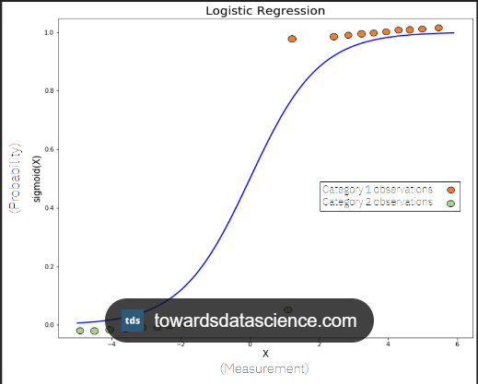
Logistic Regression

Slide 10
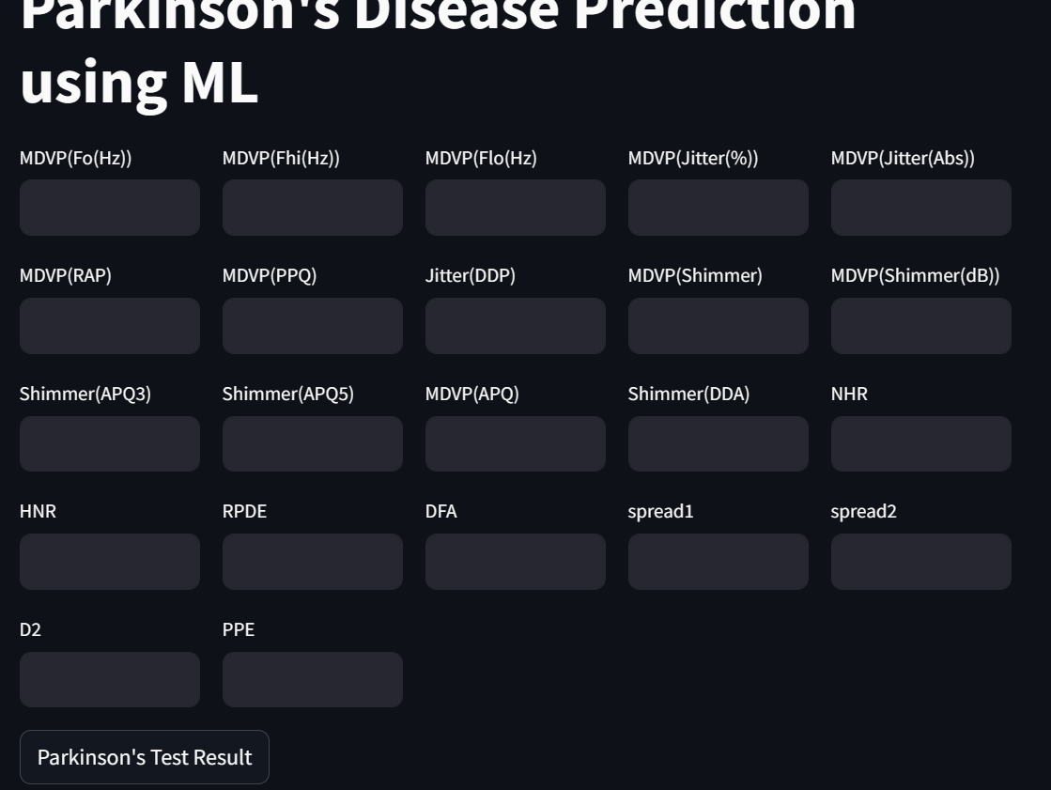
Parkinson's Disease Prediction using ML
Parkinson's disease is a progressive disorder that affects the nervous system and the parts of the body controlled by the nerves. Symptoms start slowly. The first symptom may be a barely noticeable tremor in just one hand.

Slide 11
SUPPORT VECTOR MACHINE
Support Vector Machine (SVM) is a powerful machine learning algorithm used for linear or nonlinear classification, regression, and even outlier detection tasks. SVMs can be used for a variety of tasks, such as text classification, image classification, spam detection, handwriting identification, gene expression analysis, face detection, and anomaly detection. SVMs are adaptable and efficient in a variety of applications because they can manage high-dimensional data and nonlinear relationships.Support Vector Machine (SVM) is a powerful machine learning algorithm used for linear or nonlinear classification, regression.

Slide 12
FUTURE WORK
This System could take into consideration of multiple user so we will add remedy or precaution features which will send report to the user in their respective Gmail.

Slide 13
THANKYOU

