Slide 1
Group 44 - Project Name: FoodHomiez
Shivam Agarwal 2020123
Aishwary Sharma 2020490
Rohan Kulkarni 2020537
Antonio Pedro 2020028
Lokesh 2020077

Slide 2
Problem Statement
Priya is a housewife who loves to cook and her dream is to open her own restaurant but she doesn’t have enough money and experience to do so.
She wants to start cooking professionally in a way that can help her to gain the experience,popularity and money required to fulfill her dream of opening her own restaurant.

Slide 3
Solution Statement
Priya gets to know about the foodhomiez app from her friend. The app helps her to sell her home-cooked food to people in her region.She also sees how she is comparing with other cooks in her region which motivates to come up with more creative dishes at competitive prices. She thereby earns money and gains experience which helps her in keeping her hopes of opening her own restaurant alive.

Slide 4
FIGMA LINK
https://www.figma.com/proto/59637r4A0Ivi1rvhFdgY4T/Hi_Fi?node-id=1%3A2&scaling=scale-down&page-id=0%3A1
GOOGLE FORM LINK
https://docs.google.com/forms/d/1E3oGQFRJyX82wjbWsoPWm-v4wEe1Xj_dy0MEg_5tl9k/edit?usp=sharing

Slide 5
Task Flow
Follow the words highlighted in blue,red ones are optional(from the next slide).
Outline:
Step 1 - Login
Step 2 - Go to Menu
Step 3 - Go to New Orders
Step 4 - Accept Order
Step 5 - Track Order
Step 6- Order Delivered

Slide 6
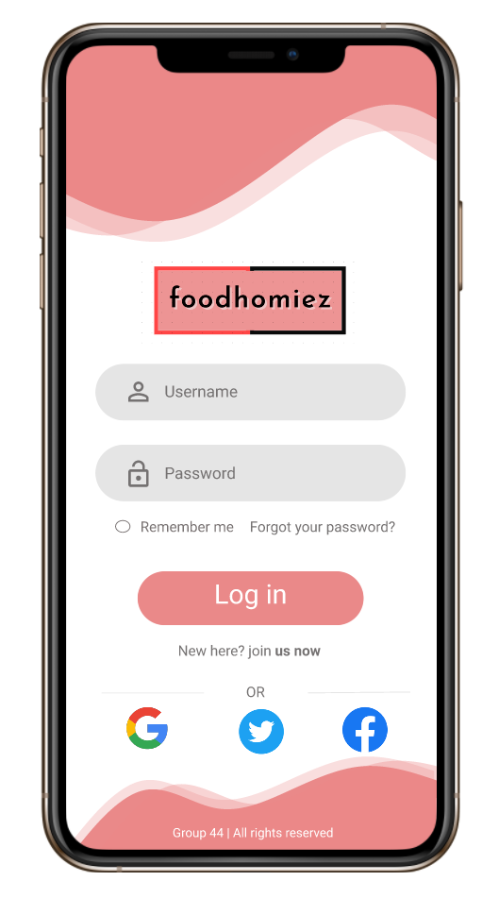
Step 1 : Login
Issue: The logo does not suit the app.
Solution: Logo can be improved.
Fill in the username and password(not possible on this prototype),then
Click on the Login button to proceed
Or if you forgot your password, click here to get an OTP for login
Select this if you want the app to remember your login details
If you want to login with your social media accounts

Slide 7
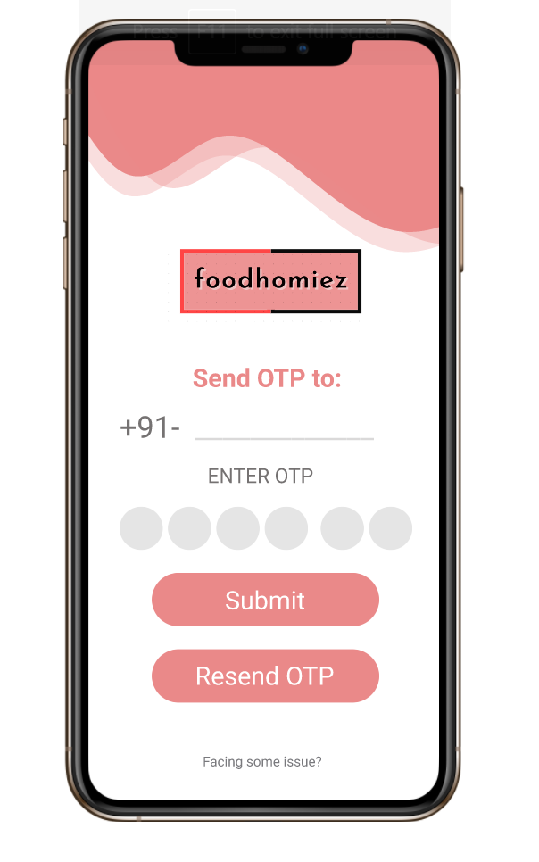
Step 2 : OTP
(only if you have selected forgot
password)
You’ll receive an OTP,then fill it(not in this prototype).
Now click on the submit button to proceed to home page

Slide 8
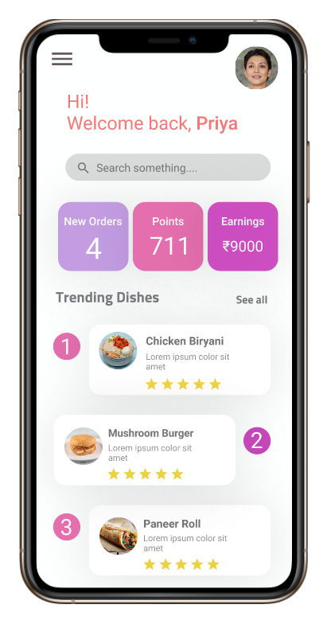
Step 3
HomeScreen
Click here to Go directly to New Orders page
In the Home page, click on the top left corner to go to the side menu
The screen is scrollable
Issue: It doesn’t show the popular dishes of the chef who is using the app.
Solution: we will provide a button beside trending dishes to check the chef’s popular dishes

Slide 9
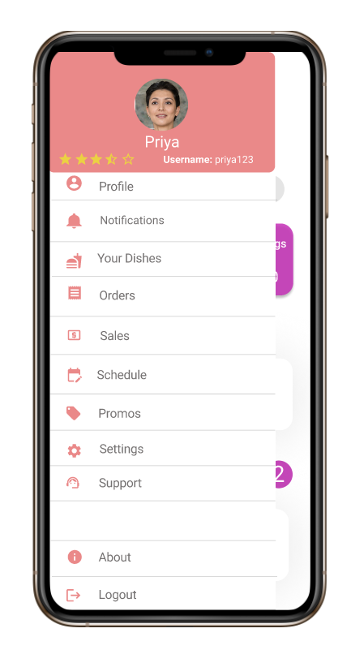
Step 4 Menu
Click here to Go back to the Home page
Here, in the menu click on the orders
Click here to back to the login screen

Slide 10
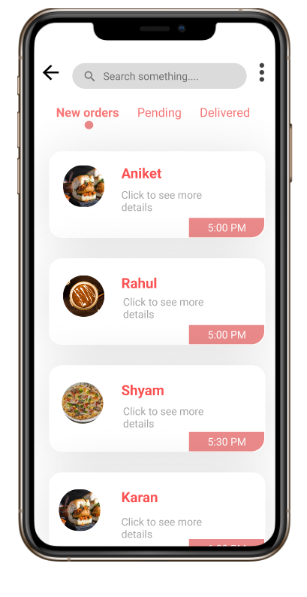
Step 5 Orders
To go back to menu, click here
Click on the first order to see the details

Slide 11
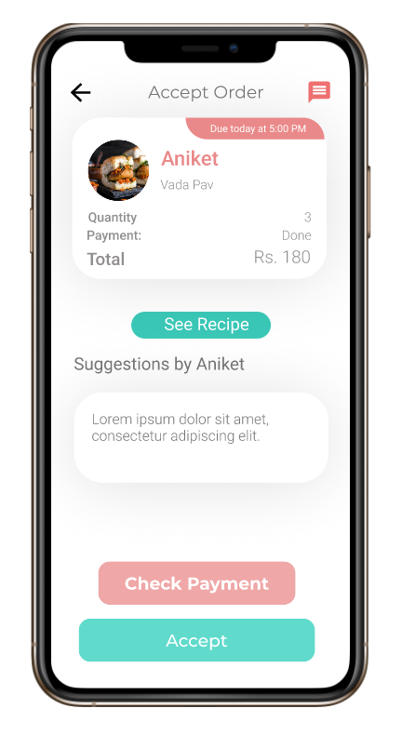
Step 6
Accept Order
Start a chat with the customer
To go back to orders, click here
Click here, to Accept the order
Issue : Repetition of check payment option.
Solution :The check payment option should be removed.

Slide 12
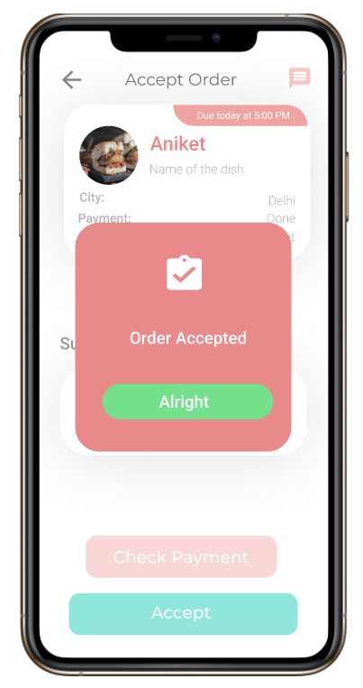
Step 7
Click here on the Order Accepted button
It is disabled until you close the dialog box

Slide 13
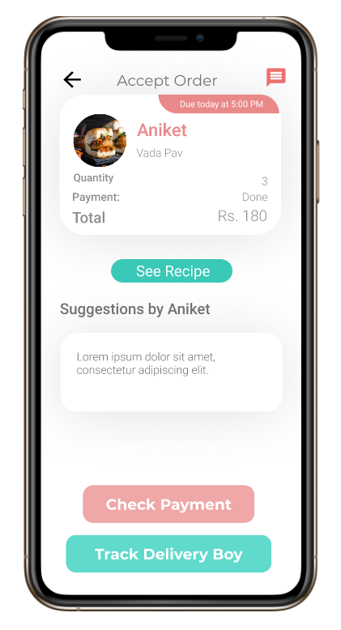
Step 8
Track Order
Click here to go back to Orders
Click here to Track the Order

Slide 14
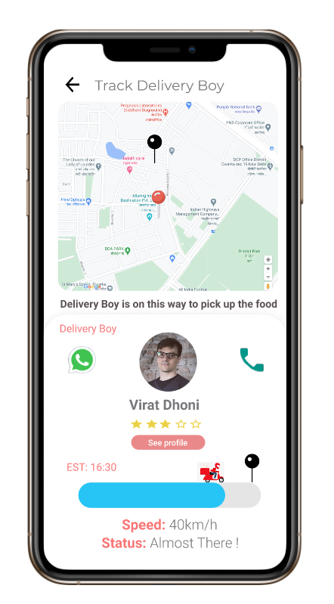
Step 9
Track Order
Issue: It is not clearly mentioned which pin represents chef and which represents customer
Solution : Making the pins more understandable for the user
To go to the next page swipe left but in the original it will come automatically when the delivery boy reaches the pick-up point.

Slide 15
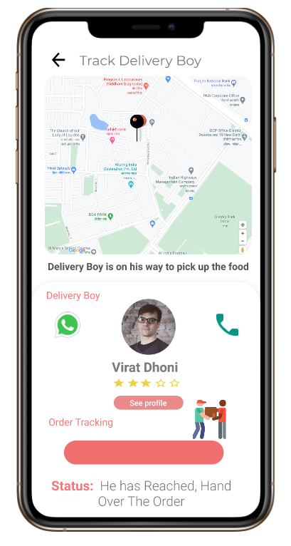
Step 10
Track Order
Swipe left to go to the next page
Click here ,to go back to previous page
Issue: No clarification about whether the delivery boy has picked up the order from the chef
Solution : Making an option for chefs stating that they have passed in the order to the delivery boy

Slide 16
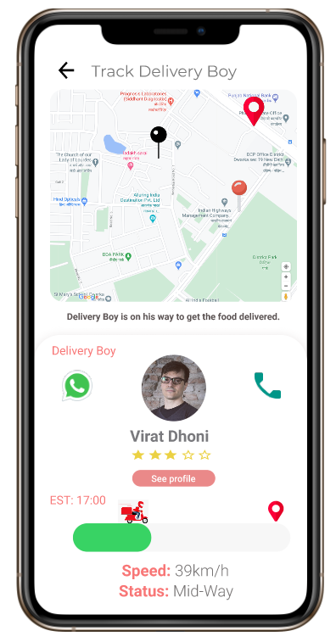
Step 11
Track Order
To go to the next page swipe left but in the original it will come automatically when the delivery boy reaches the customer.
Click here ,to go back to previous page

Slide 17
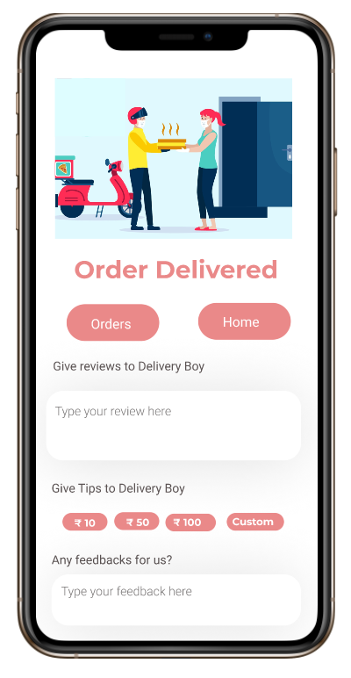
Step 12
Order Delivered
To go back to Orders, click here
Or to go back to the Home page, click here

Slide 18
General Issues
1) The UI design is not intuitive.
2) Color contrast is not good.
3) Dark Mode option is missing
Solution: The color contrast can be improved by using better color combinations and better colors in general like green.
The UI design can be improved by using better transitions between pages and a more user friendly interface.
Dark mode functionality can be made available

Slide 19
THANK YOU

