Slide 1
The Battle of Neighborhoods
By:- Shivam Chauhan

Slide 2

Motivation
Suppose a person wants to move from New York to Toronto for a job. This person does not know anything about Toronto and he would like to move into a place similar to the place where he lives now.
Is it possible to create a system that can help our user showing to him the similarities between this two countries?

Slide 3

Objectives
Develop a system able to show similarities in terms of neighborhoods in order to help a user decide whether to move near the center of Toronto or not.

Slide 4
PROPOSAL

Slide 5

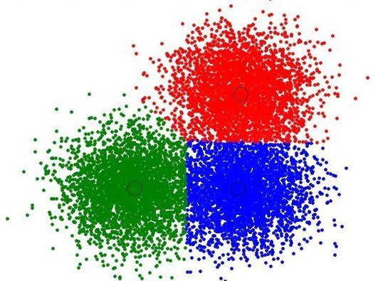
Approach
●
●
●
Neighborhoods are downloaded
Venues are requested using Foursquare API
The categories of venues are encoded using One Hot
K-means algorithm is used for finding similarities The elbow method is used for select K
●
●

Slide 6
RESULTS

Slide 7
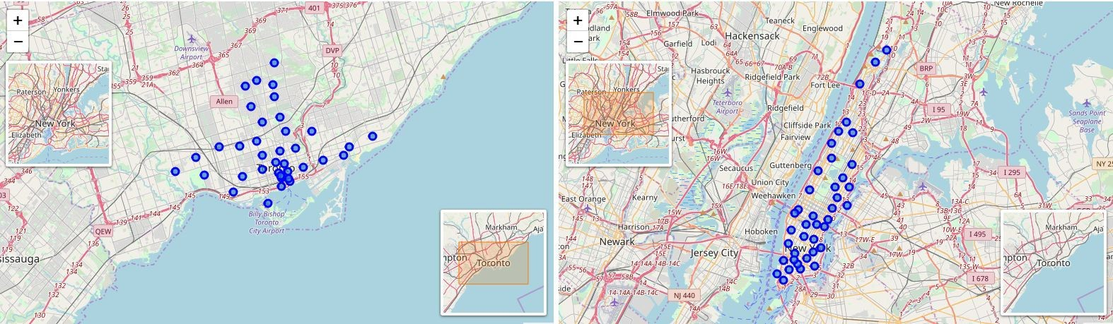
Geographical Location

Slide 8
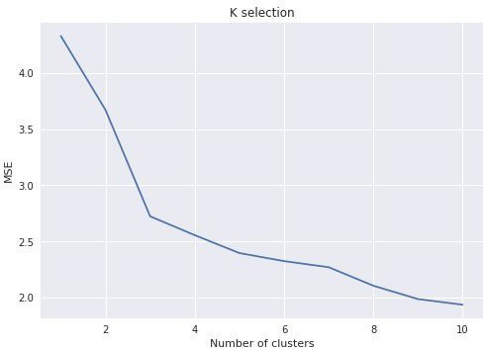
Selection of K
The best number of cluster is 5. That is, where the elbow is located. After that,
the mean squared error
without big
decrease
changes.

Slide 9
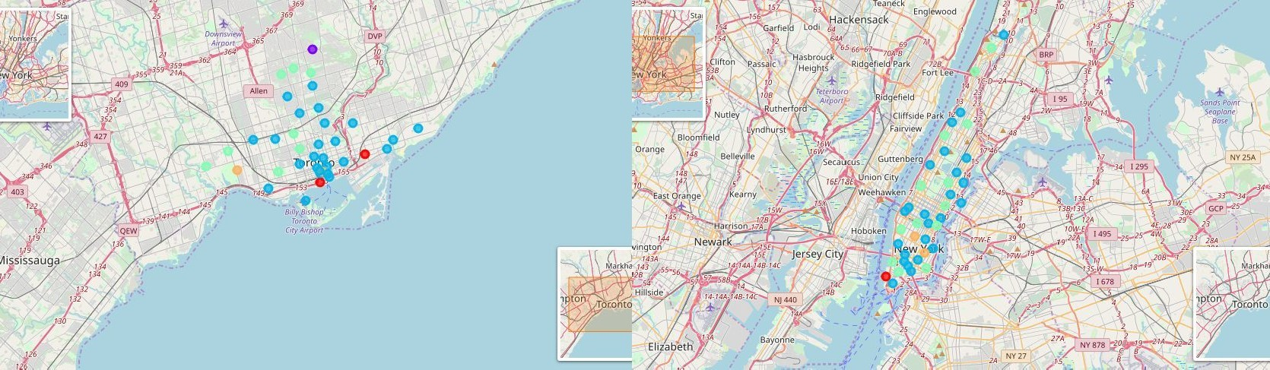
Geographical Location (Clustered)

Slide 10
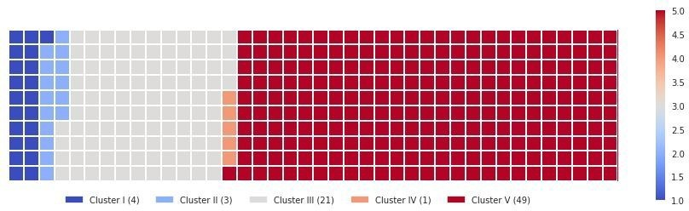
Proportion of Data Segmented

Slide 11
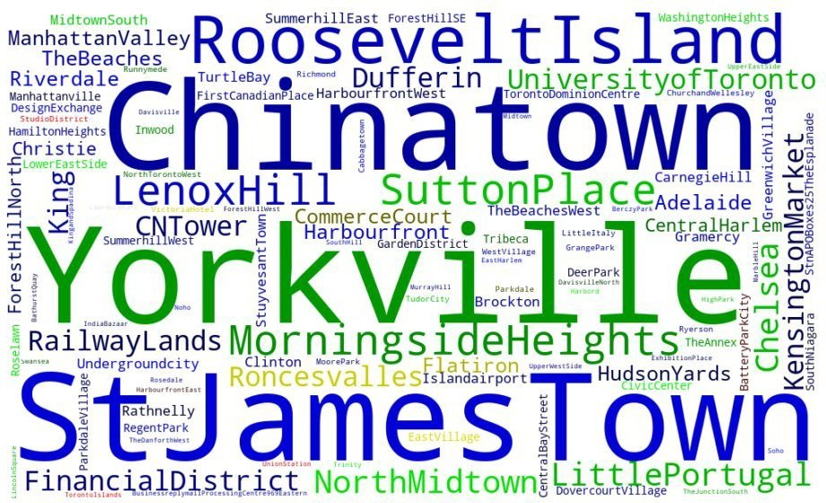
Neighborhoods Segmented by Colors

Slide 12
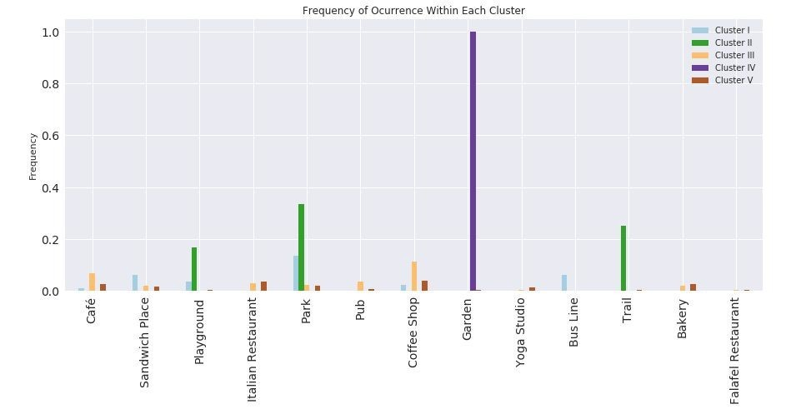
Bar Chart (Frequent Venues)

Slide 13
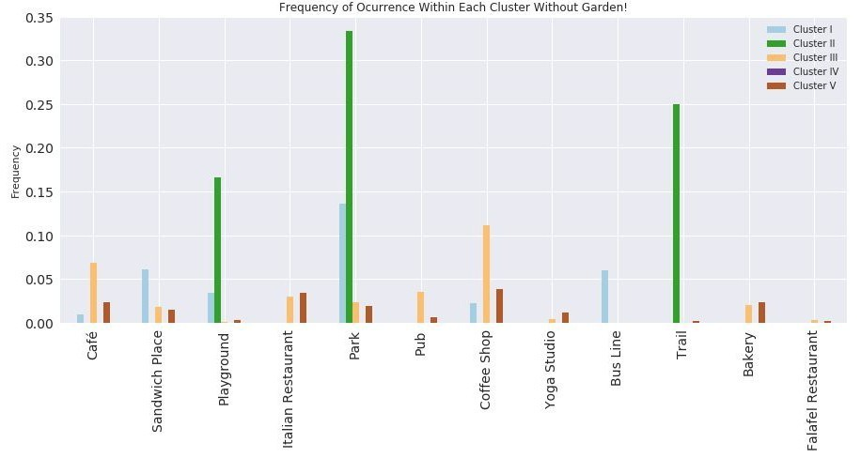
Bar Chart (Without Garden)

Slide 14
Conclusion
●
I: Neighborhoods that have around parks, bus lines and sandwich places.
I : Neighborhoods that have around parks, playgrounds and trails.
I I: Neighborhoods that have around coffee shops, pubs and italian restaurants.
IV: Neighborhood that have around gardens.
V: Neighborhoods that have around coffee shops, parks and bakeries.
●
●
●
●

