Slide 1

Predictive Maintenance in Cranes of DT Engineering at Jaguar Land Rover
- Student: Shivam Goel
- Supervisor: Dr Elon Correa

Slide 2
Goal
Goal: Predict failure type in the machine on analysing the Fluctuations in the Sensors recordings
Case: DT Engineering’s Overhead cranes used at manufacturing sites needs to be made smarter with AI based Predictive maintenance
Method:
Data Sources are Machines Metadata, Failures, Errors, Telemetry and Maintenance records.
Simple moving averages with lags using Boosting Techniques.

Slide 3
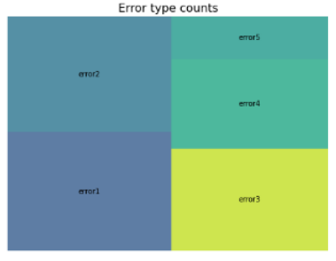
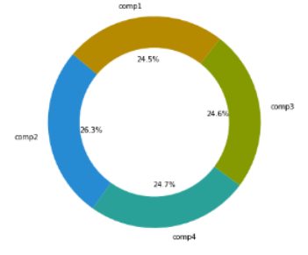
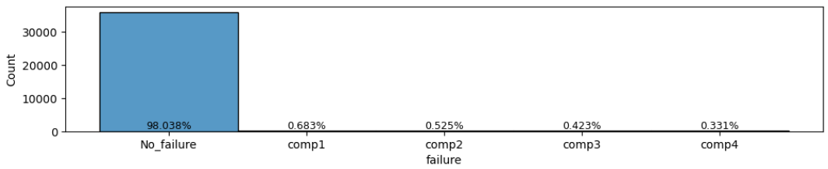
Hierarchical Data
Unique Machine Identities from 1-100.
Each Machine has further 5 components
5 Different error types and 4 Classes of maintenance to deal
Limited failures recorded

Slide 4
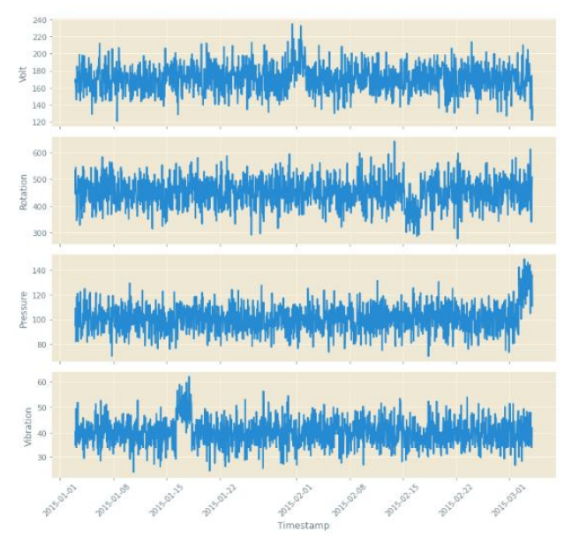
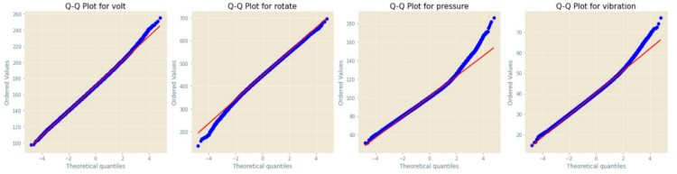
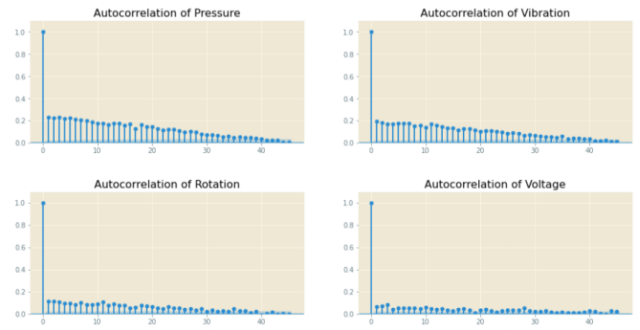
Time-Series Analysis

Slide 5

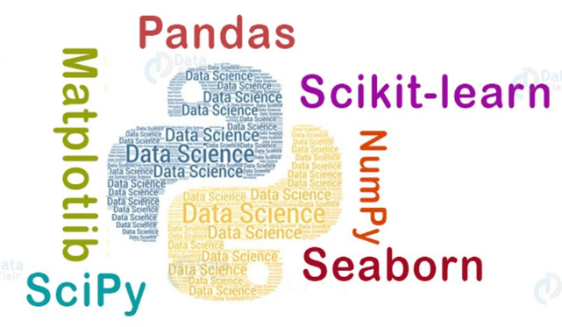
Architecture of COP V2
Validation on various time splits
Simulation Data
Train 1
Test 1
Machine Metadata
Ensemble based boosting
Data Preparation and Machine Learning
Predicted Model
Train 2
Error Logs
No change
Daily count
Test 2
Maintenance Records
How many days till last maintenance
Add no failure class
Failure (unplanned maintenance)
Evaluated on (per class):
Precision
Recall
F1-score
Kappa Statistic
Runtime
3H & 24H mean and sd.
Train 3
Telemetry
Test 3

Slide 6
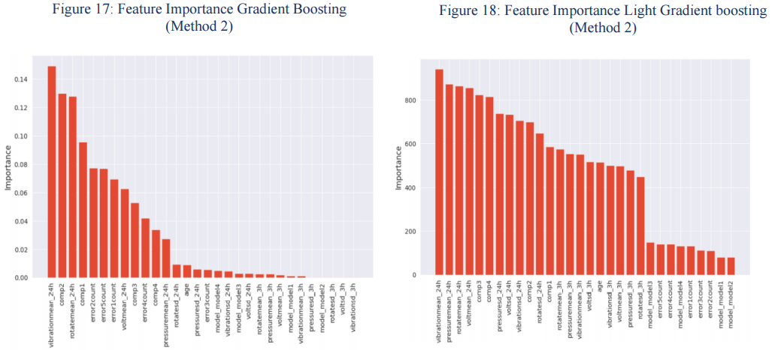
Prediction Insights

