Slide 1





Taoiq <> Akaike
Predictive Analytics
Report

Slide 2




Problem statement
Objective:
Understand employee attrition in large private organizations
Approach:
Build a predictive model to accurately predict employee attrition
Identification of key factors contributing to attrition
Goal of this analysis:
Suggestion of proactive steps to minimize employee attrition based on key factors

Slide 3
Data description
IBM HR Analytics Employee Attrition & Performance Dataset (Source: Kaggle)
No. of entries: 1470, No. of input features: 33 split into 8 categories, Target variable: attrition
Attribute types: categorical, numerical, ordinal and constant
Categories:
Demographics — Age, Gender, Marital Status
Education — Education Level , Education Field
Job & Role — Job Role , Department , Business Travel etc.
Work History & Experience — Total Working Years, Years At Company etc.
Work-Life — Work Life Balance , Environment Satisfaction , Over Time etc.
Compensation — Monthly Income , Monthly Rate , Hourly Rate etc.
Notes:
Add bullets instead of table

Slide 4
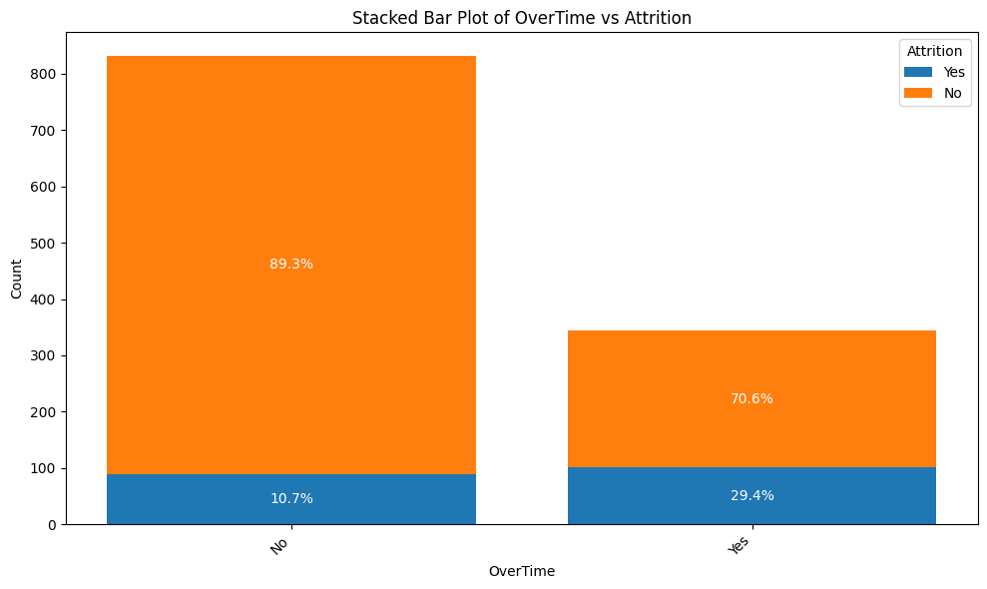
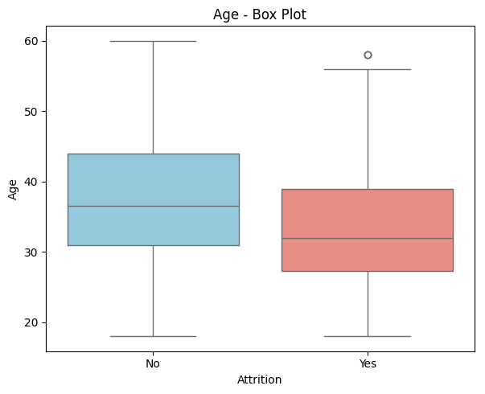
Insights from EDA
A lower ratio of No to Yes in the attrition column indicates a higher likelihood of employees leaving the company.
Employees who work overtime are more likely to leave
Employees between 28–32 years are more likely to leave
Notes:
Target = attrite
All attribute EDA with target
Add more plots (few positive and negative)
Data manupulatiion in new slide

Slide 5
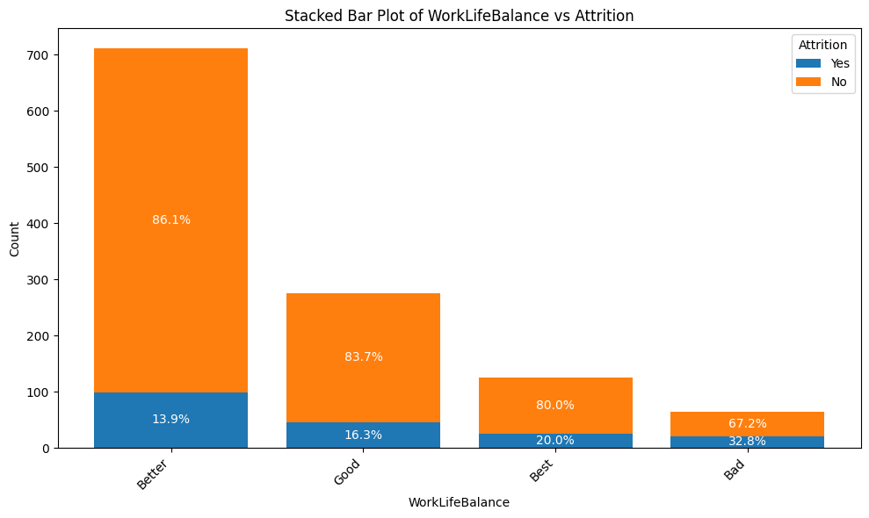
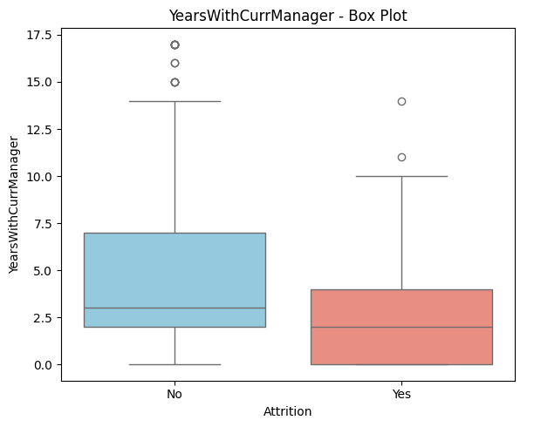
Insights from EDA
Features that exhibit greater differences in box plots tend to be more effective at distinguishing between employees who leave and those who stay.
Employees who have better work life balance are less likely to leave
Employees who remain with the same manager for more than 2.5 years are less likely to leave.
Notes:
Target = attrite
All attribute EDA with target
Add more plots (few positive and negative)
Data manupulatiion in new slide

Slide 6
Dataset preprocessing & Feature Engineering
Imbalanced Dataset - Attrition Categories - No - 986 & Yes - 190
8 new features were added based on existing features (Example):
Ratio of Role Stability = Years In Current Role / Years At Company
Promotion Rate = Years Since Last Promotion / Years At Company
Income per Year of Experience = (Monthly Income * 12) / Total Working Years
Is Manager = True if Job Level ≥ 4, else False
Loyalty Index = Years With Curr Manager / Total Working Years
Job Hop Rate = Num Companies Worked / Total Working Years
Is Recently Promoted = True if Years Since Last Promotion ≤ 2, else False
Is New Joiner = True if YearsAtCompany ≤ 2, else False
Removal of irrelevant features (Example: Employee No. Over 18)
Removal of highly correlated features. (Example: Job Level - High correlation with Monthly Income)
Scaling of the features to avoid model bias.

Slide 7
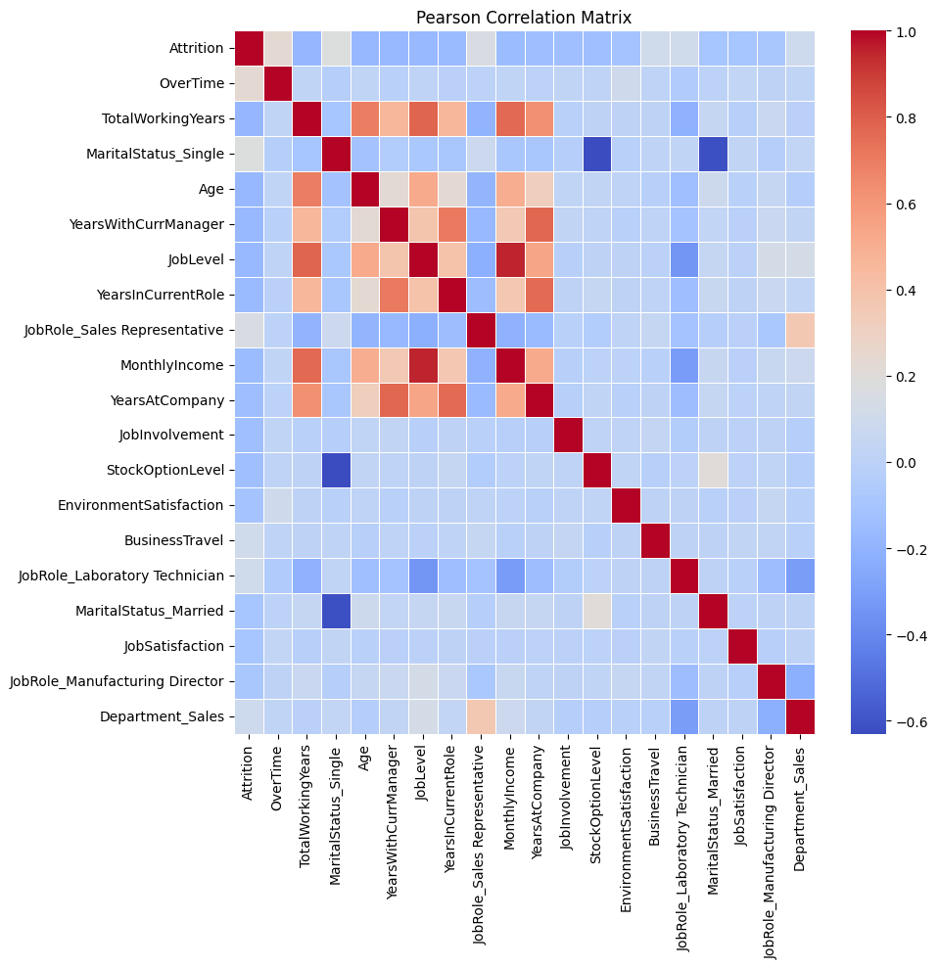
Top positively correlated features
OverTime
MaritalStatus_Single
JobRole_Sales Representative
BusinessTravel
JobRole_Laboratory Technician
Top negatively correlated features
TotalWorkingYears
Age
YearsWithCurrManager
JobLevel
YearsInCurrentRole
Notes:
Put it in the main deck, put bullet points also, top 5 posive and negative factors

Slide 8
Modelling & metrics
Tried multiple models (LogisticRegression, Random Forest, XGBoost, KNN, Naive Bayes, LightGBM, CatBoost, MLP)
Choice of benchmarking metrics - precision, recall, F1 score & AUC-ROC
Application of class balancing and SMOTE strategy to balance dataset
Classification models were considered and optimized
Dataset has been split into training (80%), evaluation (10%) and test dataset (10%)
Final Choice of Model - Voting Classifier Model (XGBoost & CatBoost)
Metric | Score (Train) | Score (Eval) | Score (Test)
Precision | 0.87 | 0.50 | 0.43
Recall | 0.98 | 0.50 | 0.53
F1 Score | 0.92 | 0.50 | 0.47
AUC-ROC | 0.99 | 0.79 | 0.79
Notes:
Call out all the modelling we did and ensemble model also

Slide 9
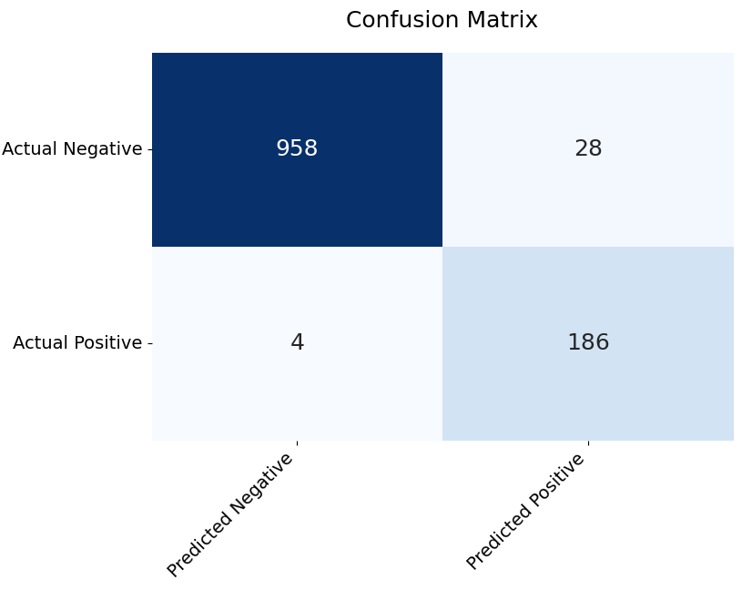
Train Set Performance
Metric | Score
Precision | 0.87
Recall | 0.98
F1 Score | 0.92
AUC ROC | 0.99
Notes:
Put it in main deck , compers in table

Slide 10
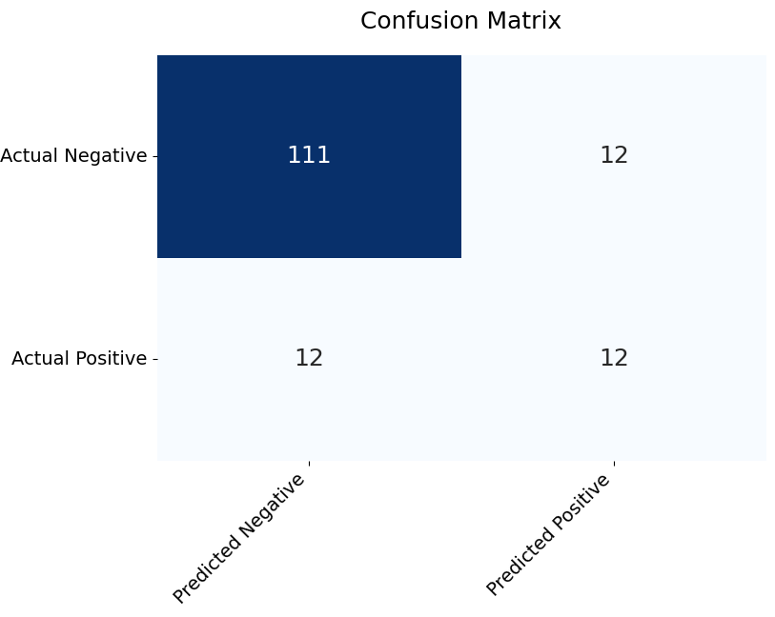
Evaluation Set Performance
Metric | Score
Precision | 0.50
Recall | 0.50
F1 Score | 0.50
AUC ROC | 0.79
Notes:
Put it in main deck , compers in table

Slide 11
Recommendations for Proactive Measures
Most influencing factors in the model
JobHopRate, OverTime are the most influencing factors
Suggested improvements in the model
Removal of outliers
RANdom SAmple Consensus (RANSAC)
Recommendations
HR team can be cautions when recruiting candidates with frequent jobs shifts.
Company policy changes to improve for restricting working hours.

Slide 12
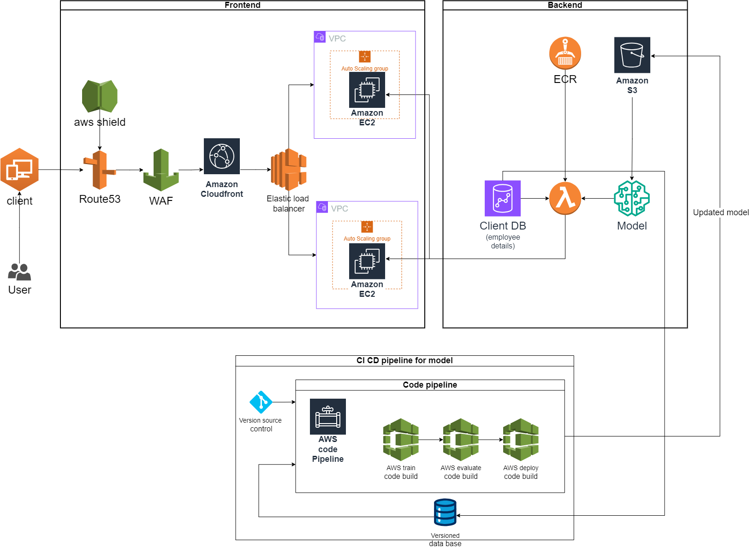
Deployment Architecture
Benefits of this Architecture
Can handle multiple requests simultaneously, because of its serverless architecture.
Its scalable architecture.
It hides sensitive data from exposing to user.
It have protection against DDoS.
It have proper CICD pipeline for future model development.
Proper separation between frontend and backend, helps in parallel development.
Notes:
Give more description also , why this architecture is good as compared to basic architecture, offers security, multi user
Separate slide streamlit app

Slide 13
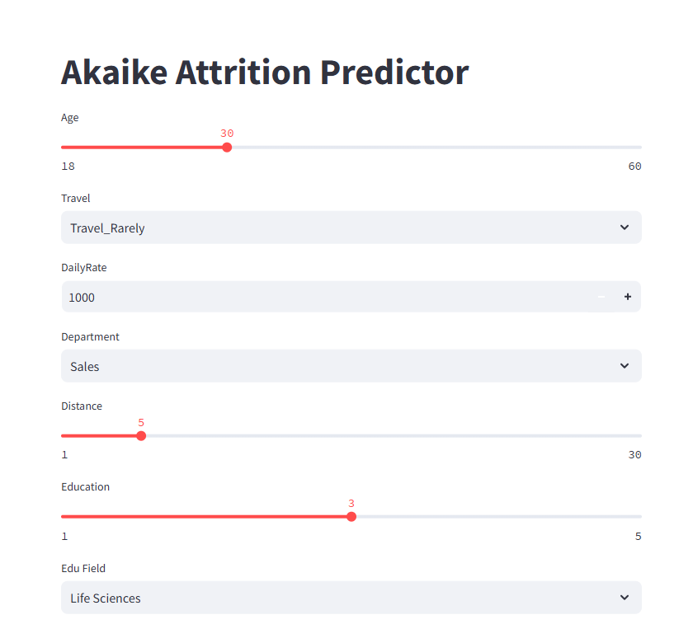
Streamlit Deployment
Notes:
Give more description also , why this architecture is good as compared to basic architecture, offers security, multi user
Separate slide streamlit app

Slide 14
Appendix

Slide 15
Model | Precision | Recall | F1 Score | AUC
Logistic Regression | 0.149123 | 0.708333 | 0.246377 | 0.410908
Random Forest | 0.545455 | 0.25 | 0.342857 | 0.721206
XGBoost | 0.521739 | 0.5 | 0.510638 | 0.765244
KNN | 0.153846 | 0.083333 | 0.108108 | 0.504065
Naive Bayes | 0 | 0 | 0 | 0.577913
LightGBM | 0.642857 | 0.375 | 0.473684 | 0.748306
CatBoost | 0.5 | 0.583333 | 0.538462 | 0.789295
MLP | 0 | 0 | 0 | 0.685637

Slide 16
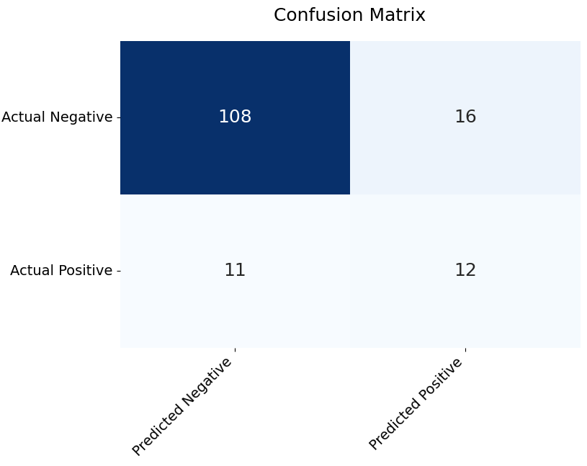
Test Set Evaluation
Metric | Score
Precision | 0.43
Recall | 0.52
F1 Score | 0.47
AUC ROC | 0.79

