Slide 1





Taoiq <> Akaike
Predictive Analytics
Report

Slide 2




Problem statement
Objective:
Understand employee attrition in large private organizations
Approach:
Build a predictive model to accurately predict employee attrition
Identification of key factors contributing to attrition
Goal of this analysis:
Suggestion of proactive steps to minimize employee attrition based on key factors

Slide 3
Data description
IBM HR Analytics Employee Attrition & Performance Dataset (Source: Kaggle)
No. of entries: 1470, No. of input features: 33 split into 8 categories, Target variable: attrition
Attribute types: categorical, numerical, ordinal and constant
Feature Count | Category | Variable (Examples) | Variable Type | Example
4 | Demographic | Age | Numerical | 25, 30
 |  | Marital Status | Categorical | Married or Single
2 | Education | Education Level | Ordinal | 1 (Below College) - 5 (Doctor)
6 | Work History | Total Working Years | Numerical | 5
3 | Internal Info | Employee Number | ID Columns | 1
 |  | Standard Hours | Constant | 80 Hours

Slide 4
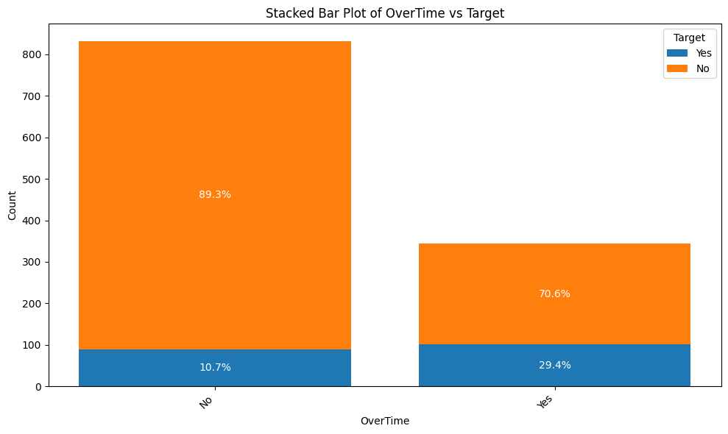
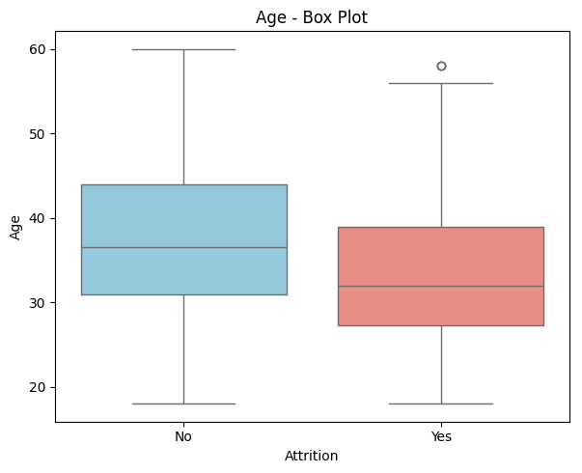
Insights from EDA
A lower ratio of No to Yes in the attrition column indicates a higher likelihood of employees leaving the company.
Employees who work overtime are more likely to leave
Employees between 28–32 years are more likely to leave
Imbalanced Dataset - Attrition Categories - No - 986 & Yes - 190
8 new features were added based on existing features (Example): Ratio of Role Stability = Years In Current Role / Years At Company
Removal of irrelevant features (Example: Employee No. Over 18)
Removal of highly correlated features. (Example: Job Level - High correlation with Monthly Income)
Scaling of the features to avoid model bias.

Slide 5
Modelling & metrics
Choice of benchmarking metrics - precision, recall, F1 score & AUC-ROC
Application of class balancing and SMOTE strategy to balance dataset
Classification models were considered and optimized
Dataset has been split into training (80%), evaluation (10%) and test dataset (10%)
Final Choice of Model - Voting Classifier Model (XGBoost & CatBoost)
Metric | Score (Train) | Score (Eval) | Score (Test)
Precision | 0.87 | 0.50 | 0.43
Recall | 0.98 | 0.50 | 0.53
F1 Score | 0.92 | 0.50 | 0.47
AUC-ROC | 0.99 | 0.79 | 0.79

Slide 6
Recommendations for Proactive Measures
Most influencing factors in the model
JobHopRate, OverTime are the most influencing factors
Suggested improvements in the model
Removal of outliers
RANdom SAmple Consensus (RANSAC)
Recommendations
HR team can be cautions when recruiting candidates with frequent jobs shifts.
Company policy changes to improve for restricting working hours.

Slide 7
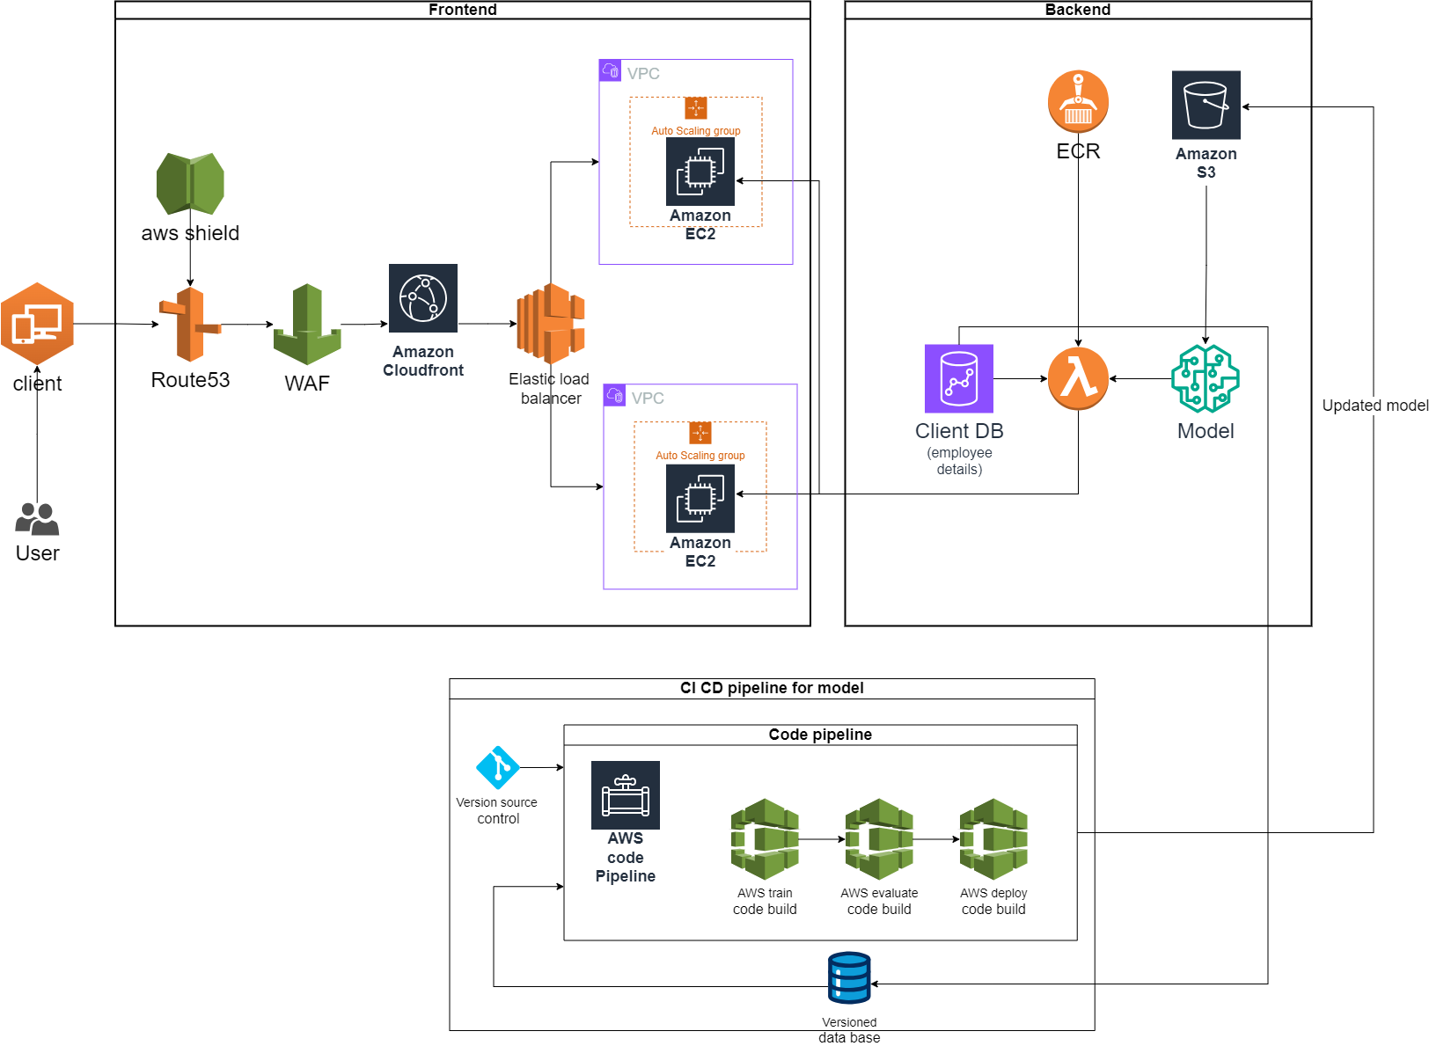
Deployment Architecture

Slide 8
Appendix

Slide 9
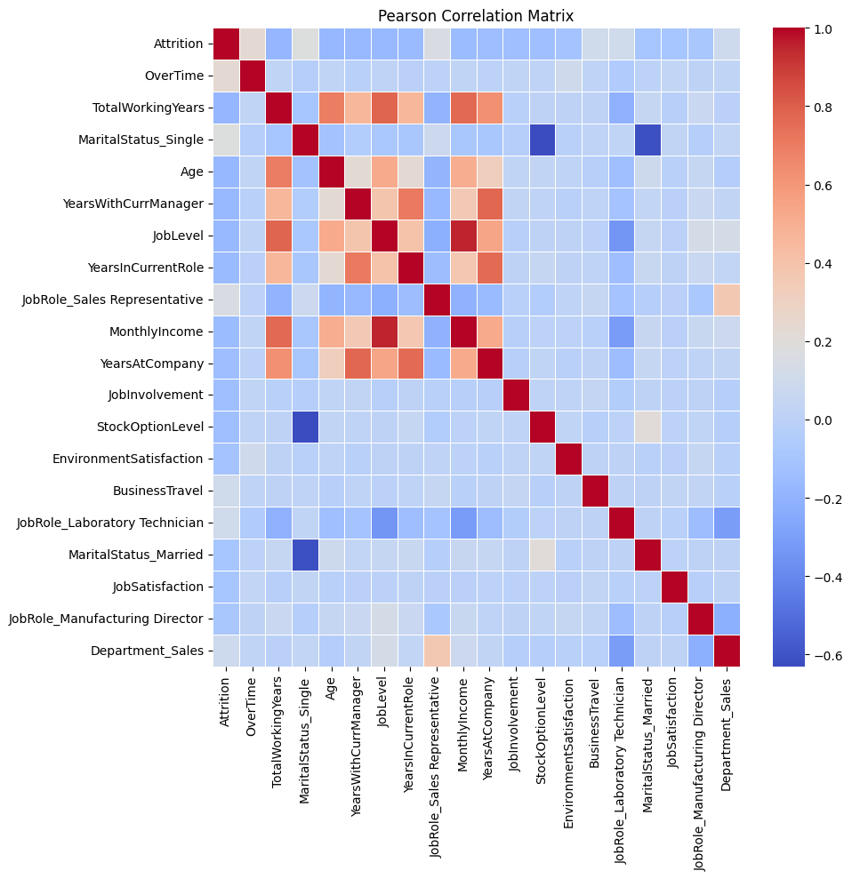

Slide 10
Model | Precision | Recall | F1 Score | AUC
Logistic Regression | 0.149123 | 0.708333 | 0.246377 | 0.410908
Random Forest | 0.545455 | 0.25 | 0.342857 | 0.721206
XGBoost | 0.521739 | 0.5 | 0.510638 | 0.765244
KNN | 0.153846 | 0.083333 | 0.108108 | 0.504065
Naive Bayes | 0 | 0 | 0 | 0.577913
LightGBM | 0.642857 | 0.375 | 0.473684 | 0.748306
CatBoost | 0.5 | 0.583333 | 0.538462 | 0.789295
MLP | 0 | 0 | 0 | 0.685637

Slide 11
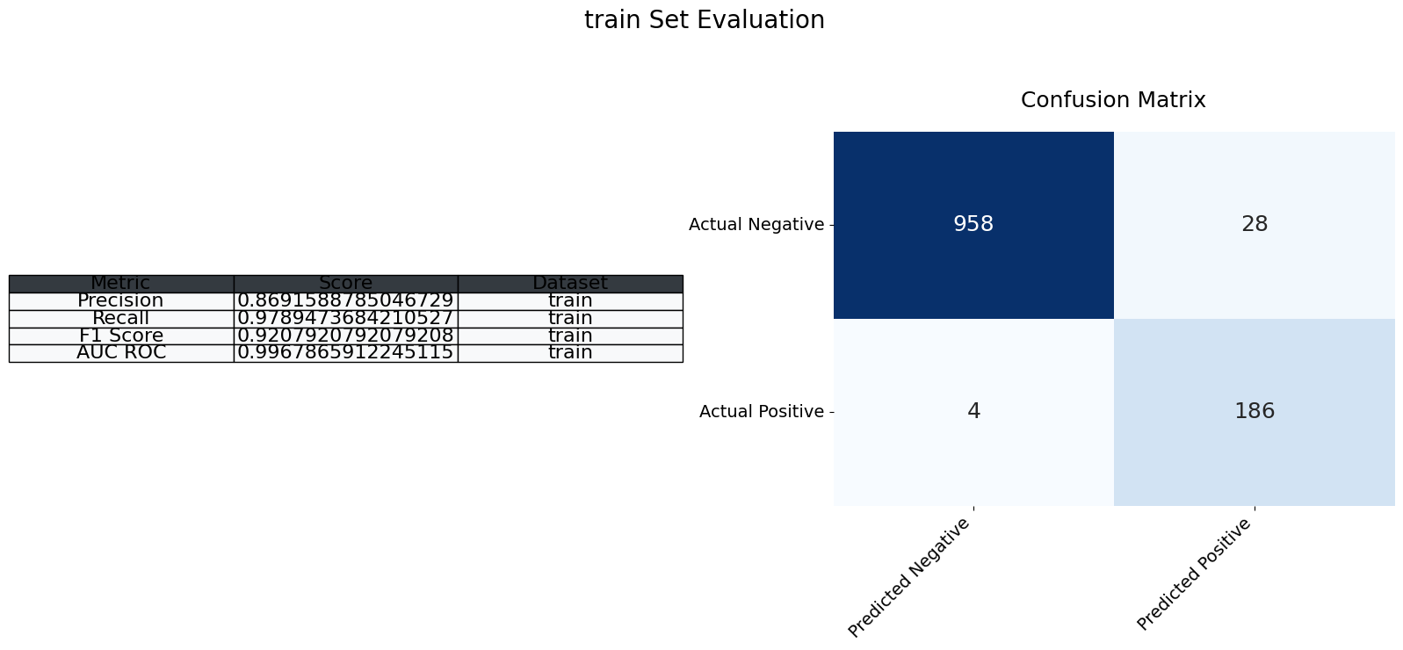

Slide 12
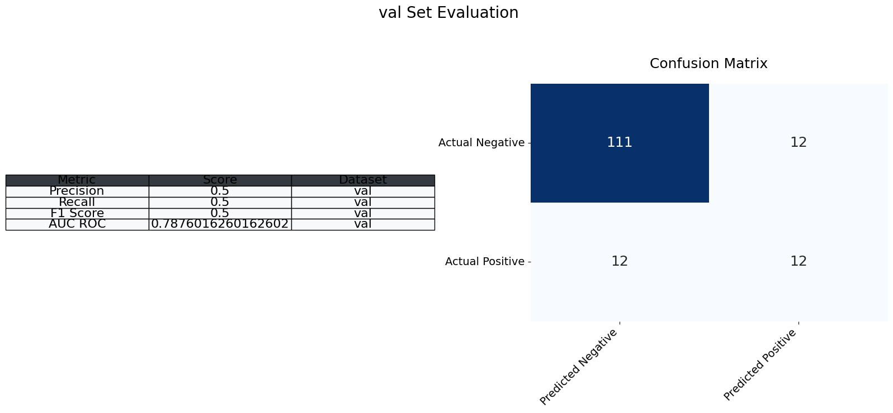

Slide 13
