Slide 1


ARTIFY AI
Name :- Shivam Javiya
Student ID :- 202312029
Company Name :- Mxicoders Pvt Ltd
Guide Name :- Paresh Dalsaniya

Slide 2
INTRODUCTION
In today's fast-paced digital world, AI tools have transformed how we access information, solve problems, and create content.
ArtifyAI is an innovative platform that integrates various AI models to provide a seamless, interactive solution for AI-driven insights, enhancing the way we interact with AI technologies.
ArtifyAI combines advanced AI models into a single platform, delivering accurate and tailored insights for a seamless user experience.
By integrating diverse AI tools into one interface, ArtifyAI enhances decision-making efficiency and transforms user interaction with AI.

Slide 3

TECHNOLOGIES
HTML
CSS
JAVASCRIPT
REACT
NODEJS
EXPRESS
MONGODB

Slide 4
Objectives
AI Tool Integration: Combine the strengths of ChatGPT, Google Gemini, and image generation AI to offer comprehensive solutions across different domains.
User-Friendly Interface: Design a visually appealing and intuitive UI/UX that boosts user engagement and accessibility.
Scalability: Build a scalable platform to support future expansions and integrate additional AI tools.
Real-Time Updates: Ensure the platform delivers real-time updates and insights, allowing users to access the latest information and solutions as they evolve.
Cross-Platform Compatibility: Develop the platform to be accessible across various devices.

Slide 5
DATA FLOW DIAGRAM
User → (1) Input Processing: User inputs queries or tasks.
Input Processing → (2) AI Model Execution: Analyzes inputs and selects appropriate AI models.
AI Model Execution → (3) Output Generation: Generates and integrates responses from the AI models.
Output Generation → (4) User: Provides personalized responses and content to the user.
User → (5) AI Tool Collection: Submits AI Tool on the responses received.
AI Tool Collection → (6) User Data: Updates user data with AI Tool for future improvements.

Slide 6
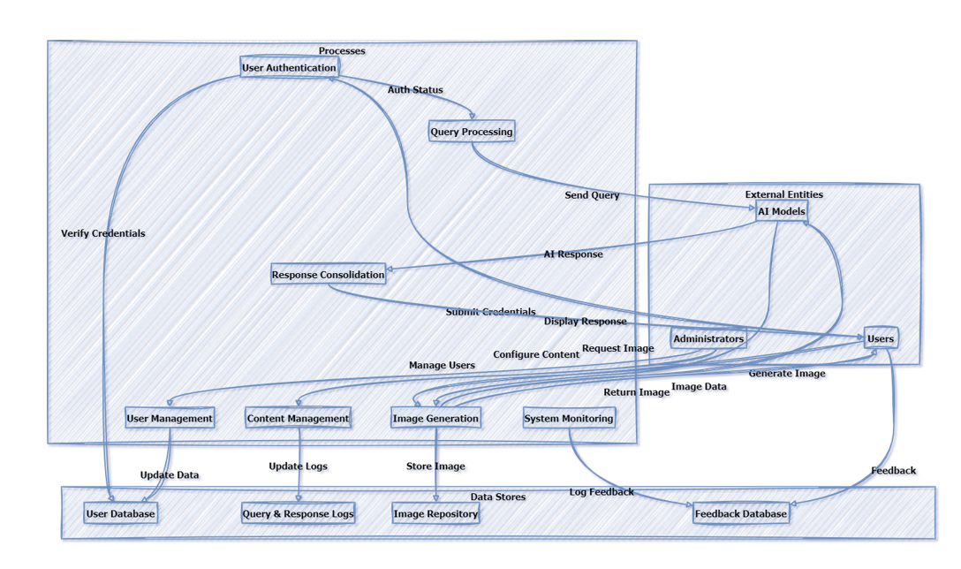
CONTEXT LEVEL DFD

Slide 7
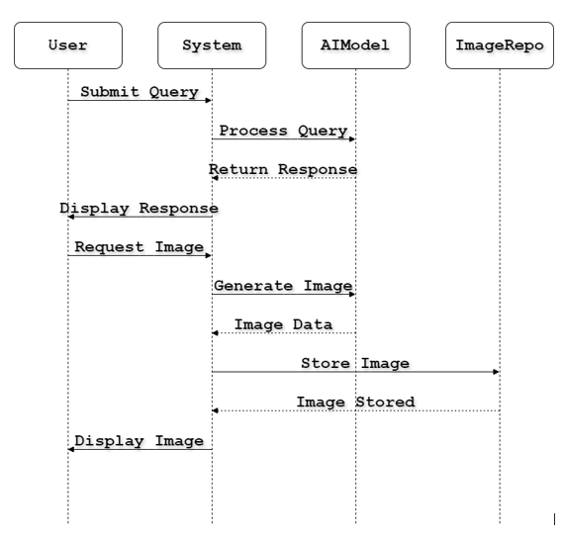
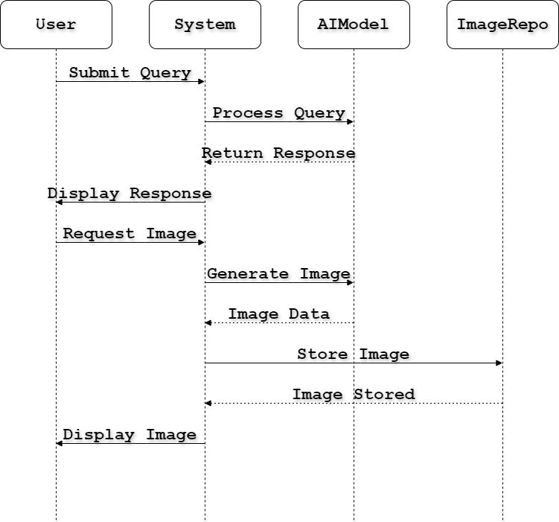
SEQUENCE DIAGRAM

Slide 8
SYSTEM FLOW
User Interaction: Users input queries via a user-friendly interface for AI assistance.
Request Processing: The system analyzes inputs to select appropriate AI models.
AI Model Integration: Selected AI models execute and integrate to generate responses.
Output Generation: The platform compiles and personalizes outputs for user clarity.
User AI tool and Iteration: User AI Tool is collected to improve system performance.
Security and Privacy: User data is protected to maintain privacy and trust.
Scalability and Maintenance: The platform scales and updates to meet growing demand.

Slide 9
ADVANTAGES
Unified AI Experience: Combines multiple AI tools into a single platform for comprehensive insights.
Enhanced User Engagement: Offers a user-friendly interface with personalized features for increased satisfaction.
Personalized Insights: Provides tailored responses based on user preferences and needs.
Real-Time Updates: Delivers current information and solutions for users.
Cross-Platform Accessibility: Ensures a seamless experience across desktops, tablets, and smartphones.

Slide 10
DISADVANTAGES
Complex Integration: Integrating multiple AI models requires significant development effort.
Data Privacy Concerns: Handling user data necessitates robust security measures to protect privacy.
Potential for Overload: Too many features may overwhelm users and decrease usability.
High Maintenance: Requires continuous updates and maintenance to function smoothly.
Dependence on AI Accuracy: Effectiveness depends on the reliability of the integrated AI models.
Time-Consuming Development: Developing and integrating the platform can be time-consuming.

Slide 11

SYSTEM ENHANCEMENT
Tool Expansion: Continuously add more AI tools and models to the platform to offer a wider range of functionalities and solutions.
Improved Natural Language Processing (NLP): Enhance NLP capabilities to better understand and respond to complex user queries in multiple languages.
Voice Interface Integration: Add voice interaction features for hands-free engagement, providing a more flexible user experience.
Expanded Language Support: Increase support for native languages, making the platform accessible to a wider global audience by offering localized experiences.
Performance Optimization: Optimize the system architecture to improve speed, responsiveness, and overall performance.

Slide 12
THANK YOU!

