Slide 1
Purpose
Hepato
Fusion
Keep the existing pediatric-liver tumor localization
available to a pathologist as decision support, and
collect radiology, molecular, and cleaned clinical
outcomes onto the same 102-patient cohort.
Goal
CS 5001 Senior Design I — Fall 2026
Deliver a model-ready outcomes table on the cohort
by December 2026, and a Dockerized tumor-map viewer
prototype validated with Dr. Patel by April 2027.
Research prototype — not a diagnostic device.
Draft Design Presentation
Speaker: Nipun Chandra
30 s
Notes:
SPEAKER: Nipun. 30 seconds. Open: 'Good afternoon, I'm Nipun Chandra, and with Shivam Kharangate I'm presenting HepatoFusion — our senior-design project with Cincinnati Children's Hospital.' Then state the purpose (helper + cohort collection) and the goal (cleaned outcomes by Dec, Docker viewer by April). Close with 'research prototype, not a diagnostic device.'

Slide 2
2 / 9
HepatoFusion | CS 5001
Team and advisor
Team
Advisor
Shivam Sinay Kharangate
Dr. Kalyani Patel
Pathology CV / multimodal ML; clinical liaison
Department of Pathology & Laboratory Medicine,
Cincinnati Children's Hospital
sinayksp@mail.uc.edu
Kalyani.Patel@cchmc.org
Nipun Chandra
Data engineering / systems; pipeline reliability
Additional advisors
chandrnu@mail.uc.edu
Dr. S. Ranganathan | Dr. S. Prasath | C. Woods
Partner: Cincinnati Children's Hospital
Speaker: Shivam Sinay Kharangate
30 s
Notes:
SPEAKER: Shivam. 30 seconds. Introduce the two of us: me on pathology CV and clinical liaison, Nipun on data engineering and systems. Our advisor is Dr. Kalyani Patel in Pathology & Laboratory Medicine at Cincinnati Children's, confirmed through April 2027. We also consult Dr. Ranganathan, Dr. Prasath, and Chris Woods. CCHMC is our clinical partner.

Slide 3
3 / 9
HepatoFusion | CS 5001
Project abstract
HepatoFusion is a multimodal research pipeline developed with Cincinnati Children's
Hospital for pediatric liver cancer decision support. The existing Silver/Gold
whole-slide workflow has produced 1,566 Silver and 1,546 Gold annotations across
248 slides from 102 patients, powering a pathology U-Net at 0.96 mean-slide Dice
and 0.99 tumor AUROC for localization. This senior-design work finalizes a
model-ready clinical-outcomes table, inventories the cohort, and surfaces the
existing tumor map inside PathPresenter and QuPath as a pathologist helper.
Radiology and molecular intake remain scoped for a later research risk score.
The system is a research prototype, not a diagnostic device.
— Approx. 100 words | Key terms bolded in accent
Speaker: Nipun Chandra
80 s
Notes:
SPEAKER: Nipun. 80 seconds. Read the abstract aloud at a measured pace, letting the bolded terms land: multimodal, pediatric liver cancer, Silver/Gold, pathology U-Net metrics, model-ready outcomes, PathPresenter and QuPath, research prototype. Make sure the last sentence 'research prototype, not a diagnostic device' is spoken clearly — it is the ethical throughline for the whole talk.

Slide 4
4 / 9
HepatoFusion | CS 5001
User stories and D0 pipeline
Five user stories (Week 4)
D0 pipeline (redrawn for the live room)
US-01 Pathologist helper
Hospital sources
(Epic, eSlide)
Identifier gate
Cohort case
index
Existing tumor map as decision support
US-02 Case-level risk estimate
Names only inputs actually used
Outcomes
cleaner (ALG-01)
Modality intake
(iced)
Modality
integrator (iced)
US-03 Radiology link
CT or MRI linked, or recorded as not-linked
US-04 Outcomes engineer
Risk scorer
(iced)
Review package
PathPresenter
+ QuPath
One cohort row, agreed fields coded
US-05 PHI gate
Block identifier values from leaving storage
Dashed box = external system / iced for 2026. Full D1/D2 in backup.
Speaker: Shivam Sinay Kharangate
95 s
Notes:
SPEAKER: Shivam. 95 seconds. Walk the five user stories left-to-right in 35 seconds — US-01 and US-02 are the pathologist; US-03 is radiology; US-04 is the research engineer; US-05 is the privacy reviewer. Spend the remaining 60 seconds on the redrawn D0: external hospital sources on the left, identifier gate guards everything that enters, cohort case index is the join point, outcomes cleaner runs ALG-01, and the review package is what lands in PathPresenter or QuPath. Point out the dashed boxes are 'on ice' for this academic year — radiology intake, genomics, and the risk scorer. The full D1 and D2 diagrams are in backup.

Slide 5
5 / 9
HepatoFusion | CS 5001
Major project constraints
Ethical
Privacy & security
Legal / regulatory
Economic
Compute
Decision support only; Silver labels never shown as ground truth.
PHI stays on approved CCHMC / UC compute; no consumer cloud.
CCHMC data-use agreement + UC IP; no FDA diagnostic claim.
Open-source PyTorch stack; reuse existing Silver/Gold pipeline.
Staged fusion fits inside existing GPU allocation.
Central trade-off: security and compliance first — accepting slower multimodal scale in exchange for a prototype that fits inside the CCHMC data-use envelope.
Speaker: Nipun Chandra
75 s
Notes:
SPEAKER: Nipun. 75 seconds. Walk the five constraint cards left-to-right in ~45 seconds — ethical (decision support, Silver never as ground truth), privacy (PHI stays on approved compute, no consumer cloud), legal (CCHMC DUA plus UC IP, no FDA claim), economic (open-source stack, reuse existing pipeline), compute (staged fusion inside GPU budget). Spend the last 30 seconds on the trade-off banner: 'the sharpest tension is security and compliance versus development speed. We chose compliance-first scoping, even where that delays fusion features.'

Slide 6
6 / 9
HepatoFusion | CS 5001
Project progress — Weeks 1-11
Completed deliverables
Inherited backbone (not rebuilt)
W1-W2
Team contract, project description, bios
1,566
Silver annotations
W3
Constraints essay
W4
User stories & use cases (US-01–US-05)
1,546
Gold annotations
W5-W7
D0 high-level, D1 detailed, D2 error paths + peer review
W8
Task list, timeline, effort matrix, risk register
248
whole-slide images
W9
Requirements doc v1.0, tech spec v1.1
W10
Test plan v1.0 (TC-001 – TC-016)
102
patients in the cohort
W11
Ethics statement, AI-use disclosure
Pathology U-Net metrics
0.96 mean-slide Dice
0.98 tumor Dice | 0.99 tumor AUROC
Speaker: Shivam Sinay Kharangate
80 s
Notes:
SPEAKER: Shivam. 80 seconds. Walk left column top-to-bottom quickly (~35s): every graded deliverable from weeks 1 through 11 is complete and committed to the repo. Then shift to the right (~45s): remind the audience that the Silver/Gold whole-slide pipeline is inherited, not rebuilt — 1,566 Silver, 1,546 Gold, 248 WSIs, 102 patients. Close on the pathology U-Net metrics card: 0.96 mean-slide Dice and 0.99 tumor AUROC are the baseline we start from, not what we promise this year.

Slide 7
7 / 9
HepatoFusion | CS 5001
Expected accomplishments — end of Fall 2026
Target: 4 Dec 2026 (M17)
T1
Epic clinical fields landed on approved storage
Shivam
T2
eSlide / PathPresenter inventory in Cohort case index
Nipun
T3
First-pass Excel coded, agreed fields coded or numeric
Nipun
T6
U-Net outlier list closed on Gold slides (M25)
Shivam
T11
TMA keys handed to radiology collaborator
Shivam
T12
Identifier-gate rules frozen in pipeline_config.yaml (M18)
Nipun
Not promised in Fall: radiology intake, genomics, modality integrator, risk scorer — all iced until M36 in Spring.
Speaker: Nipun Chandra
65 s
Notes:
SPEAKER: Nipun. 65 seconds. Frame M17 as the December 4 checkpoint. Read the six owned items in ~35 seconds, showing which ones Shivam owns (T1, T6, T11) and which ones I own (T2, T3, T12). Close with the honesty banner: radiology intake, genomics, the modality integrator, and the risk scorer are iced until M36 in April. We will not claim a fused risk number in December.

Slide 8
8 / 9
HepatoFusion | CS 5001
Division of work — 114 / 114 hours (50 / 50)
Shivam (114 h)
Nipun (114 h)
T1
Obtain Epic clinical fields
T2
eSlide / PathPresenter inventory
T4
Investigate IHC join into case index
T3
Patient-by-patient Excel cleanup
T6
U-Net outlier investigation
T5
case_link.json records
T7
Refine pathology U-Net on Gold
T8
Dockerize U-Net for QuPath
T9
PathPresenter overlay + Review package
T10
Test QuPath Docker on holdout WSI
T11
TMA-grid study keys (radiology side)
T12
Identifier-gate rules in config
T14
Validate helper with Dr. Patel
T13
Outcomes cleaner ALG-01 run
T16
Modality integrator (iced)
T15
Radiology intake design (iced)
8 owned tasks each | totals confirmed by both members | T3 is the overrun candidate (pessimistic 32 h)
Speaker: Shivam Sinay Kharangate
85 s
Notes:
SPEAKER: Shivam. 85 seconds. Walk the two columns in parallel. Left is mine: pathology-side work — Epic fields with Dr. Patel, IHC join, U-Net outliers and refine, PathPresenter overlay, validation, and the iced Modality integrator. Right is Nipun's: data-engineering side — eSlide inventory, Excel cleanup, case_link.json, Docker for QuPath, the identifier-gate config, ALG-01, and the iced Radiology intake. Columns total 114 and 114 — 50/50. Finish with the honest note at the bottom: T3 is the overrun candidate, with a documented reassignment plan if Nipun exceeds 17 hours before 24 November.

Slide 9
9 / 9
HepatoFusion | CS 5001
Expected demo at Expo
Primary demo
If the live viewer fails
Dockerized U-Net inference on a deidentified
holdout whole-slide image, opened in QuPath.
Followed by the PathPresenter helper overlay
that Dr. Patel validated in M32 (12 Mar 2027).
Pre-recorded QuPath screen capture on the
same holdout slide (recorded on approved compute).
Plus live ALG-01 run of the Outcomes cleaner,
showing source_rows / kept / excluded counts.
What the booth shows
Ground rules
Laptop with the Docker image + QuPath
Monitor mirror for the audience view
Printed one-page handout: pipeline + metrics
No PHI, no WSI files, no identifiers displayed
Prototype disclaimer spoken aloud at the start
Silver labels never presented as ground truth
Only metrics shown are the backup slide numbers
Dr. Patel's validation note available on request
Speaker: Nipun Chandra
60 s
Notes:
SPEAKER: Nipun. 60 seconds. Primary demo in 25 seconds: Docker U-Net running on a holdout WSI in QuPath, deidentified, with the PathPresenter overlay as the second scene. Fallback in 15 seconds: a pre-recorded screen capture plus a live ALG-01 run that prints the source_rows / kept / excluded counts — that always works because it needs no viewer. Last 20 seconds: booth logistics and the ground rules — disclaimer spoken aloud, no PHI on screen, Silver never shown as ground truth. Close: 'That ends our ten minutes. Dr. Patel, we're ready for feedback.'

Slide 10
Advisor Feedback | Placeholder
Advisor feedback — capture 1
To be filled after the Week 12 advisor review with Dr. Patel.
Feedback #1
Slides affected: _________________________________________
Comment: ________________________________________________
Response + change: ______________________________________ Owner / Status: _____
Feedback #2
Slides affected: _________________________________________
Comment: ________________________________________________
Response + change: ______________________________________ Owner / Status: _____
Feedback #3
Slides affected: _________________________________________
Comment: ________________________________________________
Response + change: ______________________________________ Owner / Status: _____
Feedback #4
Slides affected: _________________________________________
Comment: ________________________________________________
Response + change: ______________________________________ Owner / Status: _____
Mirrors rows 1-4 of Advisor_Feedback.md
Notes:
Placeholder slide. Does not count toward the 9-slide budget. Fill rows after the Week 12 advisor meeting; sync with Advisor_Feedback.md. Not spoken aloud in the 10-minute recording.

Slide 11
Advisor Feedback | Placeholder
Advisor feedback — capture 2 + summary
Summary of changes, open items, and additional feedback rows.
Feedback #5
Slides affected: _________________________________________
Comment / Response / Change / Owner / Status: ______________________
Feedback #6
Slides affected: _________________________________________
Comment / Response / Change / Owner / Status: ______________________
Summary of changes (3-6 sentences)
Open items (with target close date)
____________________________________
____________________________________
____________________________________
____________________________________
____________________________________
____________________________________
____________________________________
____________________________________
____________________________________
____________________________________
Mirrors rows 5-6 + §Summary + §Open items of Advisor_Feedback.md
Notes:
Placeholder slide 2. Not spoken aloud; mirrors Advisor_Feedback.md §Summary of changes and §Open items.

Slide 12
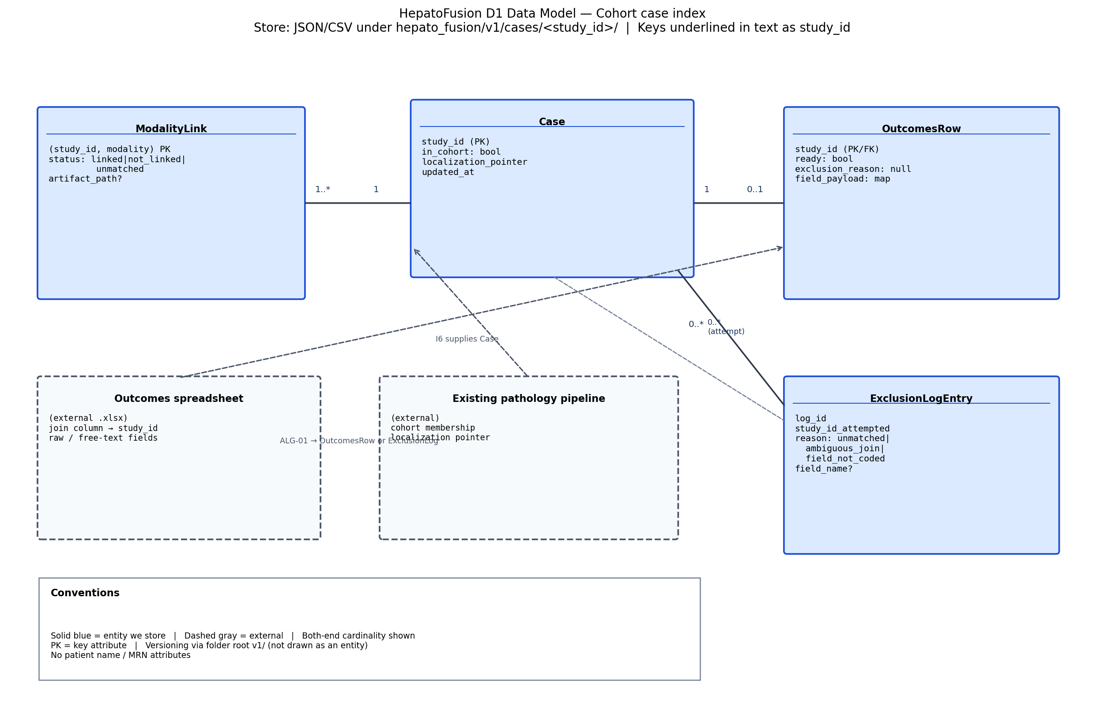
Backup slide
Backup — D1 data model (full)
Source: Design_Diagrams/D1_Detailed_Design.md

Slide 13
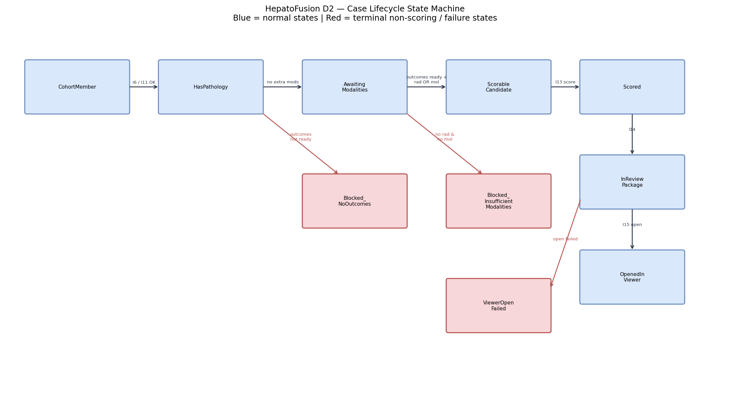
Backup slide
Backup — D2 case lifecycle (full)
Source: Design_Diagrams/D2_Detailed_Design.md

Slide 14
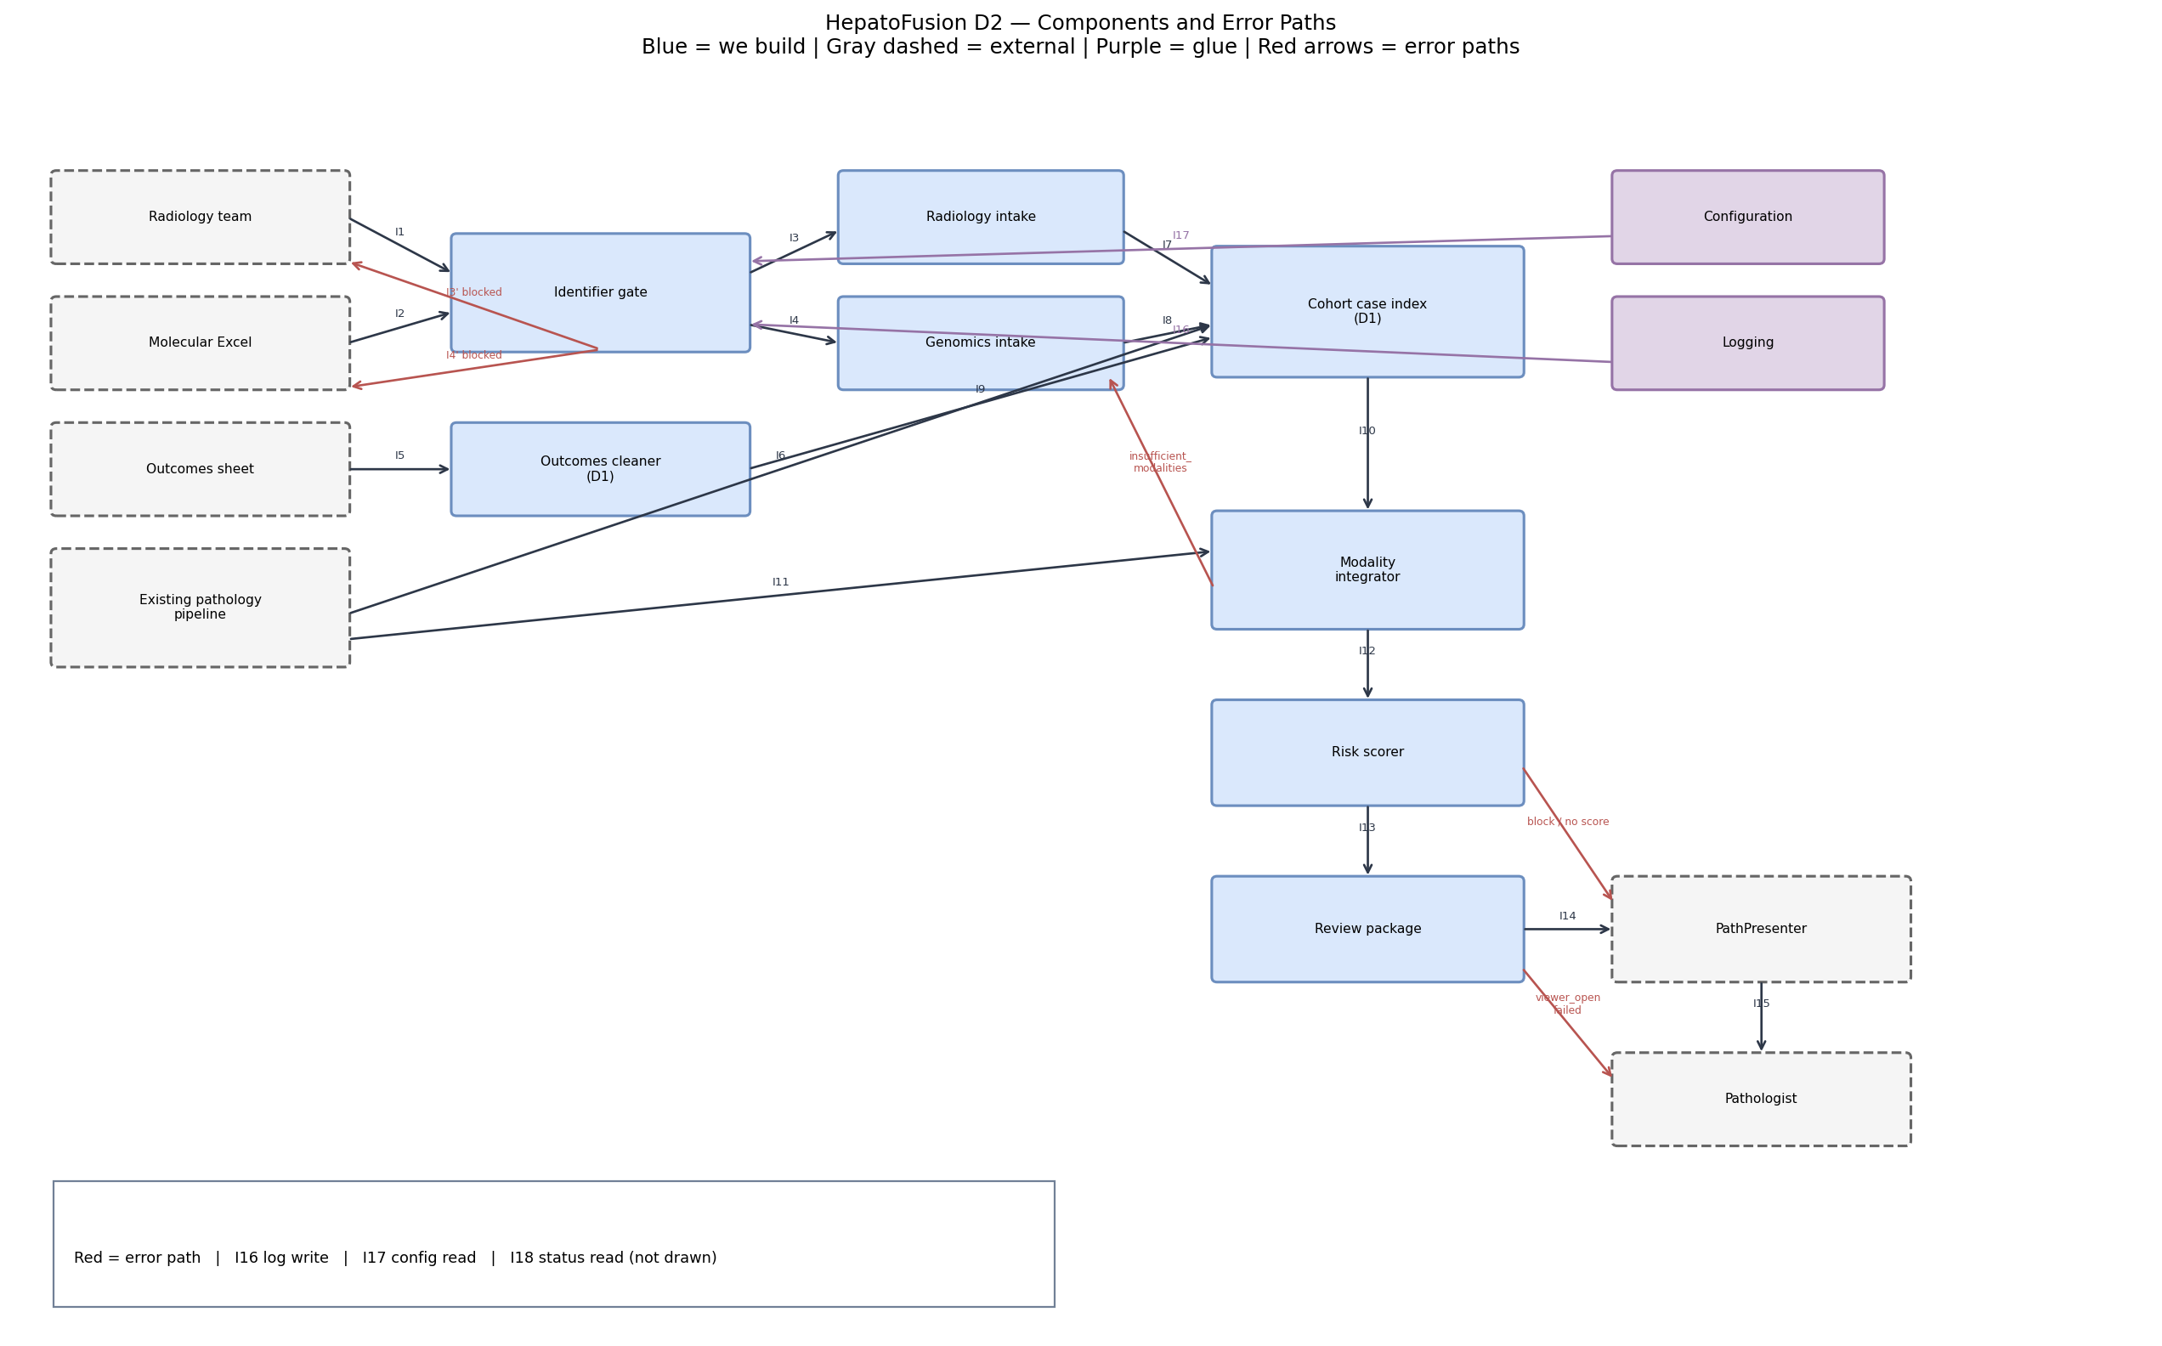
Backup slide
Backup — D2 component error paths (full)
Source: Design_Diagrams/D2_Detailed_Design.md

Slide 15
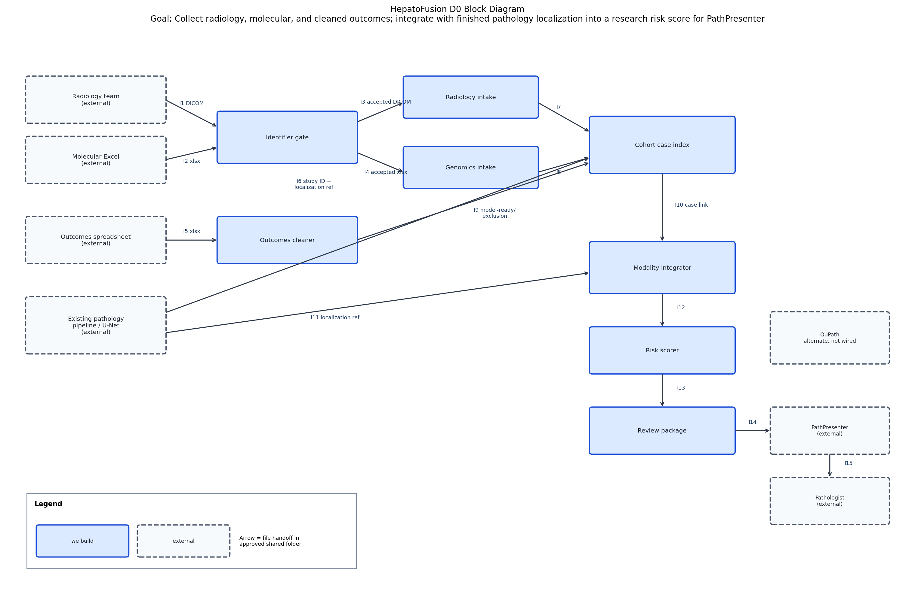
Backup slide
Backup — D0 original block diagram (reference)
Redrawn on Slide 4 for a live-room read. Source: Design_Diagrams/D0_High_Level_Design.md

Slide 16
Backup slide
Backup — Speaker outline and timing
Slide
Title
Visual
Speaker
Seconds
1
Title + purpose + goal
Hero block + text
Nipun
30
2
Team and advisor
Two contact cards
Shivam
30
3
Project abstract (~100 w)
Highlighted paragraph
Nipun
80
4
User stories + D0 (redrawn)
5 USs + pipeline sketch
Shivam
95
5
Major constraints
Five cards + trade-off
Nipun
75
6
Project progress
Completed list + stats
Shivam
80
7
Expected EOT accomplishments
6 task cards
Nipun
65
8
Division of work (50/50)
Two-column T-ID table
Shivam
85
9
Expo demo + fallback
Primary / fallback cards
Nipun
60
—
TOTAL
Shivam 290 | Nipun 310
600

Slide 17
Backup slide
Backup — Recording plan and AI use
Recording plan
AI use (Assignment #8 draft)
Presenters: Shivam Kharangate + Nipun Chandra
Software: PowerPoint Record Slide Show
Target length: 10:00 (±10 s)
Rehearsal recording: before Week 12 review
Final recording: Week 13 upload window
Deck + video links posted by: Nipun
Shared link location: team project spreadsheet
Repo path: Presentation/ folder
Commit hash: recorded in Canvas submission
Tool: Claude (Anthropic) via Claude Code CLI
Used for: layout scaffolding of the deck,
timing-table formatting, and prose polish of
the abstract and bullet phrasings.
The team wrote all technical content, timing
numbers, task assignments, metrics, and
advisor-facing commitments. Content was
confirmed by both members prior to draft
submission.

