Slide 1
Work Report 6
Shivam Kharangate
10/23/2024

Slide 2
Vibration Analysis
Theory:
Hypothesis: Test the system and predict key vibration areas.
Test the hypothesis by placing the device in predicted areas over a series of tests.
Based on data result, confirm the hypothesis and analyze key vibration areas.
Conclusion: Confirmed key vibration source.
No updates for this week, still working on wireless functionality and the vibration module testing.
Hit delays due to board issues, but expected to finish it by next week.

Slide 3
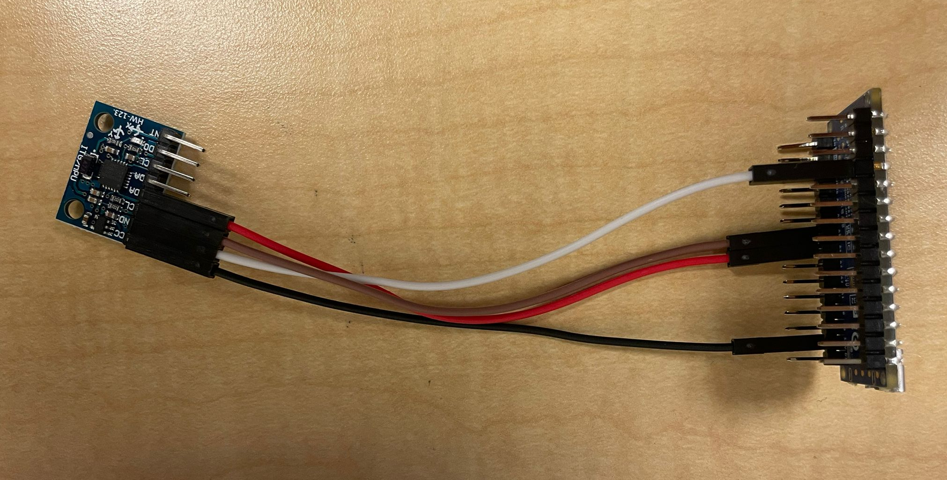
Circuit Diagram
Need to add the switch for the battery. Final pictures of the device will be uploaded soon.
VCC (MPU6050) → 3.3V (Nano ESP32)
GND (MPU6050) → GND (Nano ESP32)
SCL (MPU6050) → GPIO 22 (Pin A4) (SCL on Nano ESP32)
SDA (MPU6050) → GPIO 21 (Pin A5) (SDA on Nano ESP32)

Slide 4
PROPOSED CHANGE
Through this week to next week, I will be testing the vibration modules and validating the data range. I have to continue to finish up on the wireless functionality.
I have delayed the task planned for this week and merged it with next week’s task, adding one extra week into it. (Confirmed by Anirudh).
Merging both the tasks also helps in planning and properly gathering the results, rather than having them separate.
Task until 10/27: Test Bluetooth Wireless Functionality, with data verification on vibration modules.
Task beginning from 10/30 – 11/14 : Run initial measurements on the actual system on different locations, and identify key vibration characteristics of main source using measured data.

Slide 5
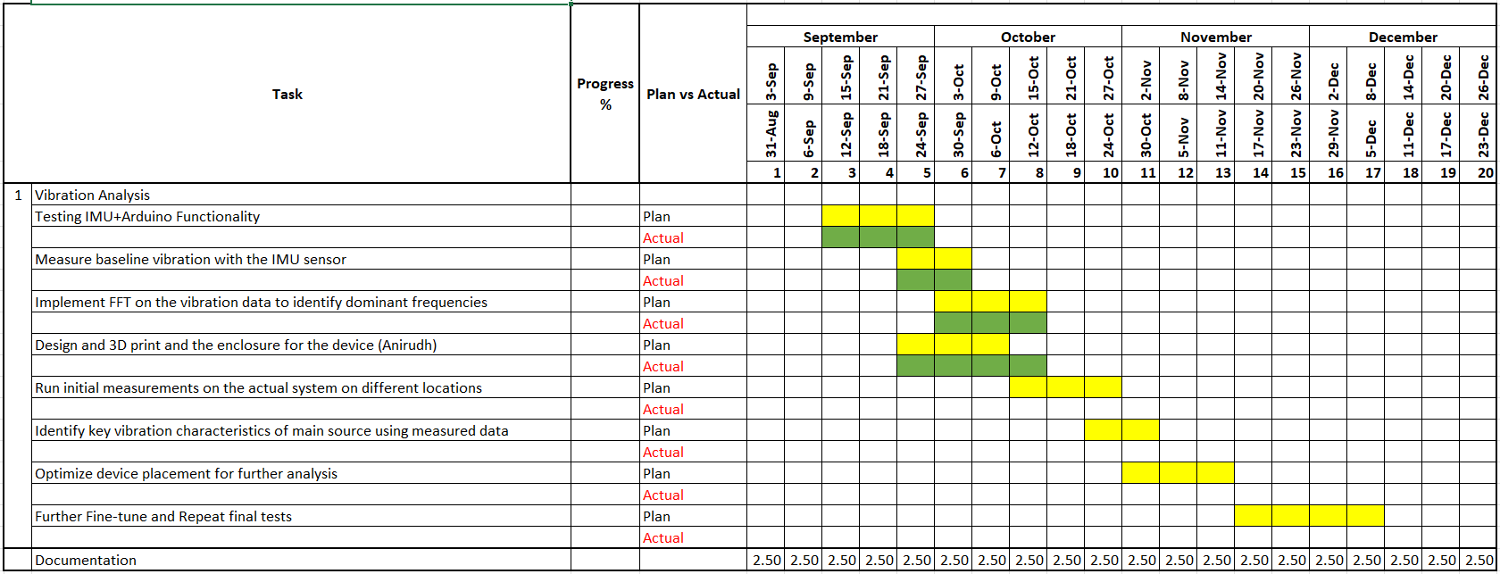
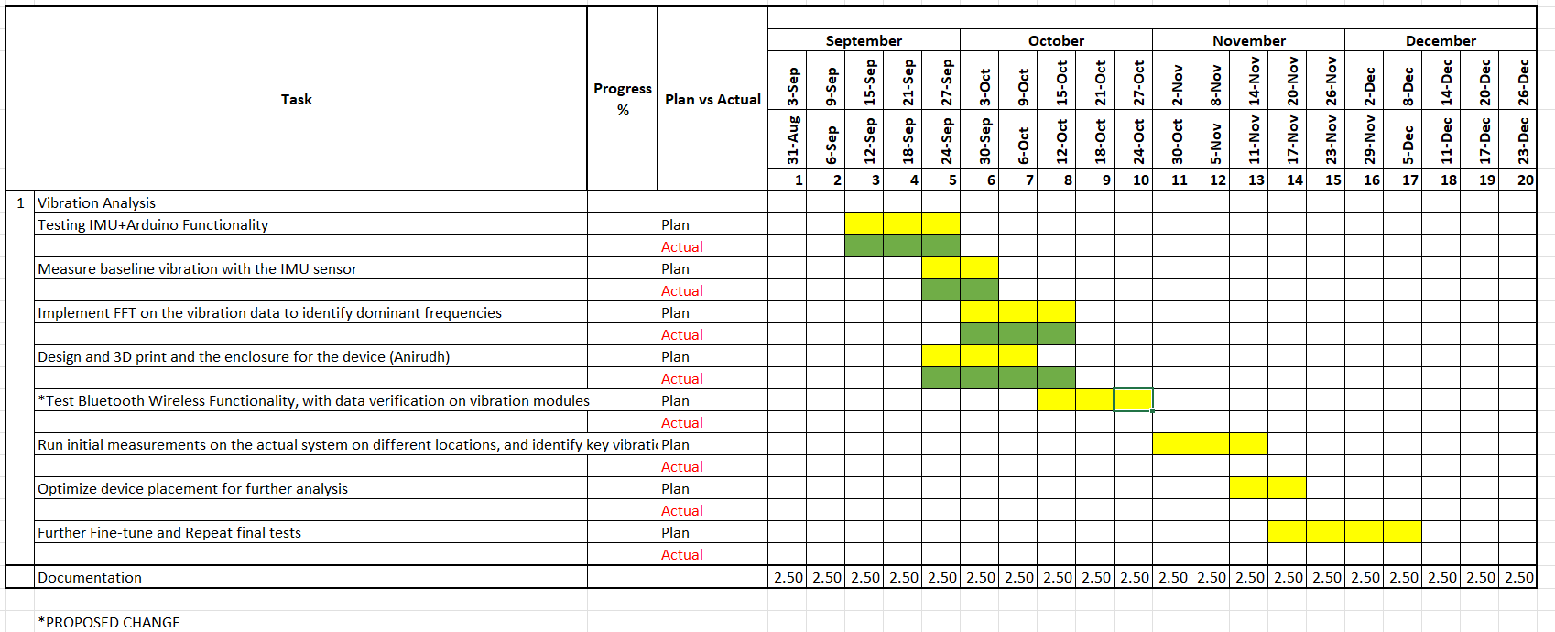
Before Proposed update

Slide 6
Work Report 5
Shivam Kharangate
10/15/2024

Slide 7
Vibration Analysis
Currently implementing wireless functionality, ran into some issues. The overall device works with data output connected via USB for now.
The 3D printed enclosure is being redesigned, so that the sensor is flat on the system, for more accurate readings.
Once the validation of data is done on the vibration modules, we can proceed to do the tests on the system, should start soon.

Slide 9
Work Report 4
Shivam Kharangate
10/9/2024

Slide 10
Vibration Analysis
Finished the setup (ESP-32+IMU+Battery), currently testing with data on vibration modules for further data validation, placed an order on a coin vibration module.
Current setup is able to get data within a 3ms time difference with a 225000 baud rate.
Implementing wireless functionality, should start testing on the system next week once the accuracy of received data is confirmed.
Theoretical analysis –
The IMU sensor would have to be airtight and flat within the enclosure to ensure that the data received is accurate.
While testing on a sample vibration module, the close the IMU is to the vibration in contact, that also improves the data accuracy.

Slide 11
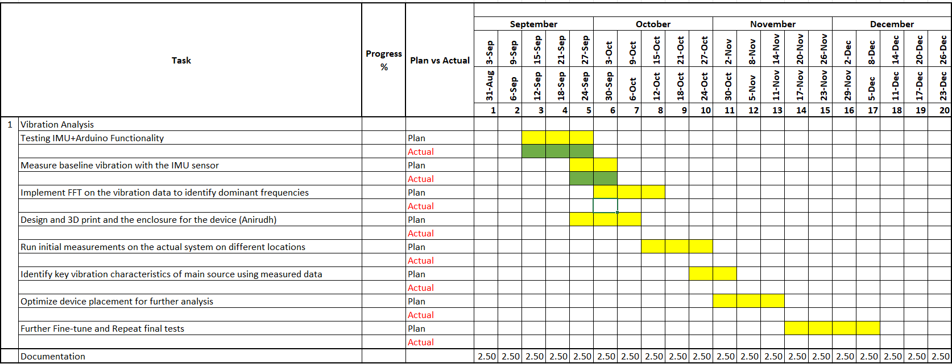

Slide 12
Work Report 3
Shivam Kharangate
10/2/2024

Slide 13
Vibration Analysis
Started testing on getting various sample data from vibration module(phone), managed to do a simple FFT for further validation.
Need to start on doing more sampling tests for validation of dominant frequencies through the accelerometer readings.
Finalized component parts for the final assembly of the device. (all ordered).
Parts List:
Arduino Nano ESP-32
MPU6050 sensor
7.6V Battery

Slide 14
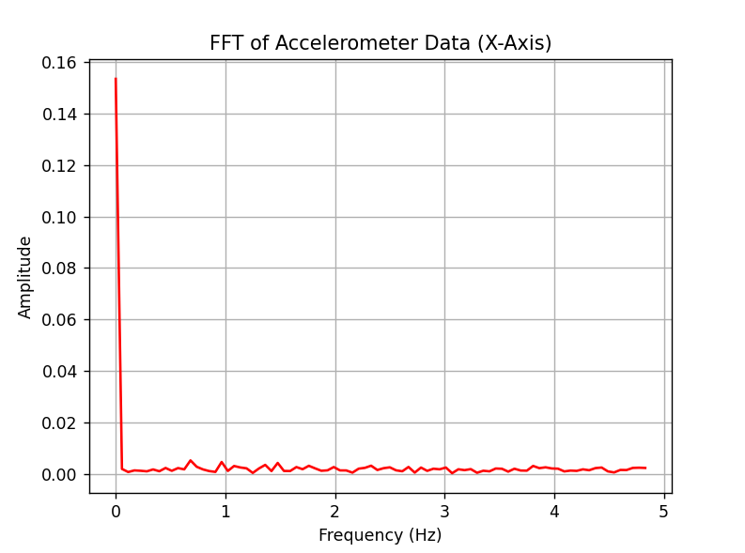
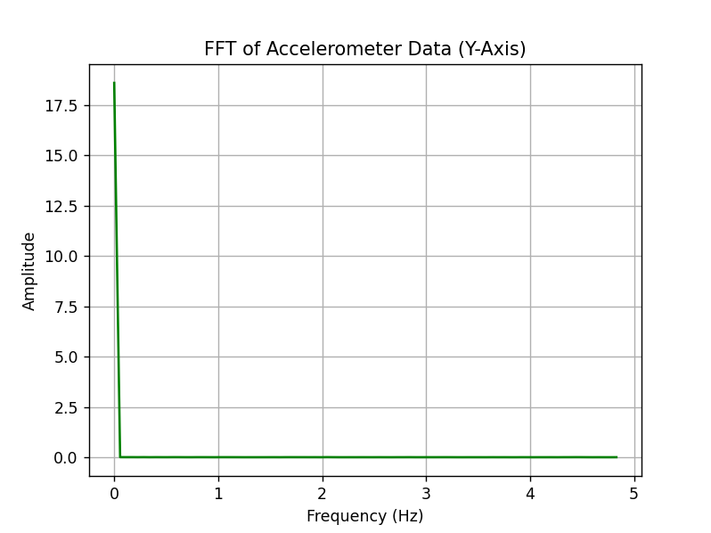
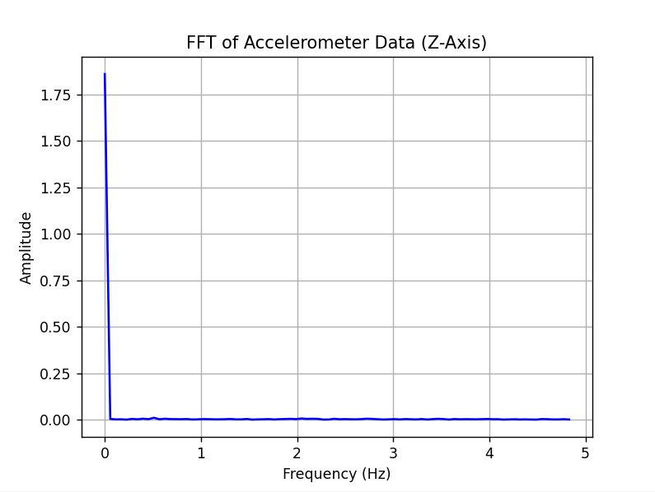
Experimented FFT

Slide 16
Work Report 2
Shivam Kharangate
9/25/2024

Slide 17
Vibration Analysis
Started testing on new BNO 055 sensor with the Arduino mega, managed to get basic accelerometer readings, and also conducted test on the vibration module (phone app).
Currently working on validating and testing the data across tests to ensure the accuracy of the results.
Will start working on basic FFT implementations.

Slide 18
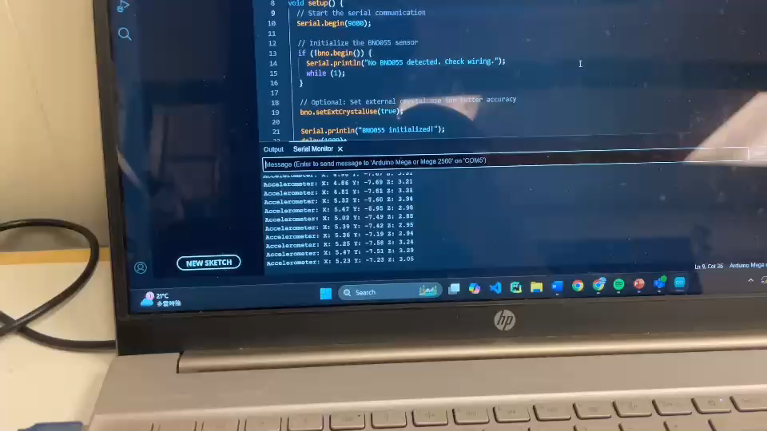

Slide 19
Work Report 1
Shivam Kharangate
9/18/2024

Slide 20
Vibration Analysis
Started with basic setup of Arduino Mega2560 Board connected with MPU6050 (IMU sensor), managed to get basic acceleration and gyroscopic readings.
Researched about a “flywheel balancing momentum wheel”, a module within the entire system for the vibration analysis.
Currently working on experimenting on vibration modules for basic data retrieval and analysis.
Researching and experimented on basic FFT implementations and exporting the data achieved through a datalogger and filtering it for frequency readings.
Working on finishing rest of the stuff to start on vibration analysis for the entire system.

Slide 21
