Slide 1
“Adventure Works”
Company Report

Slide 2
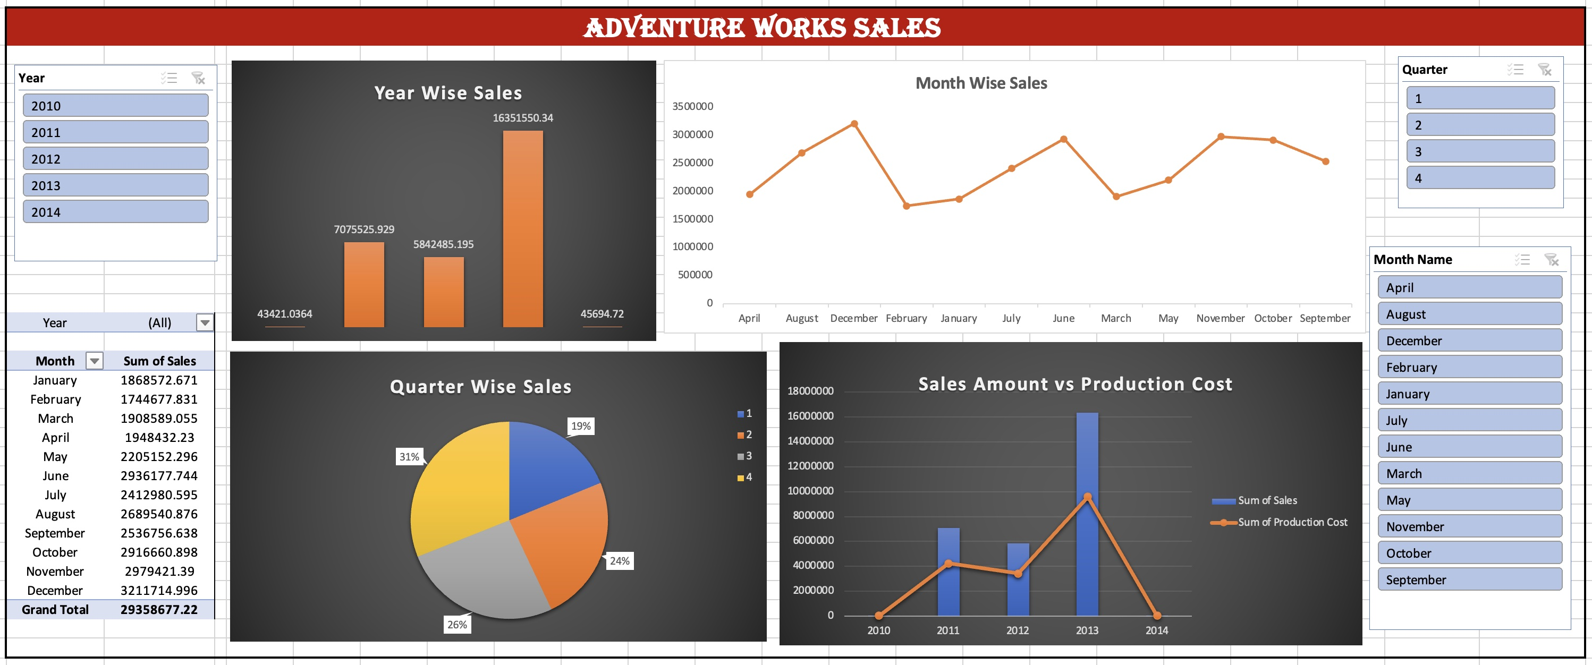
Microsoft Excel

Slide 3
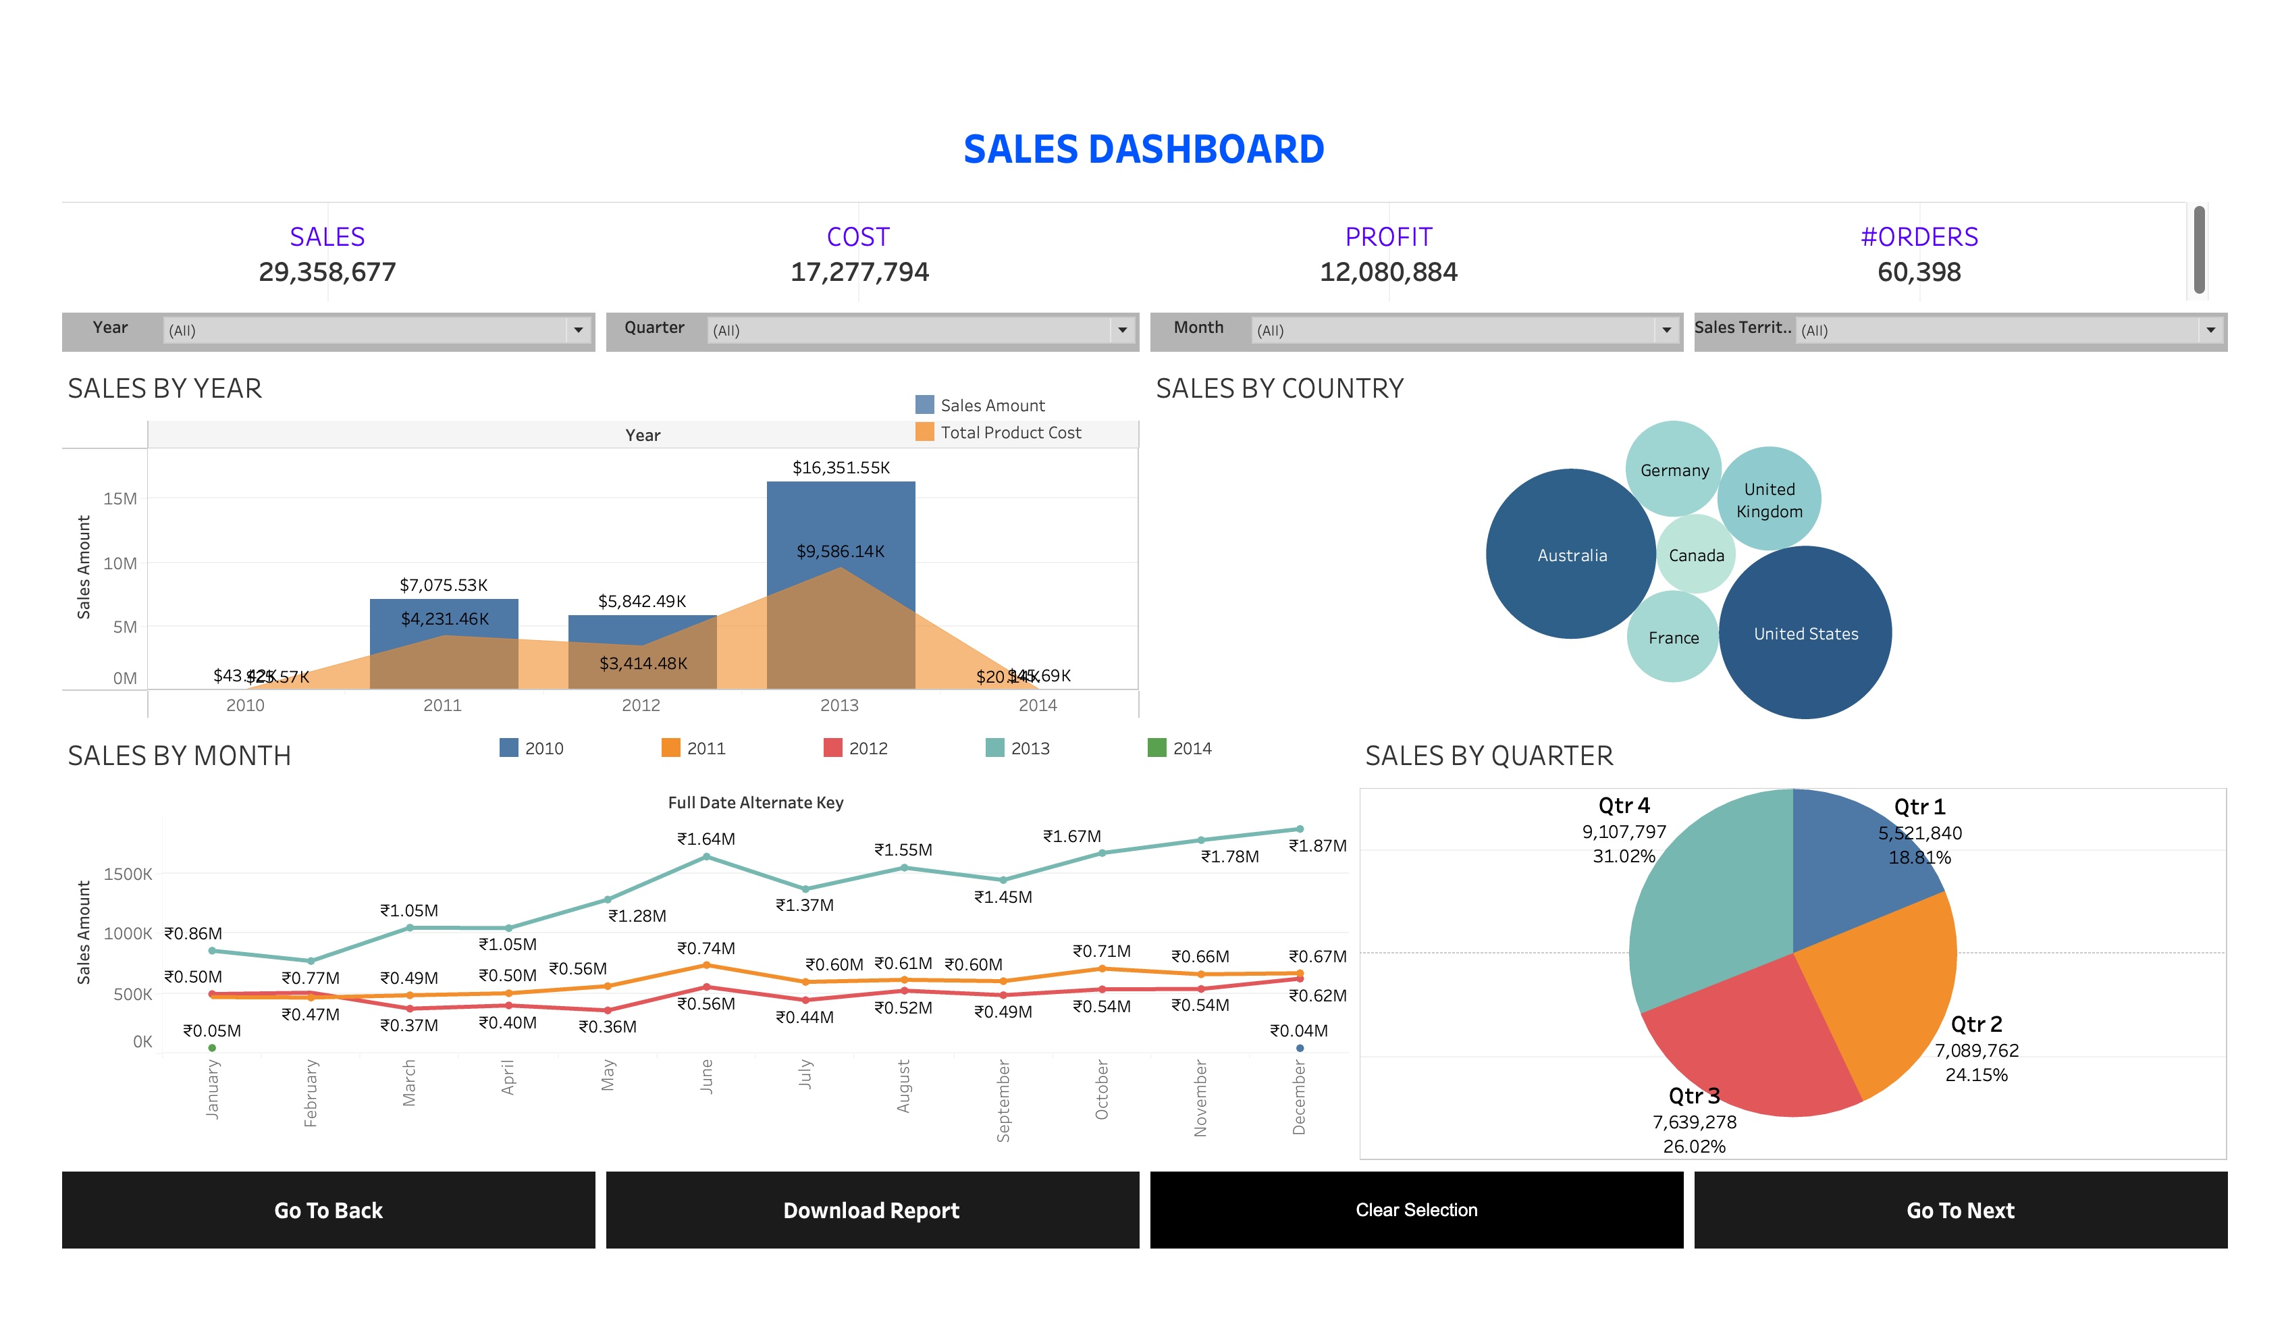
Tableau

Slide 4
Business Strategy Session: Enhancing Operational Efficiency and Market Expansion
Section 1: Production Cost Management
Section 2: Market Share Expansion
Section 3: Online Sales Platform Optimization
Section 4: Customer Targeting and Segmentation

Slide 5
Section 1: Production Cost Management
Streamlining Production Costs
Cost Analysis Insights: Identifying areas for cost reduction, particularly at the Mexico plant, based on the "Sales Amount vs Production Cost" chart.
Strategies for Efficiency: Implementing strategies to streamline production and reduce costs, leveraging insights from sales data analysis.
Operational Efficiency
Process Optimization: Enhancing operational efficiency to minimize production costs and maximize output, aligning with market demands and sales trends.
Resource Allocation: Allocating resources effectively based on the analysis of product performance and sales contributions.

Slide 6
Section 2: Market Share Expansion
Targeted Marketing Campaigns
Market Trends Analysis: Analysing market trends and customer preferences to develop targeted marketing campaigns for market share expansion.
Sales Fluctuations: Addressing fluctuations in monthly and quarterly sales through strategic marketing initiatives aligned with customer preferences.
Customer Segmentation
Tailored Services: Identifying and segmenting top customers to provide tailored services and promotions, enhancing customer loyalty and market share.
Strategic Promotions: Developing targeted promotions based on customer segmentation to expand market reach and increase sales.

Slide 7
Section 3: Online Sales Platform Optimization
User-Friendly Platform
Enhanced User Experience: Ensuring the user-friendliness, efficiency, and capability of the e-commerce platform to accommodate increased traffic and enhance customer experience.
Platform Scalability: Optimizing the online sales platform to handle increased traffic without compromising user experience or operational efficiency.

Slide 8
Section 4: Customer Targeting and Segmentation
Focused Sales Strategies
Country-Specific Targeting: Focusing on specific countries contributing more to sales and understanding the dynamics of lower-performing regions to refine sales strategies.
Market Dynamics Analysis: Understanding market dynamics to tailor sales strategies and customer targeting for enhanced market penetration.
Customer Segmentation Insights
Tailored Offerings: Leveraging customer segmentation insights to tailor offerings and promotions, enhancing customer engagement and retention.
Market Reach Expansion: Expanding market reach through targeted customer segmentation and tailored sales approaches to maximize sales potential.

