Slide 1


Infosys
Makeathon 6.0
Fraud Detection System
Using ML

Slide 2
Team and Use Case
USE CASE
A Fraud Detection System using Machine Learning helps financial institutions detect and prevent fraudulent transactions in real-time by analyzing transaction patterns and identifying anomalies. It is widely used in credit card fraud prevention, money laundering detection, banking transaction monitoring, and e-commerce fraud prevention. The system leverages ML models to reduce false positives while accurately flagging suspicious activities. It can also be applied in insurance fraud detection, loan and mortgage fraud prevention, and cryptocurrency fraud monitoring. By utilizing Python libraries like Scikit-learn and Keras, businesses can develop an efficient fraud detection system to enhance security and minimize financial losses.
Team Name - Neural Bots
Team Members With College details
12102883 - Shivam Kumar
12212359 - Abhishek Kumar
12216643 - Satha Ayyappa
Notes:
https://www.google.co.in/url?sa=t&rct=j&q=&esrc=s&source=web&cd=3&cad=rja&uact=8&ved=0ahUKEwiPrIzwtMfVAhUEu48KHWbFB1MQFggxMAI&url=http%3A%2F%2Fwww.idc.com%2Furl.do%3Furl%3D%2Fincludes%2Fpdf_download.jsp%3Bjsessionid%3D9A186708CAC760A41DC43D8496079399%3FcontainerId%3DUS41883016%26%3Bterm%3D%26position%3D19%26page%3D6%26perPage%3D25%26id%3D4f6b22e0-3828-4271-9cbb-55809210e02d&usg=AFQjCNF73akewzLB3jtbgehrjmgRKIg-Hg

Slide 3
Technical Solution
FRAUDEX tackles this problem by offering a real-time, AI-driven fraud detection and response system that proactively engages users through instant AI phone calls, enabling immediate action to prevent fraud and reduce financial and reputational risks.
Transaction → ML Model → Retell AI → Twilio → User → Supabase → Frontend Update
Kaggle is used to train the machine learning model for fraud detection.
Retell AI is used for AI-powered phone call notifications.
Twilio is used as the communication platform to enable AI-powered phone calls and SMS notifications.
Notes:
https://www.google.co.in/url?sa=t&rct=j&q=&esrc=s&source=web&cd=3&cad=rja&uact=8&ved=0ahUKEwiPrIzwtMfVAhUEu48KHWbFB1MQFggxMAI&url=http%3A%2F%2Fwww.idc.com%2Furl.do%3Furl%3D%2Fincludes%2Fpdf_download.jsp%3Bjsessionid%3D9A186708CAC760A41DC43D8496079399%3FcontainerId%3DUS41883016%26%3Bterm%3D%26position%3D19%26page%3D6%26perPage%3D25%26id%3D4f6b22e0-3828-4271-9cbb-55809210e02d&usg=AFQjCNF73akewzLB3jtbgehrjmgRKIg-Hg

Slide 4
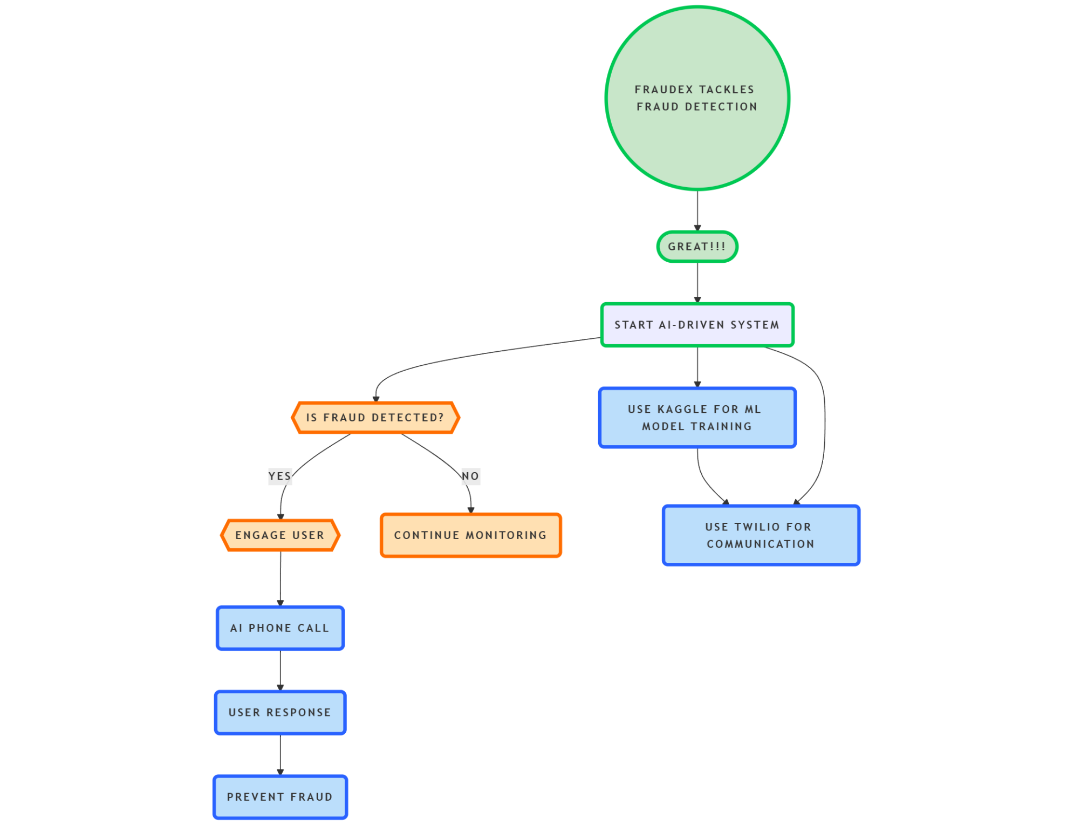
Flow Diagram:

Slide 5
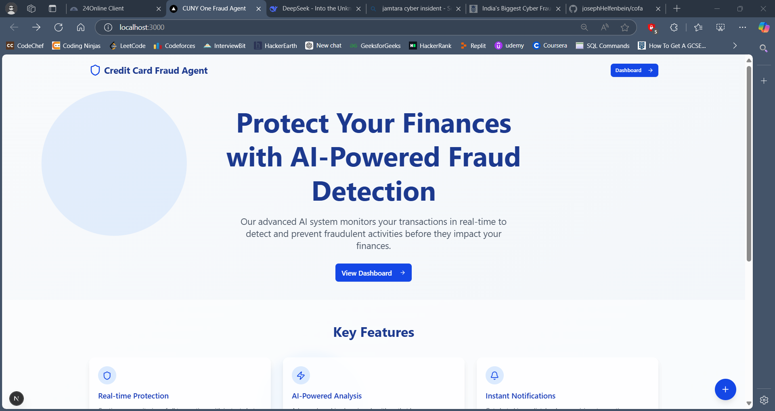
Thank You.

