Slide 1




SANT DNYANESHWAR SHIKSHAN SANSTHA’S
ANNASAHEB DANGE COLLEGE OF
ENGINEERING AND TECHNOLOGY,ASHTA
Department of Computer science and Engineering
Web based platform for pre-ordering food at various food outlets.
-By
Shivam Nimbalkar
(19131035)
Rohit Gawas
(19131084)
Aditya Vyavahare
(19131076)
Aryan Magdum
(19131079)
Guided by:
Prof. V.A Kamble

Slide 2

The challenges encountered by the existing system serve as a major drawback to the realization of efficiency and customer satisfaction. The experience of ordering in most fast food restaurants is not pleasant for the customers. Customers will have to make long queues before placing their orders especially during peak hours and then the ordering staff will record customer orders. Having placed their order, the customer must then wait near the counter until their order is ready for collection.
Problem Statement

Slide 3

Objectives
 To update database regularly by tallying the changes in food outlet menu.
 To receive food orders from customers via internet ,ultimately reducing paper.
 To process transactions via respective payment gateway (Google pay API)
 To establish connection to backend to be able to store data received with the help of dynamic UI
 To Implement database in efficient manner, to be able to retrieve required information whenever required
 To reduce restaurant’s food wastage
 To enable customers to know the ingredients of a dish before ordering with the help of pop-up dialogue box.
 To reduce time wasting by eliminating long queues

Slide 4
Methodology
 Development of computerized systems requires analysis of the process to be digitized in order to enable a correct system, a system that functions as required and to assist the potential users of the system understand the general functionality of the system. The analysis specifies the system's objectives and constraints to which designers have to comply. The purpose of doing analysis is to transform the system’s major inputs into structured specification
 This is a brief structure which depicts the environment in which a software system exists and helps in communicating about what lies outside the system boundary.

Slide 5
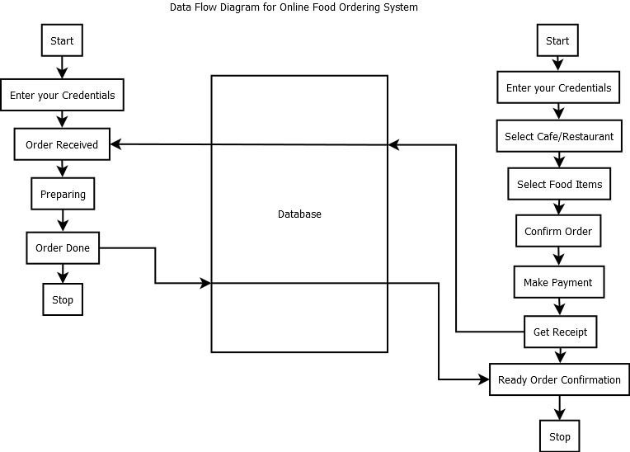

Slide 6
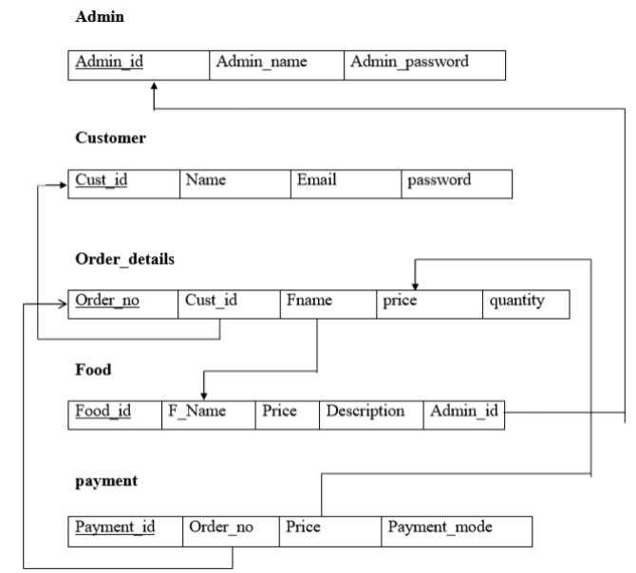

Slide 7
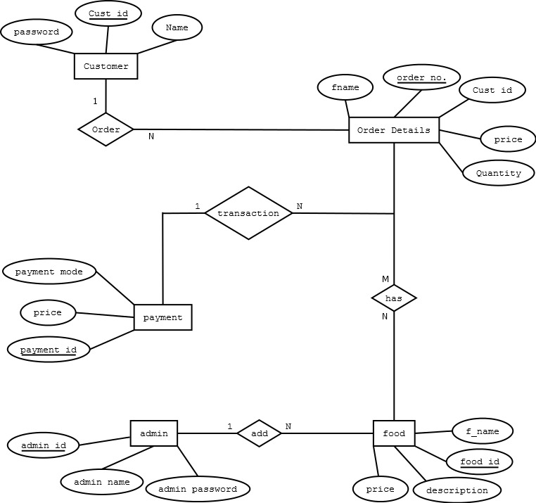

Slide 8
Functionalities provided
 Create usernames and passwords
 View/ edit / delete user accounts Customer module Functionalities provided:  View product’s list
 Register
 Place orders Manager module
Functionalities provided:
 Create product categories and functionalities
 Edit / delete product categories and descriptions

Slide 9
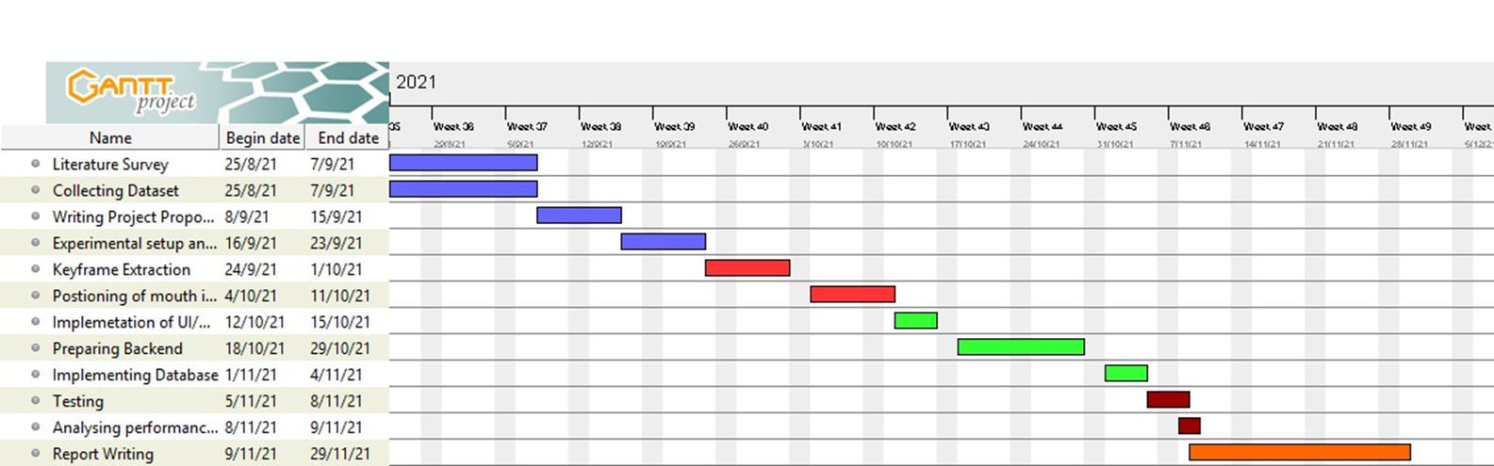
Schedule
Figure 2 shows the project schedule to be used to implement the project.

Slide 10
Software Requirement
 Operating system: Win 8 / Win 10 /Win 11/ macOS
 Technology : HTML, CSS, NodeJS
 Database : mongo DB
 Antivirus software
 Backup and Data Recovery software
Hardware requirements
 Processor: Intel dual core or above
 Processor Speed: 1.0GHZ or above
 RAM: 1 GB RAM or above
 Hard Disk: 20 GB hard disk or above
 Printer for printing reports
 Uninterruptible power supply to ensure a constant access of data.
 USB flash disk( At least 2GB)

Slide 11
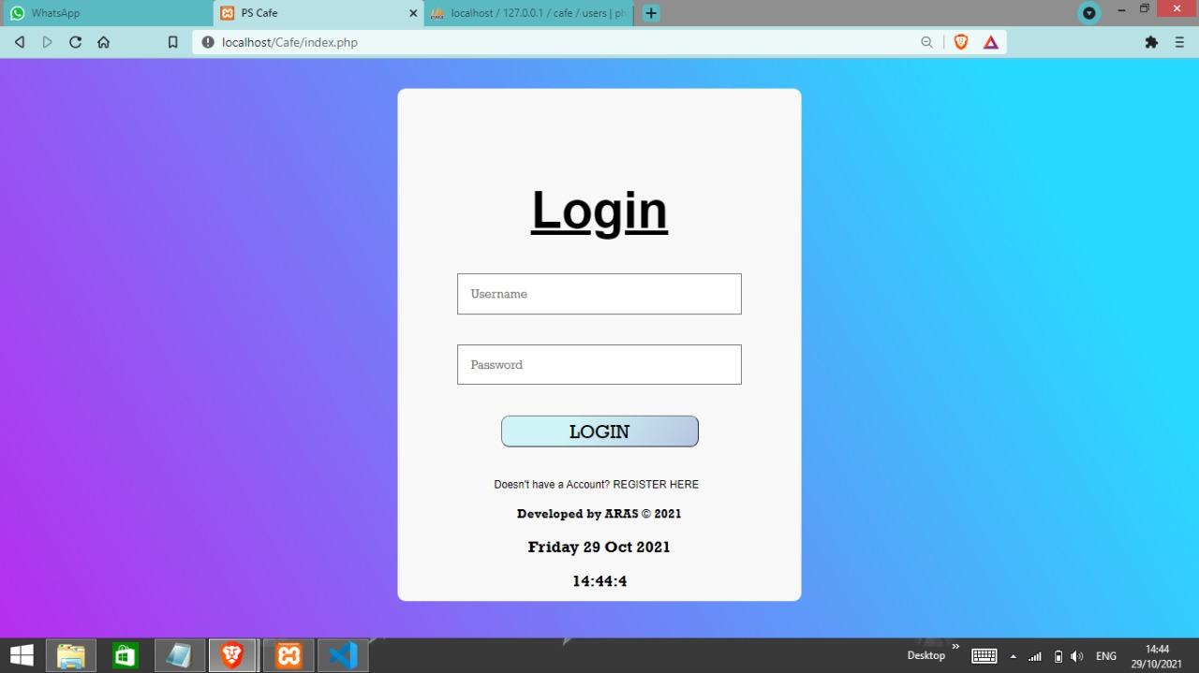

Slide 12
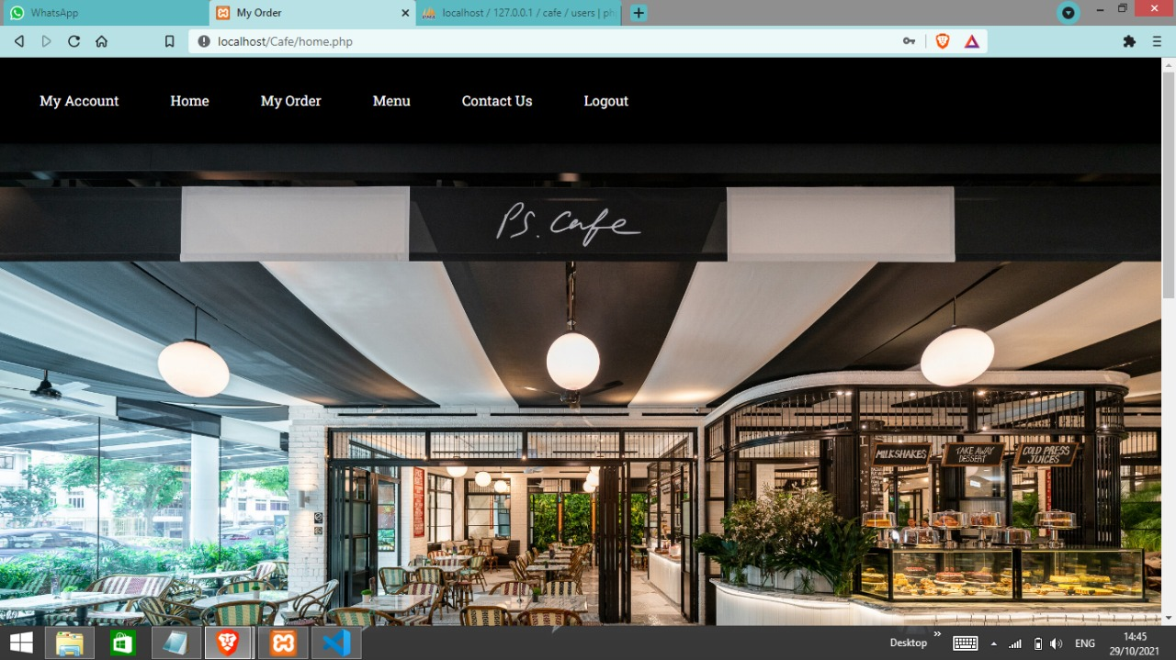

Slide 13
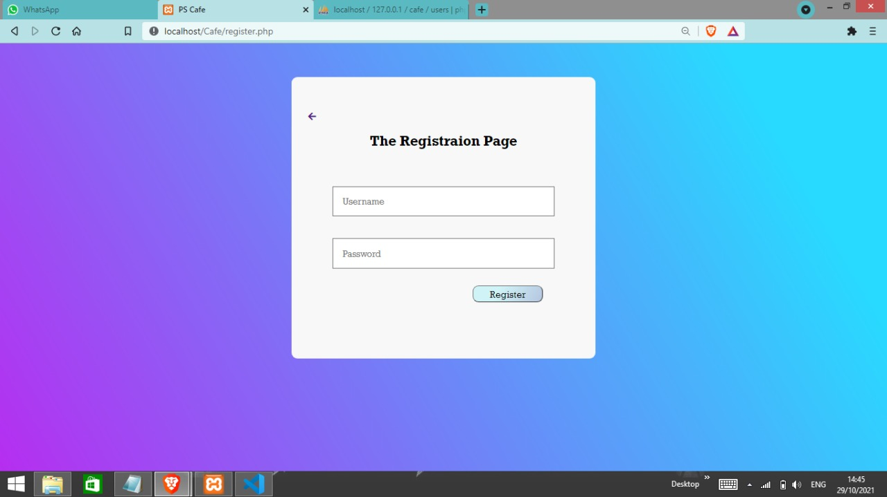

Slide 14
Thank You!!

