Slide 1
PIPELINE MIPS CPU
USING VERILOG
Presented By :-
Daxal Patel (18BEC072)
Yashasvi Shah (18BEC100)
Shivam Pandey (18BEC101)

Slide 2
INTRODUCTION
Types Of Architecture
CISC: Complex Instruction Set Computer.
RISC: Reduced Instruction Set Computer.

Slide 3
Different types of Instructions in RISC
ALU instruction.
These kinds of instructions use either two registers or a sing extended immediate and register.
Typical instructions are AND, OR, add, sub etc.
Load and Store instructions.
Base register and offset are the operands for this type of instructions. The sum of both base register and offset called as ‘effective address’ and this is being used as a memory address.
At the time of LOAD instructions, a second register operand works as the destinations register while in STORE instruction second register operand is the source of the data that needs to be stored into memory.
Branches and Jumps
These are the conditional transfer of the control.
These instructions are specified by a limited set of comparisons among a pair of registers or between zero and registers.
In RISC architecture, the branch destination is calculated by adding a sing extended offset- 16 bits in the case of MIPS to the current PC

Slide 4
Clocks/Stages in RISC Architecture
In general, every instruction in RISC architecture can be implemented using 5 clk cycles. The multi clk cycles are as follow:
Instruction Fetch (IF)
Instruction decode (ID)
Execute (EX)
Memory access (MEM)
Write Back (WB)

Slide 5
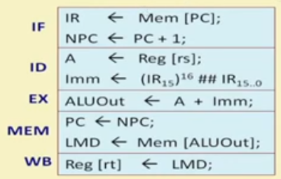
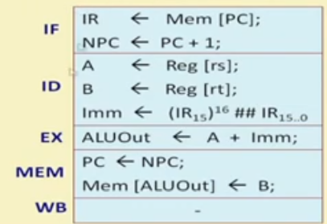
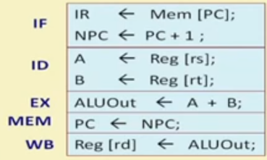
Example
LW R2 , 200(R6)
SW R3, 25(R10)
ADD R2,R5,R10

Slide 6
Basic of Single Cycle CPU
It executes all instructions in one clock cycle.
Each cycle requires a certain amount of time and this mean single cycle CPU spends same amount of time to execute each instruction, basically one cycle no matter how complex is the instruction.
The slowest instruction should be completed within one clock e.g. load (ld), which means single cycle CPU operates at the speed of slowest instruction in ISA.
Another aspect of this CPU is, since it has to complete all the instructions in one clock cycle means any element must be used once only.
So duplication of such an element has to be available. This point to the fact that if same element is used more than once than there will instruction flows and therefore different connections have to be realized and the is done by multiplexer.

Slide 7
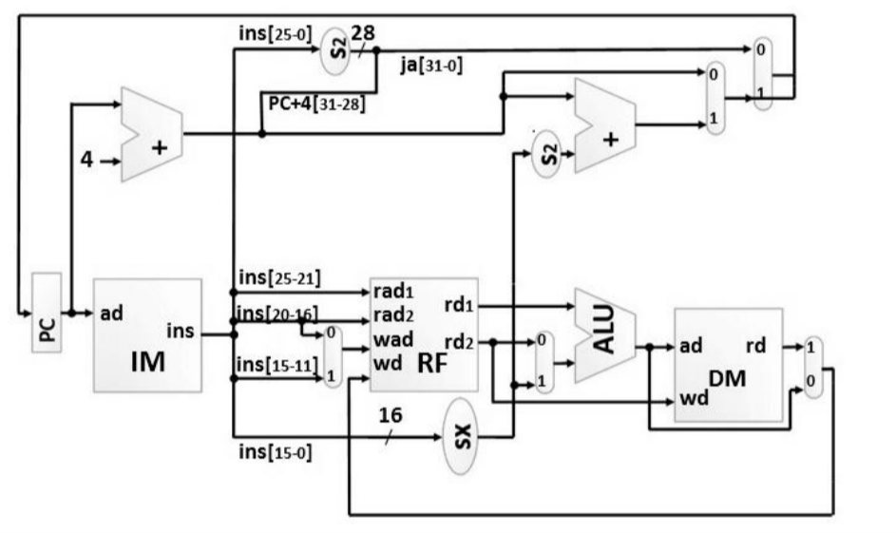

Slide 8
Concept of pipelining
Pipelining is an implementation technique whereby multiple instructions are overlapped in execution; it takes an advantage of parallelism that exists among the actions needed to execute an instruction.
All recent processors incorporate pipelining as a key implementation technique.
MIPS is a five stage pipeline structure, each stage is responsible to complete a part of an each instruction.
All these five stages are connected through a pipelining register.
All the stages are connected, all of them should be ready to perform at the same time.
The time required to move an instruction one step down to another stage among five stages sequentially is known as ‘processor cycle’.
The slowest pipeline stage decides the length of the processor cycle.

Slide 9
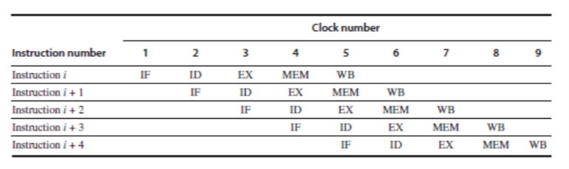
MIPS subset for an implementation
One can design pipeline processor (MIPS here) by initializing new instruction at on every clk cycles. Here each clk cycle means one of the stages of pipeline.
Adjacent figure represents the typical pipeline structure, even though an instruction takes five clocks to complete the execution, hardware will start a new instruction and will execute a part of the instruction at each stage.

Slide 10
MIPS instruction format
In MIPS, there are three different types of instructions: R-type. I-type and J-type.
R-type instructions
R-type instructions take three different arguments: rt and rs both source register and rd – destination register.
For example, add $r1, $r2, $r3 (instruction rd, rs, rt) which means it adds two values of $r2 and $r3 and stores the result in to $r1.
I-type instructions
I-type instructions takes two arguments, rs and rt and 16 bit immediate value, this immediate value is not stores in memory but it is a part of the instruction. The benefit of such immediate is that we do not need to work with the memory so accessing constant (immediate) is much faster
For example, addi $r1, $r2, 9 (instruction rt, rs, immediate) which means it adds the value 5 to the register $r2, and stores the result in to $r1.
J-type instruction
J instructions are written with labels; it is linker or assembler’s duty to convert the label in to numerical value.
For example, j label (instruction addr), which means this instruction informs the processor to skip to the instruction written at addr space.

Slide 11
A Pipeline Datapath and Control
We have pipeline registers in between each stage of the pipeline.
These pipeline stages are named in such a way that it shows connection through it from one stage to successive next stage.
It is known that each operation here must be complete in one clk cycle.
We need these pipeline registers because any operation that travels from one stage to another that needs to be stored temporarily in correspondent pipeline register.

Slide 12
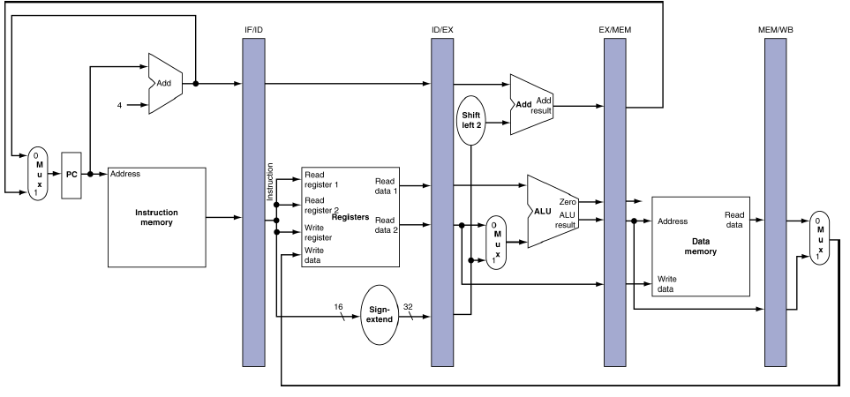

Slide 13
THE CONTROL OF PIPELINE
Instruction Fetch
There isn’t anything really in this division as control signal to write the PC and read the IM (Instruction Memory) are always there.
Instruction Decode
Since even this stage is independent to the current instruction type as explained earlier, every time same operation happens at this stage.
Execution /ALU operation
ALUSrc, ALUOp and RegDsr are the signals that need to be set, it selects the ALU operation, resulting register, and either sign extended immediate field or read the data.
Memory
This stage, MemWrite, MemRead and Branch are the signals that needs to be set, they are set by the store instruction, load instruction or by the branch equal respectively.
Write Back
There are two different control signals; MemtoReg which is responsible in deciding in between sending the memory value or ALU result from stage 3 and RegWrite which is responsible of writing the value.

Slide 14
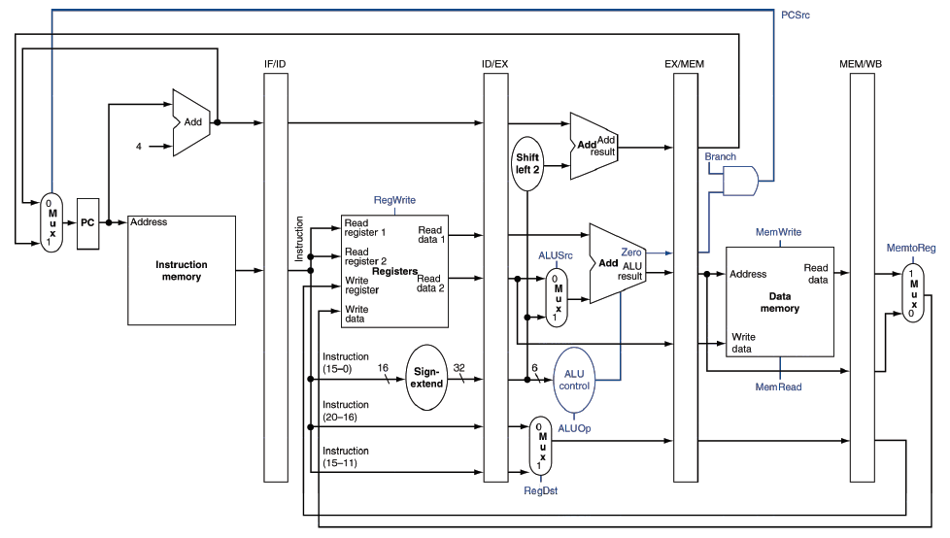

Slide 15
Control Signals
Signal Name | Signal if 0 | Signal if 1
RegDst | The register destination number for the Write register comes from the rt field (bits 20:16). | The register destination number for the Write register comes from the rd field (bits 15:11).
RegWrite | None | The register on the Write register input is written with the value on the Write data input.
ALUSrc | The second ALU operand comes from the second register file output (Read data 2). | The second ALU operand is the sign extended, lower 16 bits of the instruction
PCSrc | The PC is replaced by the output of the adder that computes the value of PC + 4. | The PC Is replaced by the output of the adder that computes the branch target.
MemRead | None | Data memory contents designated by the address input are put on the Read data output.
MemWrite | None | Data memory contents designated by the address input are replaced by the value on the Write data input.
MemtoReg | The value fed to the register Write data input comes from the ALU. | The value fed to the register Write data input comes from memory.

Slide 16
Hazards in Pipeline CPU
When next instruction cannot execute in the following clock cycle then it leads to a incorrect computation results which is called hazards. Basically there are three types of hazards occur in pipelined CPU.
Structural Hazards
Data Hazards
Control Hazards

Slide 17
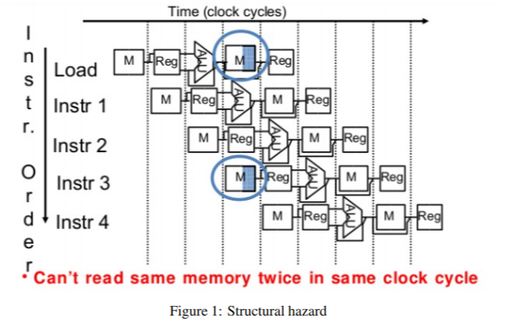
Structural Hazards
When more than one instructions tries to access the same resource in the CPU then this type of structural hazard occurs.
Here from the adjacent figure we can easily understand the structural hazard.
Here for this type of hazards to avoid this next instruction have to wait for the resource to be available and this introduces stall in the pipeline.

Slide 18
Solution.
To decrease this types of hazards we can introduce stall in between two instructions and wait for the resource to available for next instruction. Stalling reduces performance of the sys_x0002_tem but it is low cost.
Also another approach is to make use of multiple same resources it is a costly solution but it gives better performance.

Slide 19
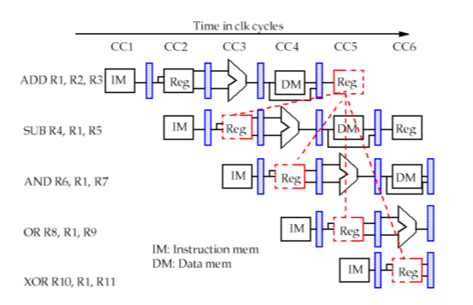
Data Hazards
When data is used before it is ready for execution this will lead to data hazards.
Example:
I1 : ADD R1, R2, R3
I2 : SUB R4, R1, R5
Here I2 instruction tries to access the data of R1 register before first execution will be completed and this will create data hazards. One can easily understand data hazard from adjacent figure.

Slide 20
Solution
To avoid this type of hazards we can introduce stall and it is the most easy and cost effective way to avoid hazards. It is also called bubble insertion.
Second solution is to introduce forwarding unit which connects new value to directly to next stage.

Slide 21
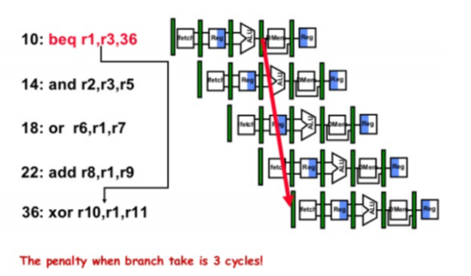
Control Hazards
When any branch or jump instruction will occur and When pipeline makes wrong decisions on branch prediction and therefore takes instructions into the pipeline that must be discarded.
This will arise control hazards/Branch hazards.

Slide 22
Solution
Common solution is to stop loading instructions until result is available.
Another solution is to predict and assume an outcome and continue featching and undo if prediction is wrong. This will lead to lose of cycles on if prediction is wrong.

Slide 23
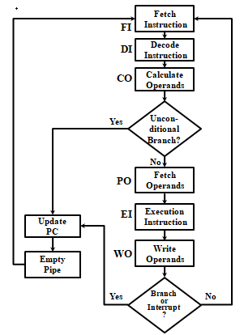
FLOW CHART

Slide 24
Example 1
ADD three numbers 12, 20, 30 stored in processor register.
So, to solve this we will do following steps:
Initialize R1 with 10.
Initialize R2 with 20.
Initialize R3 with 30.
Add R1 and R2 and store in R4 and then add R3 and R4 and strore the final result in R5.

Slide 25
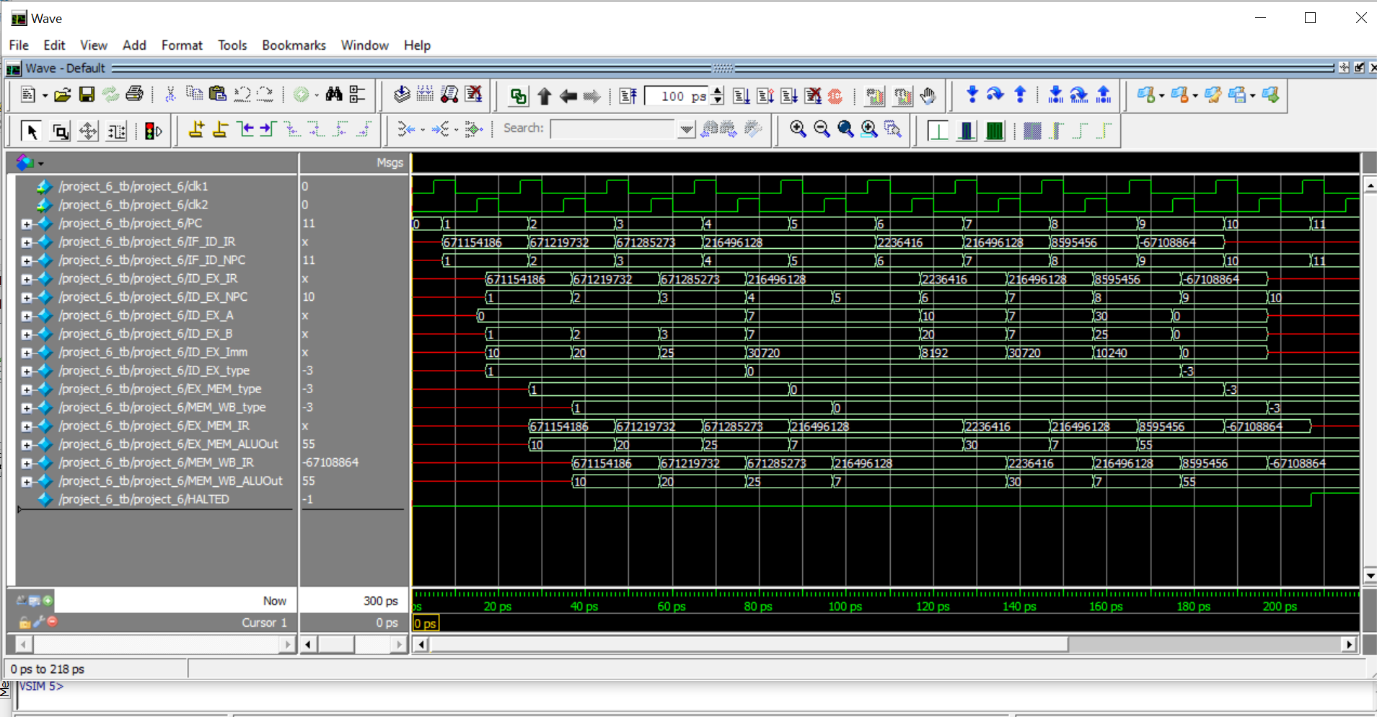
SIMULATION

Slide 26
Example 2
Load a word store in memmory location 120, add 45 to it, and store the result in memory location 121.
The following steps can be followed to do the same:
Initialize R1 with the memory address 120.
Load the contents of memory location 120 in R2.
Add 45 to R2.
Store the result in memory location 121.

Slide 27
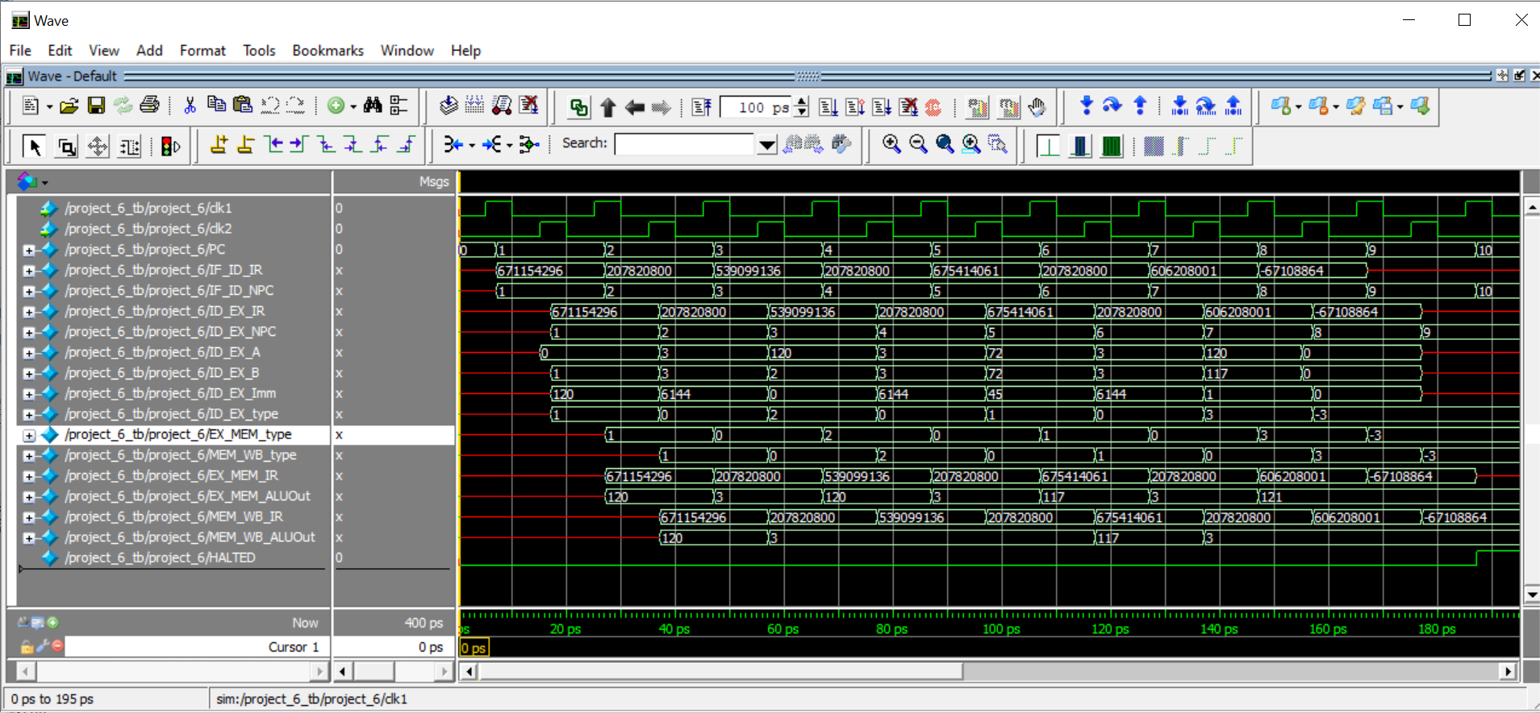
SIMULATION

Slide 28
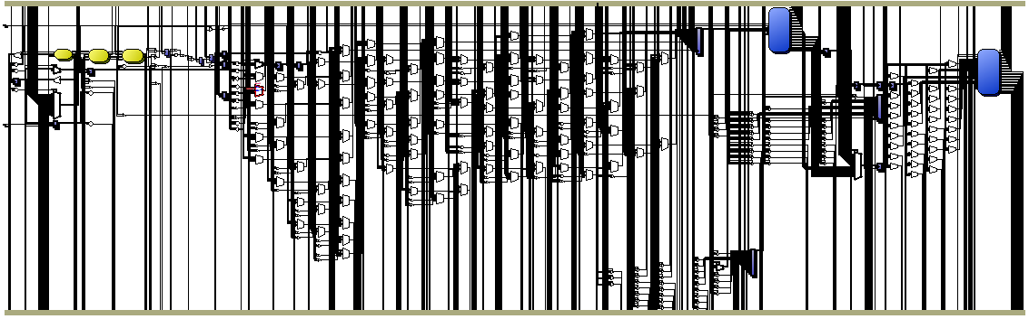
RTL VIEW

Slide 29
Conclusion
In this project, we have successfully accomplished building a MIPS CPU with pipeline functionalities. Data path of MIPS was explored during the implementation of the project.
Data hazard are resolved successfully by including dummy instruction.
This design shows the implementation of MIPS CPU capable of handling various R-type and I-type of instruction and each of these categories has a different format. .
This project shows the wide variety of logics to consider during the design.
The implementation of the project was done in Quartus II software and the simulation was performed in ModelSim Altera.
Behavioural style of modelling was used in order to code the project statement in verilog.
This project provided a vital chance to acquire hands on knowledge on MIPS five stage pipeline processor and we would wish to explore more in depth about this topic.
Obstacles and problems are sometimes helpful to get more practical knowledge on a particular subject matter.

Slide 30
References
R. S. Balpande and R. S. Keote, "Design of FPGA Based Instruction Fetch & Decode Module of 32-bit RISC (MIPS) Processor," 2011 International Conference on Communication Systems and Network Technologies, Katra, India, 2011, pp. 409-413, doi: 10.1109/CSNT.2011.91.
K. Yi and Y. Ding, "32-bit RISC CPU Based on MIPS-Instruction Decoder Module Design," 2009 Second Pacific-Asia Conference on Web Mining and Web-based Application, Wuhan, China, 2009, pp. 124-128, doi: 10.1109/WMWA.2009.62.
W. P. Kiat, K. M. Mok, W. K. Lee, H. G. Goh and I. Andonovic, "A Comprehensive Analysis on Data Hazard for RISC32 5-Stage Pipeline Processor," 2017 31st International Conference on Advanced Information Networking and Applications Workshops (WAINA), Taipei, Taiwan, 2017, pp. 154-159, doi: 10.1109/WAINA.2017.20.
J. Rohit and M. Raghavendra, "Implementation of 32-bit RISC processors without interlocked Pipelining on Artix-7 FPGA board," 2017 International Conference on Circuits, Controls, and Communications (CCUBE), Bangalore, India, 2017, pp. 105-108, doi: 10.1109/CCUBE.2017.8394137.
Jikku Jeemon. "Pipelined 8-bit RISC processor design using Verilog HDL on FPGA": IEEE International Conference on Recent Trends in Electronics, Information & Communication Technology (RTEICT), 2016
NPTEL VIDEOS

Slide 31


