Slide 1
📰
NewsNest
Personalized Interest-Based News Aggregator
🎓
STUDENT NAME:- SHIVAM KUMAR PANDEY
Notes:
Good [morning/afternoon] everyone. My name is [Your Name], and today I'll be presenting my final year project titled 'NewsNest — a Personalized Interest-Based News Aggregator.' This project was built under the guidance of [Guide Name] at [Your Institute Name]. NewsNest is a full-stack, microservices-based web application that delivers a personalized news homepage based on each user's selected interests — everything from UPSC and government policy to technology, AI, sports, and finance. Over the next few minutes, I'll walk you through the problem it solves, its architecture, the technologies used, and the live deployment on Docker and Kubernetes.

Slide 2
Problem Statement
Why do we need a smarter way to consume news?
🌐
Multiple Websites & Apps
📜
UPSC
💻
Tech
Users visit 5–6 different portals to track UPSC, tech, sports, and finance news separately.
🏏
Sports
💰
Finance
📚
Information Overload
Generic homepages flood readers with unfiltered, irrelevant articles every day.
▼ ▼ ▼ ▼
⏳
Time-Consuming
📰 NewsNest
Manually searching and filtering news across sources wastes valuable time daily.
One Personalized Feed
NewsNest
2
Notes:
Let's start with the real-world problem. Today, someone interested in multiple domains — say UPSC preparation, technology news, and the stock market — has to visit several separate websites and apps to stay updated. This leads to three core issues: first, the sheer number of sources people must juggle; second, information overload from generic, unfiltered homepages; and third, the time this manual process consumes every single day. The goal of NewsNest is simple: pull news from a single trusted News API and intelligently organize it around each user's own selected interests — replacing five or six scattered sources with one clean, personalized feed.

Slide 3
Introduction
A quick look at what NewsNest is and who it's built for
📰
What is NewsNest?
💡
Why is it Useful?
A personalized, interest-based news aggregator that pulls articles from a single News API and organizes them by category.
It removes the need to browse multiple sites — users get a single homepage tailored to exactly what they care about.
👥
Who Can Use It?
🎯
Key Benefits
Anyone — students preparing for UPSC, tech enthusiasts, investors, sports fans, or casual daily readers.
Faster access to relevant news, less clutter, a modern responsive UI, and a fully personalized experience.
NewsNest
3
Notes:
NewsNest is, at its core, a personalized news aggregator. Instead of showing every user the same generic homepage, it lets each person choose from over twenty interest categories — UPSC, technology, AI, business, sports, health, and more — and builds a homepage around those choices. It's designed for absolutely everyone, not just professionals: a student prepping for competitive exams, a working professional tracking the stock market, or someone who just wants curated cricket updates. The core benefit is time saved and relevance gained — instead of filtering through noise, users see what matters to them first.

Slide 4
Objectives
What this project set out to achieve
🎯
Unified Personalized Platform
🧩
Microservices Architecture
📱
Responsive Modern UI
Build a single homepage that adapts to each user's chosen interests.
Design independent, loosely-coupled services for news, categories, and routing.
Deliver a clean, glassmorphic interface that works on any device.
🐳
Containerized Deployment
⚙️
Stateless Scalable Backend
🔖
Smooth User Experience
Package every service with Docker and orchestrate with Kubernetes.
Keep the backend database-free and horizontally scalable.
Support search, bookmarks, and category filters seamlessly.
NewsNest
4
Notes:
The project was guided by six core objectives. First, building a unified platform that personalizes itself to the user rather than showing static content. Second, structuring the backend as independent microservices rather than one large monolith. Third, delivering a genuinely modern, responsive interface. Fourth and fifth, making sure the entire system is containerized with Docker and deployable on Kubernetes, with a backend that stays stateless and scalable. And finally, rounding out the experience with practical features like search, bookmarking, and category filtering.

Slide 5
Existing System
Limitations of current news consumption platforms
🌐
Too Many Websites
📚
Information Overload
Readers juggle multiple news portals and apps just to stay informed across topics.
Homepages show a flood of unfiltered stories with no relevance to individual interests.
🎯
Irrelevant Recommendations
⏳
Time-Consuming
Generic algorithms push trending stories rather than what a specific user actually cares about.
Manually searching and cross-checking sources eats into users' daily routine.
NewsNest
5
Notes:
Before looking at the solution, let's examine what's wrong with the existing landscape. Most news platforms today are built for the masses, not the individual. This creates four recurring problems: people rely on too many separate websites, they're overloaded with information that isn't relevant to them, recommendation engines optimize for clicks rather than genuine interest, and the entire process of finding relevant news is simply time-consuming. These four pain points directly shaped the design goals for NewsNest.

Slide 6
Proposed System
How NewsNest directly solves some existing problem
Existing System | NewsNest (Proposed)
Multiple scattered news websites | Single unified platform, one News API
Generic, one-size-fits-all homepage | Homepage personalized to selected interests
No category-based filtering | 22+ interest categories with keyword mapping
Manual searching across sources | Automatic personalized feed on login
Desktop-only or poorly responsive UI | Fully responsive, modern glassmorphic UI
Not portable across environments | Dockerized and Kubernetes-ready for any cloud
NewsNest
6
Notes:
This table maps each existing problem directly to how NewsNest solves it. Instead of multiple scattered websites, users get a single platform pulling from one News API. Instead of a generic homepage, the system builds a feed around the user's own selected interests, backed by twenty-two categories and keyword mapping in the category service. Instead of manually searching, personalized results appear automatically. And on the technical side, the entire system is fully responsive and ready to run anywhere via Docker and Kubernetes — which we'll get into shortly.

Slide 7
Project Architecture
Request flow from browser to external News API
🖥 Frontend
💾
HTML5 · CSS3 · Vanilla JS
▼
localStorage
Stores on the browser:
• Name
• Theme
• Interests
• Bookmarks
🚪 API Gateway
Routing · CORS · Rate Limiting
▼
▼
▼
📡 News Service
🗂 Category Service
Fetch · Cache · Normalize
Interest → Keyword Mapping
▼
No database
is used anywhere
☁️ News API (External)
NewsNest
7
Notes:
Here's the full architecture. The browser only ever talks to the Frontend, which is a static HTML, CSS, and vanilla JavaScript app. The Frontend sends every data request to a single entry point — the API Gateway — which handles routing, CORS, and rate limiting before forwarding requests onward. The Gateway talks to two backend microservices: the News Service, which fetches and caches articles from the external News API, and the Category Service, which maps user interests to search keywords. Notice the News Service is the only component that ever talks to the external News API directly — this keeps the API key hidden from the browser entirely. On the side, you can see localStorage — this is where the user's name, theme, interests, and bookmarks are stored, entirely on the client side, since the backend itself holds no database at all.

Slide 8
Microservices Architecture
Four independent services, each with a single responsibility
🖥
🚪
📡
🗂
Frontend
API Gateway
News Service
Category Service
→
→
→
Static HTML/CSS/JS
Talks only to API Gateway
Renders personalized UI
Single entry point
CORS & rate limiting
Routes to backend services
Fetches from News API
5-min in-memory cache
Hides the API key
22 interest categories
Keyword mapping (JSON)
No external calls
Advantages of Microservices
Independent Scaling
Fault Isolation
Easier Maintenance
Independent Deployment
NewsNest
8
Notes:
Breaking the architecture down service by service: the Frontend is purely static and only ever calls the API Gateway — it never talks to News or Category services directly. The API Gateway is the single entry point, handling cross-cutting concerns like CORS and rate limiting, then routing requests to the right backend service. The News Service is responsible for fetching, caching, and normalizing articles — and it's the only place the News API key exists. The Category Service simply serves interest-to-keyword mappings from a JSON file, with no external dependencies at all. This separation gives us real advantages: each service can scale independently, a failure in one doesn't take down the others, and the codebase is far easier to maintain and deploy piece by piece.

Slide 9
Workflow
Step-by-step execution flow, from first visit to bookmarking
1
User opens the website
6
Gateway forwards request
▼
▼
2
Enters name
7
News Service fetches news
▼
▼
3
Selects interests
8
Category Service maps interests
→
▼
▼
4
Saved in localStorage
9
Personalized news returned
▼
▼
5
Frontend requests API Gateway
10
User bookmarks articles
▼
11
Bookmarks stored in localStorage
NewsNest
9
Notes:
This is the full user journey, start to finish. A first-time visitor opens the site, enters their name, and selects their interests — all of which get saved instantly into the browser's localStorage. From that point on, whenever the Frontend needs news, it sends a request to the API Gateway, which forwards it to the News Service. The News Service, in turn, consults the Category Service to translate the user's chosen interests into search keywords, fetches matching articles from the News API, and returns a personalized feed. If the user bookmarks an article along the way, that bookmark is saved directly back into localStorage — completing a fully client-persisted, stateless-backend experience.

Slide 10
Technologies Used
Each tool was chosen deliberately for this architecture
Technology | Why Chosen
HTML | Semantic, accessible structure with zero framework overhead
CSS | Custom variables, glassmorphism & responsive layouts
JavaScript | Vanilla JS keeps the frontend framework-free and lightweight
Node.js | Fast, non-blocking runtime for all backend services
Express.js | Minimal, battle-tested framework for REST APIs
REST API | Simple, predictable contract between services
News API | Single trusted external source for live articles
Technology | Why Chosen
Docker | Consistent, portable containers for every microservice
Docker Compose | Orchestrates all 4 services locally with one command
Kubernetes | Production-grade scaling, healing & orchestration
JSON | Lightweight config for categories & keyword mapping
localStorage | Client-side persistence with zero database needed
GitHub | Version control & public project hosting
NewsNest
10
Notes:
The technology choices were deliberate at every layer. On the frontend, plain HTML, CSS, and vanilla JavaScript keep the app lightweight and dependency-free — no framework build step needed. On the backend, Node.js with Express gives us fast, minimal REST APIs across all four services. For data, we intentionally avoided a database — JSON handles static category configuration, and localStorage handles all user-specific data on the client. And for deployment, Docker containers keep every service portable and identical across environments, Docker Compose orchestrates them locally, and Kubernetes brings production-grade scaling and self-healing when deployed to a real cluster.

Slide 11
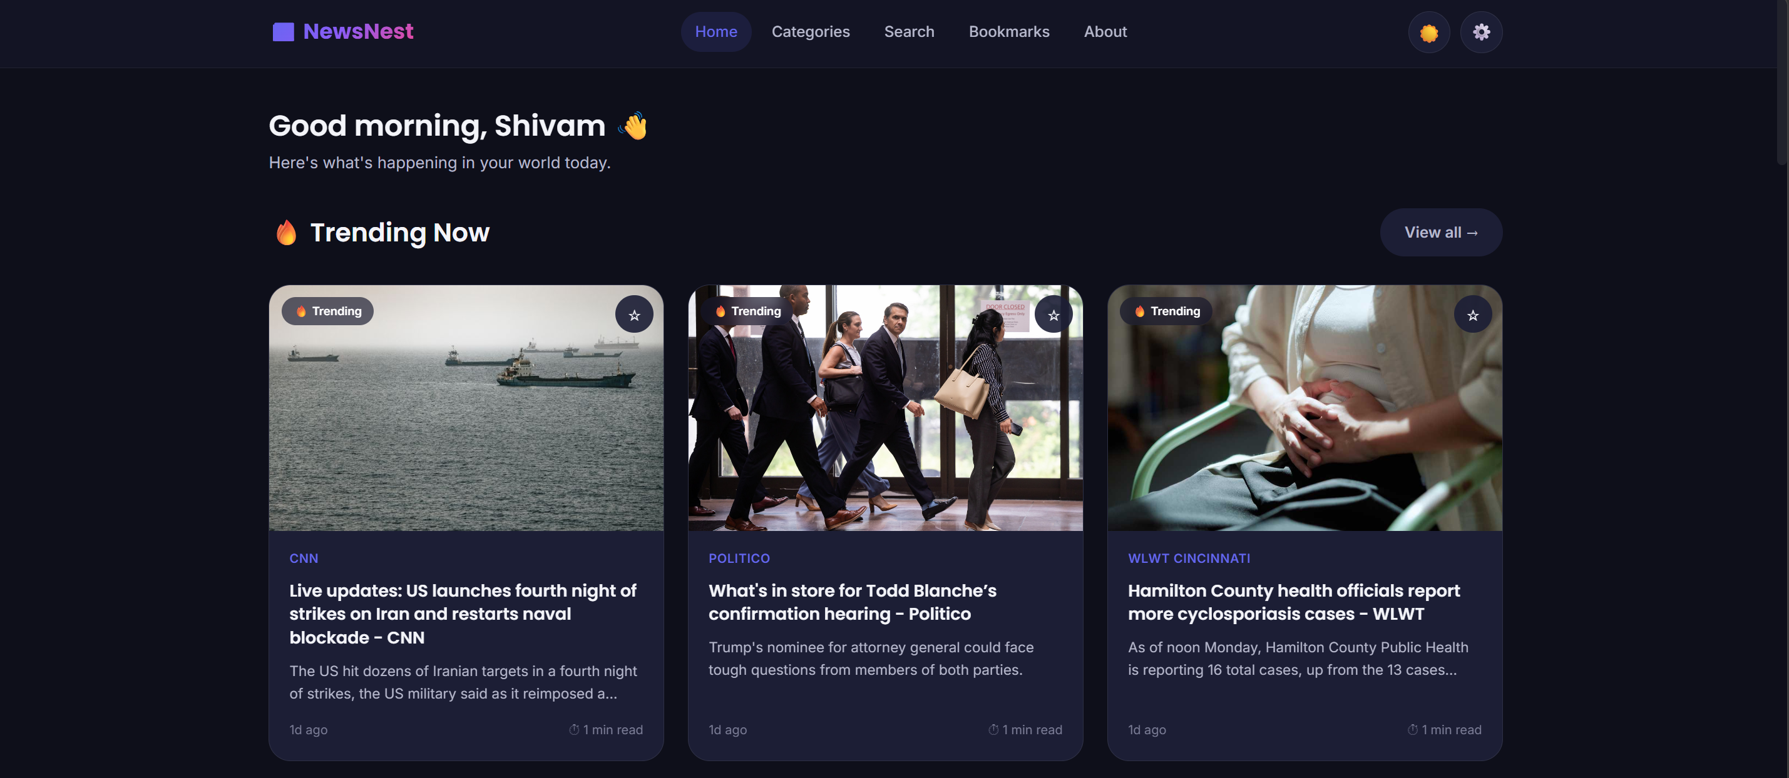
Frontend Features
A modern, responsive interface built without any framework
📱
Fully Responsive Design
🌓
Dark & Light Mode
Adapts cleanly across desktop, tablet, and mobile.
One-click theme toggle, saved per user.
🔍
Live Search
🔖
Bookmarks
Debounced search across all articles.
Save articles locally to read later.
📷 Insert Homepage / Onboarding Screenshot Here
🗂
Category Filters
Browse news by any of 22 interests.
NewsNest
11
🎬
Smooth Animations
🔔
Toast Notifications
Staggered fade-ins & hover transitions.
Instant feedback for bookmarks & errors.
Notes:
On the frontend, the focus was on making the experience feel premium despite using no framework at all. The layout is fully responsive across devices, supports dark and light themes, and includes live search with debounced input so it doesn't spam the backend on every keystroke. Users can bookmark articles and filter by category at any time. Visually, the app uses a glassmorphism design language with gradient hero sections, smooth staggered animations, and toast notifications for instant feedback. [This is a good point to switch to your browser and show the live homepage, onboarding flow, and dark/light toggle.]

Slide 12
Backend Features
What the API Gateway and services handle under the hood
🚪
API Gateway
🔗
REST APIs
⚡
In-Memory Caching
Single entry point for every frontend request.
Clean, versioned endpoints (/api/v1/...).
5-minute cache reduces redundant API calls.
🧭
Routing
🎚
Filtering
🛡
Error Handling
Forwards requests to the correct microservice.
By interest, category, and search keywords.
Centralized, consistent error responses.
⏱
Rate Limiting
🪖
Helmet Security
🔓
CORS & Validation
Protects services from request flooding.
Secure HTTP headers on every service.
Controlled origins and input validation.
NewsNest
12
Notes:
On the backend, the API Gateway is the workhorse. It exposes clean, versioned REST endpoints and routes each request to the right microservice. The News Service caches responses in memory for five minutes, cutting down repeated calls to the external News API. Requests are filtered by interest, category, or search term as needed. For robustness, every service uses centralized error handling, rate limiting to prevent abuse, Helmet for secure HTTP headers, and strict CORS and input validation — all standard production practices applied consistently across the stack.

Slide 13
How Personalization Works
From a simple interest selection to a tailored news feed
🖱
🔑
🗂
🎚
✨
→
→
→
→
Interest
Selection
Keyword
Mapping
Category
Mapping
News
Filtering
Personalized
Feed
During onboarding, a user's chosen interests (e.g. Technology, Cricket) are converted by the Category Service into specific search keywords, which the News Service then uses to filter live articles into a feed unique to that user.
NewsNest
13
Notes:
Personalization happens in five stages. It starts when the user selects interests during onboarding — say, Technology and Cricket. Those interest IDs are sent to the Category Service, which maps each one to a set of real-world search keywords — for Technology, that might include 'AI', 'cloud computing', or 'Microsoft'. Those keywords are combined into a single query, which the News Service uses to filter live articles from the News API. The end result is a feed that's genuinely tailored — not just labeled 'Technology', but built from the actual keywords that matter within that category.

Slide 14
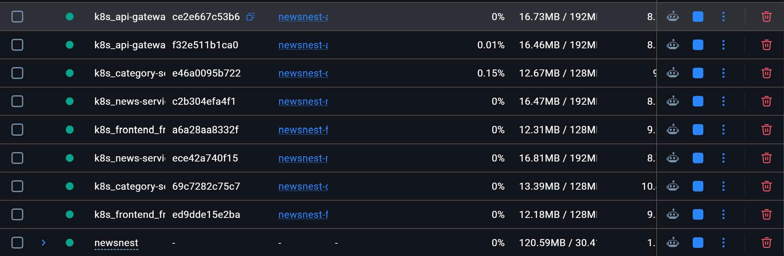
Docker Implementation
Every microservice runs in its own isolated container
🖥 Frontend
→
🐳
🚪 API Gateway
→
Docker
Network
📡 News Service
→
Isolated containers
communicate via
internal DNS names
(e.g. news-service:4001)
📷 Insert Docker Desktop / "docker ps" Terminal Screenshot Here
🗂 Category Service
→
Each service ships its own Dockerfile · Orchestrated together by a single docker-compose.yml
NewsNest
15
Notes:
Every one of the four microservices — Frontend, API Gateway, News Service, and Category Service — has its own Dockerfile using multi-stage, Node Alpine-based builds for small, secure images. Containers communicate with each other over an internal Docker network using service names as hostnames — for example, the Gateway simply calls 'http://news-service:4001' rather than a hardcoded IP. Everything is orchestrated together with a single docker-compose.yml file that defines networking, environment variables, and health checks, so the entire stack comes up with one command: docker compose up. [Switch to your terminal or Docker Desktop here to show the running containers and their health status.]

Slide 15
Kubernetes Deployment
Production-grade orchestration for scale and resilience
Pods (×2 each)
→
Services
→
Ingress Controller
→
👤 User
Frontend · Gateway
News · Category
Stable internal
ClusterIP endpoints
Single entry point
newsnest.local
External
traffic
📈
Auto-Scaling
💚
Self-Healing
Replica counts scale with load.
Crashed pods restart automatically.
🔐
Config & Secrets
🌐
Ingress Routing
ConfigMap + Secret keep keys out of code.
One host routes to all 4 services.
NewsNest
16
Notes:
For production-style deployment, NewsNest ships with full Kubernetes manifests: a Deployment and Service for each of the four microservices, plus a ConfigMap and Secret for environment configuration and the News API key, and a single Ingress resource tying it all together. Each service runs with two replica pods for basic high availability, sitting behind a stable ClusterIP Service. The Ingress Controller is the single public entry point, routing '/api' traffic to the Gateway and everything else to the Frontend, all under one hostname. Kubernetes also gives us self-healing — if a pod crashes, it's automatically restarted — and a clear path to horizontal auto-scaling as traffic grows. [This is the moment to show your live 'kubectl get pods' output or the Kubernetes dashboard with all pods running.]

Slide 16
GitHub Repository
Fully version-controlled and publicly accessible
🌳
Clean Folder Structure
📁 newsnest/
📁 frontend/
📁 api-gateway/
📁 news-service/
📁 category-service/
📁 kubernetes/
📄 docker-compose.yml
📄 README.md
📄 LICENSE
📄 .gitignore
One directory per microservice, fully documented.
📝
Version Control
Complete Git history from initial commit onward.
📘
Documentation
README covers setup, Docker & Kubernetes instructions.
🚀
Deployment Files Included
Dockerfiles, compose file & K8s manifests, ready to run.
🔗 Repository: https://github.com/ShivamPandey985/NewsNest.git
NewsNest
17
Notes:
The entire project is version-controlled and hosted publicly on GitHub at github.com/ShivamPandey985/NewsNest. The repository follows a clean structure — one top-level folder per microservice, plus a dedicated kubernetes folder for all deployment manifests. It includes a complete README with setup instructions for running locally, via Docker Compose, and via Kubernetes, along with environment variable documentation, a license file, and a proper .gitignore so secrets and node_modules never get committed. Anyone can clone this repository and have the full stack running within minutes. [Show the actual GitHub repository page here.]

Slide 17
Future Scope
Where NewsNest can go from here
🗄
Database Integration
🤖
AI Recommendation Engine
🔐
User Authentication
🌍
Multi-Language Support
🔔
Push Notifications
📴
Offline Mode
🎙
Voice Assistant
📊
Usage Analytics
🧠
ML-Based
Recommendations
📱
Native Mobile App
NewsNest
22
Notes:
Looking ahead, there's a clear roadmap for NewsNest to grow. The most natural next step is database integration, enabling true user accounts, authentication, and cross-device sync. From there, the system could layer in AI and machine-learning-based recommendations that learn from reading behavior, multi-language support for wider accessibility, push notifications for breaking news, and even an offline reading mode. Longer-term ideas include a voice assistant for hands-free browsing, an admin dashboard with usage analytics, and eventually a native mobile application — turning this from a project prototype into a genuinely production-scale product.

Slide 18
Conclusion
NewsNest successfully demonstrates how a personalized, interest-based news experience can be built using a clean microservices architecture — without relying on any database.
🧩
🐳
☸️
🌐
Microservices
Docker
Kubernetes
Modern Web Tech
Independent, maintainable, fault-isolated services
Consistent, portable containers for every service
Scalable, self-healing production deployment
Fast, responsive, framework-free frontend
Together, these choices result in a system that is scalable, maintainable, and genuinely ready for real-world, cloud-native deployment.
NewsNest
23
Notes:
To conclude — NewsNest set out to solve a genuine everyday problem: the fragmented, one-size-fits-all way most people consume news. It solves this with a single personalized platform built on four core technical pillars. Microservices keep the system modular and fault-isolated. Docker makes every service portable and consistent across environments. Kubernetes brings production-grade scalability and self-healing. And modern, framework-free web technologies keep the frontend fast and responsive. Together, these choices demonstrate not just a working prototype, but a system genuinely structured the way real-world, cloud-native applications are built today.

Slide 19
📰
Thank You
NewsNest — Personalized Interest-Based News Aggregator
👤
Shivam Kumar Pandey
✉️
shivamyahoo.nke@gmail.com
NewsNest
25
Notes:
Thank you for your time and attention. My contact details and the project's GitHub and Docker Hub links are on screen if you'd like to explore the code or pull the images yourself. I'm happy to answer any further questions.

