Slide 1


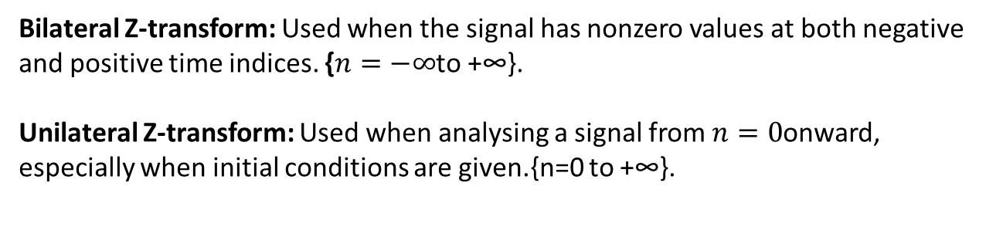
Z-TRANSFORM
→Z transform is a compact way to analyse discrete-time signals and systems.
Z-transform has two types:
unilateral(one-sided) and bilateral(two-sided). The unilateral Z-transform considers samples from zero to infinity and is mainly used for solving difference equations with initial conditions. The bilateral Z-transform considers samples from negative infinity to positive infinity and is used for general signal and system analysis, including the region of convergence.
What it does?
→Z-transform is a powerful mathematical tool used to convert the difference equations into algebraic equations. To solve the difference equations which are in time domain, they are converted first into algebraic equations in z-domain using Z-transform, the algebraic equations are manipulated in z-domain and the result obtained is converted back into time domain using inverse Z-transform.
x[n] → X(z)
Bilateral Z-transform: Used when the signal has nonzero values at both negative and positive time indices. {$n=−∞$to +∞}.
Unilateral Z-transform: Used when analysing a signal from $n=0$onward, especially when initial conditions are given.{n=0 to +∞}.
Time domain → z-domain

Slide 2
Equations, ROC & Advantages of Z-transform.
02
Bilateral Z-transform is the main general definition; unilateral form is useful with initial conditions.
Advantages of Z-transform:
→BILATERAL (TWO-SIDED)
• The Z-transform converts the difference equations of a discrete-time system into linear algebraic equations so that the analysis become easy and simple.
• convolution in time domain is converted into multiplication in z-domain.
x[n] * h[n] ↔ X(z)H(z)
•z-transform exists for most of the signals for which discrete-time Fourier transform (DTFT) does not exist.
X(z) = Σ x[n] z⁻ⁿ, n = −∞ To ∞
→UNILATERAL (ONE-SIDED)
X⁺(z) = Σ x[n] z⁻ⁿ, n = 0 To ∞
→ROC (Region of Convergence): values of z for which the defining infinite sum converges.
Limitation:
→Common causal sequence:
x[n] = aⁿu[n] ⇒ X(z) = 1/(1 − az⁻¹) = z/(z − a)
ROC: |z| > |a|
• Frequency domain response cannot be achieved and cannot be plotted.

Slide 3

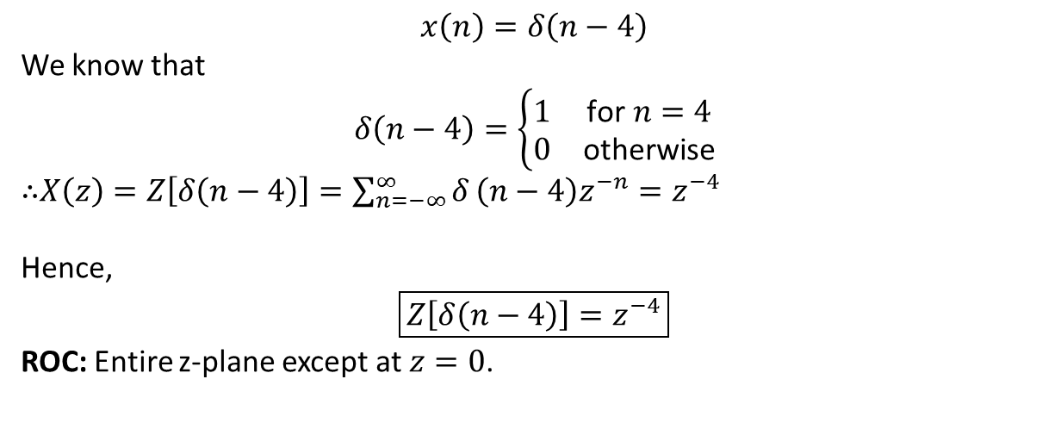
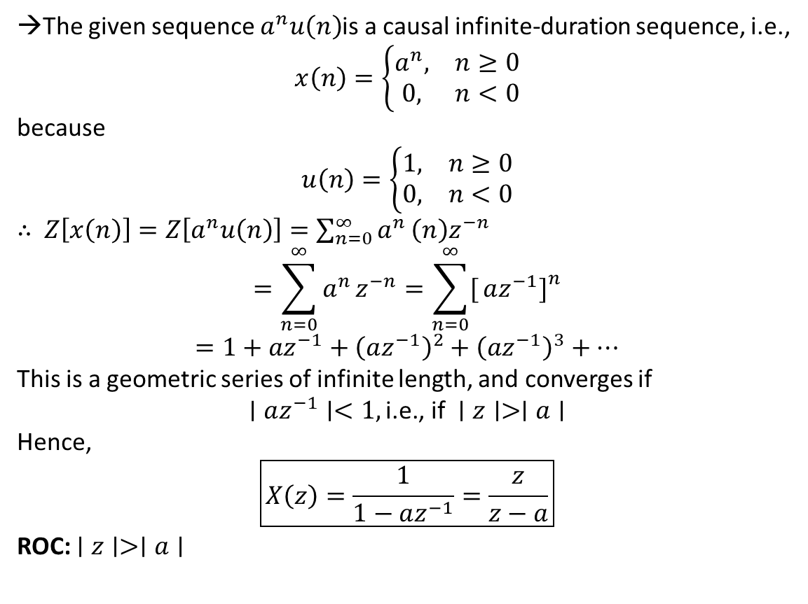
Q.Find Z-transform and ROC of
$$x\left(n\right)=a^{n}u\left(n\right)$$
03
Q.Find Z-transform d(n - 4).
→The given sequence $a^{n}u\left(n\right)$is a causal infinite-duration sequence, i.e.,
$$x\left(n\right)=\left\{\begin{matrix}a^{n}, & n≥0 \\ 0, & n<0\end{matrix}\right.$$
because
$$u\left(n\right)=\left\{\begin{matrix}1, & n≥0 \\ 0, & n<0\end{matrix}\right.$$
∴ $Z\left[x\left(n\right)\right]=Z\left[a^{n}u\left(n\right)\right]=\sum_{n=0}^{∞}{a^{n}}\left(n\right)z^{−n}$
$$=\sum_{n=0}^{∞}{a^{n}}z^{−n}=\sum_{n=0}^{∞}{[}\left.az^{−1}{\left.]\right.}^{n}\right.$$
$$=1+az^{−1}+{\left(az^{−1}\right)}^{2}+{\left(az^{−1}\right)}^{3}+⋯$$
This is a geometric series of infinite length, and converges if
$$∣az^{−1}∣<1, \text{i.e., if }∣z∣>∣a∣$$
Hence,
$$\boxed{X\left(z\right)=\frac{1}{1−az^{−1}}=\frac{z}{z−a}}$$
ROC: $∣z∣>∣a∣$
$$x\left(n\right)=δ\left(n−4\right)$$
We know that
$$δ\left(n−4\right)=\left\{\begin{matrix}1 & \text{for }n=4 \\ 0 & \text{otherwise}\end{matrix}\right.$$
∴$X\left(z\right)=Z\left[δ\left(n−4\right)\right]=\sum_{n=−∞}^{∞}{δ}\left(n−4\right)z^{−n}=z^{−4}$
Hence,
$$\boxed{Z\left[δ\left(n−4\right)\right]=z^{−4}}$$
ROC: Entire z-plane except at $z=0$.

Slide 4
04
Applications & real-world use
1. DIGITAL FILTERS
Analyse FIR/IIR filters, poles and zeros, and frequency response.
Example: Removing unwanted noise from audio or sensor signals.
2. CONTROL SYSTEMS
Analyse discrete controllers and system stability in digital control systems.
Example: Controlling motor speed in a robot.
3. DIFFERENCE EQUATIONS
Convert recursive input-output equations into algebraic equations that are easier to solve.
Example: Calculating the output of a discrete-time system.
4. SIGNAL PROCESSING
Represent and analyse sampled audio, vibration, biomedical, and communication signals.
Example: Processing digital audio signals.
5. SYSTEM DESIGN
Use poles, zeros, and the Region of Convergence (ROC) to analyse system stability and causality.
Example: Checking whether a system is stable and whether its Z-transform exists.

Slide 5
05
Questions
1.Find the X(z) of: x[n] = d(n+3),
2. Find the X(z) and ROC of: x(n) =-a^nu(-n -1)
Answer:Z^3

Slide 6
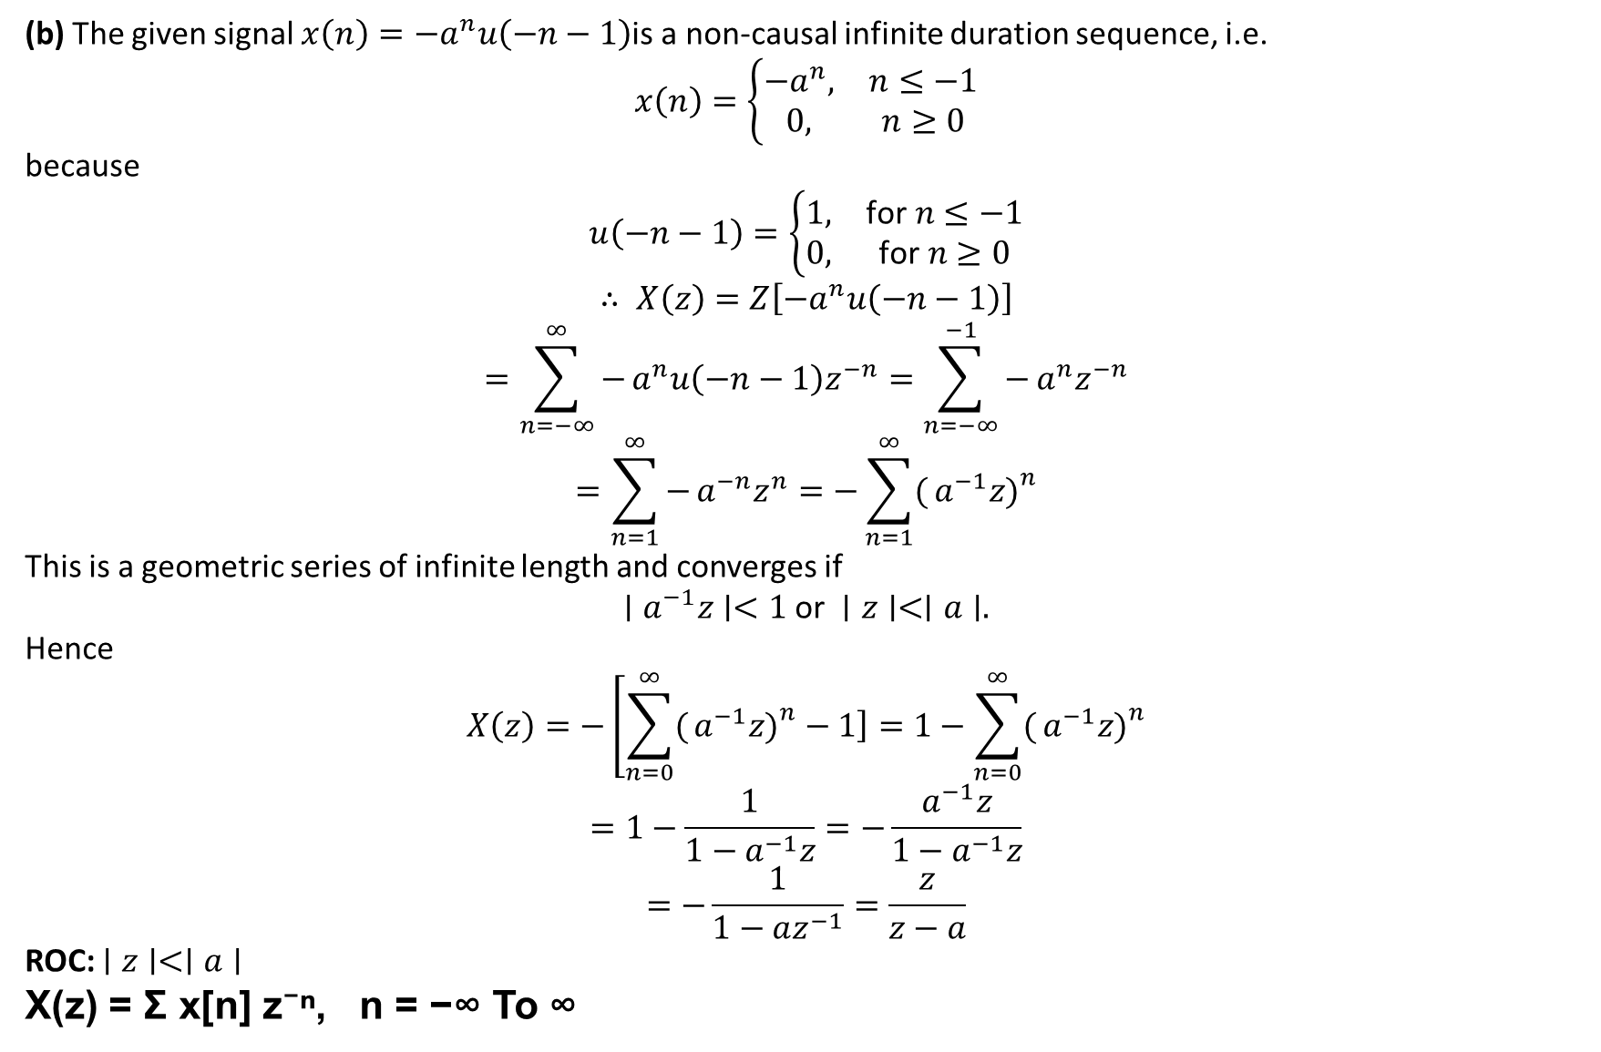
06
(b) The given signal $x\left(n\right)=−a^{n}u\left(−n−1\right)$is a non-causal infinite duration sequence, i.e.
$$x\left(n\right)=\left\{\begin{matrix}−a^{n}, & n≤−1 \\ 0, & n≥0\end{matrix}\right.$$
because
$$u\left(−n−1\right)=\left\{\begin{matrix}1, & \text{for }n≤−1 \\ 0, & \text{for }n≥0\end{matrix}\right.$$
$$∴ X\left(z\right)=Z\left[−a^{n}u\left(−n−1\right)\right]$$
$$=\sum_{n=−∞}^{∞}{−}a^{n}u\left(−n−1\right)z^{−n}=\sum_{n=−∞}^{−1}{−}a^{n}z^{−n}$$
$$=\sum_{n=1}^{∞}{−}a^{−n}z^{n}=−\sum_{n=1}^{∞}{(}\left.a^{−1}z{\left.)\right.}^{n}\right.$$
This is a geometric series of infinite length and converges if
$$∣a^{−1}z∣<1 \text{or} ∣z∣<∣a∣.$$
Hence
$$X\left(z\right)=−\left[\sum_{n=0}^{∞}{(}\left.a^{−1}z{\left.)\right.}^{n}−1\right]\right.=1−\sum_{n=0}^{∞}{(}\left.a^{−1}z{\left.)\right.}^{n}\right.$$
$$=1−\frac{1}{1−a^{−1}z}=−\frac{a^{−1}z}{1−a^{−1}z}$$
$$=−\frac{1}{1−az^{−1}}=\frac{z}{z−a}$$
ROC: $∣z∣<∣a∣$
X(z) = Σ x[n] z⁻ⁿ, n = −∞ To ∞
Solution of Q.2:

