Slide 1


SkillConnect
Web Platform for Freelance Services and Skill Matching
Mentor Name: Durga Prasad Coordinator Name: Belovedinla
Introduction
Problem Statement
A platform for freelancers and recruiters to connect seamlessly
Freelancers can create detailed profiles including education, experience, skills, and tech stack
Recruiters can post jobs with title, pay/hour, required skills, and experience level
System ensures efficient communication through automated email notifications

Slide 2


SkillConnect
A Freelance Marketplace
Introduction
A platform for freelancers and recruiters to connect seamlessly
Freelancers can create detailed profiles including education, experience, skills, and tech stack
Recruiters can post jobs with title, pay/hour, required skills, and experience level
System ensures efficient communication through automated email notifications
Problem Statement
Recruiters face difficulty finding qualified freelancers quickly
Freelancers struggle to showcase their skills effectively
Existing platforms can be complex, expensive, or limited in functionality
Goal: Build a simple, user-friendly, and efficient platform for hiring

Slide 3
Introduction
A platform for freelancers and recruiters to connect seamlessly
Freelancers can create detailed profiles including education, experience, skills, and tech stack
Recruiters can post jobs with title, pay/hour, required skills, and experience level
System ensures efficient communication through automated email notifications
Problem Statement
Recruiters face difficulty finding qualified freelancers quickly
Freelancers struggle to showcase their skills effectively
Existing platforms can be complex, expensive, or limited in functionality
Goal: Build a simple, user-friendly, and efficient platform for hiring
Objectives
Implement secure authentication for recruiters & freelancers
Allow freelancers to create and manage detailed profiles
Enable recruiters to post jobs and track applications
Provide a dashboard for recruiters to review applications and make decisions
Automate email notifications for job updates

Slide 4

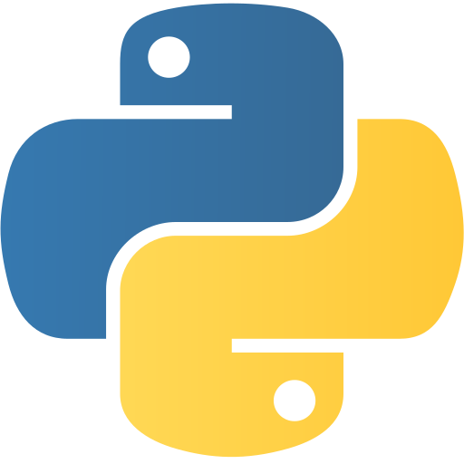




Problem Statement
Recruiters face difficulty finding qualified freelancers quickly
Freelancers struggle to showcase their skills effectively
Existing platforms can be complex, expensive, or limited in functionality
Goal: Build a simple, user-friendly, and efficient platform for hiring
Objectives
Implement secure authentication for recruiters & freelancers
Allow freelancers to create and manage detailed profiles
Enable recruiters to post jobs and track applications
Provide a dashboard for recruiters to review applications and make decisions
Automate email notifications for job updates
System Architecture
Frontend: Django Templates with Bootstrap for responsive UI
Backend: Django Framework with Python
Database: SQLite to store user and job data
Authentication: Django built-in system, extended for recruiters & freelancers
Notifications: SMTP email integration for updates
Flow: User → Django Application → Database / Email System

Slide 5
Objectives
Implement secure authentication for recruiters & freelancers
Allow freelancers to create and manage detailed profiles
Enable recruiters to post jobs and track applications
Provide a dashboard for recruiters to review applications and make decisions
Automate email notifications for job updates
System Architecture
Frontend: HTML5, CSS3, JavaScript (Vanilla) + Tailwind CSS
Backend: Django + Django REST Framework
Database: PostgreSQL
Auth: JWT (SimpleJWT) with recruiter & freelancer roles
Notifications: SMTP email + real-time in-app
Dashboards: Chart.js for analytics Flow: User → Frontend → Django API → DB / Email / Notifications
Modules Implemented
1. Authentication & Profile Setup
User registration & login
Freelancer profile: education, experience, tech stack, skills
2. Job Posting & Application System
Recruiters post jobs with pay, title, and requirements
Freelancers browse and apply (“I’m Interested”)
Application tracking system
3. Recruiter Dashboard & Notifications
View submitted applications
Accept/reject candidates
Automated email notifications for job status
4. Testing & Documentation
Unit testing of forms, models, and views
Bug fixes, security checks
Detailed user guide and technical documentation

Slide 6



System Architecture
Frontend: Django Templates with Bootstrap for responsive UI
Backend: Django Framework with Python
Database: SQLite to store user and job data
Authentication: Django built-in system, extended for recruiters & freelancers
Notifications: SMTP email integration for updates
Flow: User → Django Application → Database / Email System
Modules Implemented
Auth & Profiles: Signup/login, freelancer details (edu, experience, skills).
Jobs & Applications: Post jobs, apply, track applications.
Dashboard & Notifications: Manage candidates, accept/reject, email updates.
Testing & Docs: Unit tests, bug/security fixes, user & tech docs.
Conclusion & Demo
SkillConnect demonstrates a complete, end-to-end solution for freelance hiring
Supports job posting, application tracking, recruiter dashboard, and notifications
Provides a scalable foundation for future enhancements
Demo: Show screenshots of login, freelancer profile, job posting, recruiter dashboard, and notification system
Thank You – Questions?

Slide 7
Modules Implemented
1. Authentication & Profile Setup
User registration & login
Freelancer profile: education, experience, tech stack, skills
2. Job Posting & Application System
Recruiters post jobs with pay, title, and requirements
Freelancers browse and apply (“I’m Interested”)
Application tracking system
3. Recruiter Dashboard & Notifications
View submitted applications
Accept/reject candidates
Automated email notifications for job status
4. Testing & Documentation
Unit testing of forms, models, and views
Bug fixes, security checks
Detailed user guide and technical documentation
Conclusion
SkillConnect demonstrates a complete, end-to-end solution for freelance hiring
Supports job posting, application tracking, recruiter dashboard, and notifications
Provides a scalable foundation for future enhancements
Thank You

Slide 8
Conclusion & Demo
SkillConnect demonstrates a complete, end-to-end solution for freelance hiring
Supports job posting, application tracking, recruiter dashboard, and notifications
Provides a scalable foundation for future enhancements
Demo: Show screenshots of login, freelancer profile, job posting, recruiter dashboard, and notification system
Thank You – Questions?
Thank You

