Slide 1
Verity
Knowledge Editing and Verification Platform
Versioned memory, bounded retrieval and a learned reasoner
Technical project presentation
Notes:
Member 1
Good morning. Verity is a knowledge editing and verification platform for conversational AI. We study how an approved factual correction changes the assistant's answers across connected records, while preserving unrelated information. Our final implementation combines a frozen learned reasoner with versioned external memory. The project includes a transactional editing workflow, a working website and reproducible model comparisons. We evaluate factual answers separately from database correctness and retain the failures in our evidence.
Evidence
https://github.com/ShivamRaghav7/verity/tree/ae7bb2010a82fd1d744d008eb7c6f870198aece5/docs/CURRENT_ARCHITECTURE.md

Slide 2
The edit contract and three hop dependence
One approved ownership replacement changes a connected answer path
Relation | Initial answer path | Corrected answer path
Gateway owner | Bengaluru Platform Team | Pune Reliability Team
Owner contact | Meera Iyer | Arjun Deshmukh
Contact office | Chennai | Hyderabad
Locality controls
Hosting remains Bengaluru. Pro and release 1 retain separate owners.
Fictional Kaveri Payment Gateway, release 2. Only the ownership record changes.
2
Notes:
Member 1
An edit has a subject, relation and scope. In our fictional example, the subject is Kaveri Payment Gateway, the relation is owner, and the scope is release 2. Initially, its owner is Bengaluru Platform Team. That team's contact is Meera Iyer, whose office is in Chennai. We replace only the ownership fact with Pune Reliability Team. Its contact is Arjun Deshmukh, whose office is in Hyderabad. The office answer should therefore change through three relations. Hosting city, the Pro service and release 1 should remain unchanged. We call those unaffected questions locality controls. Rollback should restore the original reasoning path without deleting the history.
Evidence
https://github.com/ShivamRaghav7/verity/tree/ae7bb2010a82fd1d744d008eb7c6f870198aece5/docs/INDIA_DEMO.md
https://github.com/ShivamRaghav7/verity/tree/ae7bb2010a82fd1d744d008eb7c6f870198aece5/reports/reasonke/depth-final/india-acceptance.json

Slide 3
Inference architecture and evidence boundary
Browser and Python API
Validate the request and serialize memory and generation operations.
Revision aware SQLite
Read approved facts and current revision conversation pairs.
Bounded context selector
Choose up to four fact records without target answers or gold IDs.
Private neural worker
Frozen ReasonKE checkpoint generates the final answer and raw trace.
Persisted answer evidence
Store source IDs, memory revision, model revision, tokens and latency.
A source establishes supplied context. It does not certify every generated sentence.
3
Notes:
Member 2
The browser sends a question to the Python application API. The API reads the active approved facts from SQLite at a specific knowledge revision. A revision identifies a memory state, while the model checkpoint identifies fixed neural weights. The context selector chooses supporting facts and the controller adds permitted conversation history. Only complete conversation pairs from the applicable revision enter a new prompt. A separate private GPU worker generates the answer. The application stores its raw output, extracted answer, supplied fact identifiers, sources and model revision. This provenance makes the request inspectable. Retrieving a source does not certify every sentence the model generates.
Evidence
https://github.com/ShivamRaghav7/verity/tree/ae7bb2010a82fd1d744d008eb7c6f870198aece5/docs/CURRENT_ARCHITECTURE.md
https://github.com/ShivamRaghav7/verity/tree/ae7bb2010a82fd1d744d008eb7c6f870198aece5/editguard_chat/reasonke_backend.py

Slide 4
Frozen checkpoints and inference configuration
ReasonKE_plus and Qwen2.5 7B Instruct each contain 7,615,616,512 parameters
Setting | Fixed configuration
Weights | Pinned safetensors, frozen during editing
Precision | NF4 double quantization, FP16 compute, SDPA
Generation | Greedy decoding, one beam, no sampling
Token limits | 4,096 input tokens and at most 512 new tokens
Hardware | T4, one loaded model at a time
Measured load peak allocated CUDA: 6.59 GiB. Upstream authors trained both checkpoints.
4
Notes:
Member 2
We integrate the author published ReasonKE_plus checkpoint and compare it with Qwen2.5 7B Instruct. Both contain approximately 7.615 billion parameters. Their authors trained them upstream. We pin exact revisions and keep their weights frozen. NF4 double quantization compresses weight storage, while FP16 supplies the computation precision. SDPA is PyTorch's attention implementation. On the T4, the measured peak allocated CUDA memory during loading was about 6.59 gibibytes. We load one model at a time. The prompt allows at most 4,096 tokens, and generation allows 512 new tokens, using greedy decoding with one beam. These limits and the measured profile define our actual configuration.
Evidence
https://github.com/ShivamRaghav7/verity/tree/ae7bb2010a82fd1d744d008eb7c6f870198aece5/docs/REASONKE_MODEL_CARD.md
https://github.com/ShivamRaghav7/verity/tree/ae7bb2010a82fd1d744d008eb7c6f870198aece5/editguard_reasonke/runtime.py
https://huggingface.co/YukinoKaren/ReasonKE_plus
https://huggingface.co/Qwen/Qwen2.5-7B-Instruct

Slide 5
Lexical retrieval with bounded answer expansion
BM25 style ranking over question, scope and answer text. Stable fact ID tie breaks.
Original two stage selector
Iterative depth selector
Rank the question and keep two seeds.
Append their answers to the question.
Rerank and fill a four fact context.
Rank the question and keep two seeds.
Use selected answers as a frontier.
Add the top unseen fact per round.
Stop at four facts or three rounds.
Development complete paths
96/128 original versus 128/128 iterative
Three hop paths: 0/32 versus 32/32
5
Notes:
Member 2
The original selector ranks facts against the question, takes two seeds, adds their answer text to the query, and reranks to fill four context slots. On the new development packet, it supplied complete support for 96 of 128 questions, but zero of 32 three hop questions. We therefore evaluated a finite family of iterative selectors before freezing the final test. The selected policy keeps two question ranked seeds and expands through answer text for up to three rounds, with a four fact cap. It supplied complete support for all 128 development questions, including all 32 three hop paths. Those are retrieval diagnostics, not neural answer accuracy. Ordinary retrieval never receives expected answers or gold support identifiers. It also supplies no calibrated applicability probability.
Evidence
https://github.com/ShivamRaghav7/verity/tree/ae7bb2010a82fd1d744d008eb7c6f870198aece5/editguard_benchmark/retrieval.py
https://github.com/ShivamRaghav7/verity/tree/ae7bb2010a82fd1d744d008eb7c6f870198aece5/editguard_depth/retrieval.py
https://github.com/ShivamRaghav7/verity/tree/ae7bb2010a82fd1d744d008eb7c6f870198aece5/docs/DEPTH_RUN_PLAN.md

Slide 6
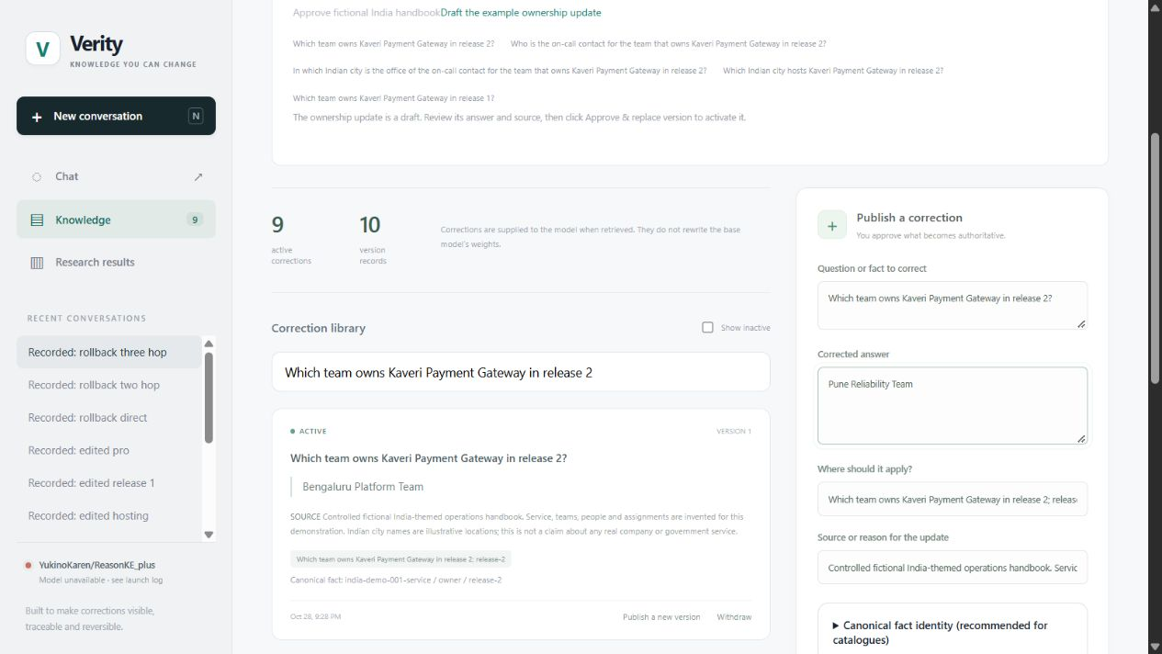
Transactional editing and rollback
Canonical fact key: entity_id, relation_id and scope_id
State invariants
One active version per key.
Named predecessor.
HTTP 409 for conflicts.
Lineage and provenance.
Atomic rollback
BEGIN IMMEDIATE
withdraw(new)
restore(previous)
write_events(revision)
COMMIT
Current Verity interface with a replacement draft. Approval remains explicit.
Rollback writes two audit events at one revision. Historical reads leave live memory unchanged.
6
Notes:
Member 3
Each fact uses the canonical key entity identifier, relation identifier and scope identifier. A partial unique database index permits at most one active version for that key. To replace a fact, the request must name the current predecessor through supersedes. An unresolved competing approval receives HTTP 409 and leaves memory unchanged. Rollback uses a BEGIN IMMEDIATE transaction: withdraw the replacement, restore its direct predecessor, and write two audit events at one new revision. The whole change commits or rolls back together. Historical reads replay events without changing live memory. These rules protect represented identities. Two contradictory statements under unrelated keys can still require administrator judgement.
Evidence
https://github.com/ShivamRaghav7/verity/tree/ae7bb2010a82fd1d744d008eb7c6f870198aece5/editguard_chat/store.py
https://github.com/ShivamRaghav7/verity/tree/ae7bb2010a82fd1d744d008eb7c6f870198aece5/docs/CHAT_API.md
Screenshots: actual local Verity website, captured 2026-10-30. The screenshot workspace restores saved India acceptance responses, not new inference. The worker status remains unavailable.
https://github.com/ShivamRaghav7/verity/blob/codex/reasonke-integration/output/presentation/screenshots/provenance.json

Slide 7
Dataset construction and leakage controls
An independently authored controlled demonstration dataset for each study
Quantity | Original operations | Separate depth
Authored lineages / questions | 48 / 384 | 48 / 384
Development / final lineages | 16 / 32 | 16 / 32
Main final questions / condition | 256 | 256
Facts per world | 9 | 12
Maximum evaluated path depth | 2 hops | 3 hops
Split lineages before augmentation. Automated labels. Templates repeat within splits.
7
Notes:
Member 3
We authored two separate fictional datasets. Each contains 48 graph lineages and 384 question records. A lineage groups one fact world and its related correction variants. Sixteen lineages support development and 32 support final evaluation. We split lineages before question augmentation, so related variants stay together. Eight variants per final lineage produce 256 main questions per condition. The original study uses nine facts per world. The depth study uses twelve and adds three hop questions with separate development and final wording banks. A deterministic graph audit checks labels and supporting paths. There is no independent human semantic review, and templates still repeat within each split.
Evidence
https://github.com/ShivamRaghav7/verity/tree/ae7bb2010a82fd1d744d008eb7c6f870198aece5/docs/OPERATIONS_DATASET_CARD.md
https://github.com/ShivamRaghav7/verity/tree/ae7bb2010a82fd1d744d008eb7c6f870198aece5/docs/DEPTH_DATASET_CARD.md

Slide 8
Frozen experiment and scoring protocol
Original operations
Separate depth
5 main conditions x 256 questions
2 oracle diagnostics x 16 questions
1,312 assigned generations
2 models x (256 main + 16 oracle)
544 assigned generations
Shared selected fact IDs per question
Primary accuracy = correct / all assigned
Score the endorsed subject, relation and short answer. UNKNOWN receives zero credit.
Separate retrieval completeness, gold support diagnostics and generation quality.
Updated baselines receive the same approved facts. Settings and scoring freeze before final inference.
8
Notes:
Member 4
The original study evaluates five main conditions on 256 questions, plus sixteen preselected oracle questions for each model. That gives 1,312 generations. The separate depth study evaluates two models on 256 main questions plus sixteen oracle questions each, giving 544. Oracle means we supply known supporting facts as a diagnostic. Updated baselines receive the same approved information, with compatible generation settings and budgets. The stale initial condition is only a diagnostic reference. We score the endorsed short answer for the requested subject and relation. Merely mentioning a target value is insufficient. UNKNOWN abstentions receive zero primary credit and remain in the denominator. Configuration and scoring freeze before final inference.
Evidence
https://github.com/ShivamRaghav7/verity/tree/ae7bb2010a82fd1d744d008eb7c6f870198aece5/reports/reasonke/operations-final/protocol.json
https://github.com/ShivamRaghav7/verity/tree/ae7bb2010a82fd1d744d008eb7c6f870198aece5/reports/reasonke/depth-final/protocol.json
https://github.com/ShivamRaghav7/verity/tree/ae7bb2010a82fd1d744d008eb7c6f870198aece5/editguard_benchmark/scoring.py

Slide 9
Original study and the full memory failure
256 assigned questions per updated condition. Count every strict mismatch and abstention.
Retrieved Qwen
15 UNKNOWN
0 wrong answers
Full memory ReasonKE
25 strict wrong answers
ReasonKE retrieval: 124/124 baseline correct controls retained, 128/128 total controls correct.
9
Notes:
Member 4
With updated retrieved facts, ReasonKE scored 256 out of 256 and Qwen scored 241, with fifteen UNKNOWN abstentions. With full updated memory, ReasonKE scored 231 while Qwen scored 241. ReasonKE therefore did not win every comparison. All 25 ReasonKE full memory failures had the required support available and endorsed an answer from another supplied fact. That identifies an output association error without proving its internal cause. We also separate two locality measures. ReasonKE retrieval retained all 124 baseline correct controls, and it answered all 128 locality questions correctly. Retention measures preservation of previously correct answers. Factual accuracy also includes controls the initial assistant answered incorrectly.
Evidence
https://github.com/ShivamRaghav7/verity/tree/ae7bb2010a82fd1d744d008eb7c6f870198aece5/reports/reasonke/operations-final/results.json
https://github.com/ShivamRaghav7/verity/tree/ae7bb2010a82fd1d744d008eb7c6f870198aece5/reports/reasonke/operations-final/FAILURE_ANALYSIS.md

Slide 10
Depth results, uncertainty and latency
64 assigned questions per group and model in the separate depth study
Main answers
256/256 vs 248/256
Warm p50 / p95
ReasonKE 15.94 / 19.28 s
Qwen 1.12 / 1.38 s
Eight Qwen abstentions
Main gain +3.125 pp, paired lineage 95% interval +1.56 to +5.08. Three hop interval includes zero.
10
Notes:
Member 4
In the depth main test, ReasonKE scored 256 out of 256. Qwen scored 248 with eight abstentions. Each locality and depth group contains 64 questions. Qwen scored 64, 64, 57 and 63 across locality, one, two and three hops. ReasonKE scored 64 in every group. The overall difference is 3.125 percentage points. We estimate uncertainty by resampling whole lineages, keeping correlated variants together. The 95 percent interval is about 1.56 to 5.08 points. The three hop interval includes zero, so that comparison remains uncertain. Warm median and 95th percentile latency were 15.94 and 19.28 seconds for ReasonKE, versus 1.12 and 1.38 for Qwen. Higher observed answer coverage has a substantial speed cost.
Evidence
https://github.com/ShivamRaghav7/verity/tree/ae7bb2010a82fd1d744d008eb7c6f870198aece5/reports/reasonke/depth-final/results.json
https://github.com/ShivamRaghav7/verity/tree/ae7bb2010a82fd1d744d008eb7c6f870198aece5/reports/reasonke/depth-final/FAILURE_ANALYSIS.md

Slide 11
Failure analysis and the meaning of 100%
Observed failure pattern
Seven Qwen two hop abstentions share one direct wording template.
Required supporting facts were present in all eight depth abstentions.
Perfect scores have a bounded population
32 held out lineages per study, with eight correlated question variants.
Small fact worlds and repeated templates with complete retrieved support.
Automated labels and no independent human semantic review.
Exact final answers do not prove explanation faithfulness or unrestricted conversation accuracy.
11
Notes:
Member 5
A perfect observed score is plausible here because each world has few explicit facts, retrieval supplied every required supporting path, answers are short, and task templates repeat. It does not establish universal natural language accuracy. The depth Qwen failures also show why depth alone is insufficient: seven of nine instances of one direct two hop wording template produced UNKNOWN, while the other direct templates scored 23 out of 23. All eight main failures had complete support. The preselected oracle set contains none of those failure identifiers, so it does not demonstrate their recovery. Separately, the explanation audit found unsupported intermediate claims. A correct final answer does not verify the whole reasoning trace.
Evidence
https://github.com/ShivamRaghav7/verity/tree/ae7bb2010a82fd1d744d008eb7c6f870198aece5/reports/reasonke/depth-final/FAILURE_ANALYSIS.md
https://github.com/ShivamRaghav7/verity/tree/ae7bb2010a82fd1d744d008eb7c6f870198aece5/docs/EXPLANATION_AUDIT.md

Slide 12
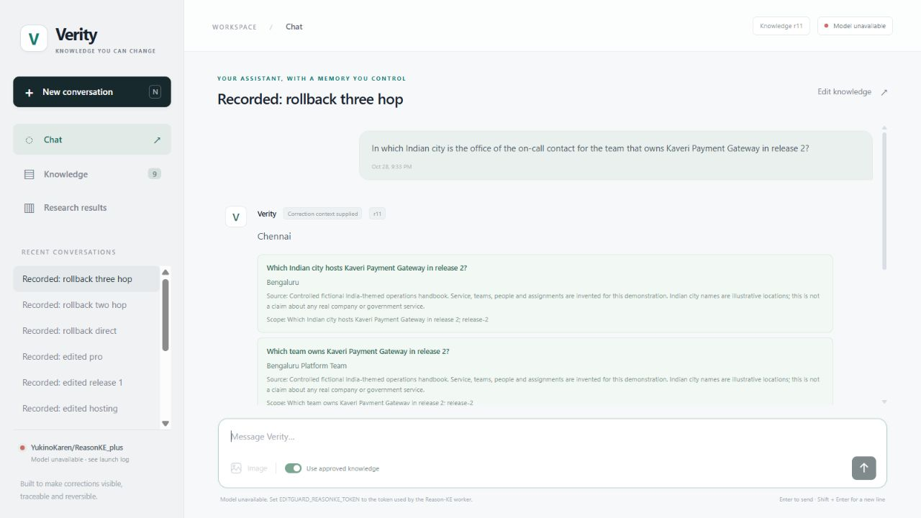
Application acceptance and project contribution
Measured workflow
r9 Initial memory
r10 Ownership edit
r11 Atomic rollback
14/14 neural answers
12 consistency checks
Our contribution
Governed memory, retrieval,
independent data and
reproducible evaluation.
Recorded model response in the current UI, not fresh inference. One fictional display lineage.
Separate from held-out accuracy. Upstream authors trained the model.
12
Notes:
Member 5
The completed website supports chat, explicit approval, conflict resolution, historical comparison and rollback. The screenshot displays a saved three hop answer after rollback, rather than a fresh generation. The finite India application workload produced fourteen correct neural answers and passed twelve provenance and transaction consistency checks. It represents one fictional display lineage and remains separate from held out accuracy. Our contribution is the governed application, versioned memory, retrieval adaptation, independent datasets and reproducible evaluation. The upstream authors supply the learned checkpoint and training. The evidence supports this system's defined short factual contract under the tested conditions. Larger memories, ambiguous scopes, missing evidence and independently reviewed operational language need further validation. We can now demonstrate a correction and its reversal. Thank you.
Evidence
https://github.com/ShivamRaghav7/verity/tree/ae7bb2010a82fd1d744d008eb7c6f870198aece5/reports/reasonke/depth-final/india-acceptance.json
https://github.com/ShivamRaghav7/verity/tree/ae7bb2010a82fd1d744d008eb7c6f870198aece5/docs/CONTRIBUTIONS_AND_EVIDENCE.md
Screenshots: actual local Verity website, captured 2026-10-30. The screenshot workspace restores saved India acceptance responses, not new inference. The worker status remains unavailable.
https://github.com/ShivamRaghav7/verity/blob/codex/reasonke-integration/output/presentation/screenshots/provenance.json

