Slide 1
Verity
Governed knowledge updates
for connected factual questions
System mechanisms · Controlled experiments · Failure analysis
Technical mid-project review | 31 October 2026
Notes:
Member 1; 00:00–00:20 (20s).
Verity studies how an assistant can use approved factual updates across connected questions while keeping its knowledge state inspectable and reversible. We will explain the implementation, the experiments and six findings, then define the next training milestone.
Mechanism and interpretation
Current system: governed external memory, bounded deterministic retrieval and alternative frozen generators. Corrections alter approved memory; they do not update the deployed weights. The reused ReasonKE_plus checkpoint is an upstream model, while our contribution is the maintenance, retrieval, application and evaluation system. Technical depth comes from implemented mechanisms and evidence, not a claim of a new trained checkpoint.
Why this matters
A maintenance system must coordinate authority, retrieval, generation and history. Measuring only a direct edited answer would miss connected failures and state inconsistencies.
Likely questions
What is the task?
Short factual and connected questions over approved records, with locality and version boundaries.
Is this RAG?
Yes. The current answering mechanism is retrieval augmented generation; our SFT/PPO adaptation is a separate future milestone.
Evidence
https://github.com/ShivamRaghav7/verity/blob/codex/reasonke-integration/docs/CURRENT_ARCHITECTURE.md
https://github.com/ShivamRaghav7/verity/blob/codex/reasonke-integration/docs/CONTRIBUTIONS_AND_EVIDENCE.md

Slide 2

A factual change can affect a chain
A familiar historical update. A bounded technical objective.
20 DEC 2021 → 27 JAN 2022
Government of India → Talace
Owner → parent company
Correct relevant answers. Preserve other scopes.
Approve, trace and reverse the local update.
Handover snapshot; not current ownership.
Government and Tata primary sources motivate the task. Experimental results use separate controlled fictional worlds.
Verity
02
Notes:
Member 1; 00:20–01:05 (45s).
Air India gives a familiar motivation. The completed handover on twenty-seven January 2022 transferred its shares to Talace, a Tata Sons subsidiary. An older government-ownership record and that handover record answer different dated questions. Connected questions must follow the applicable owner to its parent, while unrelated facts stay intact. Our bounded objective is consistent reference updating: explicit approval, correct direct and connected answers, locality preservation and atomic rollback. The example motivates the problem; our controlled experiments measure the system.
Mechanism and interpretation
Government/CCI reporting on 20 December 2021 describes government ownership. The Ministry of Finance/PIB release of 27 January 2022 documents completion and Talace’s Tata Sons parent. This is a historical handover snapshot, not present-day shareholding; subsequent arrangements changed. The previously recorded sourced demo also links the parent to its official contact city, checked separately on 31 October 2026. The current introduction does not use a current contact page to infer a historical address. The official photograph is from the PIB handover release. Application acceptance and neural accuracy are separate criteria: transaction tests establish state consistency, while assigned-question evaluation establishes observed answer quality.
Why this matters
One dated change makes scope and connectedness understandable before introducing the general architecture. It is an introduction, not the experimental dataset or an unseen-entity claim.
Likely questions
Was the government answer false?
It was correct for the earlier snapshot. Historical scope must remain distinct.
What does rollback mean?
Restoring an earlier local approved-memory state, not reversing real history.
Why an assistant rather than a page?
The use case is an existing assistant answering questions spanning changing records; a page remains appropriate for simple publication.
Evidence
https://www.pib.gov.in/pressreleasepage.aspx?lang=2&prid=1783550&reg=48
https://www.pib.gov.in/Pressreleaseshare.aspx?PRID=1792950&lang=2&reg=48
https://www.tata.com/newsroom/business/air-india-handover
https://github.com/ShivamRaghav7/verity/blob/codex/reasonke-integration/data/demos/air-india-handover.json

Slide 3
Revision-consistent request architecture
State consistency, retrieval and neural generation have separate responsibilities.
Question
API
Capture revision r
Retrieve
Approved memory
GPU worker
Generate
Answer + evidence
Compatible history only
Persist raw output, fact IDs,
checkpoint and memory revision
Operator approval
SQLite
Versions, events, messages
Frozen ReasonKE_plus / Qwen2.5-7B. NF4 + FP16, greedy, 4,096 input / 512 new-token ceilings, T4.
Verity
03
Notes:
Member 1; 01:05–02:00 (55s).
The API captures a memory revision under an application operation lock. It retrieves active approved records and keeps only compatible conversation pairs. A private GPU worker generates the answer. The application stores raw output, extracted answer, supplied fact identifiers, model identity and revision together. This separates deterministic state management and retrieval from neural generation. We compare two frozen seven-billion-class checkpoints with pinned identities, four-bit weights, FP16 computation and matched input and output ceilings. Source evidence records the model inputs; it does not automatically certify generated prose.
Mechanism and interpretation
The browser, loopback application API, SQLite store and authenticated GPU worker are separate components. The operation lock spans generation, preventing a concurrent approval/export from capturing a half-completed application operation; short SQLite transactions persist state and message pairs. Current-revision compatible complete history pairs are retained; old correction-conditioned context is excluded. Historical comparisons use matched pre-question history and exclude correction-conditioned pairs from both sides. Worker failure is reported explicitly rather than replaced with a template counted as neural success. ReasonKE_plus and Qwen2.5-7B-Instruct each contain 7,615,616,512 parameters. Both use NF4 double quantisation, FP16 compute, SDPA, greedy decoding, 4,096 input tokens and up to 512 new tokens on T4, one model at a time.
Why this matters
Capturing revision and evidence lets us diagnose whether a bad answer used wrong state, missing support or complete support but wrong generation. The process boundary keeps the lightweight application independent of GPU loading.
Likely questions
What is deterministic?
Validation, state transitions, lexical selection, history filtering and persistence. The frozen transformer generates tokens.
Do two models cooperate?
They are alternative comparison generators, not jointly trained components.
Does a source prove the answer?
It proves what was supplied, not which relation the model actually followed.
Evidence
https://github.com/ShivamRaghav7/verity/blob/codex/reasonke-integration/editguard_chat/server.py
https://github.com/ShivamRaghav7/verity/blob/codex/reasonke-integration/editguard_chat/store.py
https://github.com/ShivamRaghav7/verity/blob/codex/reasonke-integration/editguard_chat/reasonke_backend.py
https://github.com/ShivamRaghav7/verity/blob/codex/reasonke-integration/editguard_reasonke/runtime.py
https://github.com/ShivamRaghav7/verity/blob/codex/reasonke-integration/configs/reasonke-model.json
https://github.com/ShivamRaghav7/verity/blob/codex/reasonke-integration/configs/instruction-model.json

Slide 4
Fact identity and atomic rollback
A represented fact has one active version; a rollback is one atomic state change.
fact_key = (entity_id, relation_id, scope_id)
Approve
Explicit authority
Supersede
Name predecessor
Rollback
Restore predecessor
BEGIN IMMEDIATE
State + one revision + audit event pair
Commit together or restore the prior state.
Partial unique index enforces active identity. Injected late-write failures test the transaction boundary.
Verity
04
Notes:
Member 2; 02:00–02:45 (45s).
A represented fact is keyed by entity, relation and scope. A partial unique index permits one active version per key. Replacement names the active predecessor. A competing publication returns conflict instead of silently choosing a value. Rollback withdraws the replacement, restores its predecessor, increments the revision once and writes both audit events inside one immediate transaction. Fault-injection tests check that a late event-write failure restores the entire previous state. Historical versions and messages remain available for inspection.
Mechanism and interpretation
Canonical identity is the tuple (entity_id, relation_id, scope_id), normalised by the store. Alias metadata is not a learned resolver. Legacy records use normalised question/scope identity. Approval stores answer, provenance, scope, lineage, version and links. BEGIN IMMEDIATE groups updates, revision and events. An active replacement must own the direct predecessor in the same key; obsolete rollback cannot overwrite a newer unrelated state. Restore refuses a competing active version. Event replay reconstructs the approved set at historical revision r. User and assistant message insertion is separately atomic. Same-key conflict rejection does not solve arbitrary semantic contradiction under distinct operator-assigned keys.
Why this matters
Without a single transaction, interruption between withdrawal and restore could produce missing knowledge or an audit/state disagreement. A visible version chain makes recovery reviewable.
Likely questions
Why an index as well as Python checks?
The database enforces the one-active-version invariant at commit, while application checks provide explicit errors.
Are conflicts detected semantically?
Only within the represented key and declared state rules; identity/scope review remains necessary.
Can a customer approve facts?
Customer text is conversation input. Publication is an explicit operator action.
Evidence
https://github.com/ShivamRaghav7/verity/blob/codex/reasonke-integration/editguard_chat/store.py
https://github.com/ShivamRaghav7/verity/blob/codex/reasonke-integration/editguard_chat/workspace.py
https://github.com/ShivamRaghav7/verity/blob/codex/reasonke-integration/tests/test_chat_store.py
https://github.com/ShivamRaghav7/verity/blob/codex/reasonke-integration/tests/test_chat_workspace.py

Slide 5
Bounded answer-frontier retrieval
A BM25-style lexical ranker follows answer text to bridge facts.
S ← top 2 records ranked by q
frontier ← answers(S)
repeat within round limit:
next ← best unseen(frontier)
S ← S ∪ {next}
frontier ← answer(next)
Service
Owner team
On-call contact
k₁ = 1.2 b = 0.75
2 seeds · at most 3 expansion rounds · 4-fact context. Normal retrieval receives no gold support or target answer.
Verity
05
Notes:
Member 2; 02:45–03:30 (45s).
Our ranker uses a BM25-style lexical score over question, scope and answer text. We select two seeds. Their answer text forms the search frontier; each expansion adds the highest-ranked unseen record and advances that frontier. The iterative policy stops at four records, with at most three rounds. Neither gold support identifiers nor expected answers enter normal retrieval. This makes connected selection transparent and independently measurable. The original study keeps its two-stage selector; the separate depth challenge evaluates the iterative adaptation.
Mechanism and interpretation
Tokenisation lowercases alphanumeric words and removes the fixed stop list. The score uses k1=1.2 and b=0.75 with log(1+(N-df+0.5)/(df+0.5)); query tokens are a set. Ties use fact ID. Original retrieval chooses two question-ranked seeds, re-ranks using original question plus seed answers and fills to four. Iterative retrieval chooses two seeds, searches from their joined answers, adds the best remaining record each round, then optionally fills unused slots from the last frontier. Scores are relevance values, not confidence probabilities. The active-memory guard is 200 records, but measured worlds are 9 or 12 records. With this unoptimised small-memory scorer, each ranking recomputes document frequencies; the cap makes the chosen workload finite rather than establishing large-scale performance.
Why this matters
A connected question may not mention bridge entity names. Answer-text expansion introduces those names without using evaluation targets. Separating retrieval from generation prevents crediting a generator for support that a normal retriever could not find.
Likely questions
Why not embeddings?
The released comparison uses a minimal reproducible lexical baseline; a semantic retriever would be a new controlled comparison.
Can a wrong seed propagate?
Yes. It may lead to irrelevant records, which broader adversarial-memory tests should expose.
Why four records?
It is the smallest context cap selected in the declared development family, not a universal optimum.
Evidence
https://github.com/ShivamRaghav7/verity/blob/codex/reasonke-integration/editguard_benchmark/retrieval.py
https://github.com/ShivamRaghav7/verity/blob/codex/reasonke-integration/editguard_depth/retrieval.py
https://github.com/ShivamRaghav7/verity/blob/codex/reasonke-integration/reports/reasonke/depth-development/retrieval-selection.json

Slide 6
Retrieval development recovered three-hop support
Development only: 32 questions per depth group, before neural profiling and final freeze.
96/128 → 128/128
Three-hop paths
0/32 → 32/32
Six declared candidates.
Selected: 2 seeds, 4 facts.
Retrieval support is measured independently of final neural answers. Final depth support: 448/448 fact occurrences.
Verity
06
Notes:
Member 2; 03:30–04:00 (30s).
On 128 development questions, the original selector completed 96 paths and missed every three-hop path. Iterative expansion completed all 128, including all thirty-two three-hop paths. Selection used the declared candidate family before neural profiling and final freeze. This is a retrieval improvement, not an accuracy gain inferred from model outputs.
Mechanism and interpretation
The baseline found 192/224 required fact occurrences, completing 96/128 questions. Each depth group has 32 questions; the baseline completes [32,32,32,0] and the selected iterative policy [32,32,32,32]. All six declared seed/cap candidates completed the packet. Before neural profiling, two separate display-development states revealed a one-seed distractor; the final two-seed/four-record choice completed packet and display supports. The displayed chart covers the 128-question packet only. Final depth retrieval later supplied 448/448 required occurrences with 256/256 complete question paths, including 192/192 occurrences for 64 three-hop paths. These are shared selector outcomes, not independent duplicate samples for each model.
Why this matters
The graph isolates a mechanism change with an explicit support metric. It explains what the retrieval adaptation fixed before looking at generated answers.
Likely questions
Was this tuned on final answers?
The declared retrieval selection precedes final freeze and uses development support labels.
Does complete support guarantee success?
No. Later full-memory failures and Qwen abstentions occur with complete support.
Evidence
https://github.com/ShivamRaghav7/verity/blob/codex/reasonke-integration/reports/reasonke/depth-development/retrieval-selection.json
https://github.com/ShivamRaghav7/verity/blob/codex/reasonke-integration/reports/reasonke/depth-final/results.json

Slide 7
Controlled worlds and leakage controls
Split the edit lineage before generating related question variants.
Study | Facts / world | Max depth | Dev / final questions
Operations | 9 | 2 hops | 128 / 256
Depth challenge | 12 | 3 hops | 128 / 256
16 development lineages
48 fact worlds
32 final lineages
8 variants per lineage. Automatic label/graph audit. Small worlds and controlled wording bound generalisation.
Verity
07
Notes:
Member 3; 04:00–04:40 (40s).
We constructed two controlled fictional handbook studies with explicit ground truth. Each has forty-eight edit lineages, split into sixteen development and thirty-two final worlds before question variants. The original uses nine facts and reaches two hops; the depth challenge uses twelve facts and reaches three. Each final condition has 256 assigned questions. Labels were automatically audited. The split protects against sharing an edit’s variants across partitions, while controlled wording and small memories remain limits.
Mechanism and interpretation
Each study has 384 authored question records: 128 development and 256 final, eight variants per lineage. Original worlds separate current/previous ownership, related properties, other tier, other entity and version controls. The depth study adds a contact-office-city relation for a third edge. Template and relation vocabulary can repeat; the depth challenge uses separate development/final wording banks, while the original shares template families. Automated structural/graph review is not independent human semantic review. Final configurations and scorer identities were frozen before final inference. Because the released tests are now inspected, the next training study requires fresh unseen held-out material. The sourced introduction/demo is a separate population, not the dataset behind these charts.
Why this matters
Controlled worlds provide known answers for direct, paraphrased, connected and locality questions. Splitting the underlying edit rather than individual rows prevents paraphrase leakage and supports lineage-based uncertainty.
Likely questions
Why fictional data?
It gives complete controllable truth and counterfactual edits, while limiting claims about uncontrolled real data.
Are 256 questions independent?
There are 32 final lineage clusters with eight related variants each.
Were labels reviewed by people?
The released label audit is automated; independent human semantic review is not claimed.
Evidence
https://github.com/ShivamRaghav7/verity/blob/codex/reasonke-integration/docs/OPERATIONS_DATASET_CARD.md
https://github.com/ShivamRaghav7/verity/blob/codex/reasonke-integration/editguard_benchmark/data.py
https://github.com/ShivamRaghav7/verity/blob/codex/reasonke-integration/editguard_depth/data.py
https://github.com/ShivamRaghav7/verity/blob/codex/reasonke-integration/reports/reasonke/operations-final/protocol.json
https://github.com/ShivamRaghav7/verity/blob/codex/reasonke-integration/reports/reasonke/depth-final/protocol.json

Slide 8
Matched conditions and strict scoring
Updated arms share approved information; response-format prompts remain model appropriate.
Arm | Generator | Supplied context
R0 diagnostic | ReasonKE_plus | Initial full handbook
R-RAG / R-ALL | ReasonKE_plus | Current retrieved / current full
G-RAG / G-ALL | Qwen2.5-7B | Same retrieval / current full
accuracy = correct / all assigned
Whole endorsed final span. UNKNOWN receives zero accuracy credit.
Original: 1,312 generations. Depth: 544. Each main arm n=256; oracle diagnostics n=16 per model.
Verity
08
Notes:
Member 3; 04:40–05:20 (40s).
The initial ReasonKE reference receives the old full handbook. Updated conditions receive either retrieved current facts or the full current handbook; Qwen uses the same approved information. Every assigned question stays in the denominator, including UNKNOWN. The scorer checks the endorsed final span against declared aliases, rather than accepting any target mention. Original and depth studies contain 1,312 and 544 generations respectively, including smaller oracle diagnostics. These compare fixed systems, not stages of our own training.
Mechanism and interpretation
R0 is the initial-full-memory stale reference, confirmed by request_for in editguard_benchmark/run.py. It is not the application’s empty-memory comparison mode. R-RAG/R-ALL use ReasonKE_plus with updated retrieved/full context; G-RAG/G-ALL use Qwen with matching retrieval or updated full context. The original has five main arms ×256 plus two preselected oracle arms ×16 =1,312. Depth has two ×256 plus two ×16=544. Fact IDs match across generators in retrieved conditions. Model-appropriate response-format prompts differ, so describe matched information and budgets rather than identical prompts. Accuracy=correct/all assigned. UNKNOWN, execution error and unexecuted outcomes get zero primary credit. Oracle support uses gold IDs only on the diagnostic subset; it is not arbitrary-chat retrieval. Whole-final-span scoring is stricter than accepting a correct token anywhere.
Why this matters
Fairly updated baselines distinguish the benefit of current information, selection policy and checkpoint behaviour. Fixed denominators prevent abstention from making accuracy look artificially high.
Likely questions
Is R0 empty context?
No. It uses the initial full handbook. Empty context exists as a separate application comparison option.
Are oracle answers a new main sample?
No. They are declared 16-question diagnostics, kept separate.
Is every strict mismatch semantically false?
Some full-memory Qwen cases have correct chains plus extra final text; they remain frozen strict mismatches and are disclosed.
Evidence
https://github.com/ShivamRaghav7/verity/blob/codex/reasonke-integration/editguard_benchmark/run.py
https://github.com/ShivamRaghav7/verity/blob/codex/reasonke-integration/editguard_benchmark/models.py
https://github.com/ShivamRaghav7/verity/blob/codex/reasonke-integration/editguard_benchmark/scoring.py
https://github.com/ShivamRaghav7/verity/blob/codex/reasonke-integration/editguard_benchmark/metrics.py
https://github.com/ShivamRaghav7/verity/blob/codex/reasonke-integration/editguard_depth/metrics.py

Slide 9
Original study: context changes the outcome
Five matched main configurations, 256 assigned questions each.
R-ALL: 25 wrong. Retrieved Q: 15 UNKNOWN. Full Q: 13 strict mismatches, 2 UNKNOWN.
R = ReasonKE_plus; Q = Qwen. Retrieved difference +5.86 pp, 95% lineage interval [3.91, 8.20].
Verity
09
Notes:
Member 3; 05:20–06:00 (40s).
With updated retrieved facts, ReasonKE_plus scored 256 of 256, compared with 231 using full updated memory. Qwen scored 241 in both modes, but retrieval changed its failures from mostly wrong final spans to fifteen UNKNOWN responses. The initial handbook reference scored 136. Current information matters, yet more context is not automatically better. This chart preserves every assigned outcome and distinguishes wrong answers from abstention.
Mechanism and interpretation
Original main outcomes: R0 136 correct/120 wrong; R-RAG 256/0; R-ALL 231 correct/25 wrong; G-RAG 241 correct/15 UNKNOWN; G-ALL 241 correct/13 strict wrong/2 UNKNOWN. All have 256 assigned, zero execution errors and zero unexecuted. R0 is a staleness diagnostic, not a deliberately stale updated RAG baseline. The paired R-RAG minus G-RAG difference is +5.859375 percentage points, 95% lineage-bootstrap interval [3.90625,8.203125]. R-ALL minus R-RAG is −9.765625 points, interval [−13.671875,−6.25]. The former compares fixed generators/configurations and the latter a same-checkpoint context policy. Neither isolates the causal effect of upstream training. Perfect observed scores are bounded by 32 small final worlds and controlled wording.
Why this matters
Outcome composition answers more than an aggregate success percentage. Equal accuracy can conceal different wrong-versus-abstain behaviour, while full memory reveals distractor sensitivity.
Likely questions
Which method is best?
Retrieved ReasonKE_plus has highest observed answer accuracy here; Qwen is faster. The tradeoff is workload-specific.
Did full memory lack facts?
The audited updated-method failures have complete required support.
Why not merge all percentages?
Conditions and separate studies answer different comparisons and must keep their denominators.
Evidence
https://github.com/ShivamRaghav7/verity/blob/codex/reasonke-integration/reports/reasonke/operations-final/results.json
https://github.com/ShivamRaghav7/verity/blob/codex/reasonke-integration/output/presentation/analysis/failure-audit.json

Slide 10
Depth challenge: wording still matters
Separate final challenge: 64 assigned questions per group, complete retrieved support.
256/256 vs 248/256
8 Qwen abstentions
7 in one two-hop
wording family
Three-hop difference: 1/64.
Its interval includes zero.
Perfect observed scores apply to controlled small worlds. All eight Qwen nonsuccesses are UNKNOWN.
Verity
10
Notes:
Member 4; 06:00–06:35 (35s).
The separate depth challenge has sixty-four questions per group. ReasonKE_plus answered every group correctly. Qwen answered 64, 64, 57 and 63 across locality, one, two and three hops. Its eight nonsuccesses were UNKNOWN. Seven cluster in one direct two-hop wording family; only one occurs in a three-hop paraphrase. Greater hop count alone therefore does not explain difficulty. The three-hop difference is one question, with an interval that includes zero.
Mechanism and interpretation
Depth totals are 256/256 versus 248/256. Paired advantage +3.125 points has 95% lineage interval [1.5625,5.078125]. On three-hop questions alone, +1.5625 points has interval [0,4.6875]. The seven two-hop abstentions are in a direct-template subgroup with 9 assigned and 2 correct; other direct two-hop templates have 23/23 correct. Three-hop paraphrases have 31/32 correct. These are frozen, post-hoc wording subgroups, not a randomised causal experiment. None of the eight failures belongs to the 16-question oracle subset; its 16/16 results cannot explain these cases individually. Final iterative retrieval supplied complete support to every main depth question.
Why this matters
A depth breakdown prevents the misleading inference that three-hop performance proves all simpler wording is solved. It also scopes the perfect observed score to the controlled challenge.
Likely questions
Does this prove three-hop superiority?
Only one observed difference on 64 questions; its paired interval includes zero.
Are UNKNOWNs hidden?
No. They remain zero-credit accuracy outcomes and are identified as abstentions.
Did an oracle fix these exact failures?
They are outside the oracle subset; no such paired claim is made.
Evidence
https://github.com/ShivamRaghav7/verity/blob/codex/reasonke-integration/reports/reasonke/depth-final/results.json
https://github.com/ShivamRaghav7/verity/blob/codex/reasonke-integration/output/presentation/analysis/failure-audit.json

Slide 11
Failure audit: the right facts, wrong association
Original full-memory ReasonKE_plus: all 25 wrong final values match another supplied fact.
Garnet Relay · release 2
Expected service owner
Silver unit 77
Endorsed Pro owner
Saffron unit 137
All 63 updated-method nonsuccesses had complete support. These associations describe outputs, not internal causes.
Verity
11
Notes:
Member 4; 06:35–07:25 (50s).
We traced all twenty-five full-memory ReasonKE failures. Each had complete support, but its wrong final value matched another supplied record. Fifteen selected a Pro-service owner; other errors crossed version, property or contact boundaries. For Garnet Relay, the requested owner was Silver unit 77, but the model endorsed the Pro-service value Saffron unit 137. Across the released updated conditions, all sixty-three nonsuccesses had complete support and no recorded budget-hit flag. Retrieval success is necessary here, but not sufficient for a correct generated association.
Mechanism and interpretation
R-ALL off-target roles are Pro-service owner 15, release-2 owner 3, unrelated office city 3, previous-owner contact 2, hosting region 1 and current-owner contact 1, summing to25. The concrete Garnet case is R-ALL:ops-006-direct; requested f1 is Silver unit 77, selected wrong value matches f5 Saffron unit 137. This is observed output/value association, not proof of an internal attention mechanism. Two R-ALL cases mention an expected intermediate boxed value but endorse a wrong final. The 63 updated-method nonsuccesses comprise 25 R-ALL wrong +15 G-RAG UNKNOWN +13 G-ALL strict mismatches +2 G-ALL UNKNOWN +8 depth G-RAG UNKNOWN. G-ALL includes10 off-target values,2 correct owner/contact chains with extra final text and1 contaminated chain. Their frozen scores stay unchanged. R0 is excluded because it is the stale-reference diagnostic.
Why this matters
A complete support path does not ensure the model selects the requested subject/relation. Auditing raw values and exact record IDs turns a small failure count into a concrete engineering finding.
Likely questions
Did you inspect every failure?
The released63-record ledger classifies every updated-method nonsuccess, preserving raw receipts and scoring.
Is this caused by attention?
The measured diagnosis is wrong association; the experiment does not isolate an internal cause.
Could formatting explain some errors?
Two full-memory Qwen strict mismatches have correct chains plus extra text. They remain failures under the declared scorer.
Evidence
https://github.com/ShivamRaghav7/verity/blob/codex/reasonke-integration/output/presentation/analysis/failure-audit.json
https://github.com/ShivamRaghav7/verity/blob/codex/reasonke-integration/output/presentation/analysis/failure-ledger.csv
https://github.com/ShivamRaghav7/verity/blob/codex/reasonke-integration/reports/reasonke/operations-final/REASONKE_FAILURE_ANALYSIS.md

Slide 12
Preservation and factual correctness differ
Original ReasonKE_plus locality: compare the correct denominator for each question.
Initial locality: 124/128
4 prior mistakes
are excluded from
retention’s denominator.
Retrieved: 124/124 retained
128/128 factual
Preserving an already wrong answer is not factual correctness. Depth has no separate initial arm for a new retention estimate.
Verity
12
Notes:
Member 4; 07:25–08:00 (35s).
The initial reference got 124 of 128 locality questions right. Retrieved ReasonKE_plus retained all 124 and answered all 128 correctly. Full memory retained 117 of the 124, with 119 of 128 correct overall. The denominators distinguish retaining previously correct answers from factual correctness on all out-of-scope questions. Preserving an old mistake is not factual correctness. The depth study has no separate initial reference for a new preservation estimate.
Mechanism and interpretation
Original R-RAG baseline-correct retention124/124=100%, locality factual accuracy128/128=100%. R-ALL retention117/124=94.3548%, factual locality119/128=92.96875%. R0 locality124/128=96.875%. Four reference locality mistakes are excluded from the preservation denominator but included in factual correctness. Qwen original locality is128/128 retrieved and126/128 full (one wrong and one abstain). Depth locality is64/64 for both generators; there is no depth R0 arm, so do not infer a separately measured depth retention rate. These are dataset-defined locality controls, not proof that arbitrary unrelated knowledge is unchanged.
Why this matters
The distinction prevents a common editing-evaluation error: rewarding a system merely for retaining an answer that was already incorrect.
Likely questions
Why124 rather than128?
Only124 locality answers were correct in the initial reference.
Why can factual accuracy exceed retention count?
The retrieved system also answers the four initially incorrect locality questions correctly.
Is locality the same as false correction application?
No. A narrow edited-value application count and all locality errors are different measures.
Evidence
https://github.com/ShivamRaghav7/verity/blob/codex/reasonke-integration/reports/reasonke/operations-final/results.json
https://github.com/ShivamRaghav7/verity/blob/codex/reasonke-integration/reports/reasonke/depth-final/results.json
https://github.com/ShivamRaghav7/verity/blob/codex/reasonke-integration/editguard_benchmark/metrics.py

Slide 13
Higher answer coverage has a latency cost
Depth final warm pipeline: 256 generated requests per condition, including abstentions.
8 more correct answers
256 vs 248 assigned
answers correct
Median output tokens
212 vs 6
Warm timing: selection + local IPC + generation; excludes cold load and browser network.
Verity
13
Notes:
Member 5; 08:00–08:35 (35s).
Depth median latency is fifteen point nine four seconds for ReasonKE_plus and one point one two for Qwen; the ninety-fifth percentiles are nineteen point two eight and one point three eight. ReasonKE_plus answered eight more questions, with median output length 212 tokens versus six. This exposes the accuracy–latency tradeoff. Timing includes selection, local communication and generation, including abstentions, but excludes cold loading and browser network delay.
Mechanism and interpretation
The chart uses depth final generated_latency for 256 assigned generated responses per condition. p50/p95: Reason15.93582438600015/19.282786326999826 seconds; Qwen1.1189718869995886/1.3847337005004192. Original retrieved timings are15.056786640499883/16.71352412099983 and0.9161561650001246/1.1980873600000268. Median output tokens are204/5.5 original and212/6 depth. Longer output is consistent with increased decoding time, but does not causally decompose every latency source. A ratio of separate medians is not a paired per-question speedup. Resource receipts distinguish PyTorch allocation from total device usage; inference fit does not imply training fit.
Why this matters
Accuracy alone is insufficient for a user-facing assistant. The measured workload exposes a practical response-time cost for the higher-coverage configuration.
Likely questions
What is p95?
The latency quantile at which95% of measured requests are at or below the value.
Does this include downloads?
No. It is warm pipeline timing, with cold start excluded.
Will training make it faster?
That is unmeasured. The next stage must report the tradeoff rather than assume it improves.
Evidence
https://github.com/ShivamRaghav7/verity/blob/codex/reasonke-integration/reports/reasonke/depth-final/results.json
https://github.com/ShivamRaghav7/verity/blob/codex/reasonke-integration/reports/reasonke/operations-final/results.json
https://github.com/ShivamRaghav7/verity/blob/codex/reasonke-integration/output/presentation/analysis/failure-audit.json

Slide 14
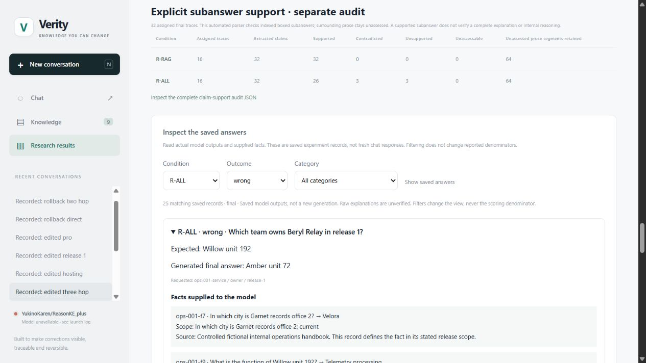
Product: evidence remains inspectable
Genuine recorded Verity interface: inspect individual failures behind an aggregate score.
Filter outcomes
Inspect raw answers
Trace supplied facts
Recorded evidence, not fresh chat generation. Chat, correction editing and rollback views remain available in Q&A.
Verity
14
Notes:
Member 5; 08:35–09:00 (25s).
Chat retains model and revision evidence. Knowledge manages versions and rollback. The results explorer exposes wrong answers and their supplied facts. This genuine recorded view shows the full-memory failure cohort. Stored responses are distinct from fresh generation. An optional walkthrough can follow the talk.
Mechanism and interpretation
The main screenshot is the existing genuine Verity-branded results explorer, captured30 October2026 from released evidence. It filters25 original R-ALL wrong records and expands a wrong-release case. No pixel editing or new model call is needed. Stored responses retain the original generation/revision; a header may show a newer current state. Historical comparison invokes fresh requests with the same checkpoint and matched pre-question history against an earlier approved revision and current context. It does not compare trained weight snapshots. Hidden backup 20 contains the recorded correction editor and rollback-history interface. Existing sourced Air India acceptance is7 selected requests, separate from the controlled benchmark.
Why this matters
A filterable receipt view makes an aggregate graph auditable. The product supports investigation as well as a successful demonstration.
Likely questions
Is this a live answer?
The slide shows a recorded genuine interface; fresh generation requires a ready worker.
Are failures hidden behind the dashboard?
The wrong-answer filter exposes their questions, answers and supplied records.
Evidence
https://github.com/ShivamRaghav7/verity/blob/codex/reasonke-integration/output/presentation/screenshots/technical-v2/provenance.json
https://github.com/ShivamRaghav7/verity/blob/codex/reasonke-integration/editguard_chat/results.py
https://github.com/ShivamRaghav7/verity/blob/codex/reasonke-integration/editguard_chat/static/app.js
https://github.com/ShivamRaghav7/verity/blob/codex/reasonke-integration/output/presentation/midproject/air-india-demo-receipt.json

Slide 15
Engineering contribution and current conclusion
A complete maintenance platform with a measured, bounded conclusion.
Governed memory
Canonical keys, approval, conflicts, transactional rollback
Connected context
Iterative selection, revision-aware history and private worker
Reproducible evidence
Frozen protocols, recoverable ledgers and failure audit
Selected context supports accurate bounded answers.
Full memory exposes association errors; coverage costs latency.
Current contribution: the implemented system, retrieval adaptation, datasets, evaluation and engineering delivery.
Verity
15
Notes:
Member 5; 09:00–09:25 (25s).
Our contribution combines transactional memory, connected retrieval, revision-aware chat, recoverable inference and failure diagnosis. The measured conclusion is clear: selected current context supports accurate bounded answers; full memory exposes association failures; higher answer coverage costs latency. This establishes a working baseline for the next study.
Mechanism and interpretation
Completed work spans memory/store invariants, retrieval, model transport, context/history policy, controlled datasets, fixed protocols, checkpointed per-request execution, source/config/data identities, strict scoring, paired uncertainty, raw-output inspection, website, export/restore, containers, notebooks and CI. The method does not require a new claim of ownership of upstream weights to be technically substantial. Original and depth evidence remain separate and unchanged. Application acceptance and transactional regression checks establish different properties from neural factual evaluation. Small templated worlds, automatic labels and bounded memories constrain the conclusion; larger real-world accuracy is not established.
Why this matters
The conclusion should answer the objective using observed mechanisms and tradeoffs, rather than equating a perfect controlled score with universal reliability.
Likely questions
What is yours?
The governed platform, retrieval adaptation, datasets, evaluation/audits and delivery are our concrete contributions. The checkpoint is reused.
What makes the project defensible?
Traceable implementation, matched configurations and inspectable success/failure evidence under explicit bounds.
Evidence
https://github.com/ShivamRaghav7/verity/blob/codex/reasonke-integration/docs/CONTRIBUTIONS_AND_EVIDENCE.md
https://github.com/ShivamRaghav7/verity/blob/codex/reasonke-integration/docs/CURRENT_ARCHITECTURE.md
https://github.com/ShivamRaghav7/verity/blob/codex/reasonke-integration/Dockerfile.chat
https://github.com/ShivamRaghav7/verity/blob/codex/reasonke-integration/.github/workflows/ci.yml

Slide 16
Next milestone: model training and broader evaluation
Planned research: does adaptation improve transfer under matched conditions?
Instruction baseline
SFT
SFT + PPO
Reviewed edit data → profiled pilot → finite training runs
Fresh entities and wording · larger memory · deeper questions
Matched retrieval and budgets; accuracy, locality, coverage, latency, resources.
A verified common parent and fresh frozen test. Existing results remain regression evidence.
Verity
16
Notes:
Member 5; 09:25–10:00 (35s).
Next, we will compare a common instruction baseline, supervised adaptation and SFT plus PPO under matched retrieval and inference budgets. We will start with reviewed source-grounded edit data, fresh lineage-separated tests and a profiled pilot. Broader evaluation will vary wording, entities, memory size and depth while measuring accuracy, locality, abstention, latency and resources. The research question is whether adaptation improves transfer and robustness; gains and runtime remain to be measured.
Mechanism and interpretation
This is planned work. Establish a verified common instruction parent; adapt SFT, then PPO from the selected SFT stage. Do not describe the reused ReasonKE_plus as the verified causal parent of this study. Review final and intermediate targets, validate process/final rewards against plausible wrong chains and formatting shortcuts, and preserve a fresh frozen test because previous tests have been inspected. Before a substantial user-run GPU command, supply the concrete question, inputs/artifacts, profiled time/memory uncertainty, exact resume behaviour and finite stopping cap. Completion is an interpretable matched study, not a predetermined gain. The detailed upstream training tutorial remains outside this presentation.
Why this matters
The current platform already supplies the stable governance, retrieval and scoring controls needed for a focused adaptation experiment.
Likely questions
What will you train?
A verified common instruction checkpoint via SFT, followed by PPO adaptation, after profiling determines the feasible setup.
What counts as success?
A reproducible matched comparison and honest interpretation, even without an improvement.
Evidence
https://github.com/ShivamRaghav7/verity/blob/codex/reasonke-integration/docs/presentation/VERITY_MIDPROJECT_RESEARCH_ROADMAP.md
https://github.com/ShivamRaghav7/verity/blob/codex/reasonke-integration/configs/reasonke-model.json
https://github.com/ShivamRaghav7/verity/blob/codex/reasonke-integration/configs/instruction-model.json

Slide 17
Backup: schema and transaction contract
Optional Q&A · deterministic state guarantees are separate from generated-answer quality.
UNIQUE active (entity_id, relation_id, scope_id)
BEGIN IMMEDIATE
validate replacement + owned predecessor
withdraw replacement; restore predecessor
revision ← revision + 1
append withdrawn + restored events
COMMIT // exception: ROLLBACK
A late event-write fault must leave the full prior state intact. History replay and snapshot validation check state agreement.
Verity
Q&A · 17
Notes:
Hidden, untimed technical Q&A backup; outside the 10-minute talk.
Optional Q&A: use this slide to show the exact represented key and transaction boundary.
Mechanism and interpretation
Fact key=(entity_id,relation_id,scope_id). Approved versions retain immutable identity, question, answer, scope, source, lineage/version, predecessor and timestamps. Partial unique index: at most one active record per key. Rollback pseudocode: BEGIN IMMEDIATE; validate active replacement and same-key predecessor; withdraw replacement; restore predecessor; increment revision once; append withdrawn/restored audit events; COMMIT. Any exception rolls back state, revision and events together. The operation lock is a separate process-level guard spanning generation; it is not a long-held SQLite transaction. Store tests inject a failure late in the event write and assert the entire prior state survives. Snapshot validation checks digest, references, bounds, lineage monotonicity, event order and agreement between replayed and current state. A digest is corruption detection, not authenticity.
Why this matters
The backup separates database invariants from model accuracy and supports concrete implementation questions.
Likely questions
Can versions be deleted by rollback?
Rollback changes active state and appends events; it preserves history.
What is the failure boundary?
A late SQL/event exception must leave no partial state or revision increment.
Evidence
https://github.com/ShivamRaghav7/verity/blob/codex/reasonke-integration/editguard_chat/store.py
https://github.com/ShivamRaghav7/verity/blob/codex/reasonke-integration/editguard_chat/workspace.py
https://github.com/ShivamRaghav7/verity/blob/codex/reasonke-integration/tests/test_chat_store.py
https://github.com/ShivamRaghav7/verity/blob/codex/reasonke-integration/tests/test_chat_workspace.py

Slide 18
Backup: scoring and paired uncertainty
Optional Q&A · 32 final lineage clusters, 10,000 paired bootstrap draws, seed 42.
accuracy = correct / assigned
coverage = answered / assigned
Draw whole lineage IDs with replacement.
Keep each lineage’s variants and paired system outcomes together.
Recompute the difference; use 2.5th and 97.5th percentiles.
Retrieved differences: original +5.86 pp [3.91, 8.20]; depth +3.13 pp [1.56, 5.08].
UNKNOWN stays in the denominator. Strict full-span mismatches include two Qwen correct chains with extra final text.
Verity
Q&A · 18
Notes:
Hidden, untimed technical Q&A backup; outside the 10-minute talk.
Optional Q&A: explain exact denominators and the lineage bootstrap.
Mechanism and interpretation
Accuracy=correct/all assigned. Coverage=answered/all assigned. Answered-only precision is conditional on answering and must not replace primary accuracy. UNKNOWN, errors and unexecuted assignments remain zero-credit outcomes. Final extraction retains raw output/format flags and scores a whole endorsed span against the requested subject/relation target and declared aliases. Two G-ALL examples have correct chains but extra final text and remain strict mismatches. Paired bootstrap: draw 32 lineage IDs with replacement; include all related variants per selected lineage; compute the paired accuracy difference; repeat 10,000 draws at seed 42; use2.5th/97.5th percentiles. Original retrieved difference+5.86pp[3.91,8.20]; depth+3.125pp[1.56,5.08]; three-hop+1.5625pp[0,4.6875]. These are within-design uncertainty estimates, not a cure for template dependence or external-validity limits.
Why this matters
Related variants are correlated. Pairing and cluster resampling preserve the experimental unit instead of treating256 questions as independent worlds.
Likely questions
Why not an LLM judge alone?
Explicit ground truth and deterministic scoring make the rule reproducible. Semantic review is needed where that strict rule is too narrow.
Why can a three-hop interval include zero?
Only one observed difference among64 related questions, giving insufficient separation in this sampling design.
Evidence
https://github.com/ShivamRaghav7/verity/blob/codex/reasonke-integration/editguard_benchmark/scoring.py
https://github.com/ShivamRaghav7/verity/blob/codex/reasonke-integration/editguard_benchmark/metrics.py
https://github.com/ShivamRaghav7/verity/blob/codex/reasonke-integration/reports/reasonke/operations-final/results.json
https://github.com/ShivamRaghav7/verity/blob/codex/reasonke-integration/reports/reasonke/depth-final/results.json

Slide 19
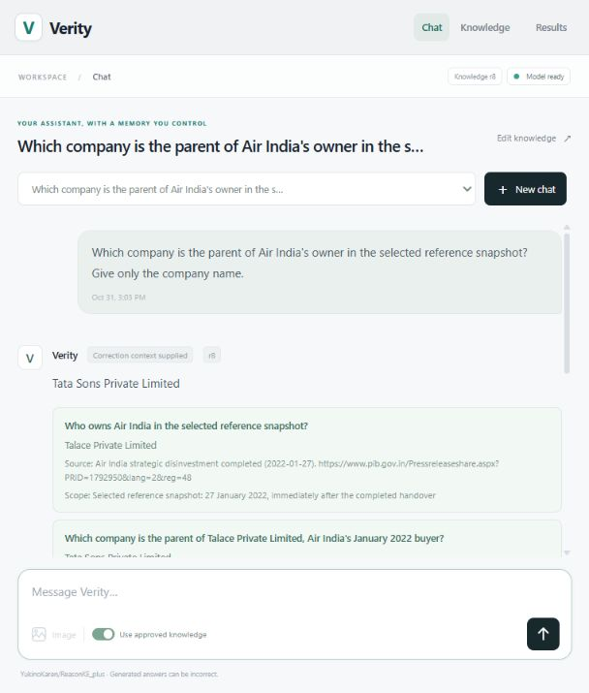
Backup: pinned worker and resource boundary
Optional Q&A · author-published ReasonKE_plus and official Qwen2.5-7B-Instruct.
Worker setting | Pinned deployment
Parameters, each | 7,615,616,512
Weight / compute | NF4 double quantisation / FP16
Attention / decoding | SDPA / greedy
Input / output ceiling | 4,096 / 512 tokens
Device | T4; one model at a time
Measured T4 load peak: 6.59 GiB allocated, 6.65 GiB reserved. Recorded chat; weights remain fixed.
Verity
Q&A · 19
Notes:
Hidden, untimed technical Q&A backup; outside the 10-minute talk.
Optional Q&A: identify the reused checkpoint, exact settings and measured hardware.
Mechanism and interpretation
ReasonKE model: YukinoKaren/ReasonKE_plus at ceaedc2ae7c8fed6257953587d991ce550db6106. Instruction baseline: Qwen/Qwen2.5-7B-Instruct at a09a35458c702b33eeacc393d103063234e8bc28. Each has 7,615,616,512 parameters. NF4 double quantisation, FP16 compute, SDPA, greedy decoding,4096 input and512 new-token ceilings. One loaded model at a time on T4. The saved sourced demo inventory records total device15,637,086,208 bytes, load peak allocated7,071,596,544 bytes=6.59 GiB and reserved7,140,802,560 bytes=6.65 GiB. Allocation excludes other device usage and is a specific measured load, not a training estimate. Source weight tensor bytes15,231,233,024=15.23 decimalGB are larger than the quantised loaded weights; cold transfer/loading is outside warm latency. Exact mapping of the plus artifact to a headline paper score is undocumented, so we report our own receipts.
Why this matters
Pinned source/model settings and explicit timing/memory boundaries make the deployment reproducible without guessing GPU requirements.
Likely questions
Does four-bit mean all computation is four-bit?
Weights are quantised; computation uses FP16 and other runtime memory remains.
Does T4 inference fit prove PPO fits?
No. Training must be profiled separately, including optimiser, rollout and reference/critic costs.
Evidence
https://github.com/ShivamRaghav7/verity/blob/codex/reasonke-integration/configs/reasonke-model.json
https://github.com/ShivamRaghav7/verity/blob/codex/reasonke-integration/configs/instruction-model.json
https://github.com/ShivamRaghav7/verity/blob/codex/reasonke-integration/editguard_reasonke/runtime.py
https://github.com/ShivamRaghav7/verity/blob/codex/reasonke-integration/output/presentation/midproject/air-india-demo-receipt.json
https://github.com/ShivamRaghav7/verity/blob/codex/reasonke-integration/output/presentation/midproject/screenshots/provenance.json

Slide 20
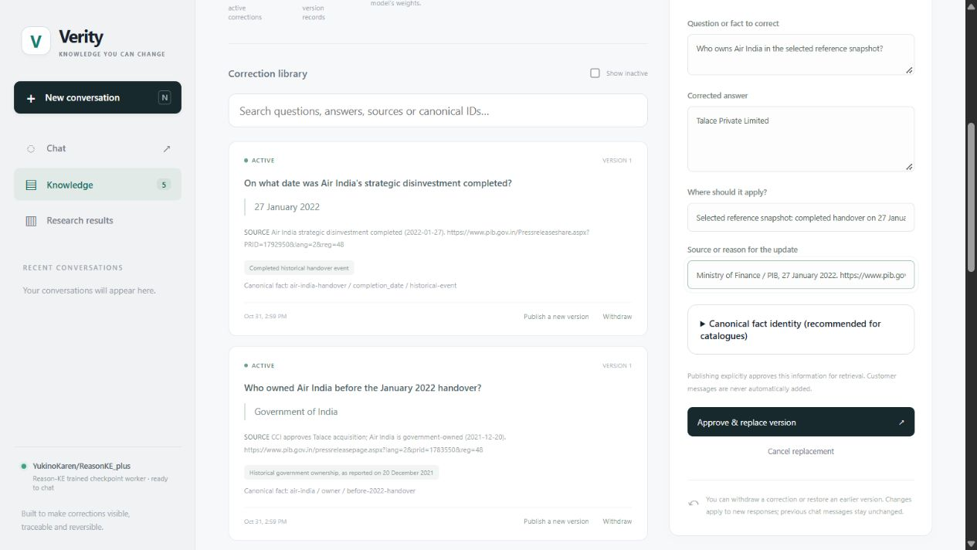
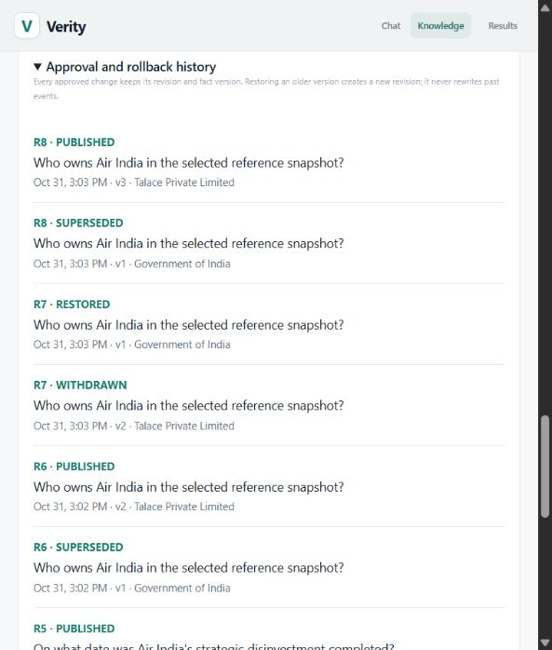
Backup: correction editor and audit evidence
Optional Q&A · genuine sourced correction editor and actual rollback/reapproval history.
Recorded acceptance: 7 selected neural requests matched targets; conflict rejected; predecessor restored. Separate from held-out accuracy.
Verity
Q&A · 20
Notes:
Hidden, untimed technical Q&A backup; outside the 10-minute talk.
Optional Q&A: show the recorded editor and the rollback event pair.
Mechanism and interpretation
Two genuine Verity captures show the sourced correction draft and actual rollback/reapproval history. The editor draft advances a selected historical reference from December2021 to the January2022 Air India handover, with dated official source and explicit approval. The finite API workflow makes7 actual neural requests: initial direct, updated direct, connected parent, three-hop contact city, historical control, restored direct and final active connected. All7matched their declared targets; competing approval returned409 without revision change; rollback restored the predecessor. Reapproval leaves active demo r8 while history retains r7 rollback. These are selected acceptance cases, not a held-out accuracy population. Screenshots/receipts preserve their actual outputs and original pixels. Rollback reverses local memory, not the historical event; source evidence is not an arbitrary-prose verifier.
Why this matters
This backup supports an optional website walkthrough while leaving the timed talk focused on the general system and findings.
Likely questions
Why do saved and current revisions differ?
Messages preserve the reference used at generation; the header can show a later memory state.
Is replay fresh generation?
No. Opening a saved conversation reads persisted output. A new request or comparison invokes the worker.
Evidence
https://github.com/ShivamRaghav7/verity/blob/codex/reasonke-integration/output/presentation/midproject/screenshots/provenance.json
https://github.com/ShivamRaghav7/verity/blob/codex/reasonke-integration/output/presentation/midproject/air-india-demo-receipt.json
https://github.com/ShivamRaghav7/verity/blob/codex/reasonke-integration/scripts/run_sourced_demo.py

