Slide 1
EditGuard
Knowledge Editing and Verification Platform
Approved corrections for connected factual questions
Project presentation
Notes:
Member 1
Good morning. Our project is EditGuard, a knowledge editing and verification platform for conversational AI. Our goal is to make a factual correction change the assistant's relevant answers, preserve unrelated information, and remain traceable and reversible. We combine an existing learned reasoning model with an approved external memory and a working application. We also measure where that combination succeeds and where it fails.
Evidence

Slide 2
One change affects connected answers
Fictional India operations example: Kaveri Payment Gateway, release 2
BEFORE APPROVAL
AFTER APPROVAL
Bengaluru Platform Team
Pune Reliability Team
Meera Iyer
Arjun Deshmukh
Office in Chennai
Office in Hyderabad
Hosting stays in Bengaluru. Older releases keep their own facts.
02
Notes:
Member 1
Consider Kaveri Payment Gateway in release 2. Its owner is Bengaluru Platform Team. The team's contact is Meera Iyer, whose office is in Chennai. Now an administrator changes the owner to Pune Reliability Team. Its contact is Arjun Deshmukh, whose office is in Hyderabad. A correct assistant should update the owner, the contact and the office answer. The office question requires three connected facts. However, the gateway's hosting city should remain Bengaluru, and an older release should retain its own owner. A website can list individual records. Our task is to maintain consistent answers when users query across those records.
Evidence
https://github.com/ShivamRaghav7/verity/tree/ae7bb2010a82fd1d744d008eb7c6f870198aece5/docs/INDIA_DEMO.md
https://github.com/ShivamRaghav7/verity/tree/ae7bb2010a82fd1d744d008eb7c6f870198aece5/reports/reasonke/depth-final/india-acceptance.json

Slide 3
The model and memory have separate roles
01
Approved memory
SQLite keeps scoped fact versions, sources and history.
02
Context selection
Lexical retrieval expands from the question to connected facts.
03
Learned answer generation
The pinned ReasonKE_plus checkpoint generates a short answer.
04
Visible evidence
The interface shows supplied facts and the memory revision.
ReasonKE training belongs to the upstream authors. A new edit changes memory.
03
Notes:
Member 2
The final system uses the author published ReasonKE_plus checkpoint. Its authors trained the model upstream. Our project integrates and evaluates it. We keep its weights frozen. When an administrator approves a correction, we update the external fact memory without retraining the model. For each question, a bounded lexical selector retrieves relevant approved records. In the depth extension, it expands through answer text to collect connected facts. The private model worker then generates the answer from that context. We store the supplied facts and model output so we can inspect the evidence. The selector is deterministic software, not a newly trained scope classifier.
Evidence
https://github.com/ShivamRaghav7/verity/tree/ae7bb2010a82fd1d744d008eb7c6f870198aece5/docs/CURRENT_ARCHITECTURE.md
https://github.com/ShivamRaghav7/verity/tree/ae7bb2010a82fd1d744d008eb7c6f870198aece5/docs/REASONKE_MODEL_CARD.md
https://github.com/YukinoshitaKaren/Reason-KE
https://huggingface.co/YukinoKaren/ReasonKE_plus

Slide 4
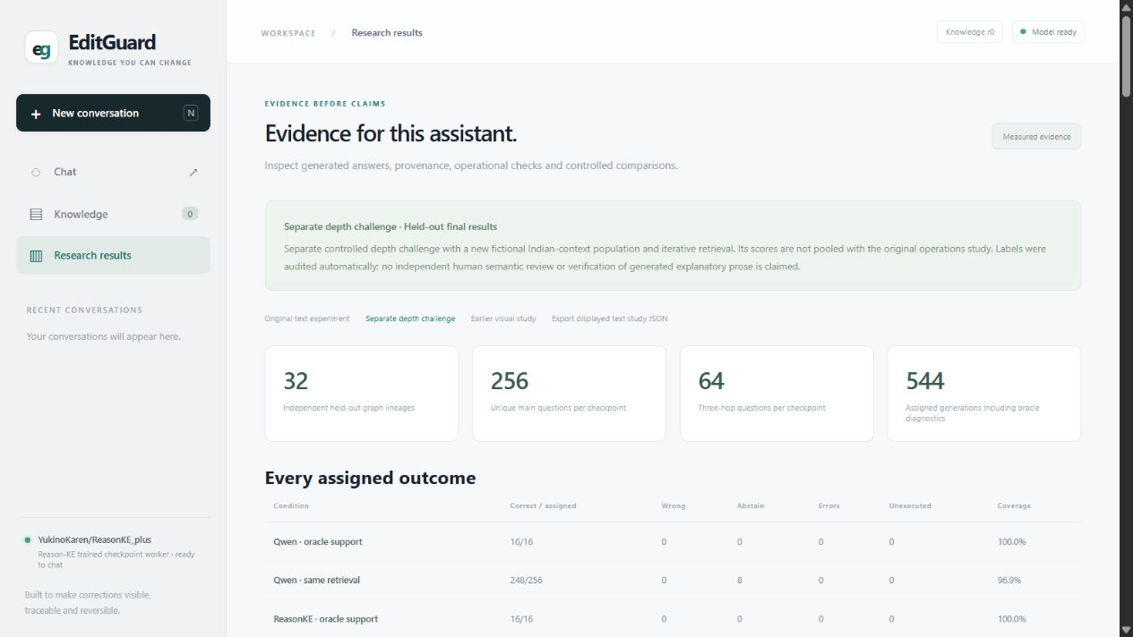
Every correction has a controlled lifecycle
Approve
An operator supplies the fact, scope and source.
Resolve conflicts
A competing active version requires explicit resolution.
Compare history
Generate answers using historical and current memory.
Roll back
Restore the predecessor in one transaction.
Audit trail and evidence dashboard
04
Notes:
Member 2
Knowledge changes pass through an explicit administrator workflow. Each fact has a source, entity, property and scope identity. A customer's chat message cannot silently become an approved correction. Publishing a replacement records its predecessor and a new knowledge revision. A competing approval for the same active key triggers a conflict instead of choosing silently. Historical comparison generates answers from earlier and current approved states. Rollback restores the previous active version in one database transaction. These controls establish which information the model receives. They do not automatically prove that every generated sentence is true.
Evidence
https://github.com/ShivamRaghav7/verity/tree/ae7bb2010a82fd1d744d008eb7c6f870198aece5/docs/CHAT_API.md
https://github.com/ShivamRaghav7/verity/tree/ae7bb2010a82fd1d744d008eb7c6f870198aece5/docs/CURRENT_ARCHITECTURE.md
https://github.com/ShivamRaghav7/verity/tree/ae7bb2010a82fd1d744d008eb7c6f870198aece5/editguard_chat/store.py

Slide 5
Controlled data makes the edit testable
Two independent fictional studies, reported separately
48
32
256
authored graph lineages per study
held out lineages per study
main questions per condition
Original study
Separate depth study
9 facts per world. Direct, paraphrased and two hop questions, plus locality controls.
12 facts per world. Adds three hop paths and separate wording banks.
Split lineages before augmentation. Labels have automated audits, without independent human review.
05
Notes:
Member 3
We authored fictional operational records so that we control the original fact, correction and expected answers. Each study contains 48 graph lineages and 384 questions. We separate 16 development lineages from 32 final lineages before creating related question variants. Each main model condition therefore receives 256 final questions. The original study tests direct, paraphrased, connected and unrelated questions. The separate depth study uses twelve facts per world and includes three hop questions with a separate wording bank for the final split. Labels were audited automatically. Related variants still share a lineage, and wording templates repeat within each split.
Evidence
https://github.com/ShivamRaghav7/verity/tree/ae7bb2010a82fd1d744d008eb7c6f870198aece5/docs/OPERATIONS_DATASET_CARD.md
https://github.com/ShivamRaghav7/verity/tree/ae7bb2010a82fd1d744d008eb7c6f870198aece5/docs/DEPTH_DATASET_CARD.md
https://github.com/ShivamRaghav7/verity/tree/ae7bb2010a82fd1d744d008eb7c6f870198aece5/reports/reasonke/depth-final/README.md

Slide 6
Matched comparisons and frozen scoring
Same approved information
Both updated models receive the same facts and context selection policy.
Same output contract
Greedy generation. Fixed budgets. Abstentions receive zero primary credit.
Separate failure sources
Measure retrieval, gold support diagnostics and generated answers separately.
1,312 original requests and 544 depth requests completed under separate frozen protocols.
06
Notes:
Member 3
The original evaluation contains 1,312 generations across five main conditions and two small gold support diagnostics. The separate depth study contains 544 generations. Updated baselines receive the same approved facts and supporting information. We keep generation settings and answer budgets compatible, using fixed greedy generation and four bit loading on a T4. We score the endorsed short answer against explicit ground truth. An UNKNOWN response receives zero accuracy credit and stays in the denominator. We measure retrieval separately from generation and use preselected gold support questions as diagnostics. We freeze the final configuration and scoring before the final run.
Evidence
https://github.com/ShivamRaghav7/verity/tree/ae7bb2010a82fd1d744d008eb7c6f870198aece5/reports/reasonke/operations-final/protocol.json
https://github.com/ShivamRaghav7/verity/tree/ae7bb2010a82fd1d744d008eb7c6f870198aece5/reports/reasonke/depth-final/protocol.json
https://github.com/ShivamRaghav7/verity/tree/ae7bb2010a82fd1d744d008eb7c6f870198aece5/reports/reasonke/operations-final/results.json
https://github.com/ShivamRaghav7/verity/tree/ae7bb2010a82fd1d744d008eb7c6f870198aece5/reports/reasonke/depth-final/results.json

Slide 7
Selected context improves this ReasonKE result
Original operations study, 256 assigned questions in each condition
15 Qwen abstentions
with updated retrieval
25 ReasonKE errors
with full updated memory
Every updated condition receives the correction. The model comparison reverses under full memory.
07
Notes:
Member 4
In the original study, ReasonKE with updated retrieved facts answered all 256 main questions correctly. Qwen with the same retrieval answered 241 correctly and abstained on fifteen. More context did not always help. ReasonKE with the full updated memory scored 231 out of 256, while Qwen full memory scored 241. That result prevents us from claiming ReasonKE wins every comparison. Retrieval supplied the required support, but the generator could still confuse facts or abstain. We also measured preservation separately: ReasonKE retrieval retained all 124 previously correct locality answers and answered all 128 locality controls correctly. Preservation and factual accuracy use different denominators.
Evidence
https://github.com/ShivamRaghav7/verity/tree/ae7bb2010a82fd1d744d008eb7c6f870198aece5/reports/reasonke/operations-final/results.json
https://github.com/ShivamRaghav7/verity/tree/ae7bb2010a82fd1d744d008eb7c6f870198aece5/reports/reasonke/operations-final/FAILURE_ANALYSIS.md

Slide 8
Depth accuracy has a substantial speed tradeoff
Separate depth study, 64 assigned questions per group and model
256 / 256
ReasonKE main answers
248 / 256
Qwen, eight abstentions
Warm median latency
15.94 s vs 1.12 s
Main difference +3.125 pp, 95% lineage interval +1.56 to +5.08 pp. Three hop interval includes zero.
08
Notes:
Member 4
In the separate depth study, ReasonKE scored 256 out of 256 and Qwen scored 248, with eight UNKNOWN responses. On three hop questions, the scores were 64 out of 64 and 63 out of 64. The overall difference was 3.125 percentage points. A paired analysis resampling whole lineages gave a 95 percent interval of about 1.56 to 5.08 points. The three hop difference interval included zero, so that subset supports a weaker comparison. There is also a clear speed cost. Warm median latency was 15.94 seconds for ReasonKE and 1.12 seconds for Qwen. The stronger observed answer score therefore comes with substantially slower responses.
Evidence
https://github.com/ShivamRaghav7/verity/tree/ae7bb2010a82fd1d744d008eb7c6f870198aece5/reports/reasonke/depth-final/results.json
https://github.com/ShivamRaghav7/verity/tree/ae7bb2010a82fd1d744d008eb7c6f870198aece5/reports/reasonke/depth-final/FAILURE_ANALYSIS.md

Slide 9
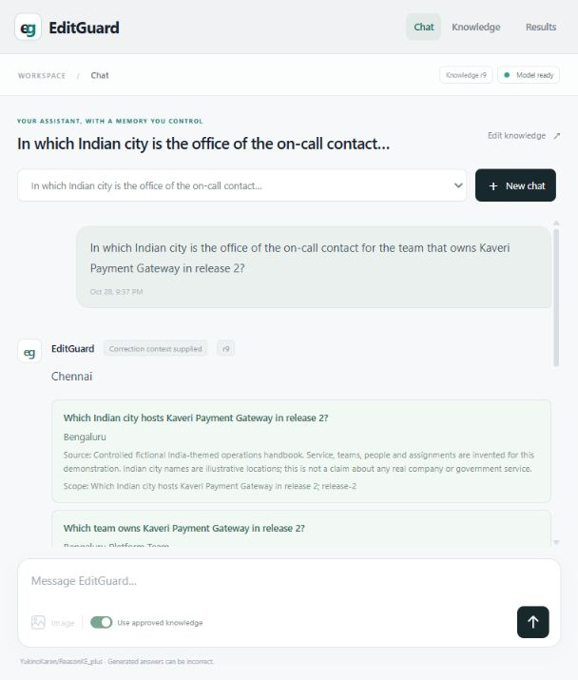
The website makes changes inspectable
1
Ask the original office question
2
Approve the ownership replacement
3
Check paraphrases and unaffected facts
4
Compare history and roll back
14/14 model answers and 12 consistency checks passed in the finite website workload.
09
Notes:
Member 5
The application provides normal text chat, a knowledge editor, source display, history, comparison and rollback. Research results shows saved experiments and raw outputs. In the demonstration, we ask for the original owner and contact's office, approve the ownership replacement, and ask again using different wording. We also check hosting and the older release, then roll back and request a fresh answer. Our recorded India application acceptance workload completed fourteen actual model answers correctly and passed twelve transaction and provenance consistency checks. This is one fictional display lineage. We report it separately from held out benchmark accuracy.
Evidence
https://github.com/ShivamRaghav7/verity/tree/ae7bb2010a82fd1d744d008eb7c6f870198aece5/docs/INDIA_DEMO.md
https://github.com/ShivamRaghav7/verity/tree/ae7bb2010a82fd1d744d008eb7c6f870198aece5/reports/reasonke/depth-final/india-acceptance.json
https://github.com/ShivamRaghav7/verity/tree/ae7bb2010a82fd1d744d008eb7c6f870198aece5/reports/reasonke/depth-final/india-host-audit.json

Slide 10
What the evidence supports
A working correction and rollback platform
Approved memory supports connected answers with visible history.
100% describes these controlled main tests
Small fact worlds, repeated templates and complete retrieved support limit generalisation.
Our contribution
Governance, context selection, independent data, reproducible evaluation and the application.
10
Notes:
Member 5
Our completed product supports approved, traceable and reversible knowledge changes, with reproducible measurements of connected answers. Our contribution includes the application, knowledge lifecycle, independent datasets, context selection adaptations and evaluation infrastructure. The observed 100 percent scores are real results on small controlled tests. Each world has few explicit facts, the selector supplied complete support, and templates repeat. Those conditions limit what the score establishes. We retain the full memory failures, abstentions and latency cost. The conclusion is that this design met its defined short answer contract in these tests. Broader operational language, larger memories and ambiguous or missing information require further validation. Thank you.
Evidence
https://github.com/ShivamRaghav7/verity/tree/ae7bb2010a82fd1d744d008eb7c6f870198aece5/docs/CONTRIBUTIONS_AND_EVIDENCE.md
https://github.com/ShivamRaghav7/verity/tree/ae7bb2010a82fd1d744d008eb7c6f870198aece5/reports/reasonke/depth-final/FAILURE_ANALYSIS.md

