Slide 1
Verity
Governed knowledge editing for
connected factual questions
Reason-KE++ with versioned memory and bounded retrieval
Notes:
Member 1
Verity addresses a specific maintenance problem: an assistant must use an approved correction when answering connected factual questions, preserve information outside its scope, and support reversal. Updating a webpage or database establishes the new fact. The additional question is whether a conversational model uses that state correctly. We built a versioned memory platform around Reason-KE++, then evaluated the complete retrieval and generation path. Our evidence covers short factual answers, controlled paraphrases and reasoning paths of up to three relations.
Technical detail
The final system uses a frozen released checkpoint and external approved memory. It is a parameter-preserving editing deployment. It supports ordinary text conversation, but the scientific accuracy claim concerns the bounded factual task. The presentation separates the published learning method, our implementation and our measured outcomes.
Visual cue
State the maintenance problem and the evaluated contract.
Evidence
https://github.com/ShivamRaghav7/verity/blob/codex/reasonke-integration/docs/CURRENT_ARCHITECTURE.md
https://github.com/ShivamRaghav7/verity/blob/codex/reasonke-integration/docs/CONTRIBUTIONS_AND_EVIDENCE.md

Slide 2
One ownership edit changes a connected answer
Kaveri Payment Gateway, release 2. One ownership fact changes.
Initial approved path
Kaveri Gateway
release 2
Bengaluru
Platform Team
Meera Iyer
Chennai
After ownership replacement
Kaveri Gateway
release 2
Pune
Reliability Team
Arjun Deshmukh
Hyderabad
Hosting remains Bengaluru. Pro and release 1 retain separate owners.
Actual implemented example with fictional services, people and assignments.
2
Notes:
Member 1
This example comes from the implemented India demonstration. Kaveri Payment Gateway in release two initially belongs to Bengaluru Platform Team. That team’s contact is Meera Iyer, whose office is in Chennai. Replacing only ownership with Pune Reliability Team changes the connected path to Arjun Deshmukh and Hyderabad. The hosting city must remain Bengaluru. The Pro service and release one retain separate owners. These services, people and assignments are fictional. The familiar Indian locations help us demonstrate a real software workflow without making claims about an actual company.
Technical detail
The replacement changes one approved ownership record. The alternate team's contact and office records already exist. The three-hop answer changes by following owner, on_call_contact and office_city. An unchanged hosting answer tests another relation on the same entity. The older release and Pro service test version and similarly named entity boundaries.
Visual cue
Trace the initial and replacement paths, then point to the unchanged controls.
Evidence
https://github.com/ShivamRaghav7/verity/blob/codex/reasonke-integration/docs/INDIA_DEMO.md
https://github.com/ShivamRaghav7/verity/blob/codex/reasonke-integration/editguard_chat/examples.py
https://github.com/ShivamRaghav7/verity/blob/codex/reasonke-integration/reports/reasonke/depth-final/india-acceptance.json

Slide 3
The task and acceptance contract
The source of truth is approved memory. The evaluation observes generated answers.
Correction transfer
Direct questions, paraphrases and connected paths endorse the applicable value.
Locality and scope
Other properties, similarly named services and historical releases retain their facts.
Authority and reversibility
Explicit approval, conflict rejection, event lineage and atomic rollback.
Accountable evaluation
Neural answers, structured operations, abstentions and errors remain distinguishable.
Bounded task: short factual QA over controlled operations handbooks, with paths up to three relations.
3
Notes:
Member 1
We define success through observable requirements. A relevant direct or paraphrased question should endorse the corrected answer. A connected question should follow the revised chain. An unaffected question should retain the applicable fact, including its release or plan scope. A competing correction must not silently overwrite active knowledge. Approval and rollback must update fact state and audit history together. We score actual model answers separately from database consistency. Abstentions and errors remain in the evaluation denominator. These requirements give the project a finite, testable objective without promising universal language accuracy.
Technical detail
The fact store determines authority, not real-world truth. Scope is represented by canonical IDs and explicit text, rather than a calibrated semantic applicability classifier. Conflicts under the same represented key can be rejected deterministically. Arbitrary contradictions under unrelated keys and ambiguous customer language remain limits. A rule-based clarification must never count as a neural answer success.
Visual cue
Separate answer quality, locality and operational consistency.
Evidence
https://github.com/ShivamRaghav7/verity/blob/codex/reasonke-integration/docs/CURRENT_ARCHITECTURE.md
https://github.com/ShivamRaghav7/verity/blob/codex/reasonke-integration/docs/CHAT_API.md
https://github.com/ShivamRaghav7/verity/blob/codex/reasonke-integration/tests/test_chat_store.py

Slide 4
Method choice and the recorded decisions
The editing route and the retrieval layer answer different design questions.
Approach | What changes | Role in this project
Conventional RAG | Retrieved context | Matched Qwen instruction baseline
Reason-KE++ + memory | Approved context, frozen weights | Deployed reasoning-aware generator
Parametric editing | Selected neural parameters | Alternative route, not evaluated here
Recorded development policy choice
Reason-KE++ retrieved 24/24 vs full memory 21/24. Qwen retrieved also 24/24.
Three development lineages. This selected context delivery before the final test, not model superiority.
4
Notes:
Member 1
Conventional RAG retrieves context and asks a general instruction model to answer. Parametric editing changes model weights. Our approach keeps the weights fixed, maintains approved corrections externally, and uses a reasoner trained to apply contextual updates across connected facts. Retrieval is still part of the system. The documented development comparison selected bounded retrieval because the deployed Reason-KE++ checkpoint answered twenty-four of twenty-four questions, versus twenty-one with full memory. Qwen also answered twenty-four with retrieval. That development result selected a context policy; it did not establish model superiority or a causal benefit from training.
Technical detail
The project first built governance and earlier editor experiments, then integrated the released reasoner on 25 October. We do not claim a complete parametric-method comparison or an originally planned progression. Source-pinned integration established feasibility on a T4. The deployment-policy receipt records three development lineages and twenty-four questions per condition. Final results were not used to select that policy. Reason-KE++ and RAG are complementary layers here, not mutually exclusive labels.
Visual cue
Distinguish the editing route from the context-delivery mechanism.
Evidence
https://github.com/ShivamRaghav7/verity/blob/codex/reasonke-integration/docs/REASONKE_INTEGRATION.md
https://github.com/ShivamRaghav7/verity/blob/codex/reasonke-integration/docs/PROJECT_JOURNEY_AND_FINISH_PLAN.md
https://github.com/ShivamRaghav7/verity/blob/codex/reasonke-integration/configs/deployment-policy.json
https://github.com/ShivamRaghav7/verity/blob/codex/reasonke-integration/reports/reasonke/operations-development-v1/results.json

Slide 5
Reason-KE++ learning pipeline
Cold-start supervised learning establishes structure. PPO optimizes the scored response.
Edited fact +
portability question
Teacher-generated
structured examples
Supervised fine-tuning
structured response likelihood
PPO policy update
critic + KL control
Stage-aware reward
format + process + outcome
Policy rollouts
acknowledge / decompose / action
updated policy
Training data design: rewritten facts and labelled reasoning steps. Verity supplies its own separate evaluation worlds.
5
Notes:
Member 1
The learning method comes from Wu and colleagues’ Reason-KE++ paper and official implementation. We use their released ReasonKE_plus checkpoint; we did not run its SFT or PPO training. The data generator supplies a rewritten fact and a portability question to a teacher model. Supervised learning then teaches a structured response format. PPO subsequently trains against signals that inspect intermediate work as well as the final answer. This matters because a model can reproduce a reasoning format or reach a correct endpoint while using an incorrect intermediate association. Our independent operations datasets evaluate the deployed system, not this training pipeline.
Technical detail
The data-generation code reads requested_rewrite and portability.New Question and calls gpt-4o-mini. The paper's Appendix A reports 718 curated cold-start instances and an 8,296/922 MQuAKE-CF PPO partition. Section 3.2 and Appendix A describe the cold-start source differently in granularity; use the concrete generation code and Appendix A rather than claiming a re-created dataset. The SFT trainer requests assistant-completion-only loss when that TRL collator is available, with a language-model collator fallback. No training-loss curves for our deployment exist. The exact released revision is not linked to the paper's headline score in a model card.
Visual cue
Explain training once, then distinguish it from runtime editing.
Evidence
https://aclanthology.org/2026.findings-acl.1137/
https://github.com/YukinoshitaKaren/Reason-KE/blob/d515c6ac5ec747029484af65103a6270fa693058/ReasonKE%2B%2B/data_preprocessing/generate_sft_data.py
https://github.com/YukinoshitaKaren/Reason-KE/blob/d515c6ac5ec747029484af65103a6270fa693058/ReasonKE%2B%2B/train/sft.py
https://github.com/YukinoshitaKaren/Reason-KE/blob/d515c6ac5ec747029484af65103a6270fa693058/ReasonKE%2B%2B/train/sft.sh
https://github.com/ShivamRaghav7/verity/blob/codex/reasonke-integration/configs/reasonke-model.json

Slide 6
Structured reasoning and stage-aware rewards
The output format makes intermediate steps machine-readable for training rewards.
<think>
<acknowledge> ... </acknowledge>
<decompose> ... </decompose>
<action>
[Sub question i] ... \boxed{aᵢ}
</action>
</think>
<answer>final answer</answer>
Released reward implementation
H Correct hop count
D Aligned subquestion similarity
A Correct boxed subanswer fraction
F Final-answer token F1
R = 0.2H + 0.4D + 0.4A + F
Invalid structure receives −1. Training rewards score generated stages. Chat displays text and its supplied sources.
6
Notes:
Member 1
Reason-KE++ organizes output into acknowledge, decompose and action stages, followed by a final answer. The reward first rejects malformed structure. For valid output, the released reward code combines a hop-count check, semantic similarity between aligned subquestions, exact subanswer checks and final-answer token F1. PPO uses those reward components to update a policy while limiting large policy changes. Intermediate-step supervision here means scoring the generated stages. It does not mean that Verity verifies every displayed explanation or calls a separate neural verifier during chat. The deployment only runs the trained checkpoint for inference.
Technical detail
The pinned reward implementation uses process = 0.2H + 0.4D + 0.4A and total = process + final F1. D uses all-MiniLM-L6-v2 cosine similarity on aligned action-section subquestions when hop count matches. A is the fraction of exact or alias-matched boxed subanswers. Invalid format returns -1. The paper instead writes alpha*process+(1-alpha)*outcome, with alpha=0.5 as its main setting. The code's sum is twice that normalized blend, which can affect reward scale relative to KL. This is documented in the backup slide. Dense component scoring is not evidence of a separate reward on every generated token.
Visual cue
Read the structured stages, then the separate reward components.
Evidence
https://aclanthology.org/2026.findings-acl.1137/
https://github.com/YukinoshitaKaren/Reason-KE/blob/d515c6ac5ec747029484af65103a6270fa693058/ReasonKE%2B%2B/verl/verl/utils/reward_score/my_reward.py
https://github.com/YukinoshitaKaren/Reason-KE/blob/d515c6ac5ec747029484af65103a6270fa693058/ReasonKE%2B%2B/verl/reasonke.sh

Slide 7
The implemented inference architecture
Approved state and lexical context selection feed a separately hosted frozen model.
Deterministic state
Deterministic context
Neural inference
Browser + API
validation and operation lock
Bounded lexical selector
at most four approved facts
Private Reason-KE++ worker
authenticated inference
SQLite approved memory
facts, events and revision
History and prompt assembly
compatible complete pairs
API extraction + persistence
answer, raw trace and evidence
The store defines approved state. Retrieval selects context. The neural worker generates the answer.
7
Notes:
Member 2
The application separates deterministic state, deterministic retrieval and neural generation. The browser sends a question to the Python API. SQLite stores approved fact versions, chats and audit events. The selector ranks the current approved snapshot and supplies at most four records. A history filter adds compatible conversation pairs. An authenticated private worker runs the pinned checkpoint and returns generated text. The API extracts and persists the answer together with its supplied facts, revision and model metadata. The website can therefore display the exact evidence associated with a response. Source display establishes what the model received, not that every generated sentence is true.
Technical detail
The website and worker are separate processes. The application lock serializes mutation and generation operations for a single local operator. The worker has separate request validation and a bearer-token boundary. An unavailable worker produces an explicit unavailable state rather than a template answer. The 200-record retrieval bound is a software guard; neural tests use much smaller worlds.
Visual cue
Follow the request across the three computation categories.
Evidence
https://github.com/ShivamRaghav7/verity/blob/codex/reasonke-integration/editguard_chat/server.py
https://github.com/ShivamRaghav7/verity/blob/codex/reasonke-integration/editguard_chat/reasonke_backend.py
https://github.com/ShivamRaghav7/verity/blob/codex/reasonke-integration/editguard_reasonke/server.py
https://github.com/ShivamRaghav7/verity/blob/codex/reasonke-integration/docs/CURRENT_ARCHITECTURE.md

Slide 8
A question through the actual request path
Example request: the contact-office question at knowledge revision r11.
Browser
Python API
SQLite
Selector
Model worker
question
capture r11 + facts
query + approved snapshot
four selected fact IDs
selected facts + revision-compatible history
raw generation + final answer
atomic turn + evidence
answer + source display
The application lock spans generation. A short SQLite transaction persists the successful turn afterward.
8
Notes:
Member 2
Consider the office-city question after rollback, at revision eleven. The API validates the message and operating mode under the application operation lock. It captures the knowledge revision, reads active approved facts, and passes the question to the iterative selector. It combines selected records with permitted history and calls the worker. Only after a successful response does SQLite commit the user and assistant messages, evidence and conversation metadata together. A failed model call leaves no dangling user turn. The revision stays fixed across this operation. The long generation call is outside the short SQLite transaction, although the application lock remains held.
Technical detail
mutate() acquires the operation lock non-blockingly and reports HTTP 409 if another operation is running. ask() checks model readiness, obtains history and revision, generates before storing, then calls add_turn(). The message transaction and the knowledge-change transaction are different boundaries. This local lock is not a distributed concurrency guarantee. The matched benchmark uses local worker IPC and does not measure the website network path.
Visual cue
Trace request validation, revision capture, generation and atomic turn persistence.
Evidence
https://github.com/ShivamRaghav7/verity/blob/codex/reasonke-integration/editguard_chat/server.py
https://github.com/ShivamRaghav7/verity/blob/codex/reasonke-integration/editguard_chat/store.py
https://github.com/ShivamRaghav7/verity/blob/codex/reasonke-integration/tests/test_chat_reasonke.py
https://github.com/ShivamRaghav7/verity/blob/codex/reasonke-integration/tests/test_chat_store.py

Slide 9
Fact identity, authority and version lineage
Canonical key = (entity_id, relation_id, scope_id). Separate keys preserve scope.
Stored field | Concrete ownership record
entity_id | india-demo-001-service
relation_id / scope_id | owner / release-2
answer / source | Pune Reliability Team / handbook
lineage / version | Same ownership lineage, v2
supersedes / approval | v1 predecessor / explicit approval
Draft
browser state only
Approved active v1
unique represented key
Replacement active v2
v1 becomes superseded
Aliases are metadata. A partial unique index permits at most one active version per canonical key.
9
Notes:
Member 2
A fact has a canonical entity, relation and scope key. The ownership key for the gateway’s second release is distinct from hosting, release one and the Pro service. Each approved version also retains its question, answer, source, aliases, approval metadata and lineage links. A draft remains in the browser until the operator explicitly approves it. A first approval creates an active record and event. A replacement must identify the active predecessor for the same key. A partial unique index prevents two active versions for that represented identity. These controls define authoritative state without turning customer messages into approved facts.
Technical detail
The normalized canonical key is encoded through question_key and scope_key. All three canonical identifiers must be supplied together. Without them, legacy records use normalized question/scope text. Aliases are metadata, not a trained entity resolver. Status can change between active, superseded and withdrawn, while fact content/version records and audit events preserve lineage. Approval actor metadata identifies a local research operator, not an independently authenticated enterprise administrator role.
Visual cue
Distinguish the browser draft from committed approved state.
Evidence
https://github.com/ShivamRaghav7/verity/blob/codex/reasonke-integration/editguard_chat/store.py
https://github.com/ShivamRaghav7/verity/blob/codex/reasonke-integration/editguard_chat/workspace.py
https://github.com/ShivamRaghav7/verity/blob/codex/reasonke-integration/editguard_chat/static/app.js
https://github.com/ShivamRaghav7/verity/blob/codex/reasonke-integration/docs/CHAT_API.md

Slide 10
Atomic supersession and rollback
State, revision and both audit events commit together, or all writes roll back.
Validate active replacement
and same-key predecessor
BEGIN IMMEDIATE
reserved writer lock
Withdraw v2, restore v1
one new revision, two events
try:
advance_revision_once()
withdraw(replacement)
restore(predecessor)
write_both_audit_events()
COMMIT
except: ROLLBACK
Failure and history rules
Competing approval returns HTTP 409.
Injected late-event failure restores state.
Historical replay leaves live state intact.
Knowledge changes invalidate context caches.
These transaction guarantees concern represented identities and operational consistency.
10
Notes:
Member 2
The critical guarantee is that fact state, revision and audit events change together. Replacement supersedes the old version and activates the new one at a shared revision. Rollback validates an active replacement and its direct same-key predecessor. Inside BEGIN IMMEDIATE it withdraws the replacement, restores the predecessor, advances the revision once and writes both events. Any exception rolls back every write. Tests inject a late audit-event failure to check that boundary. A competing active approval returns HTTP 409. Historical reads replay earlier events without changing current memory, and knowledge changes invalidate the retriever interface cache.
Technical detail
Rollback is idempotent when the predecessor is already active. An obsolete replacement cannot revert a newer successor. WAL, foreign keys, a thread-safe connection and explicit transactions provide local durability/concurrency behavior. The current lexical selector has no persistent embedding or answer cache to serve a withdrawn correction. Transaction tests establish consistency, not factual model correctness or automatic semantic conflict detection across unrelated keys.
Visual cue
Show the one-revision, two-event rollback boundary.
Evidence
https://github.com/ShivamRaghav7/verity/blob/codex/reasonke-integration/editguard_chat/store.py
https://github.com/ShivamRaghav7/verity/blob/codex/reasonke-integration/tests/test_chat_store.py
https://github.com/ShivamRaghav7/verity/blob/codex/reasonke-integration/tests/test_chat_workspace.py
https://github.com/ShivamRaghav7/verity/blob/codex/reasonke-integration/docs/CURRENT_ARCHITECTURE.md

Slide 11
Bounded iterative retrieval algorithm
BM25-style ranking uses approved question + scope + answer text, with fact-ID tie breaks.
S = top2(rank(question, memory))
frontier = answers(S)
repeat at most 3 rounds:
stop if |S| = 4 or no unseen facts
f = top1(rank(frontier, unseen))
S = S + [f]
frontier = answer(f)
return S
Concrete expansion
Question seeds
Hosting + ownership
Pune Reliability Team
On-call contact record
Arjun Deshmukh
Office-city record
Four-fact context cap. No expected answer, gold support ID or question-depth metadata enters retrieval.
11
Notes:
Member 2
The ranker tokenizes approved question, scope and answer text and applies a BM25-style score. It removes declared stop words and breaks ties by fact identifier. The query first selects two seed records. Their answer text becomes the search frontier. Each expansion round adds the highest-ranked unseen fact and advances the frontier to that fact’s answer. The selected deployment stops at four records, exhaustion or the round bound. With two seeds and a four-fact cap, at most two additions are normally needed. This is deterministic lexical expansion. It never reads a target answer, depth label or gold supporting identifier during retrieval.
Technical detail
The ranker uses k1=1.2 and b=0.75, unique query terms and idf=log(1+(N-df+0.5)/(df+0.5)). The iterative method permits at most three rounds and fills any unused slots from the last frontier ranking. In the concrete India query, hosting and ownership seed the search, then the selected owner answer retrieves its contact and that contact retrieves the office. The inclusion of a hosting distractor is visible rather than hidden. Ranking may still retrieve irrelevant records or fail unfamiliar wording.
Visual cue
Explain the frontier update and the finite stopping rules.
Evidence
https://github.com/ShivamRaghav7/verity/blob/codex/reasonke-integration/editguard_benchmark/retrieval.py
https://github.com/ShivamRaghav7/verity/blob/codex/reasonke-integration/editguard_depth/retrieval.py
https://github.com/ShivamRaghav7/verity/blob/codex/reasonke-integration/reports/reasonke/depth-final/india-acceptance.json

Slide 12
Retrieval selection before final evaluation
Development support completeness, 32 questions per depth group. No model generation.
Complete paths
96/128 original
128/128 iterative
Six declared candidates.
Two display states checked.
Selected: two seeds, four facts.
Selection precedes neural profiling and final freeze. Development retrieval recall is not final answer accuracy.
12
Notes:
Member 2
The original two-stage selector expanded its query only once. On the new depth development packet it completed ninety-six of 128 supporting paths, including zero of thirty-two three-hop paths. The iterative policy completed all 128, including all thirty-two three-hop paths. Selection compared six declared candidates before neural profiling and final freeze. An explicit India display-development question exposed a one-seed distractor, so the final choice used two seeds and four facts after checking both display states. These figures measure support retrieval on development data. They are separate from final generated-answer accuracy and do not prove that more supplied context is always better.
Technical detail
The original method found 192/224 required fact occurrences. Every candidate completed the packet; the additional two display memory states distinguish the selected policy. Selection revision two documents that adjustment before profiling/freeze. The selected candidate completed 230/230 required occurrences across the 128 packet questions and two display states. Those two states are not independent held-out questions. The depth challenge preserves the original frozen operations retriever and results.
Visual cue
Read complete paths, not neural accuracy, on this graph.
Evidence
https://github.com/ShivamRaghav7/verity/blob/codex/reasonke-integration/reports/reasonke/depth-development/retrieval-selection.json
https://github.com/ShivamRaghav7/verity/blob/codex/reasonke-integration/editguard_depth/retrieval.py
https://github.com/ShivamRaghav7/verity/blob/codex/reasonke-integration/docs/DEPTH_RUN_PLAN.md

Slide 13
Prompt assembly and revision-safe history
The latest user turn contains approved facts and the current question.
[Updated Information]
JSON: id, question, answer, scope, source
[Query]
In which city is the owner team’s
on-call contact’s office?
Stored conversation
all prior revisions remain visible
Compatible complete pairs
current revision and model only
Matched historical comparison
Replay approved memory at the requested revision.
Generate both sides with the same pre-question history.
Exclude correction-conditioned pairs from both sides.
At most eight history messages and 6,000 characters. A comparison generates new answers and does not rewrite stored turns.
13
Notes:
Member 3
The worker serializes approved facts as JSON inside the updated-information block of the latest user message, followed by the current query. The tokenizer applies the checkpoint’s chat template. History includes only complete user-assistant pairs compatible with the current knowledge revision and model. Old pairs remain visible in the website but do not enter a new prompt. For historical comparison, both generations receive the same pre-question history with correction-conditioned pairs removed. This prevents a newer answer from leaking the correction into the older reference side. The comparison generates two new responses; it does not retrieve two weight snapshots or rewrite saved messages.
Technical detail
Normal edited chat can retain correction-conditioned pairs from the same revision. The application limits history to eight messages and 6,000 total characters, dropping complete pairs. Worker fields have additional size checks. The two comparison contexts are an approved historical snapshot or no correction facts, and the current snapshot. Revision zero means empty approved memory. JSON delimiters and source text do not establish general prompt-injection resistance.
Visual cue
Distinguish visible history, supplied history and freshly generated comparison.
Evidence
https://github.com/ShivamRaghav7/verity/blob/codex/reasonke-integration/editguard_chat/server.py
https://github.com/ShivamRaghav7/verity/blob/codex/reasonke-integration/editguard_reasonke/runtime.py
https://github.com/ShivamRaghav7/verity/blob/codex/reasonke-integration/tests/test_chat_reasonke.py

Slide 14
Frozen model worker and answer evidence
Exact checkpoint IDs and revisions stay pinned. Corrections change memory, not weights.
Worker setting | Measured deployment
Parameters per checkpoint | 7,615,616,512
Weight storage / compute | NF4 double quantization / FP16
Attention / decoding | SDPA / greedy, one beam
Input / output ceiling | 4,096 / 512 tokens
Device | T4, one loaded model at a time
Load peak allocated CUDA | 6.59 GiB
Answer extraction
<think> ... </think>
<answer>Hyderabad</answer>
One nonempty answer block:
extract the final span.
Otherwise disclose raw fallback.
Persist raw output, sources,
revision, tokens and latency.
Measured on T4. CUDA allocation excludes other device usage. Extraction preserves raw output and format flags.
14
Notes:
Member 3
Both checkpoints contain approximately 7.615 billion parameters. Our measured configuration uses pinned safetensors, NF4 double-quantized weights, FP16 computation and SDPA attention. Decoding is greedy with one beam, a 4,096-token input ceiling and at most 512 new tokens. A T4 loads one model at a time. The measured loading peak allocated CUDA memory was about 6.59 gibibytes. After generation, exactly one nonempty answer block yields the extracted final text. Malformed or plain output uses a disclosed raw fallback. The response record retains raw text, selected facts, checkpoint revision, timing and token metadata. Nothing in that extraction labels the explanation verified.
Technical detail
The pinned ReasonKE_plus revision is ceaedc2ae7c8fed6257953587d991ce550db6106. Qwen's revision is a09a35458c702b33eeacc393d103063234e8bc28. Corrections never change weights. Allocated memory is a PyTorch measurement, not total device usage or a guarantee for another GPU. The benchmark has a hard 240-second parent request watchdog and 1,800-second load watchdog; the 120-second Transformers generation setting is soft. The worker rejects oversize input rather than silently changing the declared budget.
Visual cue
Separate weight storage, compute precision, decoding and extraction.
Evidence
https://github.com/ShivamRaghav7/verity/blob/codex/reasonke-integration/configs/reasonke-model.json
https://github.com/ShivamRaghav7/verity/blob/codex/reasonke-integration/configs/instruction-model.json
https://github.com/ShivamRaghav7/verity/blob/codex/reasonke-integration/editguard_reasonke/runtime.py
https://github.com/ShivamRaghav7/verity/blob/codex/reasonke-integration/reports/reasonke/operations-profiles-v1/README.md

Slide 15
Fact worlds, lineages and split control
Split edit lineages before augmenting related questions.
Dataset property | Operations study | Depth challenge
Authored fact worlds | 48 | 48
Development / final lineages | 16 / 32 | 16 / 32
Development / final questions | 128 / 256 | 128 / 256
Facts per world | 9 | 12
Maximum tested path | 2 hops | 3 hops
Final wording bank | Shared template families | Separate dev/final banks
Automated graph/label review, without independent human semantic review. Simple values and relation vocabulary can repeat.
15
Notes:
Member 3
Each study contains forty-eight authored fictional fact worlds and 384 question records. Sixteen lineages support development and thirty-two support final evaluation. Eight related variants per final lineage create 256 main questions. We split lineages before question augmentation, so connected variants stay in one partition. The original study has nine facts per world and paths up to two hops. The separate depth study has twelve facts and extends to three hops. Its development and final wording banks differ. Graph audits check labels and supporting paths automatically. Service, team and person identities separate across splits, but simple values and relation vocabulary can repeat.
Technical detail
An edit lineage groups original and updated facts plus its related question variants. A lineage is the statistical cluster, not each paraphrase. Each authored pool includes 128 development and 256 final questions. The operations neural policy comparison used a predetermined 24-question development subset, while the depth retrieval-selection diagnostic used the 128-question development packet. Do not pool the two studies or describe all 256 variants as independent entities. Automated review is not independent human semantic review.
Visual cue
Explain a world, a lineage, a question and a generated request.
Evidence
https://github.com/ShivamRaghav7/verity/blob/codex/reasonke-integration/docs/OPERATIONS_DATASET_CARD.md
https://github.com/ShivamRaghav7/verity/blob/codex/reasonke-integration/docs/DEPTH_DATASET_CARD.md
https://github.com/ShivamRaghav7/verity/blob/codex/reasonke-integration/data/reasonke/operations-v1/manifest.json
https://github.com/ShivamRaghav7/verity/blob/codex/reasonke-integration/data/reasonke/depth-v1/manifest.json

Slide 16
Matched conditions and diagnostic populations
Updated baselines receive the same approved information. Retrieved fact IDs match across generators.
Main condition | Generator | Supplied context | Assigned
R0 diagnostic | Reason-KE++ | Initial full memory | 256
R-RAG | Reason-KE++ | Updated retrieved facts | 256
R-ALL | Reason-KE++ | Full updated memory | 256
G-RAG | Qwen | Same retrieved fact IDs | 256
G-ALL | Qwen | Full updated memory | 256
Original: 5 × 256 + 2 × 16 oracle = 1,312 generations
Separate depth: 2 × (256 main + 16 oracle) = 544 generations
Oracle supplies labelled supporting facts to a preselected smaller subset. It does not replace main retrieval accuracy.
16
Notes:
Member 3
The original study has five main conditions: Reason-KE++ with initial facts, updated retrieval or full updated memory, and Qwen with updated retrieval or full updated memory. Every condition receives 256 questions. Both updated generators receive the same approved information and identical retrieved fact IDs, with compatible decoding budgets. Each model also answers sixteen preselected gold-support questions. The separate depth challenge has two iterative-retrieval conditions of 256 questions and sixteen oracle questions per model. That produces 1,312 original and 544 depth generations. Oracle diagnostics are smaller separate populations. The initial condition diagnoses staleness against updated truth.
Technical detail
Qwen uses its official instruction chat template and explicit short-answer/UNKNOWN instructions; ReasonKE uses the updated-information format. Matched facts and budgets do not make Qwen a verified causal ablation of ReasonKE++ training. Full memory receives all nine current facts, so its failures are not caused by deliberately stale baselines. No parametric editing baseline was measured in these final studies. The original and depth protocols freeze sources, configurations, datasets and scoring before final inference.
Visual cue
Read conditions across generators and context policies, then the distinct request totals.
Evidence
https://github.com/ShivamRaghav7/verity/blob/codex/reasonke-integration/reports/reasonke/operations-final/protocol.json
https://github.com/ShivamRaghav7/verity/blob/codex/reasonke-integration/reports/reasonke/depth-final/protocol.json
https://github.com/ShivamRaghav7/verity/blob/codex/reasonke-integration/editguard_benchmark/models.py

Slide 17
Scoring and paired uncertainty
The primary unit is an assigned question. The uncertainty cluster is an edit lineage.
Whole endorsed-answer scoring
Paired lineage bootstrap
accuracy = correct / all assigned
coverage = answered / all assigned
UNKNOWN, errors and unexecuted cases
receive zero primary accuracy credit.
Resample 32 whole lineages.
Keep related variants together.
Compare matched conditions.
10,000 draws, fixed seed 42.
Preservation: initially correct locality subset.
Factual locality accuracy: every locality question.
Fixed aliases score the requested subject, relation and final span. Extra target mentions do not earn automatic credit.
17
Notes:
Member 3
Primary accuracy is the number of correct endorsed final answers divided by every assigned question. UNKNOWN, execution errors and unexecuted cases receive zero accuracy credit. Coverage separately measures how often the model answers. The frozen scorer matches the entire final span against reviewed controlled aliases for the requested subject and relation. Mentioning the target alongside extra owner text can therefore fail a request for only a person’s name. Preservation uses only locality questions the initial assistant already answered correctly. Factual locality accuracy uses all locality questions. Uncertainty resamples paired whole lineages, preserving correlations between their wording variants.
Technical detail
The scorer performs NFKC, whitespace and case normalization and strips limited final punctuation/formatting. It is not a general semantic judge. Aliases were fixed before final inference and audited automatically. The bootstrap uses 10,000 draws, seed 42 and 32 lineages per study. It estimates variation under this controlled design, not real-world representativeness. A narrow false-edited-value metric captures fewer failures than all possible scope mistakes. Correct final text also does not certify the full reasoning trace.
Visual cue
Use all assigned outcomes and keep preservation distinct from correctness.
Evidence
https://github.com/ShivamRaghav7/verity/blob/codex/reasonke-integration/editguard_benchmark/scoring.py
https://github.com/ShivamRaghav7/verity/blob/codex/reasonke-integration/editguard_benchmark/metrics.py
https://github.com/ShivamRaghav7/verity/blob/codex/reasonke-integration/editguard_depth/metrics.py

Slide 18
Original operations results
All five main conditions contain 256 assigned questions.
Retrieved gain: +5.86 pp, 95% lineage interval +3.91 to +8.20.
R = Reason-KE++. Q = Qwen. UNKNOWN: retrieved Q 15, full Q 2. Errors / unexecuted: 0.
18
Notes:
Member 3
The complete original scorecard shows both success and failure. Updated retrieval gives Reason-KE++ 256 correct answers and Qwen 241, with fifteen abstentions. Full updated memory gives Reason-KE++ 231 and Qwen 241. Qwen’s full-memory condition has thirteen strict mismatches and two abstentions. Equal total accuracy can therefore hide different wrong-answer behavior. The retrieved-condition advantage is 5.86 percentage points, with a paired lineage interval from 3.91 to 8.20 points. All assigned requests completed. These results support the chosen bounded retrieval configuration and also show that Reason-KE++ did not win every context condition.
Technical detail
R0 has 136/256 correct against updated truth, comprising 12/128 applicable and 124/128 locality questions. It is a staleness diagnostic, not original-handbook accuracy. Both oracle conditions have 16/16 on their separate subsets. Main outcomes sum to 256 per condition. G-RAG answered-only precision is 241/241, but its primary accuracy remains 241/256. G-ALL coverage is 254/256. Later diagnosis preserves all thirteen scored-wrong G-ALL outcomes even when extra text explains some strict failures.
Visual cue
Read the stacked outcomes and each 256-question denominator.
Evidence
https://github.com/ShivamRaghav7/verity/blob/codex/reasonke-integration/reports/reasonke/operations-final/results.json
https://github.com/ShivamRaghav7/verity/blob/codex/reasonke-integration/reports/reasonke/operations-final/FAILURE_ANALYSIS.md

Slide 19
Separate depth challenge results
64 assigned main questions per group and checkpoint.
Main final answers
256/256 vs 248/256
+3.125 pp
95% interval +1.56 to +5.08
Three-hop difference: 1/64.
Its interval includes zero.
All eight Qwen nonsuccesses are UNKNOWN. Separate preselected oracle diagnostics: 16/16 per model.
19
Notes:
Member 4
The separate depth packet gives sixty-four questions per group: locality, one hop, two hops and three hops. Reason-KE++ answers all sixty-four in every group. Qwen scores sixty-four, sixty-four, fifty-seven and sixty-three. Its eight remaining outcomes are UNKNOWN, not wrong nonabstaining answers or crashes. The overall difference is 3.125 percentage points, with a paired interval from 1.56 to 5.08. The three-hop difference is one answer and its interval includes zero. Depth alone does not explain the failures, because the wording constructions also change. This is an independent extension of the task, not a rerun of the original study.
Technical detail
The depth main conditions each contain 256 assigned questions. Both sixteen-question oracle groups answered correctly, but none of the eight Qwen failure IDs belongs to that oracle subset. The interval for the three-hop difference is [0,4.6875] points. The 64 two-hop questions consist of 32 direct and 32 paraphrased questions. Qwen's seven two-hop failures are all direct questions in the same wording family; all 32 two-hop paraphrases are correct. No retries or prompt changes were made after inspecting the final failures.
Visual cue
Read the group counts, then qualify the small three-hop difference.
Evidence
https://github.com/ShivamRaghav7/verity/blob/codex/reasonke-integration/reports/reasonke/depth-final/results.json
https://github.com/ShivamRaghav7/verity/blob/codex/reasonke-integration/reports/reasonke/depth-final/FAILURE_ANALYSIS.md

Slide 20
Reason-KE++ full-memory failure diagnosis
All 25 strict wrong answers had required support and matched another supplied fact’s value.
Endorsed off-target fact | Cases
Pro-service owner | 15
Release-2 owner | 3
Unrelated office city | 3
Previous owner contact | 2
Hosting region | 1
Contact instead of owner | 1
Garnet Relay, release 2
Requested fact f1
Silver unit 77
Pro-service fact f5
Saffron unit 137
The explanation names f5 as if it
answered the requested service.
Post-hoc output association diagnosis, not proof of an internal attention mechanism. No inference or scoring changes.
20
Notes:
Member 4
We inspected all twenty-five full-memory failures. Every one had the required support present, and every wrong final value exactly matched another supplied fact. Fifteen matched the Pro-service owner. The remaining cases matched another release’s owner, an unrelated city or region, or a contact. In the Garnet Relay case, the explanation explicitly names the Pro fact identifier while describing it as the requested service. In the Juniper Scheduler case, a correct owner appears as an intermediate boxed answer, but the model returns that owner’s contact as the team. These are observable association failures. They do not establish an internal attention or training defect.
Technical detail
The exact supplied-value groups are 15 Pro owners, 3 release-2 owners, 3 unrelated office cities, 2 previous-owner contacts, 1 hosting region and 1 current-owner contact. Two wrong finals contain the correct expected value as an indexed boxed subanswer, under a conservative parser diagnostic. R-ALL has 16 edit-applicable and 9 locality errors. The separate audit regenerates these counts from raw ledgers without inference or rescoring. Retrieved ReasonKE++ answers these same main questions correctly, but that comparison changes context, not weights.
Visual cue
Connect the output value to its actual supplied fact and requested identity.
Evidence
https://github.com/ShivamRaghav7/verity/blob/codex/reasonke-integration/reports/reasonke/operations-final/REASONKE_FAILURE_ANALYSIS.md
https://github.com/ShivamRaghav7/verity/blob/codex/reasonke-integration/output/presentation/analysis/failure-audit.json
https://github.com/ShivamRaghav7/verity/blob/codex/reasonke-integration/scripts/analyze_presentation_failures.py

Slide 21
Qwen failures and strict-format mismatches
Failures can occur after complete supporting facts reach the prompt.
Observed cohort | Correct | UNKNOWN | Population
Original two-hop paraphrases | 17 | 15 | 32
Depth direct two-hop template 1 | 2 | 7 | 9
Other depth direct two-hop templates | 23 | 0 | 23
Depth three-hop paraphrases | 31 | 1 | 32
Full-memory Qwen has a different error profile
10 off-target values + 2 correct chains with extra text + 1 contaminated chain.
All 13 remain strict mismatches. Two additional UNKNOWN responses.
Frozen, nonrandomized wording groups. All 63 updated-method nonsuccesses received their required supporting facts.
21
Notes:
Member 4
The failure audit also explains Qwen’s different behaviors. In the original retrieved condition, all fifteen nonsuccesses are two-hop paraphrase abstentions despite complete support. In the depth test, seven of nine examples from one direct two-hop template abstain, while the other direct templates score twenty-three out of twenty-three. The final three-hop paraphrase also abstains. Full memory adds ten outputs matching an off-target fact, two correct owner-contact chains with unwanted extra text, and one contaminated owner-contact concatenation, plus two abstentions. We retain the frozen scores. These observations locate failures after support selection but do not prove a causal effect of wording or distractors.
Technical detail
The supplementary ledger covers all 63 updated-method nonsuccesses across the two studies: 25 R-ALL, 15 operations G-RAG, 15 G-ALL and 8 depth G-RAG. Every record has complete required support and no token/time-budget flag. Two G-ALL outputs give the correct requested contact alongside its correct owning team and fail the person-only contract. Another combines the Pro owner and correct requested contact. Template concentration is descriptive after evaluation. The original oracle subset overlaps one operations G-RAG failure ID, while the depth oracle overlaps none of its eight failure IDs; neither is a full targeted recovery study.
Visual cue
Distinguish abstention, incorrect fact association and strict answer-contract failure.
Evidence
https://github.com/ShivamRaghav7/verity/blob/codex/reasonke-integration/reports/reasonke/operations-final/FAILURE_ANALYSIS.md
https://github.com/ShivamRaghav7/verity/blob/codex/reasonke-integration/reports/reasonke/depth-final/FAILURE_ANALYSIS.md
https://github.com/ShivamRaghav7/verity/blob/codex/reasonke-integration/output/presentation/analysis/failure-ledger.csv

Slide 22
Retrieval support and preserved locality
Reason-KE++ original-study locality: preservation and factual accuracy use different denominators.
Supplied required support
Original: 320/320 facts
64/64 complete two-hop paths
Depth: 448/448 facts
256/256 complete main paths
Shared selector per study.
No independent duplicate
retrieval sample per model.
Depth locality: 64/64 correct per model. It has no initial-base condition for an independent preservation estimate.
22
Notes:
Member 4
Retrieval success and answer success are separate measurements. The original shared selector supplies all 320 required fact occurrences and all sixty-four two-hop paths. The depth selector supplies all 448 occurrences and all 256 main paths. Both generators receive the same selected records, so this is not two independent retrieval studies. For original-study locality, retrieved Reason-KE++ preserves all 124 answers that the initial model already got right, and answers all 128 locality questions correctly. Full memory preserves 117 and answers 119 correctly. Preserving an initially wrong answer would not be factual correctness, which is why we report both denominators.
Technical detail
The full-memory condition loses seven R0-correct locality answers but fixes two of the four R0-incorrect locality answers. The narrow false-edited-value endorsement count is 3/128 for full-memory ReasonKE versus 0/128 retrieved, while full memory has nine locality errors overall. The separate depth study has no initial-base condition, so it reports 64/64 locality correctness per model but does not independently estimate baseline-correct preservation. A complete labelled path in a small world does not guarantee large-memory retrieval performance.
Visual cue
Explain each chart denominator before comparing percentages.
Evidence
https://github.com/ShivamRaghav7/verity/blob/codex/reasonke-integration/reports/reasonke/operations-final/results.json
https://github.com/ShivamRaghav7/verity/blob/codex/reasonke-integration/reports/reasonke/depth-final/results.json
https://github.com/ShivamRaghav7/verity/blob/codex/reasonke-integration/reports/reasonke/operations-final/REASONKE_FAILURE_ANALYSIS.md

Slide 23
The measured accuracy–latency tradeoff
Warm pipeline timing, n=256 generated requests per condition, including abstentions.
Retrieved answer coverage
Original
100% vs 94.14%
Depth
100% vs 96.88%
Median output tokens
Ops: 204 vs 5.5
Depth: 212 vs 6
Includes selection, local IPC and generation. Excludes cold load and browser/network. R = Reason-KE++. Q = Qwen.
23
Notes:
Member 4
Higher observed coverage has a substantial latency cost. In the original retrieved conditions, Reason-KE++ has a median pipeline time of 15.06 seconds versus Qwen’s 0.92. In the depth study, the medians are 15.94 and 1.12 seconds, with 95th percentiles of 19.28 and 1.38 seconds. All 256 generated requests per condition contribute, including Qwen abstentions. Our saved-token audit also shows much longer Reason-KE++ outputs: median 204 versus 5.5 tokens originally and 212 versus six in the depth study. These are configured system measurements, not normalized compute comparisons or a causal isolation of model architecture.
Technical detail
Latency includes context selection, local IPC and generation. It excludes loading, downloads and the browser/network round trip. The token-count difference is consistent with explicit generated reasoning versus short direct answers, but does not by itself decompose the latency cause. Original median-quantile ratio is approximately 16.43 and the depth ratio is approximately 14.24. These are ratios of reported quantiles, not paired per-request speedups. The India HTTP workload measures a different mixed request population, including a two-generation comparison.
Visual cue
Read accuracy and latency together, then explain the timing boundary.
Evidence
https://github.com/ShivamRaghav7/verity/blob/codex/reasonke-integration/reports/reasonke/operations-final/results.json
https://github.com/ShivamRaghav7/verity/blob/codex/reasonke-integration/reports/reasonke/depth-final/results.json
https://github.com/ShivamRaghav7/verity/blob/codex/reasonke-integration/output/presentation/analysis/failure-audit.json

Slide 24
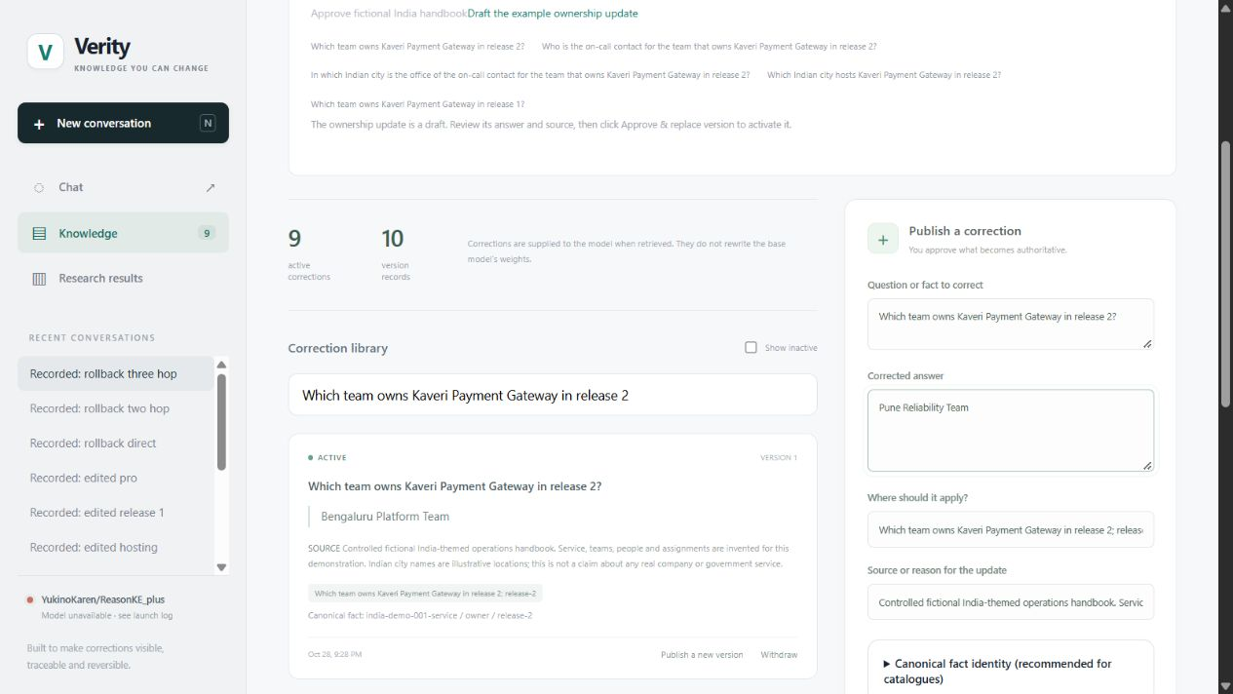
Correction editor and explicit authority
A draft changes nothing until explicit approval.
Authority is visible
Active predecessor
Replacement answer
Explicit scope
Recorded source
Verity correction editor. Browser-local replacement draft over the restored r11 workspace.
24
Notes:
Member 5
The product exposes these mechanisms through a usable workflow. This genuine Verity capture shows the active Bengaluru ownership fact beside a Pune replacement draft, with scope and source fields. Drafting alone does not activate a correction. The operator must approve the replacement and name the predecessor. The library keeps a canonical identity, source and version for inspection. The screenshot workspace restores the audited demonstration receipt rather than issuing new model calls. Our model worker was offline during capture, and the interface reports that state honestly. The editor remains useful for inspecting governed memory independently of inference readiness.
Technical detail
The image is an unedited full-viewport website capture. It shows a browser-local draft against restored r11 state. No approval was performed for screenshot creation. The source is a controlled fictional handbook, not an external assertion about a real payment company. The application uses a local research-operator workflow rather than hosted role-based multi-user administration. Customer chat text never silently publishes authoritative knowledge.
Visual cue
Show the active answer, replacement draft, scope and source.
Evidence
https://github.com/ShivamRaghav7/verity/blob/codex/reasonke-integration/output/presentation/screenshots/provenance.json
https://github.com/ShivamRaghav7/verity/blob/codex/reasonke-integration/scripts/prepare_verity_screenshot_workspace.py
https://github.com/ShivamRaghav7/verity/blob/codex/reasonke-integration/editguard_chat/static/app.js

Slide 25
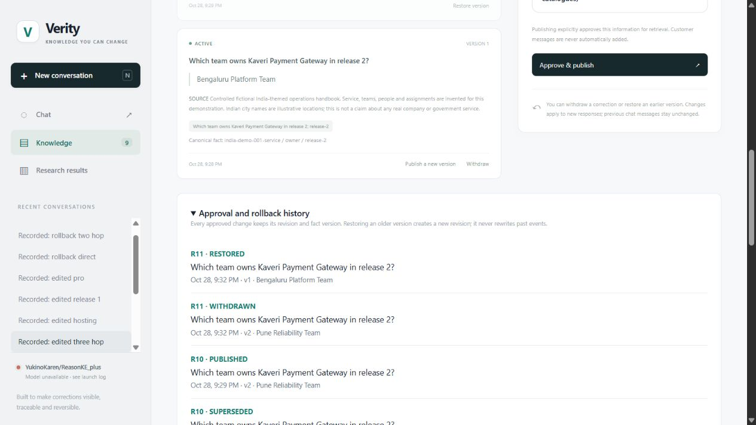
History, rollback and application acceptance
The audit timeline preserves what changed at each revision.
r9 Initial handbook
r10 Replace ownership
r11 Atomic rollback
14/14 neural answers
12 consistency checks
One fictional display lineage,
separate from held-out tests.
Recorded application acceptance, one fictional display lineage. Displayed history comes from the audited receipt.
25
Notes:
Member 5
The history view shows why reversal is more than changing a textbox. Revision ten contains both publication of the replacement and supersession of the predecessor. Revision eleven contains withdrawal of the replacement and restoration of the predecessor. The same revision labels demonstrate the atomic event pairs. In the actual India acceptance workload, fourteen neural answers matched their targets and twelve consistency checks passed. It exercised corrected questions, unchanged scopes, conflict rejection, historical comparison and rollback. Those results cover one fictional display lineage and remain separate from held-out accuracy. The screenshot displays restored saved state, not a new live rollback execution.
Technical detail
Thirteen HTTP generation requests produce fourteen model answers because one comparison invokes generation twice. HTTP p50/p95 is 17.11/33.39 seconds over those thirteen mixed requests, not per-answer latency. The acceptance receipt and host audit retain exact request/response state and provenance. A new rollback demonstration requires a running worker for the fresh follow-up answers; historical SQLite state inspection itself does not require the GPU.
Visual cue
Identify both events at r10 and both at r11, then state the separate acceptance population.
Evidence
https://github.com/ShivamRaghav7/verity/blob/codex/reasonke-integration/reports/reasonke/depth-final/india-acceptance.json
https://github.com/ShivamRaghav7/verity/blob/codex/reasonke-integration/reports/reasonke/depth-final/india-host-audit.json
https://github.com/ShivamRaghav7/verity/blob/codex/reasonke-integration/output/presentation/screenshots/technical-v2/provenance.json

Slide 26
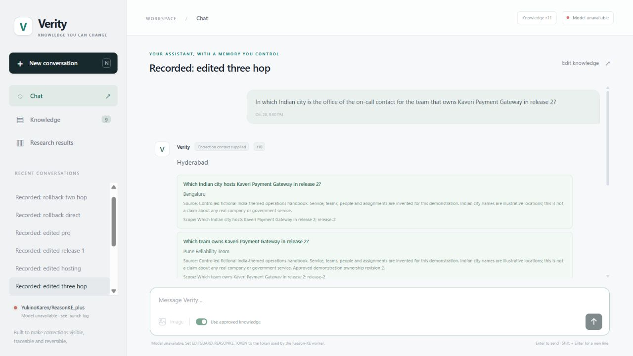
Chat evidence and stored-response semantics
The answer’s revision and the current memory revision can correctly differ.
Stored response
Generated at r10
Hyderabad
Current memory: r11
Restored Chennai path
New questions use the
current snapshot.
Stored messages retain
their original evidence.
Recorded r10 model response displayed against restored r11 memory. Fresh generation requires the model worker.
26
Notes:
Member 5
The chat capture displays an actual saved Hyderabad answer generated at revision ten. The top bar reports that current memory is revision eleven. Those labels can differ correctly: rollback changes future context and does not rewrite historical messages. Each response retains the supplied fact records and its own revision, so we can inspect what produced that answer. A fresh query after rollback should use the restored Chennai path. Historical comparison generates two new responses from matched history. The screenshot is explicitly recorded evidence, and no new generation occurred while making the slides.
Technical detail
The selected conversation is Recorded: edited three hop, from the published generate_edited_three_hop operation. The saved answer evidence identifies r10 and the Pune/Arjun/Hyderabad chain. The restored screenshot workspace is r11. A displayed historical message is not a cache used for new answers. Without an available worker, send is disabled and no deterministic target substitutes for model output. The original acceptance receipt contains the actual fresh post-rollback Chennai answer separately.
Visual cue
Contrast the answer’s r10 badge with current r11 memory.
Evidence
https://github.com/ShivamRaghav7/verity/blob/codex/reasonke-integration/reports/reasonke/depth-final/india-acceptance.json
https://github.com/ShivamRaghav7/verity/blob/codex/reasonke-integration/output/presentation/screenshots/technical-v2/provenance.json
https://github.com/ShivamRaghav7/verity/blob/codex/reasonke-integration/editguard_chat/server.py

Slide 27
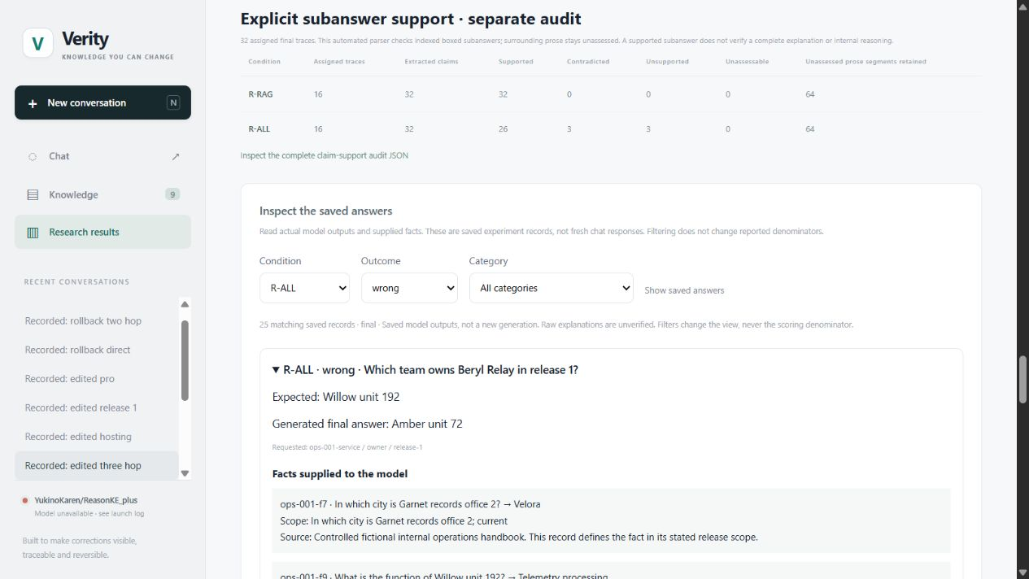
Results explorer and failure inspection
Aggregate findings remain connected to individual outputs and supplied facts.
Inspectable failure
Requested release 1
Expected Willow unit 192
Returned Amber unit 72
The release-2 owner
Filters change the view.
Every assigned outcome
keeps its denominator.
Saved experiment records. The explorer supports raw-output inspection and JSON, CSV and scientific-figure exports.
27
Notes:
Member 5
The results explorer keeps the evaluation inspectable. Here it filters the twenty-five full-memory Reason-KE++ wrong answers and expands a release-scope failure. The interface shows the expected answer, generated final text, requested canonical identity, supplied facts and raw output. Filtering changes the view, never the scoring denominator. Users can switch between the original and depth studies and export scorecards, figures and raw evidence. This connects aggregate graphs to individual failures instead of displaying only a perfect headline score. The capture uses released saved records and requires no fresh GPU inference.
Technical detail
The expanded case asks Beryl Relay release 1, expects Willow unit 192 and endorses Amber unit 72, the release-2 owner. The app retains the raw model revision, prompt digest and pipeline latency. Explanatory prose remains labelled unverified. The screenshot captures the real frontend, including its Verity branding and offline worker state. The underlying frozen raw files and scoring rules are unchanged by this presentation or its post-hoc audit.
Visual cue
Move from the aggregate outcome to expected, actual and supplied facts.
Evidence
https://github.com/ShivamRaghav7/verity/blob/codex/reasonke-integration/editguard_chat/results.py
https://github.com/ShivamRaghav7/verity/blob/codex/reasonke-integration/output/presentation/screenshots/technical-v2/provenance.json
https://github.com/ShivamRaghav7/verity/blob/codex/reasonke-integration/reports/reasonke/operations-final/final-reasonke.json

Slide 28
Engineering contribution and reproducibility
Concrete software and analysis artifacts connect the product to defensible measurements.
Contribution | Implemented mechanism | Reviewable artifact
Governed memory | Identity, approval, events, rollback | store.py + workspace.py
Context adaptation | Bounded frontier + history rules | retrieval.py + server.py
Independent evaluation | Worlds, splits, fixed scoring | datasets + protocols + metrics
Evidence and diagnosis | Raw ledgers, replay, 63-case audit | receipts + audit scripts
Usable deployment | Chat, editor, explorer, container | static/ + notebooks + CI
Reproducibility uses pinned model/data/config identities, atomic per-request records and resume of unexecuted requests only.
28
Notes:
Member 5
Our contribution is the system and the evidence around the reasoner. We implemented governed fact memory, canonical identity, conflict and rollback transactions, revision-safe conversation handling and the private serving boundary. We adapted bounded retrieval, authored independent controlled datasets and built matched finite evaluation with complete ledgers. Protocol hashes, atomic receipts and host audits make the results replayable. Resume executes only unexecuted records under the same identities and preserves completed outcomes. The website, container, CI, data cards, reports and demonstration make that core usable and reviewable. The new failure ledger adds a reproducible description of every updated-method nonsuccess.
Technical detail
The current runtime loads published weights rather than reproducing multi-GPU training. Earlier auxiliary-model training remains a separate archived experiment and is not the source of current ReasonKE++ metrics. Source/data/configuration identity checks protect resume. Saved depth checkpoints at 174,197,235 and 247 records agree with the completed ledger. Software regression tests, neural accuracy, mechanical evidence audits and resource measurements have distinct purposes. A hash protects recorded identity, not semantic truth or independent human review.
Visual cue
Name concrete artifacts and explain what reproducibility checks establish.
Evidence
https://github.com/ShivamRaghav7/verity/blob/codex/reasonke-integration/docs/CONTRIBUTIONS_AND_EVIDENCE.md
https://github.com/ShivamRaghav7/verity/blob/codex/reasonke-integration/reports/reasonke/depth-final/resume-audit.json
https://github.com/ShivamRaghav7/verity/blob/codex/reasonke-integration/.github/workflows/ci.yml
https://github.com/ShivamRaghav7/verity/blob/codex/reasonke-integration/Dockerfile.chat
https://github.com/ShivamRaghav7/verity/blob/codex/reasonke-integration/scripts/analyze_presentation_failures.py

Slide 29
A reversible editing platform, evaluated
Approved corrections transfer across connected facts
and retain an inspectable, reversible history.
Original retrieved: 256/256 vs 241/256
Separate depth: 256/256 vs 248/256
Depth median latency: 15.94 s vs 1.12 s.
Stronger observed coverage has a substantial generation cost.
Evidence is bounded by small fact worlds, repeated templates and automated review.
Larger memory, ambiguous scope and fully faithful explanations remain unestablished.
Notes:
Member 5
We set out to make approved factual changes transfer across connected questions while preserving scoped knowledge and supporting reversal. The implemented platform provides that workflow, and the frozen retrieved configurations answered 256 of 256 questions in each controlled study. The matched Qwen conditions answered 241 and 248, while responding substantially faster. Full-memory failures show why context selection matters, and recorded rollback acceptance establishes operational consistency separately. The conclusion is definite but bounded: this is a functioning, auditable editing platform with strong results on its defined task. Larger memories, ambiguous scopes, unfamiliar operational language and fully faithful explanations are not established by these tests.
Technical detail
A perfect observed score remains plausible in a small explicit fact world with complete support, short aliases and repeated templates. Each study has only 32 final lineages and automated label review. The result is not 512 independent worlds, a general-chat benchmark or an unrestricted three-hop guarantee. Single-operator deployment, lexical scope matching and absent calibrated confidence are material limits. The principal observed tradeoff is greater answer coverage at higher generation latency. No missing training or test-loss plots are invented for an inference-integration project.
Visual cue
Close with the achieved contract, the accuracy–latency cost and the actual limits.
Evidence
https://github.com/ShivamRaghav7/verity/blob/codex/reasonke-integration/reports/reasonke/operations-final/results.json
https://github.com/ShivamRaghav7/verity/blob/codex/reasonke-integration/reports/reasonke/depth-final/results.json
https://github.com/ShivamRaghav7/verity/blob/codex/reasonke-integration/reports/reasonke/depth-final/india-host-audit.json

Slide 30
PPO objective and reward implementation
The clipped surrogate constrains policy updates. Training reference settings follow below.
rₜ(θ) = πθ(oₜ | q, o<ₜ) / πold(oₜ | q, o<ₜ)
Jclip = E[min(rₜ Aₜ, clip(rₜ, 1−ε, 1+ε) Aₜ)]
Reference setting | SFT | PPO
Learning rate | 1e−5 | Actor 1e−6, critic 1e−5
Epochs | 10 | 15
KL coefficient | — | 0.001
Paper: αRprocess + (1−α)Routcome, main α=0.5. Pinned reward code: Rprocess + Routcome.
Equal component weighting with different reward scale relative to KL.
30
Notes:
Member 1 (optional backup)
PPO compares the current policy’s token probabilities with the previous policy through a likelihood ratio. The clipped objective prevents an estimated advantage from rewarding arbitrarily large probability changes. The reference configuration includes a critic, vLLM rollouts and KL control. The paper expresses a normalized blend of process and outcome rewards, while the pinned released code adds those components. At alpha one half the sum has the same weighting but twice the scale. That difference matters for reproduction claims. Our deployment does not run PPO, and the released checkpoint’s complete training history is not established by these example scripts.
Technical detail
The official SFT launcher specifies 10 epochs, learning rate 1e-5, cosine schedule and eight GPU processes. The PPO launcher specifies actor 1e-6, critic 1e-5, KL coefficient 0.001 and 15 epochs. These are published reference settings, not our measured training resources or completed runs. The collator fallback and reward-scale difference are reproducibility caveats. The paper's training hardware/time is not an estimate for the T4. The policy-ratio/advantage formula is the standard clipped surrogate, not a complete accounting of critic and entropy losses.
Visual cue
Use only if asked about PPO or faithful reproduction.
Evidence
https://aclanthology.org/2026.findings-acl.1137/
https://github.com/YukinoshitaKaren/Reason-KE/blob/d515c6ac5ec747029484af65103a6270fa693058/ReasonKE%2B%2B/train/sft.py
https://github.com/YukinoshitaKaren/Reason-KE/blob/d515c6ac5ec747029484af65103a6270fa693058/ReasonKE%2B%2B/train/sft.sh
https://github.com/YukinoshitaKaren/Reason-KE/blob/d515c6ac5ec747029484af65103a6270fa693058/ReasonKE%2B%2B/verl/reasonke.sh
https://github.com/YukinoshitaKaren/Reason-KE/blob/d515c6ac5ec747029484af65103a6270fa693058/ReasonKE%2B%2B/verl/verl/utils/reward_score/my_reward.py

Slide 31
Answer-contract failures in detail
All strict primary scores stay unchanged after inspection.
G-ALL record | Expected person | Endorsed final span
ops-045 two-hop paraphrase | Nira Wren | Cedar unit 116 Nira Wren
ops-047 two-hop paraphrase | Serin Wren | Indigo unit 118 Serin Wren
ops-005 two-hop paraphrase | Nira Dane | Indigo unit 136 Nira Dane
Two outputs contain a compatible correct owner/contact chain but add unwanted text.
One combines a Pro owner with the correct contact.
Two Reason-KE++ wrong finals also contain the expected value in a boxed intermediate step.
Post-hoc description distinguishes answer-contract and fact-association failures. It does not turn failures into new successes.
31
Notes:
Member 4 (optional backup)
This backup distinguishes final-answer strictness from factual association. In two Qwen full-memory cases, the output contains the correct owning team and requested contact, but violates the instruction to give only the contact name. Another concatenation combines a Pro-service owner with the correct contact, so its additional text is also factually contaminated. All retain their original wrong scores. Similarly, a correct intermediate boxed answer can coexist with a wrong final answer. The failure ledger retains every case and its evidence, so the panel can inspect these distinctions without replacing the frozen metric with a post-hoc success score.
Technical detail
The compatible concatenations are ops-045 and ops-047 two_hop_paraphrase. The contaminated concatenation is ops-005. The new parser finds two R-ALL wrong-final records containing the expected value in an action-section boxed answer; this is a narrow text diagnostic and not a semantic certification of the trace. Twenty-three operations/depth retrieved Qwen abstentions remain literal UNKNOWN. Together with two G-ALL abstentions, the updated-method ledger has 25 abstentions and 38 strict mismatches. The unchanged-base R0 diagnostic is excluded from that failure cohort.
Visual cue
Keep contract violations, false associations and explanation quality distinct.
Evidence
https://github.com/ShivamRaghav7/verity/blob/codex/reasonke-integration/output/presentation/analysis/failure-ledger.csv
https://github.com/ShivamRaghav7/verity/blob/codex/reasonke-integration/output/presentation/analysis/failure-audit.json
https://github.com/ShivamRaghav7/verity/blob/codex/reasonke-integration/reports/reasonke/operations-final/FAILURE_ANALYSIS.md

Slide 32
Evidence and configuration reference
Use the source artifact that supports the question being asked.
Claim or mechanism | Primary project evidence
Model identity and budgets | configs/reasonke-model.json + instruction-model.json
Original frozen comparison | reports/reasonke/operations-final/
Separate depth and uncertainty | reports/reasonke/depth-final/
Real correction/rollback acceptance | depth-final/india-acceptance.json + host audit
All updated-method nonsuccesses | output/presentation/analysis/failure-audit.json
Displayed interface provenance | screenshots/technical-v2/provenance.json
Raw outputs, protocol hashes, scoring code and labelled populations remain separate from presentation graphics.
32
Notes:
Member 3 (optional backup)
Every major claim has a concrete artifact. Model manifests identify exact revisions and budgets. Dataset manifests and frozen protocols bind the task. Raw ledgers retain all assigned outputs, supports and resources. Host replay recomputes extraction and scoring. Derived reports and chart workbooks expose the displayed values. The application acceptance receipt covers real HTTP generations and revision consistency separately. Our supplemental failure audit and screenshot provenance add no new model observations. This evidence chain is how another team member can reproduce the analysis and defend a result without relying only on a slide headline.
Technical detail
The current code and protocol sources must retain their recorded hashes. Presentation edits affect documentation and analysis outputs, not the frozen model/data/scoring files. The code checkout should use the version recorded with each protocol. CI and container definitions are reproducibility infrastructure, not proof of enterprise security or throughput. A generated answer with retrieved sources is still model output. The missing checkpoint README does not justify assigning the paper's headline benchmark score to the exact deployed revision.
Visual cue
Find the artifact that supports the question being asked.
Evidence
https://github.com/ShivamRaghav7/verity/blob/codex/reasonke-integration/configs/reasonke-model.json
https://github.com/ShivamRaghav7/verity/blob/codex/reasonke-integration/reports/reasonke/operations-final/protocol.json
https://github.com/ShivamRaghav7/verity/blob/codex/reasonke-integration/reports/reasonke/depth-final/protocol.json
https://github.com/ShivamRaghav7/verity/blob/codex/reasonke-integration/reports/reasonke/depth-final/india-acceptance.json
https://github.com/ShivamRaghav7/verity/blob/codex/reasonke-integration/output/presentation/analysis/failure-audit.json

