Slide 1
PRESENTATION ON
C PROJECT

Slide 2
THE BRAIN SHOOTERS
group members : shivam , akashDEEP , AMAN , TUSHAR ,
BHANUPRIYA , MEHVISH

Slide 3
THREE TYPE OF FANTASIES IN PEOPLE

Slide 4

ACTION/ADVENTURE

Slide 5


KNOWLEDGE

Slide 6


MONEY

Slide 7
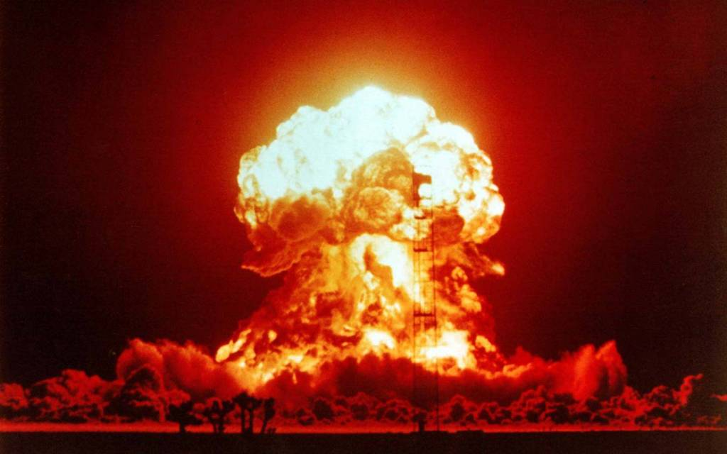
WHAT IF ALL TOGETHER..???

Slide 8
THE
BRAIN
SHOOTERS
“WHERE KNOWLEDGE TURNS INTO MONEY WITH EVERY SHOT”

Slide 9
ABOUT THE PROJECT
It is a quiz game.
With all three fantasies….

Slide 10
OBJECTIVE
To give the users the fun of Shooting, Brain Exercise at one place at home….

Slide 11
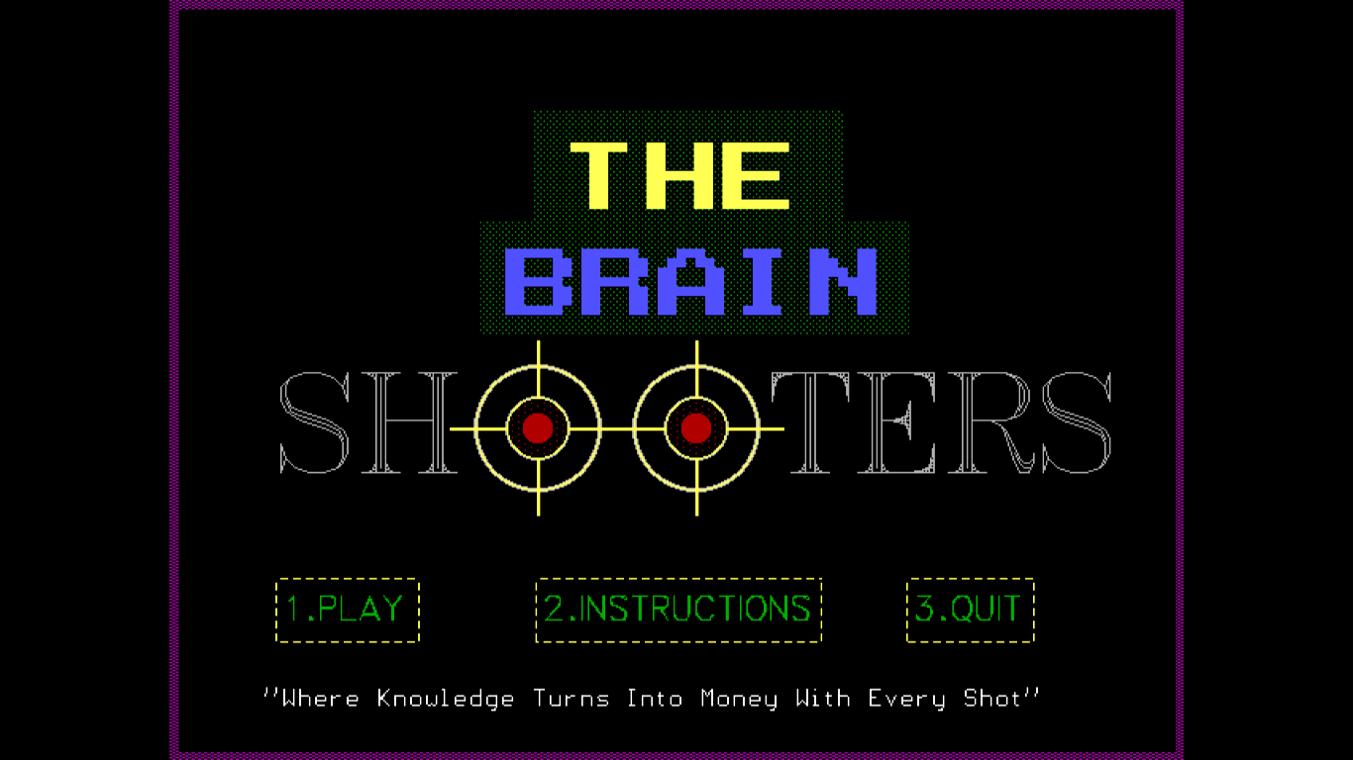
MAIN SCREEN

Slide 12
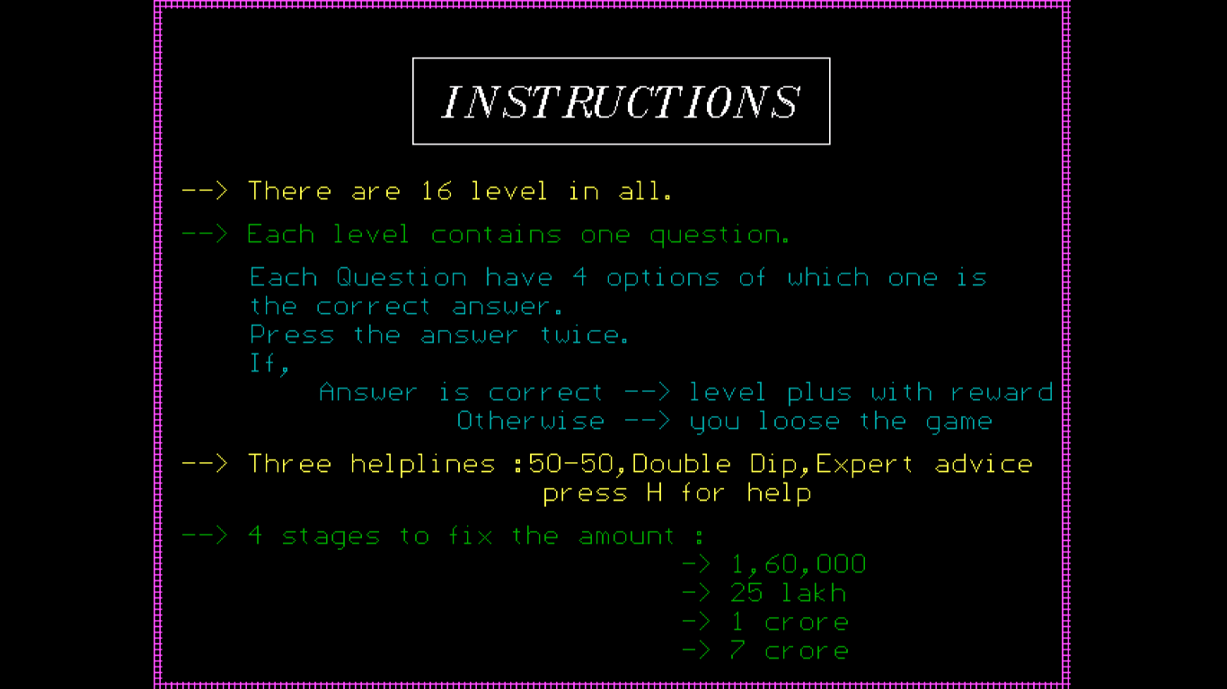
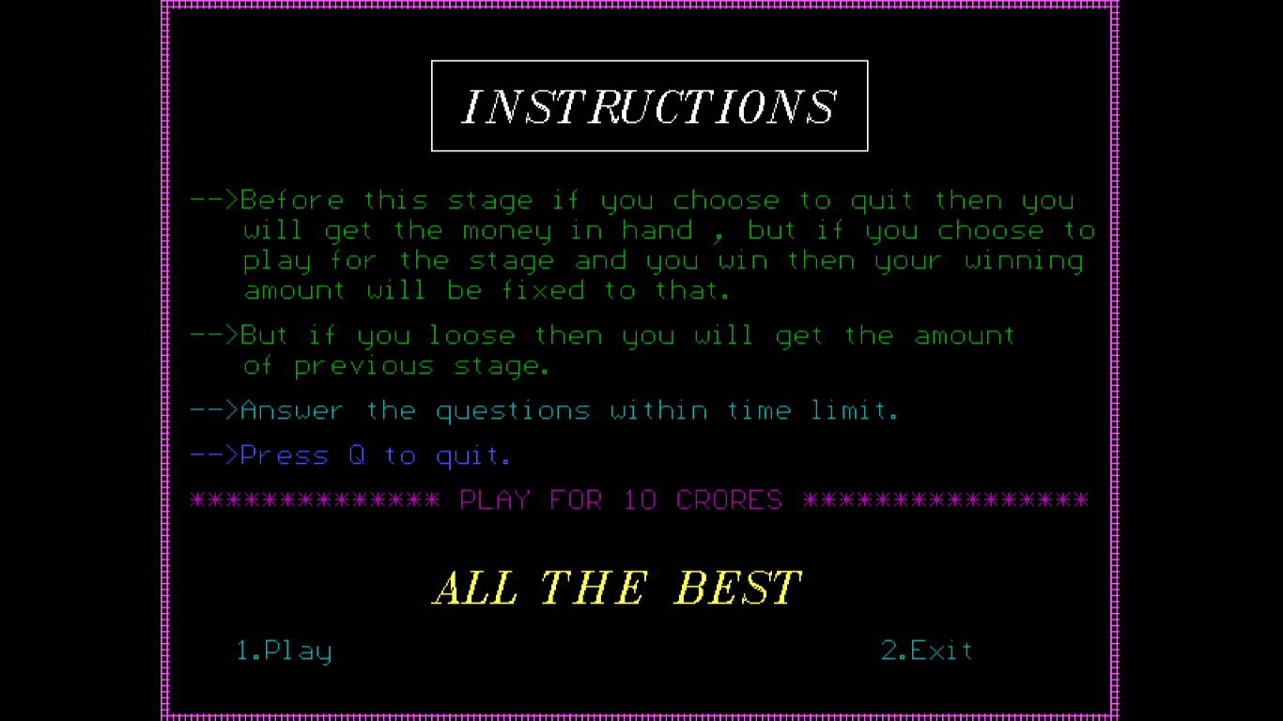
RULES

Slide 13
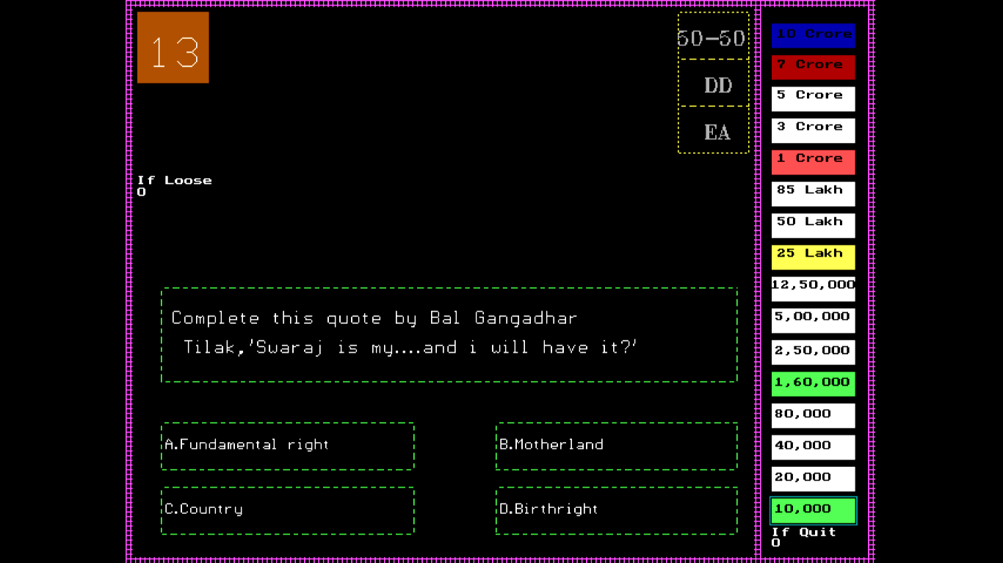
PLAY SCREEN

Slide 14
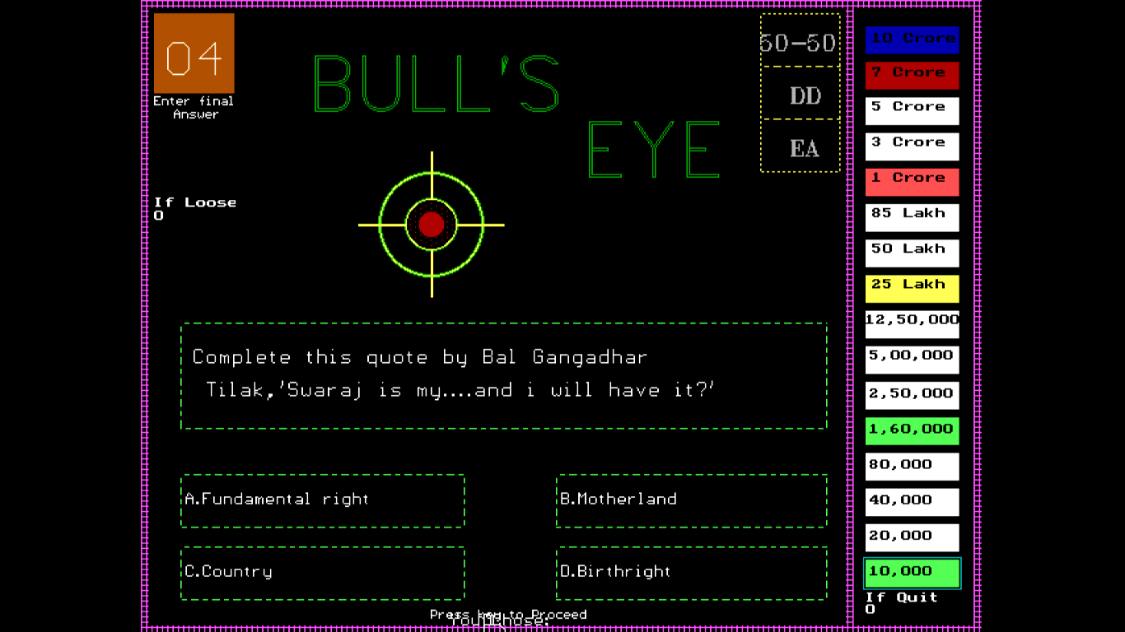
PLAY SCREEN ON RIGHT ANSWER

Slide 15
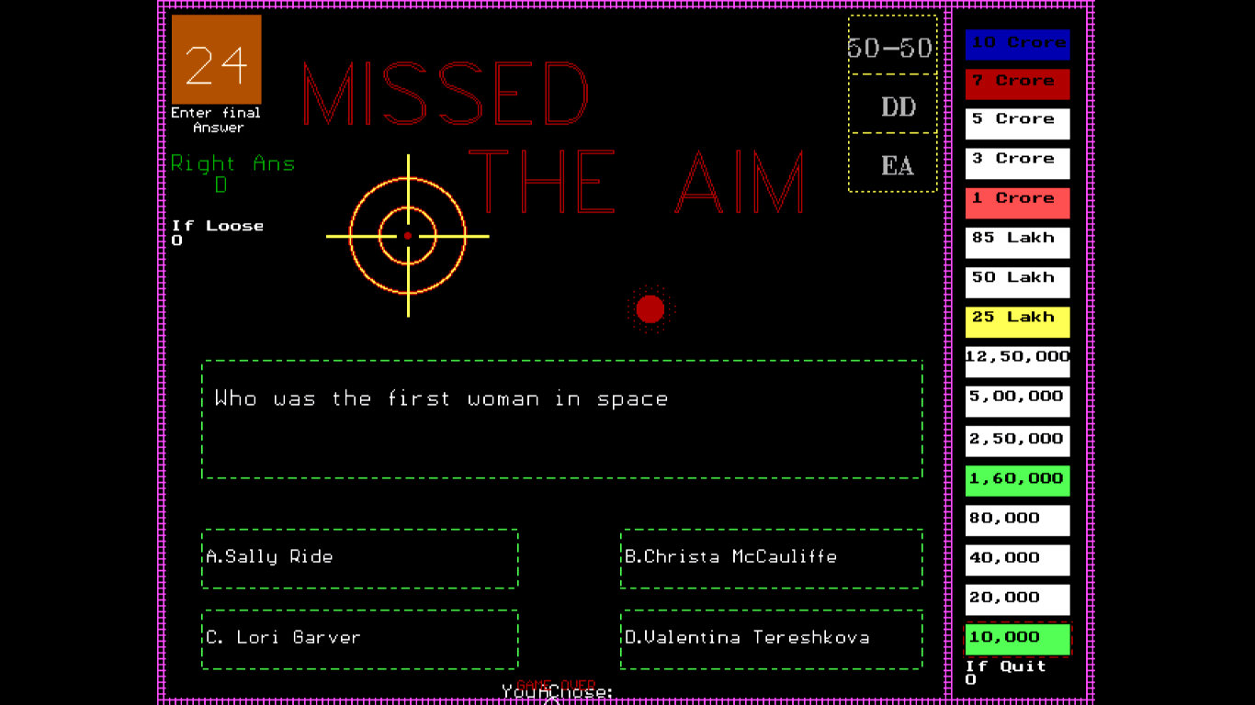
PLAY SCREEN ON WRONG ANSWER

Slide 16
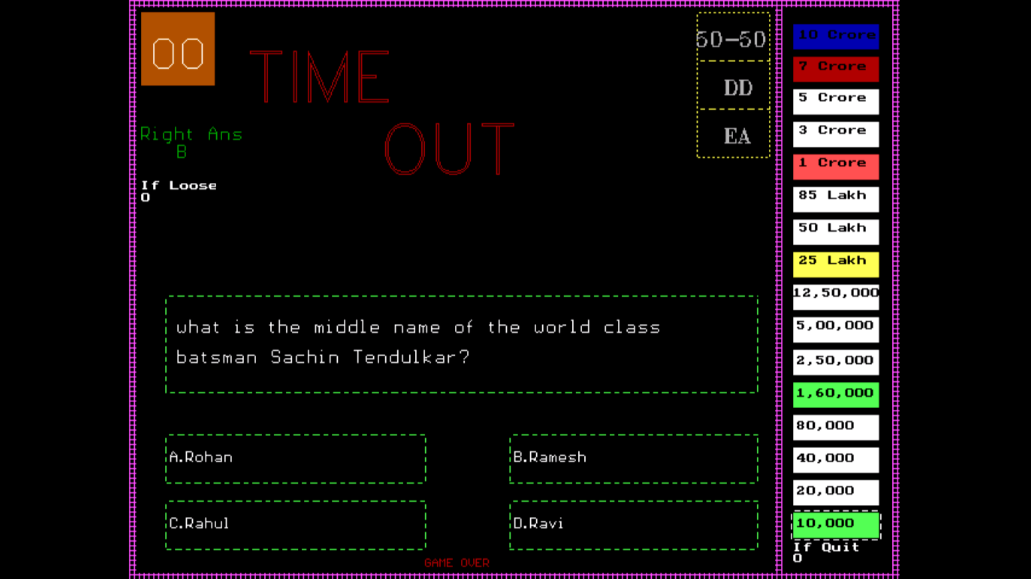
PLAY SCREEN AT TIMEOUT

Slide 17
ON WINNING JACKPOT

Slide 18


Slide 19

LIMITATIONS
Validations are less.
Sorry…..no real money

Slide 20
FUTURE SCOPE
Multiple players game.
Creative helplines.
More Better Graphics…

Slide 21
CONCLUSION
We hope that we have reached our objective

Slide 22


