Slide 1

COERCION
Under section-15 of Indian Contract Act ,1872

Slide 2

INTRODUCTION
Coercion comes under Section-15 Of The Indian Contract Act,1872
It is simply means forcing a person to enter into a contract by adopting unfair means. The basics idea of ‘coercion ‘ is that a person may be forced to make an agreement by the use of fear of some kind of physical harm or loss
Example: An agreement obtained at gun point

Slide 3


Essential Ingredients To Coercion
(1)Committing or threating to commit any act forbidden by the Indian Penal Code
(2)The unlawful detaining or threating to detain any property to the prejustice of any person
(3)Whatever with the intention of causing any person to enter into an agreement

Slide 4
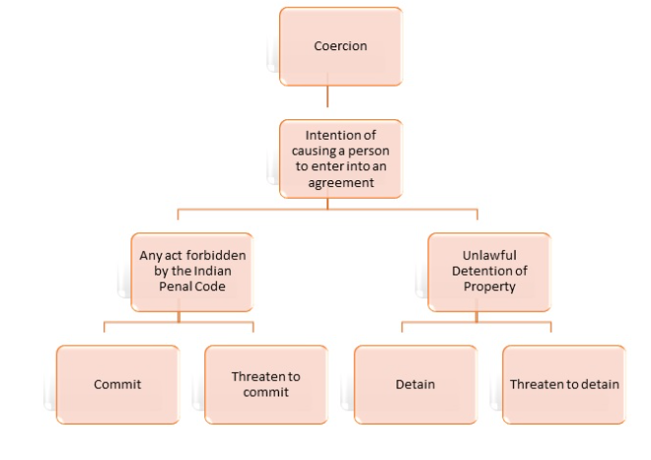

Slide 5


Threats not amounting to coercion:-
Treat to sue:- Treat to prosecute a person or file a suit against the person is not coercion Approaching a Court and seeking appropriate remedy by filling a suit is the fundamental right of every person .
Statutory compulsions:- If anything is done at the insistence of the order of the court . It is not coercion
Threat to strike:- A threat by the employees to go on a strike in support of their demands is not regarded as coercion. This is because ,the threat to strike is not an offence under the IPC . It is a right given under the industrial Disputes Act .
Detaining property under mortgage:- Detention of property under a mortgage contract ,until the payment of the loan is made, does not amount to coercion .

Slide 6
Illustration A threatens to shoot B, if he does not let out his house to A. B under fear agrees to let out his house to A. This agreement is brought under by coercion. B’s consent was not free. B can avoid the contract , even after agreeing.

Slide 7
Conclusion Any contract under coercion is voidable. (Or which agreement is not taken with free consent is not a valid agreement & that agreement is not becoming a valid contract ,parties should not try any unfair way to do contract like coercion which is punishable offence by law.

Slide 8


