Slide 1

COERCION
Under section-15 of Indian
Contract Act ,1872

Slide 2

INTRODUCTION
Coercion comes under Section-15 Of
The Indian Contract Act,1872
It is simply means forcing a person to enter into
a contract by adopting unfair means. The
basics idea of ‘coercion ‘ is that a person may
be forced to make an agreement by the use of
fear of some kind of physical harm or loss
Example: An agreement obtained at gun point
Sample footer text
3/1/20XX
2

Slide 3

Essential Ingredients
To Coercion
(1)Committing or threating to
commit any act forbidden by the
Indian Penal Code
(2)The unlawful detaining or
threating to detain any property to
the prejustice of any person
(3)Whatever with the intention of
causing any person to enter into
an agreement
Sample footer text
3/1/20XX
3

Slide 4
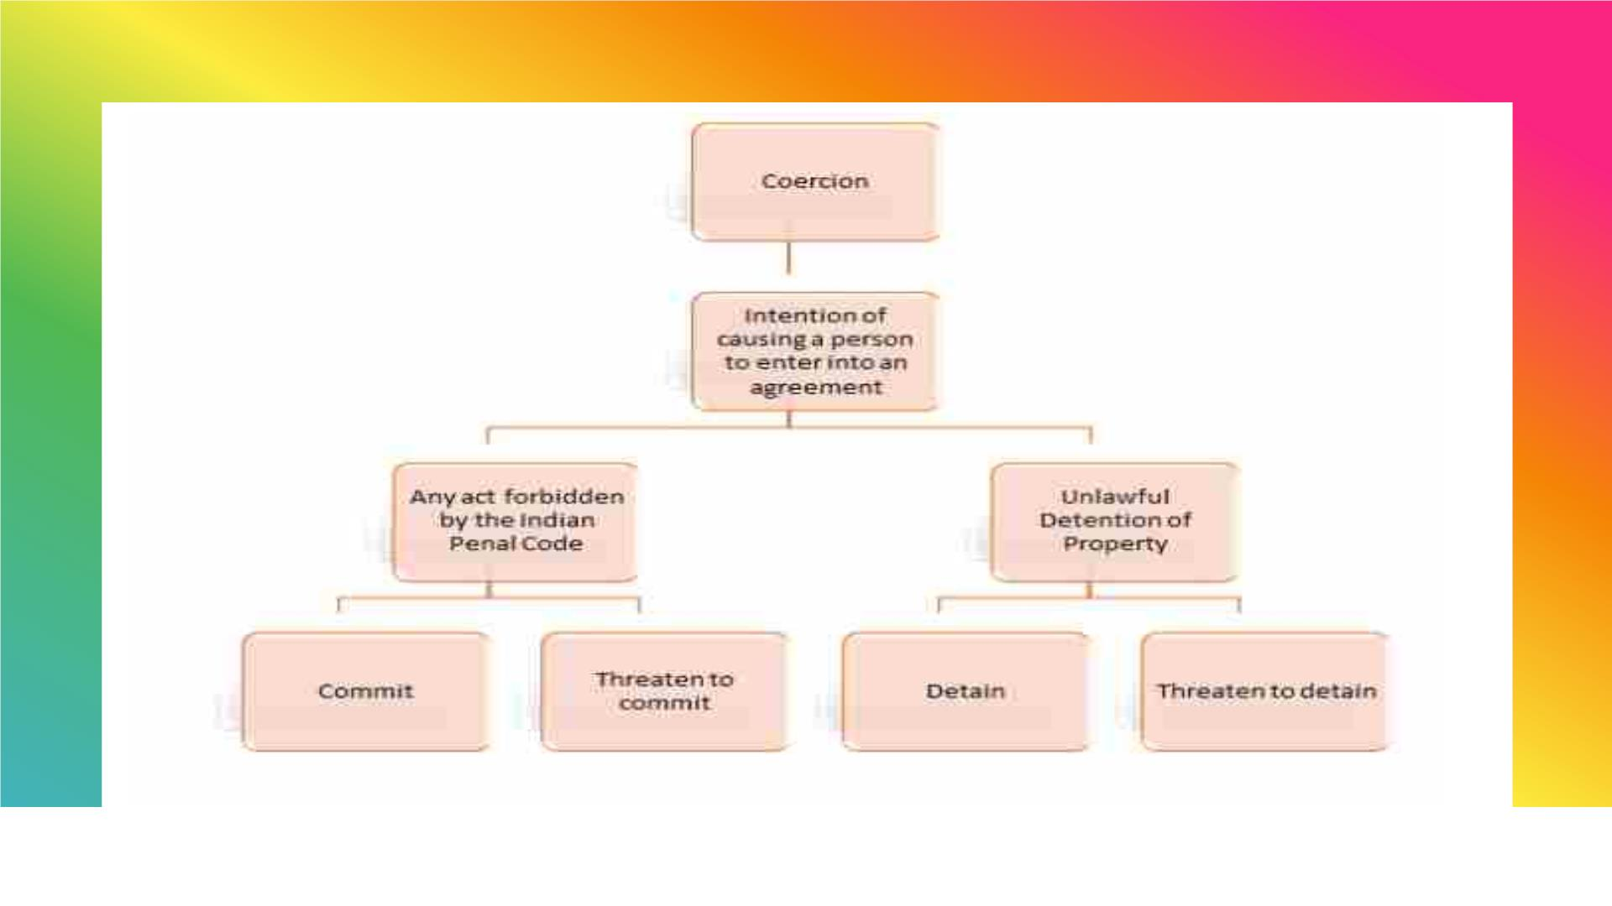
Sample footer text
3/1/20XX
4

Slide 5

Threats not amounting to coercion:-
Treat to sue:- Treat to prosecute a person or file a suit against the person
is not coercion Approaching a Court and seeking appropriate remedy by filling
a suit is the fundamental right of every person .
Statutory compulsions:- If anything is done at the insistence of the order
of the court . It is not coercion
Threat to strike:- A threat by the employees to go on a strike in support of
their demands is not regarded as coercion. This is because ,the threat to strike
is not an offence under the IPC . It is a right given under the industrial Disputes
Act .
Detaining property under mortgage:- Detention of property under a
mortgage contract ,until the payment of the loan is made, does not amount to
coercion .

Slide 6

Illustration
A threatens to shoot B, if he does not let out
his house to A. B under fear agrees to let out
his house to A. This agreement is brought
under by coercion. B’s consent was not free.
B can avoid the contract , even after
agreeing.
Sample footer text
3/1/20XX
6

Slide 7
Conclusion
Any contract under coercion is voidable.
(Or which agreement is not taken with free
consent is not a valid agreement & that
agreement is not becoming a valid contract
,parties should not try any unfair way to do
contract like coercion which is punishable
offence by law.
Sample footer text
3/1/20XX
7

Slide 8


