Slide 1

Project Title -SEASONAL AGRICULTURE PERFORMANCE ANALYSIS
Student Name- Shivam Saket
College Name- Govt. Rewa Engineering College
AICTE STU ID : STU6811e00a8d4511746001930

Slide 2

PROBLEM STATEMENT
Agricultural activities are influenced by seasonal variations in environmental conditions, farming practices, resource availability and market conditions. As a result, agricultural performance may differ from one season to another. However, raw agricultural data does not clearly explain how agricultural performance changes across seasons or what patterns can be observed in different seasonal conditions. The problem is to analyze the given agricultural dataset and investigate seasonal differences in agricultural performance by identifying meaningful patterns, trends, relationships and variations within the available data.

Slide 3
Project Description
Seasonal Agriculture Performance Analysis is a data analytics project focused on understanding how agricultural performance changes across different seasons, crops, geographical areas and farming conditions.
The project uses Python-based data analysis, statistical techniques and data visualization to examine:
Crop yield and production
Environmental conditions
Fertilizer and pesticide usage
Irrigation and water utilization
Water efficiency
Revenue, cost and profit
Seasonal and crop-level variations
The objective is to convert raw agricultural data into meaningful, evidence-based insights that can support agricultural planning and resource management.

Slide 4

WHO ARE THE END USERS?
Farmers For understanding seasonal crop performance, resource usage and profitability.
Agricultural Departments For studying seasonal agricultural patterns and regional performance.
Agricultural Researchers For analyzing relationships between environmental conditions and crop outcomes.
Irrigation & Resource Managers For evaluating water utilization and irrigation efficiency.
Agricultural Planners & Analysts For supporting evidence-based agricultural planning and decision-making.

Slide 5

Technology Used
Programming Language
Python
Libraries
Pandas — Data manipulation and analysis
NumPy — Numerical computation
Matplotlib — Data visualization
Seaborn — Statistical visualization
SciPy — Statistical analysis
Platform
Google Colab

Slide 6
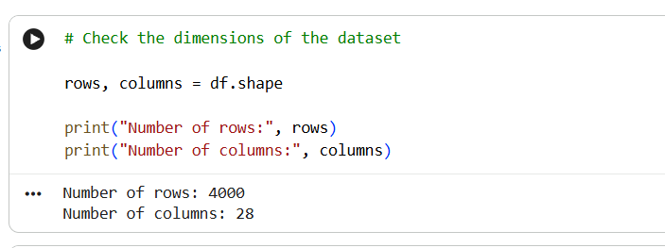
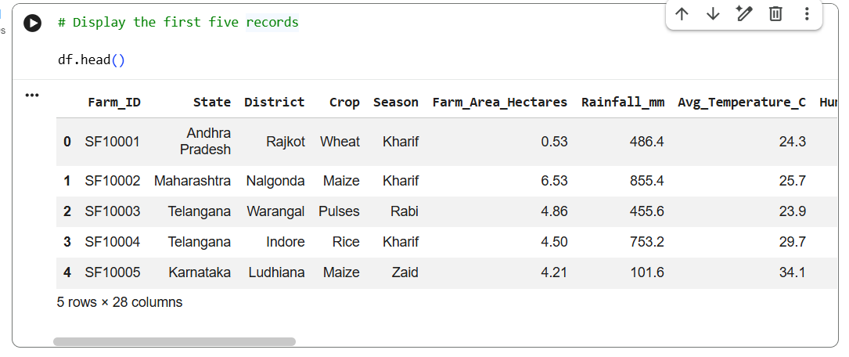
RESULT-DATASET OVERVIEW
Agricultural activities across different seasons
Multiple crops and geographical areas
Environmental and soil conditions
Resource utilization
Production and yield
Economic performance

Slide 7
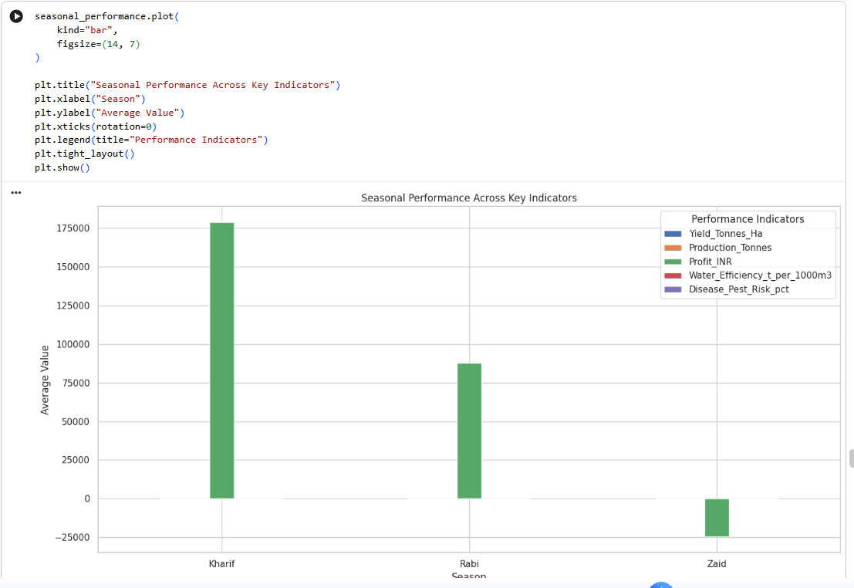
RESULT-SEASONAL PERFORMANCE
Highest average yield:
Highest average profit:
Highest water efficiency:
Lowest/Highest disease risk:

Slide 8
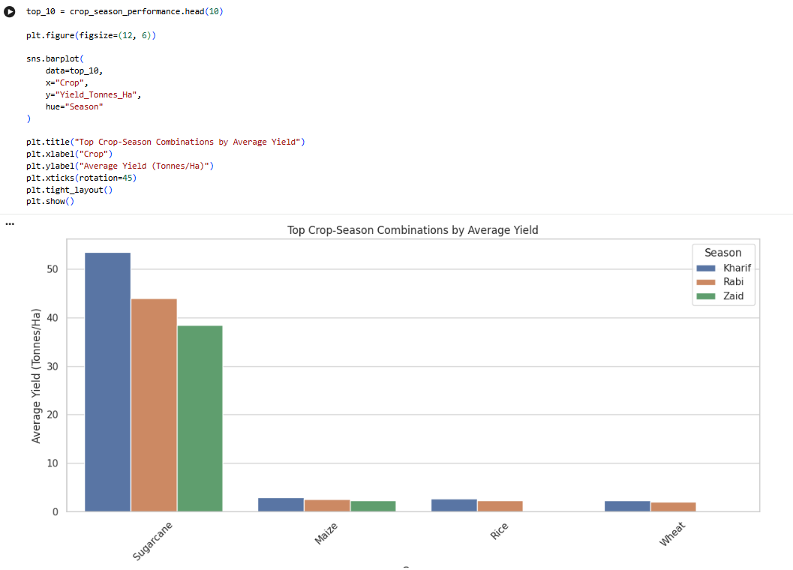
RESULTS — CROP & SEASON PERFORMANCE

Slide 9
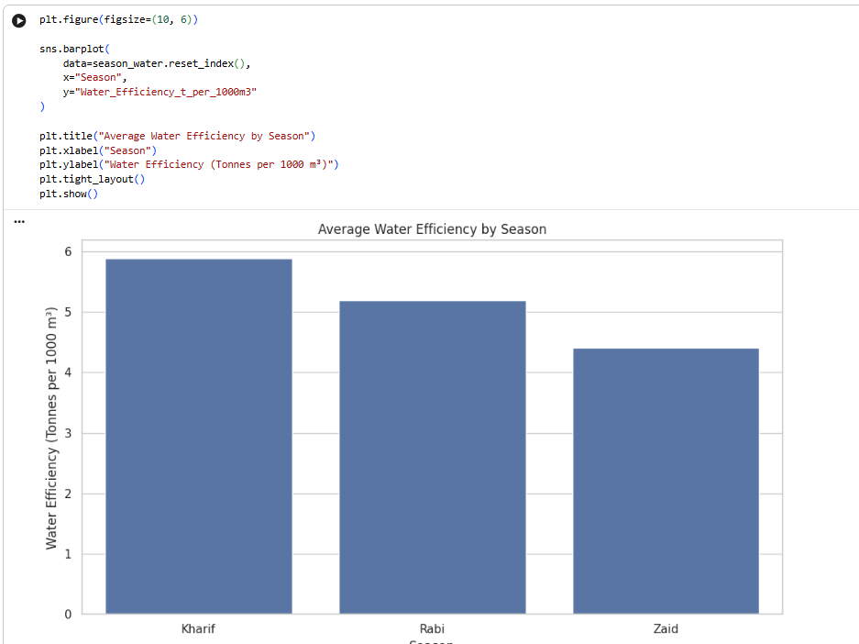
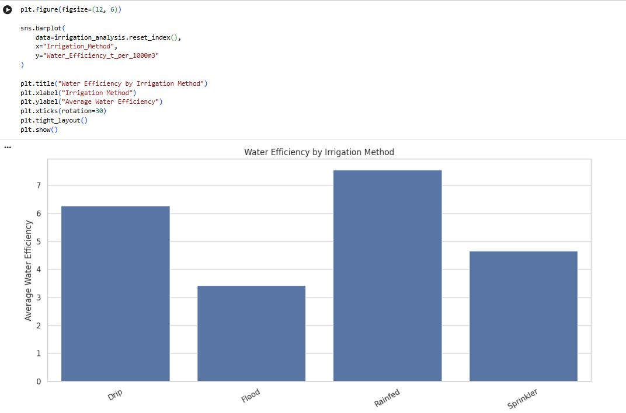
RESULTS — WATER EFFICIENCY ANALYSIS
Average water usage
Average water efficiency
Average yield
Irrigation method comparison

Slide 10
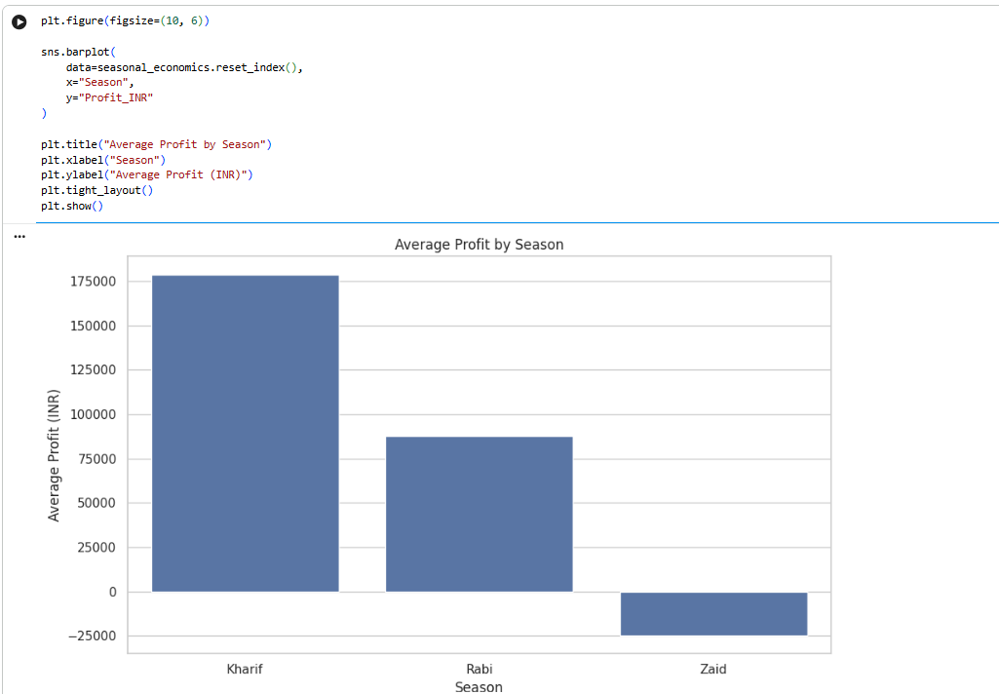
RESULTS — ECONOMIC PERFORMANCE
Average Revenue
Average Cost
Average Profit
Loss-making farm percentage

Slide 11
Future scope
Integration of real-time weather and climate data
Incorporation of historical multi-year agricultural data
Development of predictive crop yield models
Crop recommendation based on seasonal conditions
Advanced water and resource optimization
Regional-level agricultural performance dashboards
Integration of real-time market price information
Machine Learning-based yield and profitability prediction

Slide 12
GitHub Link
https://github.com/ShivamSaket-88/Seasonal-Agriculture-Performance-Analysis.git

Slide 13
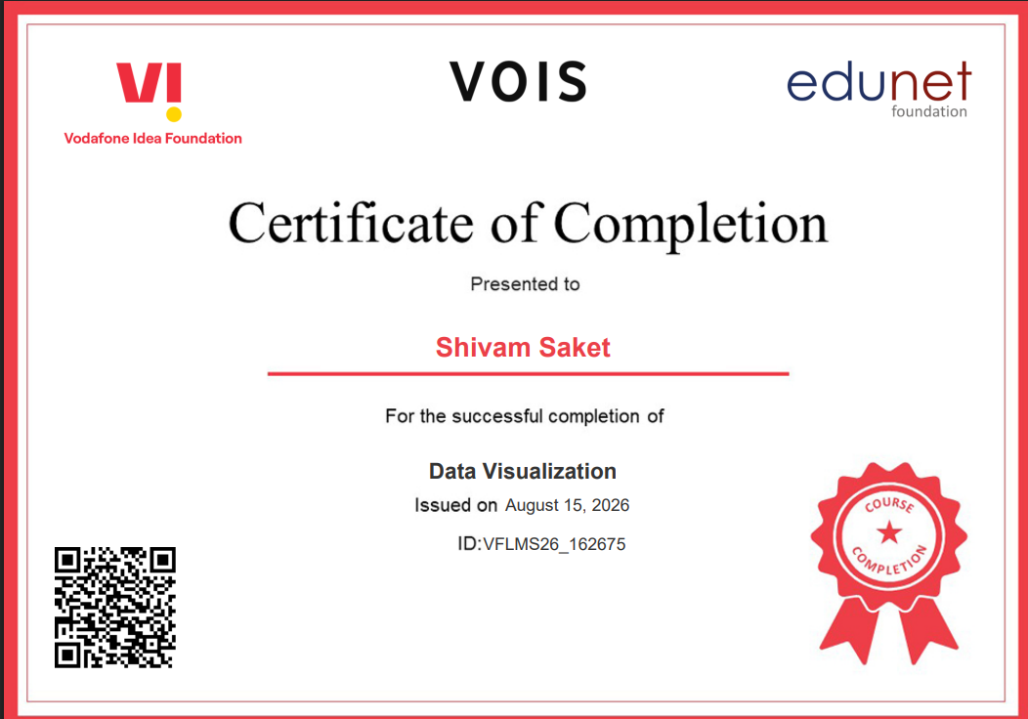
VOIS Course completion certificate - Course name- Data Visualization

Slide 14
THANK YOU
.
.

