Slide 1
ADAPTIVE NOISE
CANCELLATION
LMS / NLMS Adaptive Filtering — Software Implementation
9 dB
LMS
50 Hz
64
SNR Improvement
Core Algorithm
Noise Target
Filter Taps
ECE 6th Semester · Jalpaiguri Government Engineering College

Slide 2
What is Adaptive Noise Cancellation?
Definition
Real-world Applications
ANC uses a reference noise signal and an adaptive filter to estimate and subtract unwanted noise from a primary signal in real time.
Noise-cancelling headphones (Sony, Bose)
Aircraft cockpit communication
ECG / EEG biomedical signal processing
Power-line hum removal in audio
Sonar & radar signal processing
Primary mic
Reference mic
Adaptive filter
Error output
d(n) = signal + noise
x(n) = noise only
W(n) — updates per LMS
e(n) ≈ clean signal
⟶ Feedback loop: e(n) drives the LMS update of W(n)
2

Slide 3
The LMS Algorithm
1
Filter Output
2
Error Signal
3
Weight Update (LMS)
y(n) = W(n) · X(n)
e(n) = d(n) − y(n)
W(n+1) = W(n) + 2μ · e(n) · X(n)
Dot product of weight vector W and input buffer X gives the noise estimate y(n)
Primary signal minus noise estimate — this is the recovered clean signal
Gradient descent step: μ is step size, e(n)·X(n) is the instantaneous gradient
NLMS — Normalized Variant
Choosing μ (step size)
W(n+1) = W(n) + (μ / ‖X(n)‖²) · e(n) · X(n)
μ too large → unstable (diverges)
μ too small → slow convergence
Typical range: 0.001 – 0.05
3

Slide 4
Python Implementation
class LMSFilter:
def __init__(self, order=64, mu=0.005):
self.w = np.zeros(order)
self.x_buf = np.zeros(order)
self.mu = mu
def update(self, x_n, d_n):
self.x_buf = np.roll(self.x_buf, 1)
self.x_buf[0] = x_n
y_n = np.dot(self.w, self.x_buf)
e_n = d_n - y_n
self.w += 2 * self.mu * e_n * self.x_buf
return e_n # recovered signal
Filter weights initialised to zero
Circular input buffer (last N samples)
Slide new sample into buffer
y(n) — noise estimate
e(n) = d(n) − y(n)
Dependencies
LMS weight update equation
numpy — arrays & DSP math
scipy — signal analysis
matplotlib — plotting
sounddevice — live audio
4

Slide 5
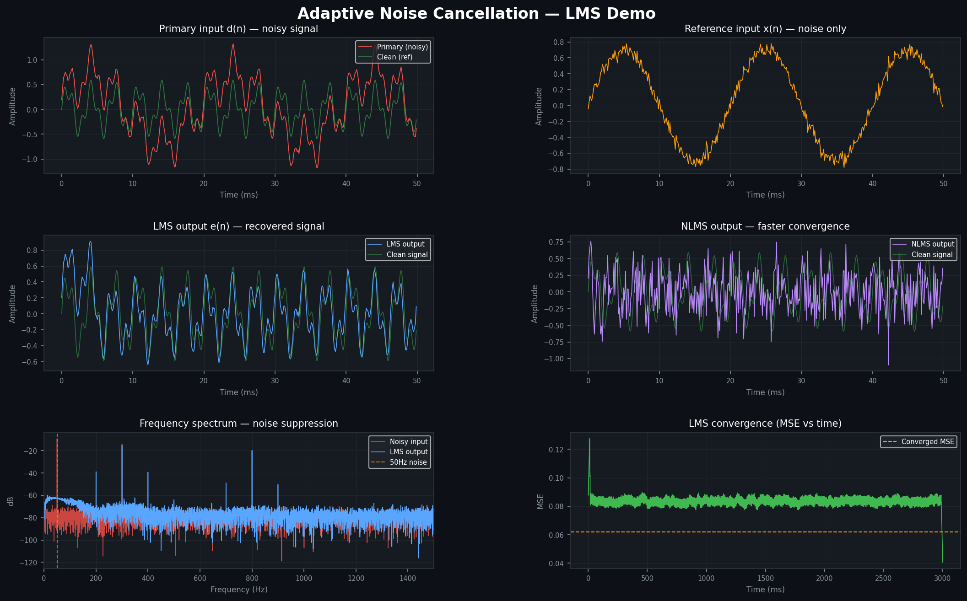
Simulation Results
−3.9 dB
SNR before ANC
+5.1 dB
SNR after LMS
+9.0 dB
Improvement
Setup: 300+800 Hz speech | 50 Hz power-line noise | LMS order=64 | μ=0.005
5

Slide 6
LMS vs NLMS — Algorithm Comparison
Property | LMS | NLMS
Update rule | W += 2μ · e · X | W += (μ / ‖X‖²) · e · X
Step size | Fixed μ | Adaptive (normalized)
Convergence speed | Slower | Faster
Stability | Depends on signal power | More robust
Complexity | O(N) — N filter taps | O(N) + 1 division
Best used when | SNR is roughly constant | Signal amplitude varies
For this project we implement both. LMS is simpler and sufficient for steady hum. NLMS performs better when noise amplitude fluctuates (e.g. engine vibration).
6

Slide 7
Live Demo Architecture
Microphone
Primary input d(n)
LMS Filter
Error output
Live plot
order=64, μ=0.01
e(n) ≈ clean speech
Animated waveform
Sine gen.
Reference x(n) @ 50Hz
e(n) feedback → weight update
How to run
Live demo features
# Offline demo (no mic needed)
python anc_live_demo.py
# Real-time mic demo
python anc_live_demo.py --live
Block-by-block real-time processing (512 samples)
Synthesised reference at target frequency
Animated dual-panel waveform display
Works on single-mic laptop setup
Ctrl+C to stop cleanly
7

Slide 8
Conclusion & Future Scope
Key Achievements
Future Scope
9.0 dB SNR improvement
RLS algorithm
LMS filter, 50 Hz target noise
Recursive Least Squares — faster convergence
Dual algorithm
Deep learning ANC
LMS and NLMS both implemented
CNN/LSTM-based noise cancellation
Live demo ready
Multi-channel ANC
Real-time mic processing with animation
Stereo / spatial noise suppression
Frequency proof
Hardware deployment
FFT confirms 50 Hz spike eliminated
STM32 / Raspberry Pi implementation
Pure Python
Real-world audio
numpy / scipy — no MATLAB needed
Test on recorded speech + noise files
8
Jalpaiguri Government Engineering College · Electronics & Communication Engineering · 6th Semester

