Slide 1
MDS LAB
Assignment
Group Number : 11

Slide 2
TEAM MEMBERS :
Shivam Snehil BTECH/10646/22
Ayush Kumar BTECH/10672/22
Group Number : 11

Slide 3
PROBLEM STATEMENT
Find there's a connection between the parents' educational background in the dataset and the student's grades in dataset Students Performance in Exams (kaggle.com). Show your appropriate analysis and interpretation in form of graphs/plot. Give your own comments on the interpretation given by the graphs.
*Dataset : Students Performance in Exams (kaggle.com)

Slide 4
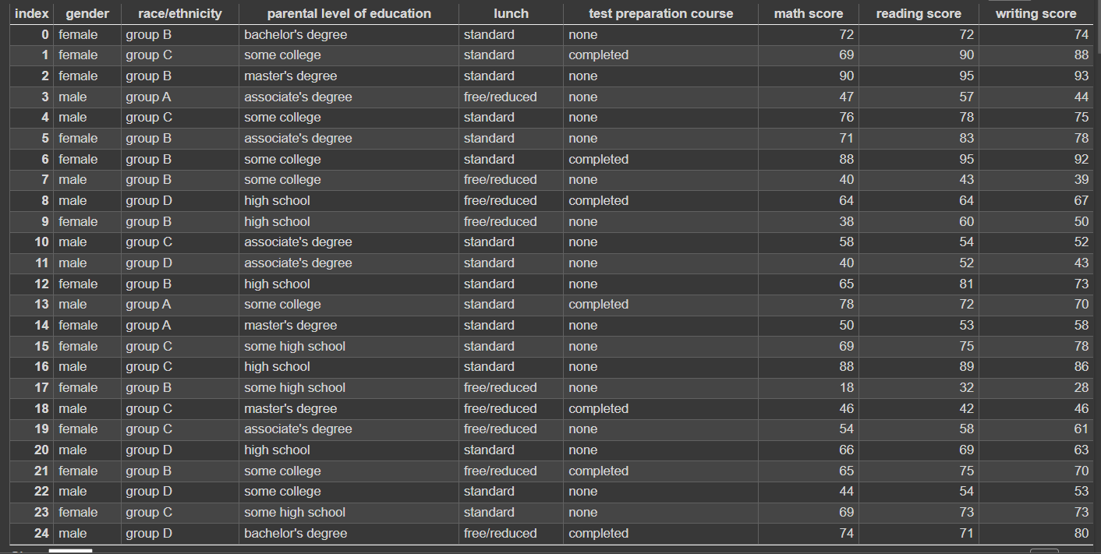
Analyzing Dataset

Slide 5
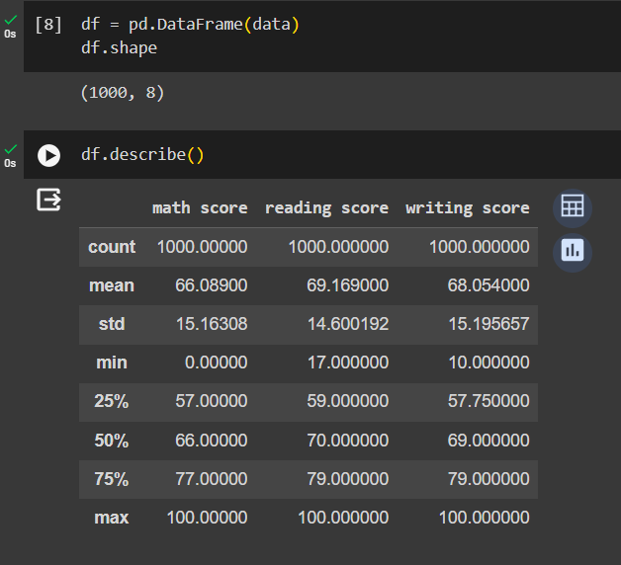
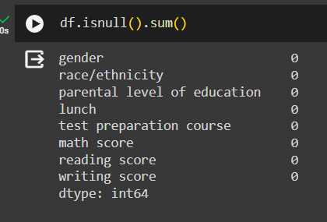
Analyzing Dataset
We have started our analysis of data from getting the size of the data using an inbuilt function df.shape where df is our data set. The size of the data is (1000, 8) which means there are 1000 rows and 8 columns in the data set. We also used describe function to get the overview of the data.
We also checked whether there is any row in the dataset so that we can handle it in analysis.

Slide 6
How to find out the connection
Find out the parameter which defines all the subjects score in one value i.e mean.
Add a column of mean in the dataset to visualize the connection .
Give label encoding to the different types of educational background of the parents.
Plot the bar plot to visualize the connection in a better way.

Slide 7
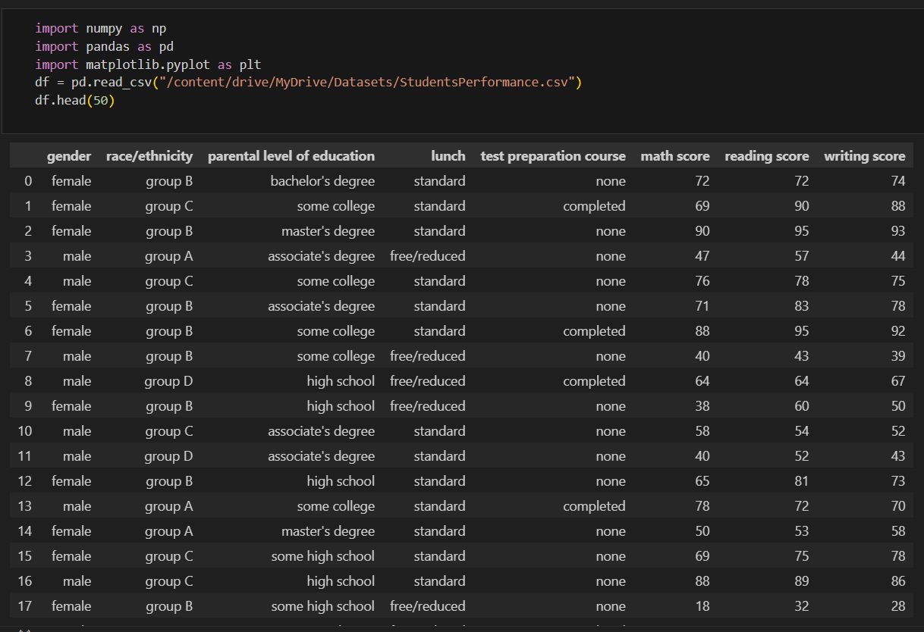
Steps taken to perform the EDA (Exploratory Data Analysis)
Step 1 :-
First we import the data in notebook for analysis and to do so we used pandas library to read the data and represent it in a tabular form.

Slide 8
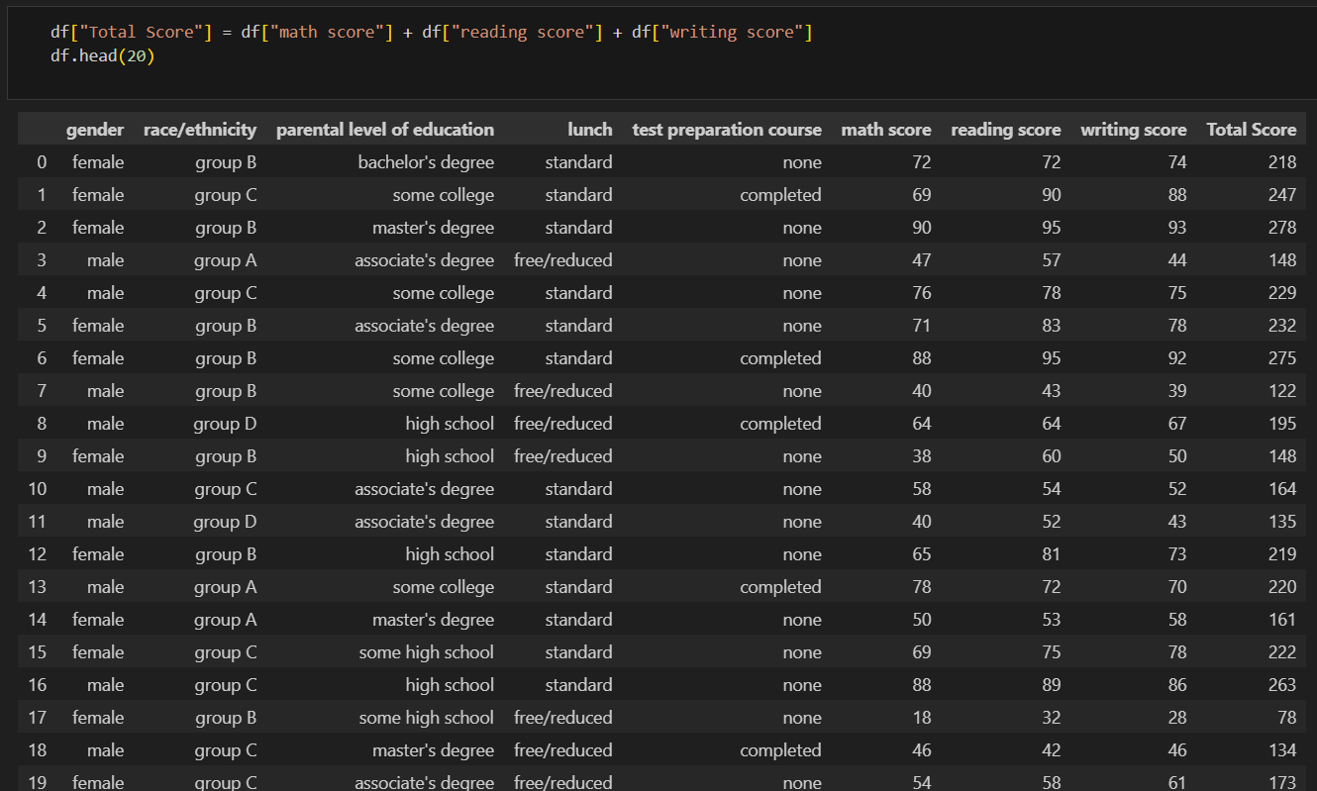
Preprocessing
Step2 :-
In this step we are adding a new column to the data which is the total score of the student which will help to assess the grade of the student and to calculate the mean of marks scored by students.

Slide 9
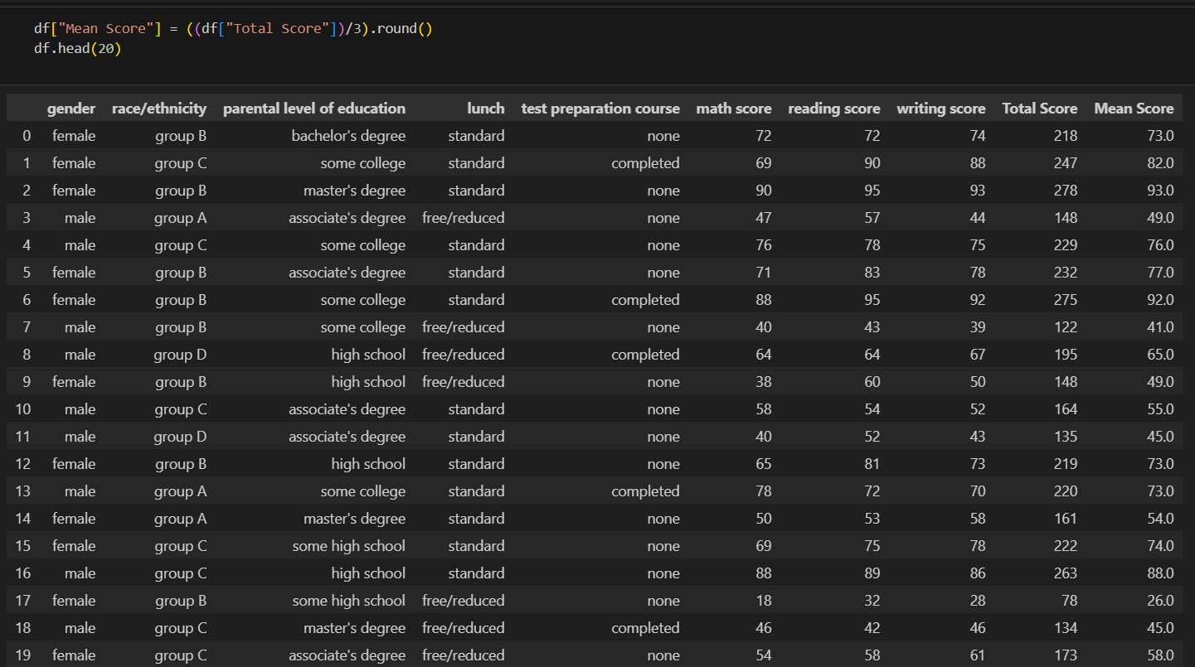
In this step we have calculated the mean score for every student from the total score which will be used to show the relation between the grade of a student and parents education.

Slide 10
Label Encoding
Step3:-
In this step we have encoded the data of parents education background into a numerical column using sklearn library so that it can be used to plot the relation between student’s grade and parent’s education background.
Numeric form of parent’s education are :
“0” for associate’s degree
“1” for bachelor’s degree
“2” for high school
“3” for masters degree
“4” for some college
“5” for some high school

Slide 11
Outliers Detection
An outlier is a data item/object that deviates significantly from the rest of the (so-called normal)objects. They can be caused by measurement or execution errors. The analysis for outlier detection is referred to as outlier mining. There are many ways to detect outliers, and the removal process of these outliers from the dataframe is the same as removing a data item from the panda’s dataframe.
To detect the outliers we have plot the data using boxplot of seaborn library. Box plot is a data visualization plotting function. It shows the min, max, median, first quartile, and third quartile. All of the things will be explained briefly.
The dots that are below 30 in the boxplot are the outliers for this dataset.

Slide 12
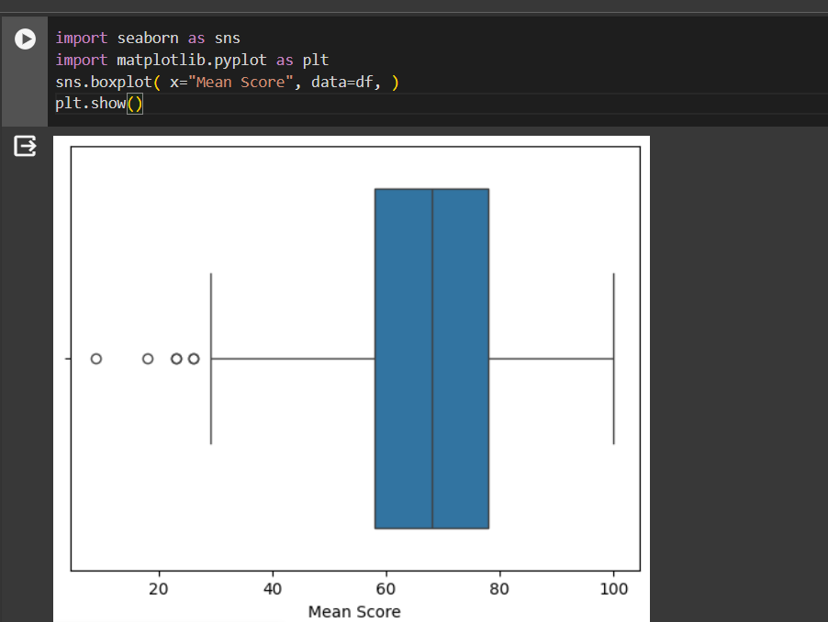
Boxplot to show outliers

Slide 13
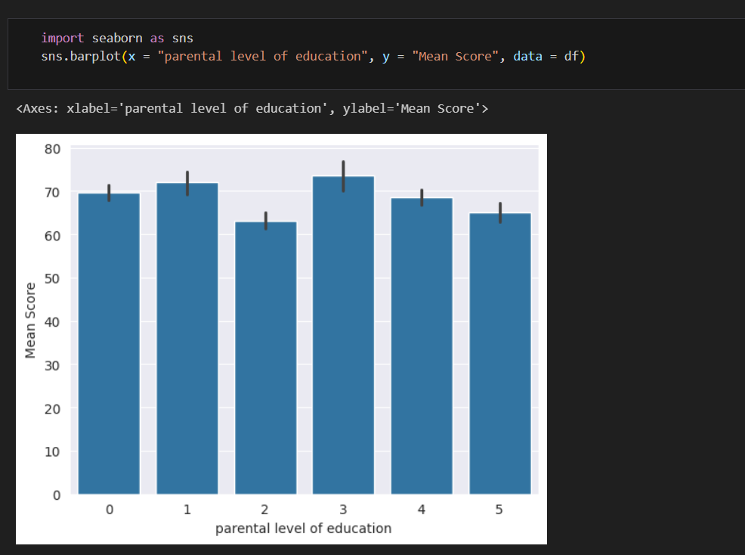
Visualisation of Data
In this step we have plotted a bar graph between student’s grade and parent’s education background to show the relation between these two variables using seaborn library.

Slide 14
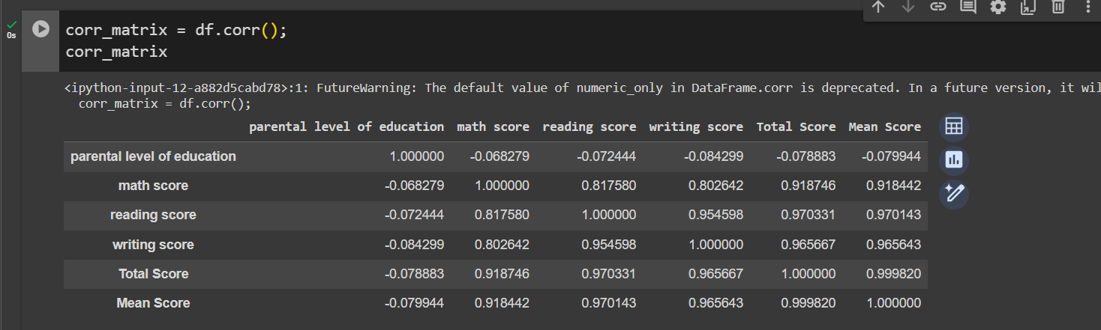
Correlation Analysis
Correlation matrix describes the relation between different factors over mean score of the students.

Slide 15
Interpretation
We have plotted a graph using the relationship between the student’s grade and parent’s education background. From the above graph we can interpreted that students whose parents have studied till high school have scored low on an average and students whose parents have completed theirs masters scored higher from other students on an average.Thus from the data we can say that parents education background matters in students grades i.e when parents education is higher then, the students grade also goes higher.

