Slide 1
Super Resolution With GAN
Dhruv Kabariya - AU1940188
Shivam Thakkar - AU1940193
Pranav Gandhi - AU1940290

Slide 2
Introduction
The super important task of estimating a High Resolution(HR) image from it’s low resolution(LR) image is known as Super Resolution(SR). A lot of research has been carried out in this field in the computer vision field. Super resolution tries to reconstruct high quality clean image from it’s low quality degraded image. It also try to reduce noise in generated image.

Slide 3
Problem Statement
Generating High resolution image from given Low resolution image with texture information preserved and minimize noise as much as possible.

Slide 4
Existing Work
SRResNet
Super Resolution ResNet up sample the image by x factor with help of convolution network
Use Residual Network as Backbone
Use Simple Convolution network

Slide 5
Our Approach
We create two network (1) Generative Network ( GN ) and (2) Discriminator Network(DN).
Here GN generate super resolution Image.
Now from generated image DN decide whether the given is same as HR.
Now the loss is back propagate through network, for GN loss will content loss and adversarial loss ( weighted ).

Slide 6
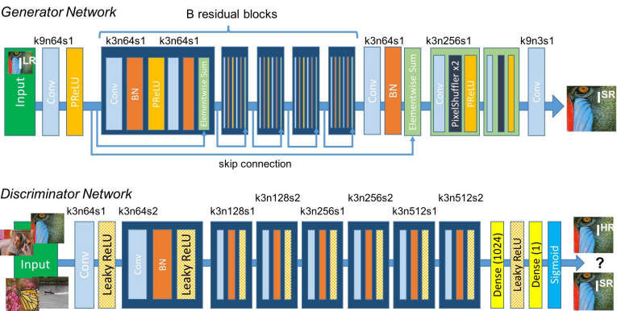
C. Ledig, L. Theis, F. Husz ar, J. Caballero, A. Cunningham, A. Acosta, A. Aitken, A. Tejani, J. Totz, Z. Wang et al., “Photo-realistic single image super-resolution using a generative adversarial network,” in Proceedings of the IEEE conference on computer vision and pattern recognition, 2017, pp. 4681–4690.

Slide 7
Model Approach
Generative Model
Block : 3x3 kernel with convolution method followed by batch normalization, activation
4 block sequentially connected with residual connections
2 block with convolution operation for upscaling
Discriminator Model
Block : 3x3 kernel with convolution method followed by batch normalization, ReLU activation
8 block connected sequentially
Dense Connected Layer (MLP) with 1024 node and Relu Activation
Sigmoid activation used for last layer
Content Loss : I_{c} = (I_{HR} - G(I_{LR}) )2
Adversarial Loss : I_{g} = - log D(G(I_{LR}))

Slide 8
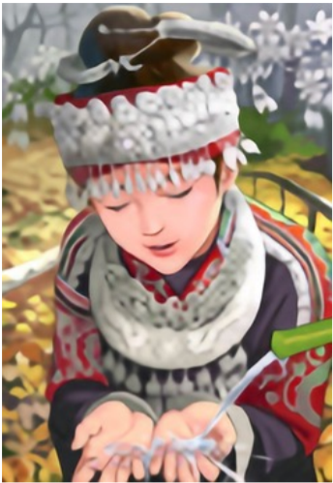
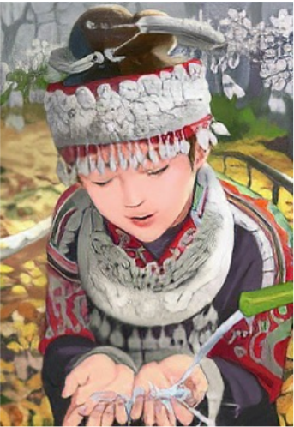

Results Comparisons
SResNet
GAN
Original
C. Ledig, L. Theis, F. Husz ar, J. Caballero, A. Cunningham, A. Acosta, A. Aitken, A. Tejani, J. Totz, Z. Wang et al., “Photo-realistic single image super-resolution using a generative adversarial network,” in Proceedings of the IEEE conference on computer vision and pattern recognition, 2017, pp. 4681–4690.

Slide 9
Future Works
Contributions
Adding Self Attention to Model ( for better feature extraction )
Better performance in Machine translation
Visual self attention give better result too
Mechanism of focus on texture thing
Creating graphs of epoch loss and noise in generated image.
Graph of noise in our and SRResNet and other work
Graph of Content Loss and adversarial Loss
Dhruv : Model Architecture
Shivam : loss functions and comparison of results
Pranav: collecting data from youtube and open datasets, training of model

Slide 10
References
C. Ledig, L. Theis, F. Husz ar, J. Caballero, A. Cunningham, A. Acosta, A. Aitken, A. Tejani, J. Totz, Z. Wang et al., “Photo-realistic single image super-resolution using a generative adversarial network,” in Proceedings of the IEEE conference on computer vision and pattern recognition, 2017, pp.
4681–4690.
Christian Ledig, Lucas Theis, Ferenc Huszar, Jose Ca-ballero, Andrew Cunningham, Alejandro Acosta, Andrew Aitken, Alykhan Tejani, Johannes Totz, Zehan Wang, et al. Photo-realistic single image super-resolution using a generative adversarial network. In IEEE Conference on Computer Vision and Pattern Recognition, pages 4681–4690, 2017.
Wenbo Li, Kun Zhou, Lu Qi, Nianjuan Jiang, Jiangbo Lu, and Jiaya Jia. Lapar: Linearly-assembled pixel-adaptive regression network for single image super-resolution and beyond. arXiv preprint arXiv:2105.10422, 2021.
Yulun Zhang, Yapeng Tian, Yu Kong, Bineng Zhong, and Yun Fu. Residual dense network for image super resolution. In IEEE Conference on Computer Vision and Pattern Recognition, pages 2472–2481, 2018
Xintao Wang, Ke Yu, Shixiang Wu, Jinjin Gu, Yihao Liu, Chao Dong, Yu Qiao, and Chen Change Loy. Esrgan: Enhanced super-resolution generative adversarial networks. In European Conference on Computer Vision Workshops, pages 701–710, 2018
Jiang, Y., Chang, S., & Wang, Z. (2021). Transgan: Two pure transformers can make one strong gan, and that can scale up. Advances in Neural Information Processing Systems, 34.

