Slide 1
Super Resolution Using Transformer based GAN
Dhruv Kabariya - AU1940188
Shivam Thakkar - AU1940193
Pranav Gandhi - AU1940290

Slide 2
TransGAN
Purely Transformer based and no convolution
Contains a memory friendly generator, a multi-scale discriminator and grid-self attention mechanism.
A training technique which includes data augmentation, modifying layer normalization and relative position encoding.

Slide 3
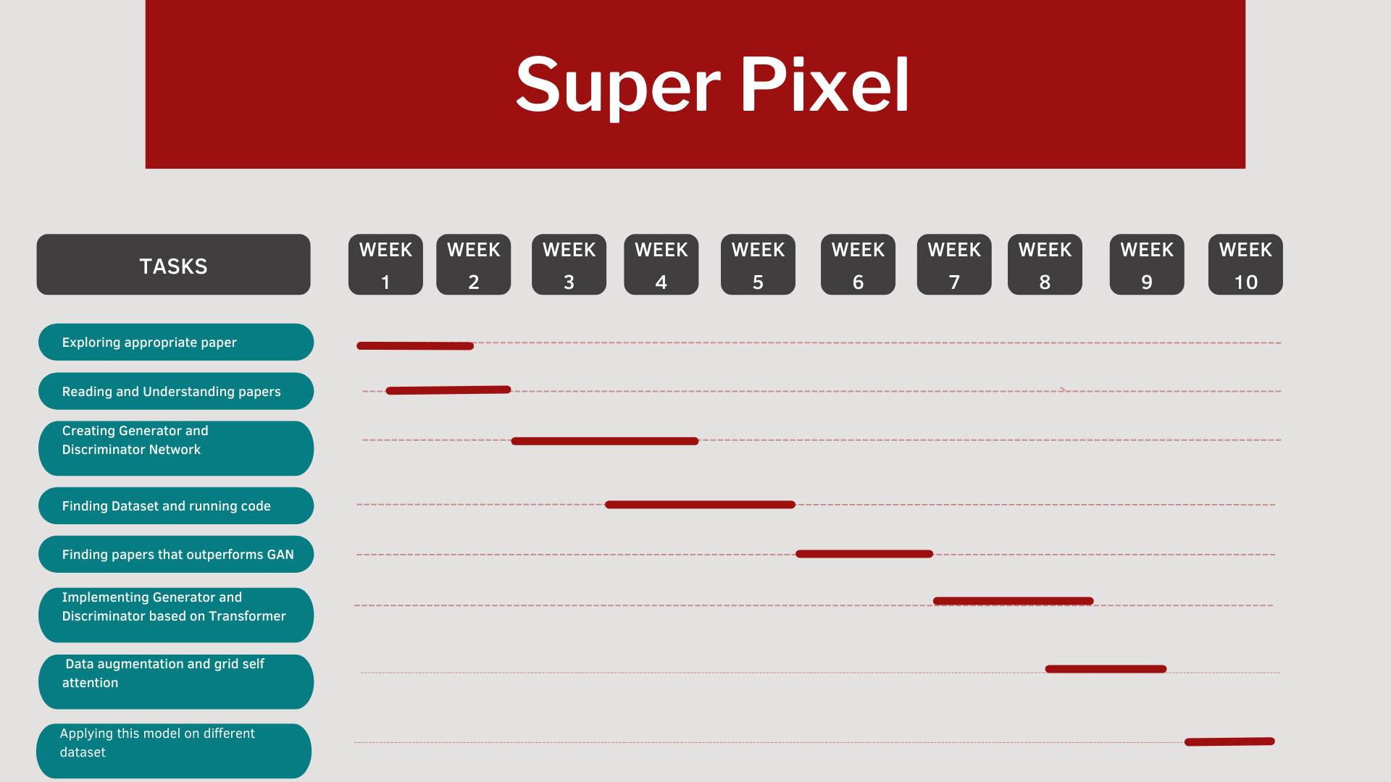
Gantt Chart

Slide 4
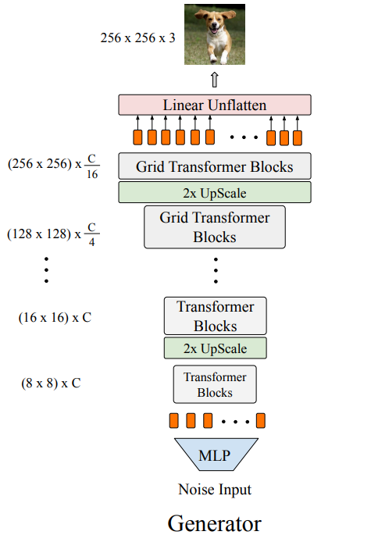
Generator Model
For low-resolution stages, the upsampling module adopts the bicubic layer to upsample it’s resolution by twice keeping it’s dimension unchanged.
For high-resolution stages, the bicubic upscaling layer is replaced with pixelshuffle module which increases the resolution by 2*ratio and reduces the dimension of input size by a quarter.

Slide 5
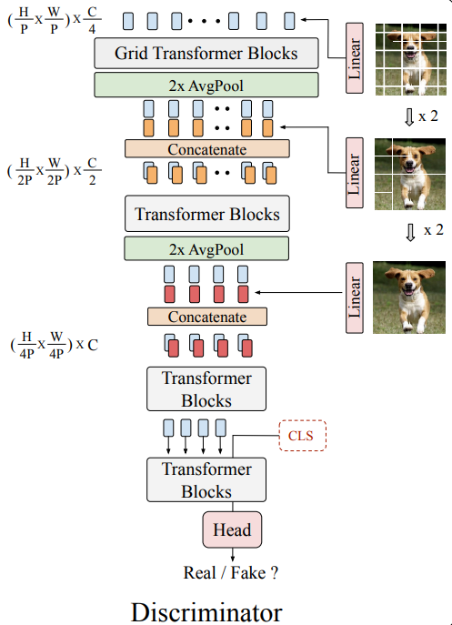
Discriminator Model
As per the model, we first split the input image into three different sequence by choosing 3 different patches (P, 2P, 4P).
These 3 sequences are combined and will give us the semantic structure and the texture details.
We add an Average Pooling layer to downsample the feature map resolution , between each stage and at last we get an output that whether the generated image is real/fake.

Slide 6
Grid Self-Attention
The Grid self-attention partitions the full size feature map into several non-overlapped grids and the token interactions are calculated inside each local grid.
Grid Self-Attention is mainly used in High Resolution stages and standard self attention in low resolution stages.
The main benefit of using Grid-Self Attention is that the local details and global awareness both are taken care of.

Slide 7
Training Technique
Data Augmentation - Doing data augmentation using change in Translation, Cutoff and Color leads to a rapid performance improvement.
Relative Position Encoding - Considering relative position as compared to absolute helps in learning stronger relationship between local contents which leads to the performance improvement.
Modified Normalization - It uses token-wise scaling layer and a simple rescaling which helps in stabilizing Trans-GAN training and helps in better Trans-GAN training.

Slide 8
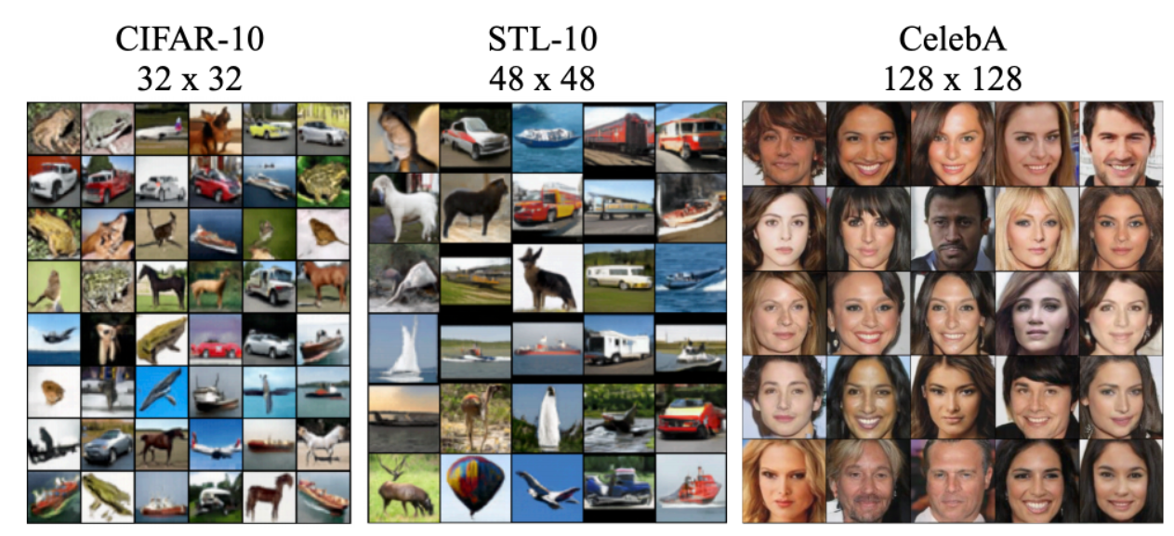
Results

Slide 9
Datasets
CIFAR-10 dataset which consists of 60,000 32*32 images with 50,000 images for training and 10,000 images for testing.
STL-10 dataset which contains 5,000 training images and 1,00,000 48*48 unlabeled images
Celeb A dataset which contains 2,00,000 128*128 unlabeled images

Slide 10
Why TransGAN
Takes care of texture level detail which is not possible using Convolution Neural Network.
Decreases the training instability.
Assigns appropriate weights to every minute detail wherever required.
Convolution is not effective for long range dependency modelling.

Slide 11
Contribution of each team member
Dhruv : Generator and Discriminator model using Transformer
Shivam : Grid Self Attention and Training method(Data Augmentation, Relative position Encoding)
Pranav: Finding relevant papers and collecting data from open source datasets and training of model

Slide 12
References
Jiang, Y., Chang, S., & Wang, Z. (2021). Transgan: Two pure transformers can make one strong gan, and that can scale up. Advances in Neural Information Processing Systems, 34.
Ashish Vaswani, Noam Shazeer, Niki Parmar, Jakob Uszkoreit, Llion Jones, Aidan N Gomez, Łukasz Kaiser, and Illia Polosukhin. Attention is all you need. In Advances in neural information processing systems, pages 5998–6008, 2017.
Tero Karras, Timo Aila, Samuli Laine, and Jaakko Lehtinen. Progressive growing of gans for improved quality, stability, and variation. arXiv preprint arXiv:1710.10196, 2017.
Emily Denton, Soumith Chintala, Arthur Szlam, and Rob Fergus. Deep generative image models using a laplacian pyramid of adversarial networks. arXiv preprint arXiv:1506.05751, 2015.
Yunyang Xiong, Zhanpeng Zeng, Rudrasis Chakraborty, Mingxing Tan, Glenn Fung, Yin Li, and Vikas Singh. Nystromformer: A nystrom-based algorithm for approximating self-attention. arXiv preprint arXiv:2102.03902, 2021.

