Slide 1
PROJECT REVIEW 2
EPES
Employee Performance
Evaluation System
PEOPLE • PERFORMANCE
A role-based Java web application for employee records,
performance evaluations, goals, feedback and reports.
Java 25
Jakarta Servlet / JSP
MySQL 8 • Tomcat 11
TEAM MEMBERS
Shivam Kumar Upadhyay • Himanshu Raj Singh • Sahil Uttam
Galgotias University | B.Tech CSE (AI & ML)

Slide 2
1. Project Overview
Why EPES was developed
The challenge
The solution
Employee information, performance reviews, goals and feedback can become scattered across manual records and separate processes.
EPES brings employee records and performance workflows into one web application with separate Manager and Employee access.
PROJECT OBJECTIVES
• Centralize employee information and performance records.
• Support structured evaluations, ratings and manager feedback.
• Assign goals and track progress.
• Give employees secure access to their own performance information.
EPES | Review 2 | Galgotias University
2

Slide 3
2. User Roles & Workflow
Two role-specific experiences share one database
MANAGER
EMPLOYEE
Sign in → Manage employees → Create evaluations → Assign goals → Provide feedback → View reports
Sign in → View personal dashboard → Review evaluations → Track assigned goals → Read feedback and reports
Login
Role check
Application modules
DAO / JDBC
MySQL
Authorization and CSRF checks protect the request flow before data-changing operations are processed.
EPES | Review 2 | Galgotias University
3

Slide 4
3. Application Architecture
Layered design separates the interface, request handling, security and data access
PRESENTATION
JSP • HTML • CSS • JavaScript
CONTROLLERS
Login, Employee, Evaluation, Goal, Feedback, Report and Logout Servlets
SECURITY FILTERS
Authentication / role authorization • CSRF token validation
DATA ACCESS
DAO classes • JDBC • PreparedStatement
DATABASE
MySQL 8 • epes_db
EPES | Review 2 | Galgotias University
4

Slide 5
4. Functional Modules
Features available to Managers and Employees
Employee Management
Performance Evaluations
Add, view, update and delete employee records. Manager-only access.
Managers record evaluation criteria, ratings (1–5) and comments.
Goals & Feedback
Performance Reports
Managers assign goals and provide feedback; employees view their own records and update goal status.
Application calculates evaluation counts and average ratings for performance summaries.
EPES | Review 2 | Galgotias University
5

Slide 6
5. Database Design
Eight MySQL tables support employee and performance workflows
employees
users
evaluations
feedback
PK employee_id
name • department • job_title
PK user_id
email • password_hash • role
FK employee_id
PK evaluation_id
FK employee_id
criteria • rating • comments
PK feedback_id
FK employee_id
rating • comments
goals
teams
team_members
performance_reports
PK goal_id
FK employee_id
description • target_date • status
PK team_id
team_name
PK/FK employee_id
PK/FK team_id • role
PK/FK employee_id
total_evaluations • average_rating
Foreign-key relationships connect performance records and user accounts to employees; team_members links employees and teams.
EPES | Review 2 | Galgotias University
6

Slide 7
6. Security & Data Integrity
Security controls are applied across login, requests and database operations
Password storage
Role-based access
PBKDF2WithHmacSHA256, per-password random salt.
Manager and Employee permissions are checked on protected routes and actions.
CSRF protection
Session handling
Session token is rotated at login and validated for state-changing POST requests.
Fresh authenticated session; HttpOnly cookie; cookie-only session tracking.
SQL safety
Validation
PreparedStatement parameters and try-with-resources for JDBC resources.
Server-side checks plus database CHECK constraints for ratings and goal status.
EPES | Review 2 | Galgotias University
7

Slide 8
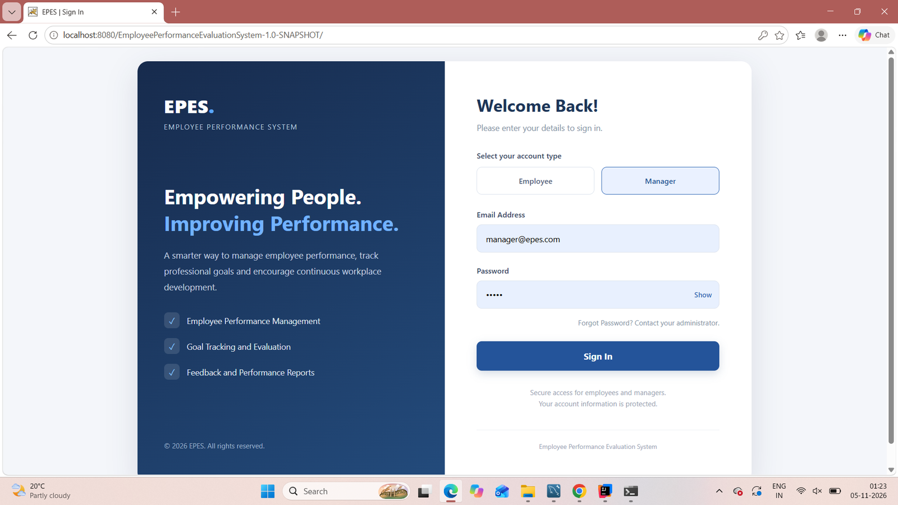
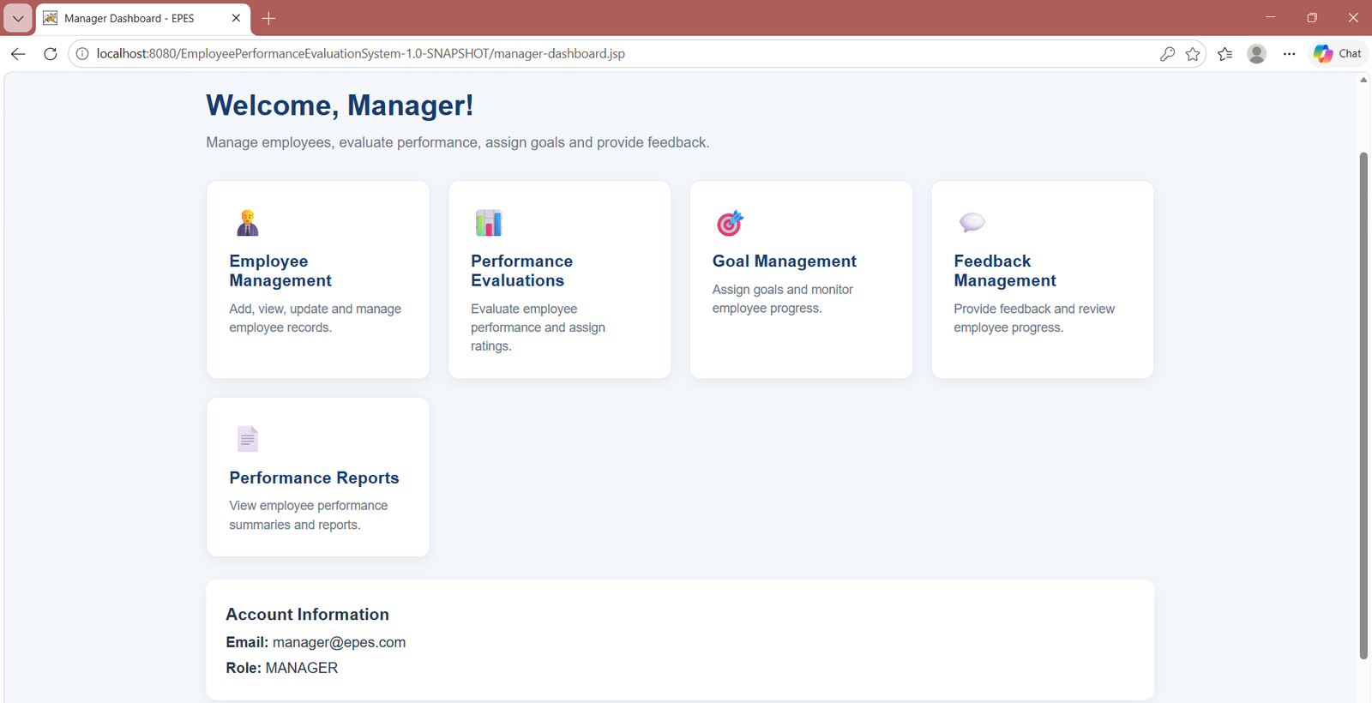
7. Application Screenshots — Login & Manager
Actual screenshots captured from the local application
Login page with Employee / Manager selection
Manager dashboard and management modules
EPES | Review 2 | Galgotias University
8

Slide 9
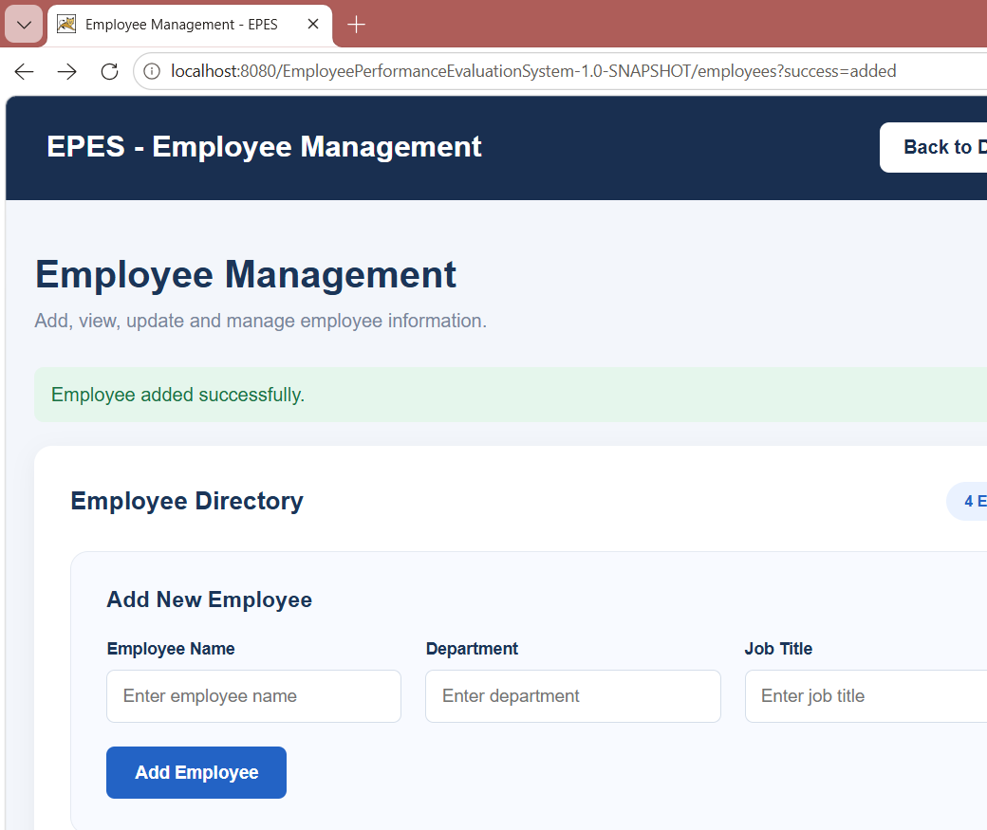
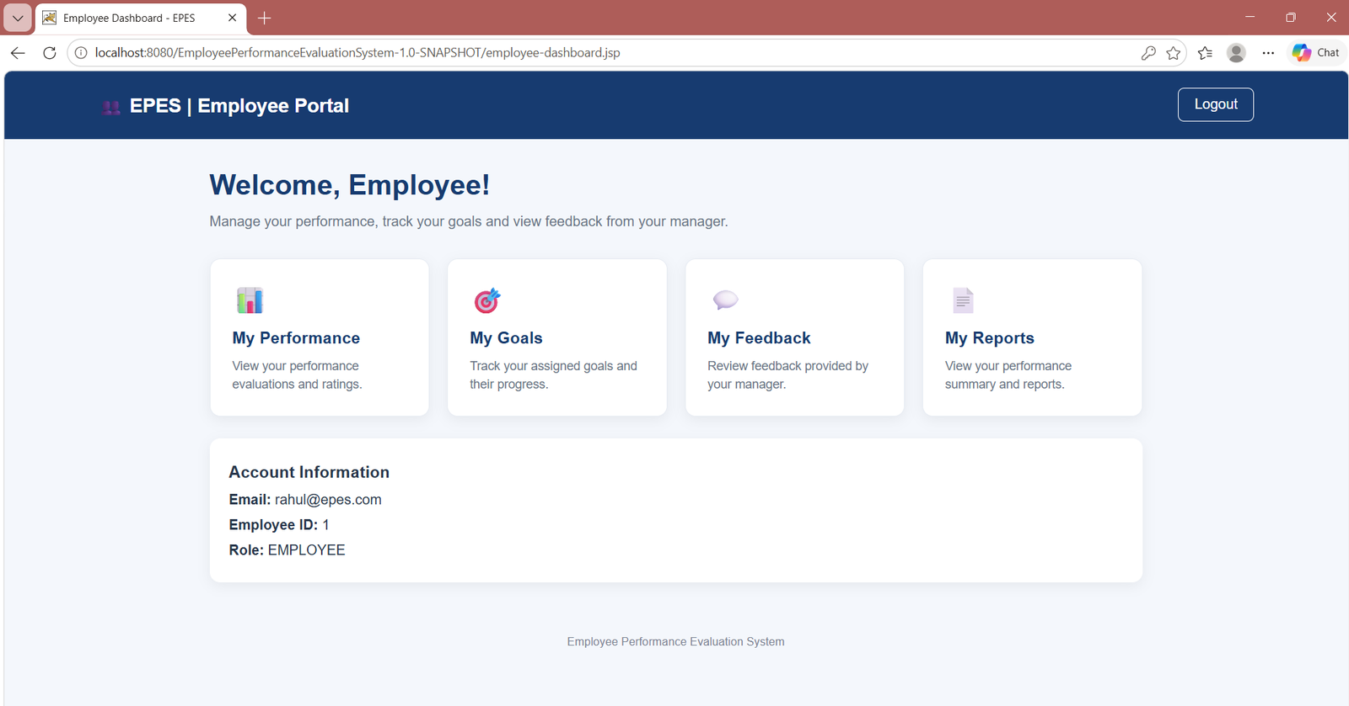
8. Application Screenshots — Employee & Directory
Employee self-service and employee administration
Employee dashboard: performance, goals, feedback and reports
Employee directory and add-employee form
EPES | Review 2 | Galgotias University
9

Slide 10
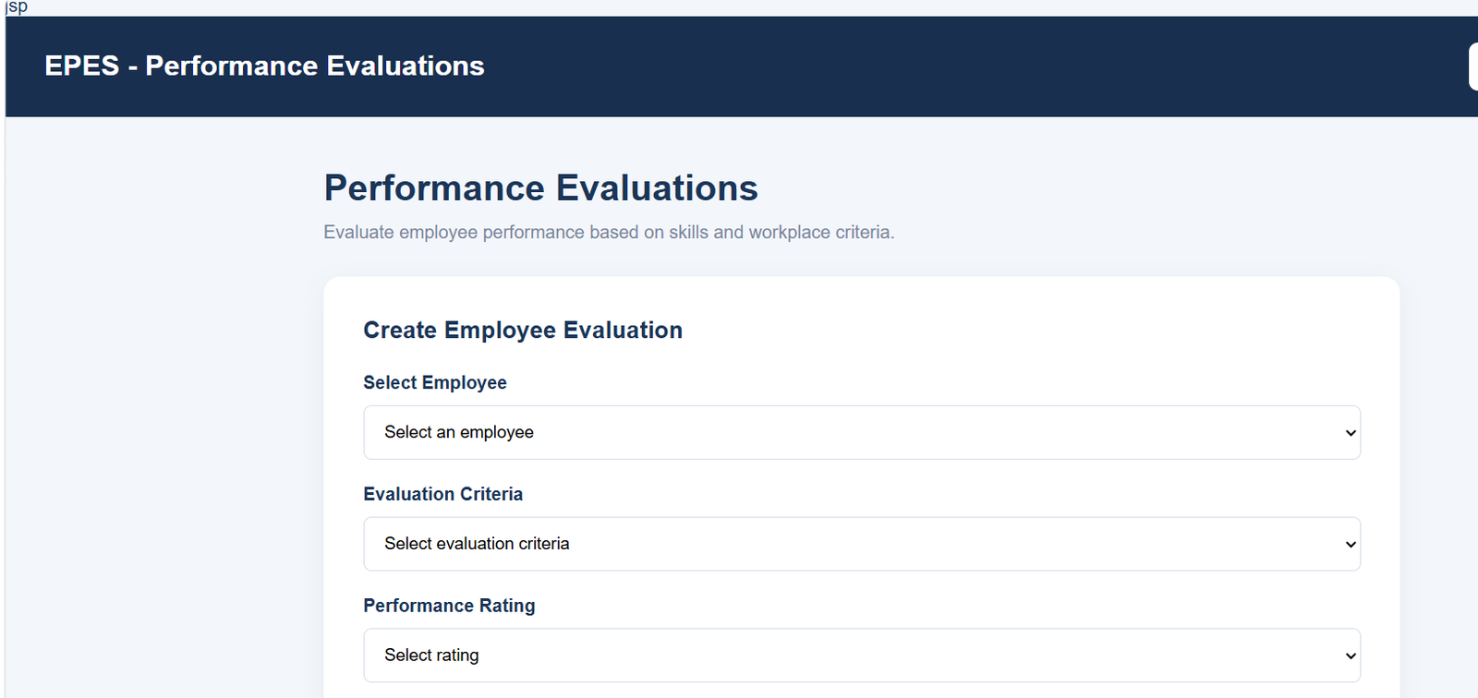
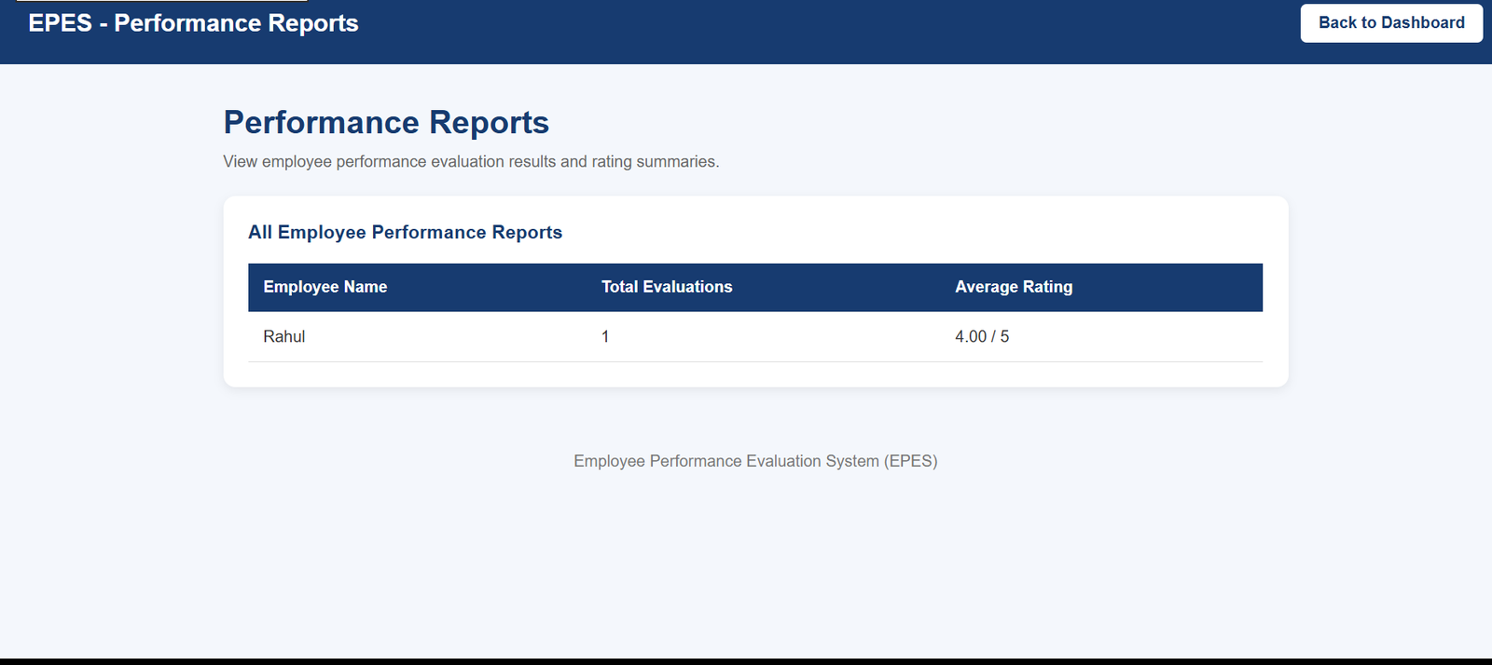
9. Application Screenshots — Evaluation & Reports
Evidence of evaluation entry and calculated performance summary
Manager evaluation form with criteria and rating inputs
Performance report: evaluation count and average rating
EPES | Review 2 | Galgotias University
10

Slide 11
10. Code Quality & Testing
Modular implementation and functional checks
Code organization
Functional checks recorded
• model: domain objects
• dao: database operations
• servlet: request handling
• util: DB, password, CSRF and HTML helpers
Prepared statements and try-with-resources support safer database access.
• Manager and Employee login
• Employee CRUD operations
• Manager-only route restrictions
• Employee-specific access
• Logout and protected-page behavior
• Invalid rating and goal status rejection
• CSRF token coverage on POST forms
Run the Maven build on the submission computer before final upload.
Note: The repository includes manual test utilities; these should not be described as a complete automated JUnit test suite.
EPES | Review 2 | Galgotias University
11

Slide 12
11. Conclusion & Review 2 Outcome
EPES has progressed from the employee-management foundation shown in Review 1 to a role-based application covering key performance workflows.
WORKING MODULES
Employee management
Performance evaluations
Goals and feedback
Performance summaries
TECHNICAL FOUNDATION
Java 25 • Jakarta Servlets • JSP
MySQL 8 • JDBC • DAO
Tomcat 11 • Maven
Authentication and request security
SUBMISSION MATERIAL
Public GitHub repository
README setup instructions
Database schema SQL
Application screenshots
Next improvements: password recovery, email notifications, downloadable PDF reports and analytics.
GitHub: github.com/ShivamUpadhyay303/EmployeePerformanceEvaluationSystem
Galgotias University | B.Tech CSE (AI & ML) | Team: Shivam Kumar Upadhyay • Himanshu Raj Singh • Sahil Uttam

