Slide 1

SENTIMENT ANALYSIS
MACHINE LEARNING
SHIVAM VERMA
B.SC. (H) COMPUTER SCIENCE
6th SEMESTER
19HCS4048

Slide 2


SENTIMENT
ANALYSIS
#1. Used to determine whether a given text contains negative, positive or neutral emotions.
#2. Also known as Opinion mining and Emotion AI.
#3. Form of text analytics that uses Natural Language Processing (NLP) and machine learning.

Slide 3
APPLICATION: SENTIMENT ANALYSIS
Social Media Sentiment Analysis
#4
Helps in elimination of tweets or posts which spread false rumors, hate etc.
Market Research
Helps identify market trends, competitors and new market.
#3
Product Experience
#2
Helps to know how well received the product has been.
Customer Service Experience
Customer reviews can make or break a company.
#1

Slide 4

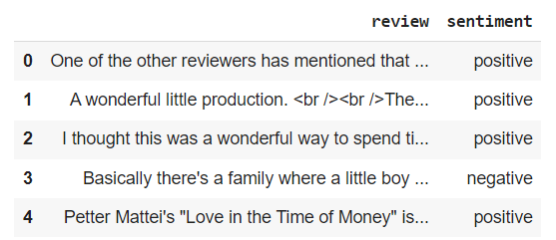
IMDb Movie Review
DATASET
#1. Some special characters are present like HTML tags, @, # etc.
#2. Need to represent the reviews in some numerical form in order to employee machine learning algorithms.
#3. Cumbersome task to vectorize so we need to preprocess the data before.

Slide 5
TEXT
PREPROCESSING
Stemming
Removal of Special Characters
Reduction of words into their root forms.
Removal of HTML tags and other special characters like @, # etc.
Removal of Stopwords
Tokenization
Removal of words that don’t add up anything in the sentiment of a sentence.
Splitting of larger entities into smaller chunks called tokens.

Slide 6
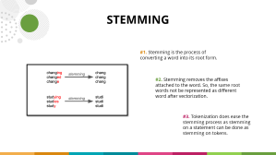
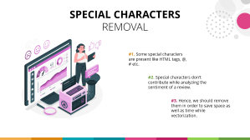
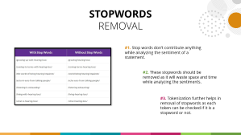
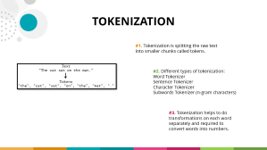
TEXT
PREPROCESSING
Removal of Special Characters
Tokenization
Removal of Stopwords
Stemming
Removal of HTML tags and other special characters like @, # etc.
Splitting of larger entities into smaller chunks called tokens.
Removal of words that don’t add up anything in the sentiment of a sentence.
Reduction of words into their root forms.

Slide 7


SPECIAL CHARACTERS
REMOVAL
#1. Some special characters are present like HTML tags, @, # etc.
#2. Special characters don’t contribute while analyzing the sentiment of a review.
#3. Hence, we should remove them in order to save space as well as time while vectorization.

Slide 8

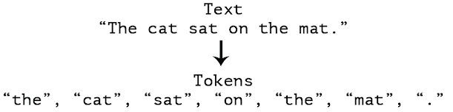
TOKENIZATION
#1. Tokenization is splitting the raw text into smaller chunks called tokens.
#2. Different types of tokenization:
Word Tokenizer
Sentence Tokenizer
Character Tokenizer
Subwords Tokenizer (n-gram characters)
#3. Tokenization helps to do transformations on each word separately and required to convert words into numbers.

Slide 9

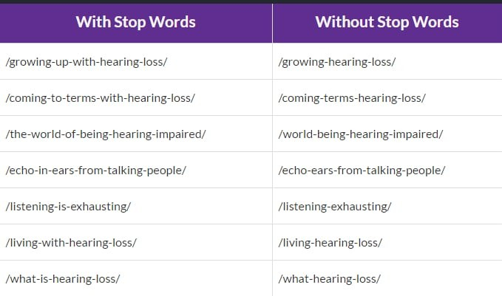
STOPWORDS
REMOVAL
#1. Stop words don’t contribute anything while analyzing the sentiment of a statement.
#2. These stopwords should be removed as it will waste space and time while analyzing the sentiments.
#3. Tokenization further helps in removal of stopwords as each token can be checked if it is a stopword or not.

Slide 10
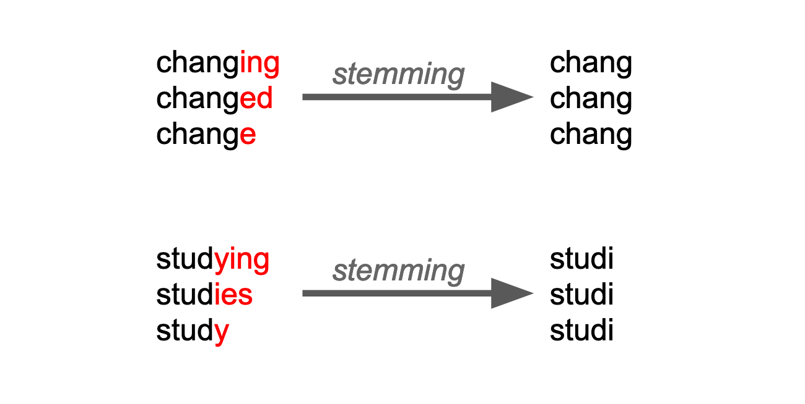
STEMMING
#1. Stemming is the process of converting a word into its root form.
#2. Stemming removes the affixes attached to the word. So, the same root words not be represented as different word after vectorization.
#3. Tokenization does ease the stemming process as stemming on a statement can be done as stemming on tokens.

Slide 11
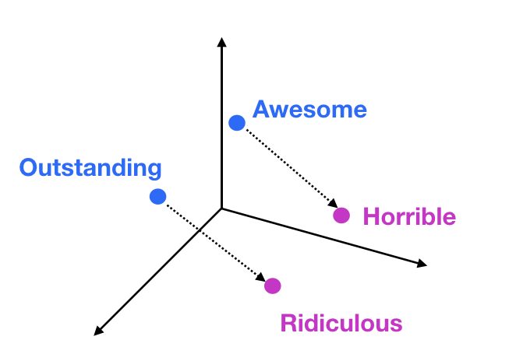
VECTORIZATION
WORD EMBEDDINGS
#1. Word embeddings are words mapped to real number vectors such that it can capture the semantic meaning of words.
#2. Word embeddings use some models to map a word into vectors such that similar words will be closer to each other.
#3. It captures semantical and syntactical information of words.
#4. There are different ways of deriving the word embedding vectors. Word2vec is one such method where neural embeddings model is used to learn that.

Slide 12

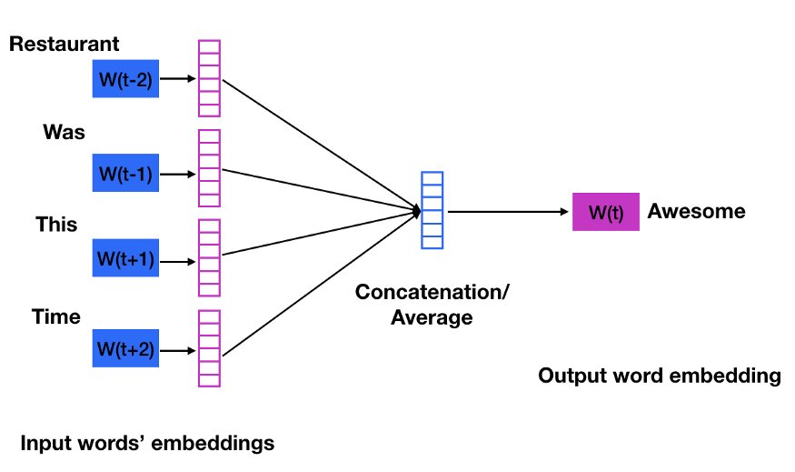
VECTORIZATION
WORD EMBEDDINGS
To train the model it takes into consideration the words surrounding that word of particular window size.
#1. Here the model predicts the word under consideration given context words within specific window.
#2. The hidden layer has the number of dimensions in which the current word needs to be represented at the output layer.
CBOW: Continuous Bag of Words

Slide 13
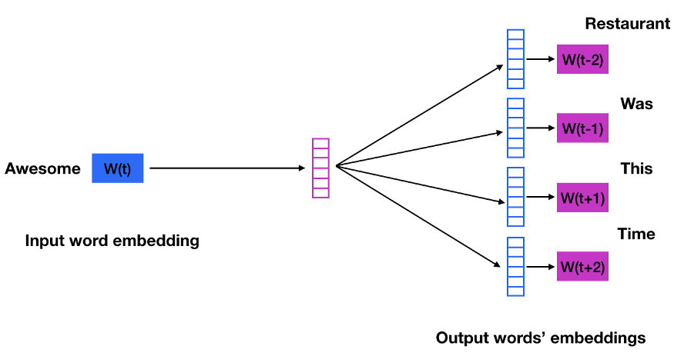
VECTORIZATION
WORD EMBEDDINGS
To train the model it takes into consideration the words surrounding that word of particular window size.
#1. Skip gram is opposite of CBOW where it predicts embeddings for the surrounding context words in the specific window given a current word.
#2. The input layer contains the current word and the output layer contains the context words.
#3. The hidden layer contains the number of dimensions in which we want to represent current word present at the input layer.
Skip Gram

Slide 14
VECTORIZATION
WORD EMBEDDINGS
Parameters for Word2Vec
#1. size: The number of dimensions of the embeddings and the default is 100.
#2. window: The maximum distance between a target word and words around the target word. The default window is 5.
#3. min_count: The minimum count of words to consider when training the model; words with occurrence less than this count will be ignored. The default for min_count is 5.
#4. workers: The number of partitions during training and the default workers is 3.
#5. sg: The training algorithm, either CBOW(0) or skip gram(1). The default training algorithm is CBOW.

Slide 15
LOGISTIC
REGRESSION
Logistic Regression model is first used on validation data and then the best model was used on test samples.

Slide 16

SUPPORT VECTOR
MACHINE
Support Vector Machine model is first used on validation data and then the best model was used on test samples.

Slide 17
K-NEAREST NEIGHBORS
CLASSIFIER
KNN model is first used on validation data and then the best model was used on test samples. The distance metric used here is ‘cosine’ as we’re dealing with vectors.

Slide 18
ACCURACY
CHART
The accuracy of the best models on test samples are shown below:

Slide 19
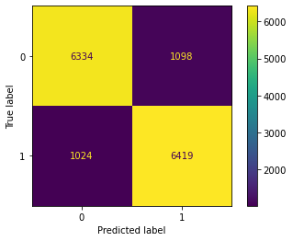
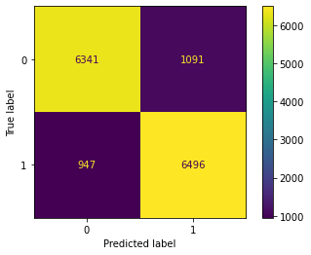
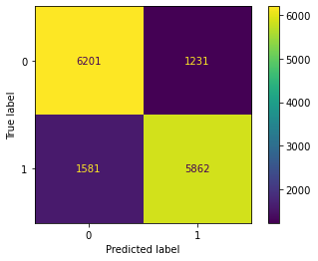
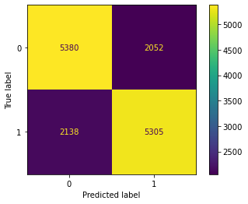
CONFUSION
MATRIX
The Confusion Matrix of all the applied models on test samples are shown below:
Logistic Regression
Support Vector Machine
KNN Classifier
Decision Tree Classifier

Slide 20

CONCLUSION
#1. Support Vector Machine gave the best result on the analysis of IMDb movie reviews with 86.29% accuracy.
#2. Logistic Regression model was giving tough competition to SVM with 85.73% accuracy. We also observed that SVM with linear kernel and Logistic Regression were performing similar on validation set.
#3. KNN Classifier was working best when 15 nearest samples were taken into consideration for classification with accuracy of 81.09%.
#4. Lastly, the Decision Tree Classifier was working 71.83% accuracy. The tree was expanded fully to maximize the accuracy. The depth of the tree was 42.

Slide 21

THANK YOU!

