Slide 1
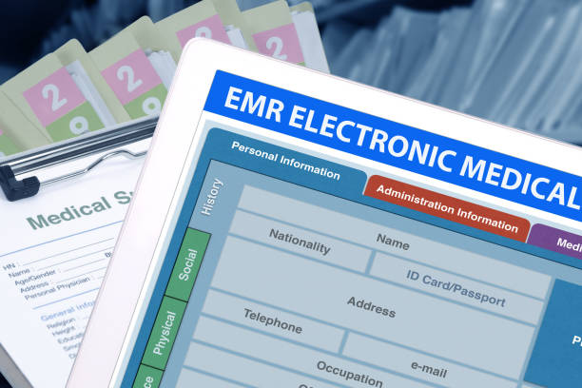
e-HealthBook

Slide 2
Abstract
e-HealthBook is a web-based application which is used to capture, organize, maintain and retrieve individual medical records on day-to-day basis.
User can upload prescriptions, test reports and daily health related events in an image or pdf format.
They can give access to this information to the doctors. This is achieved by using modules like Authentication, Document management, Event management, Access management and Encryption.

Slide 3
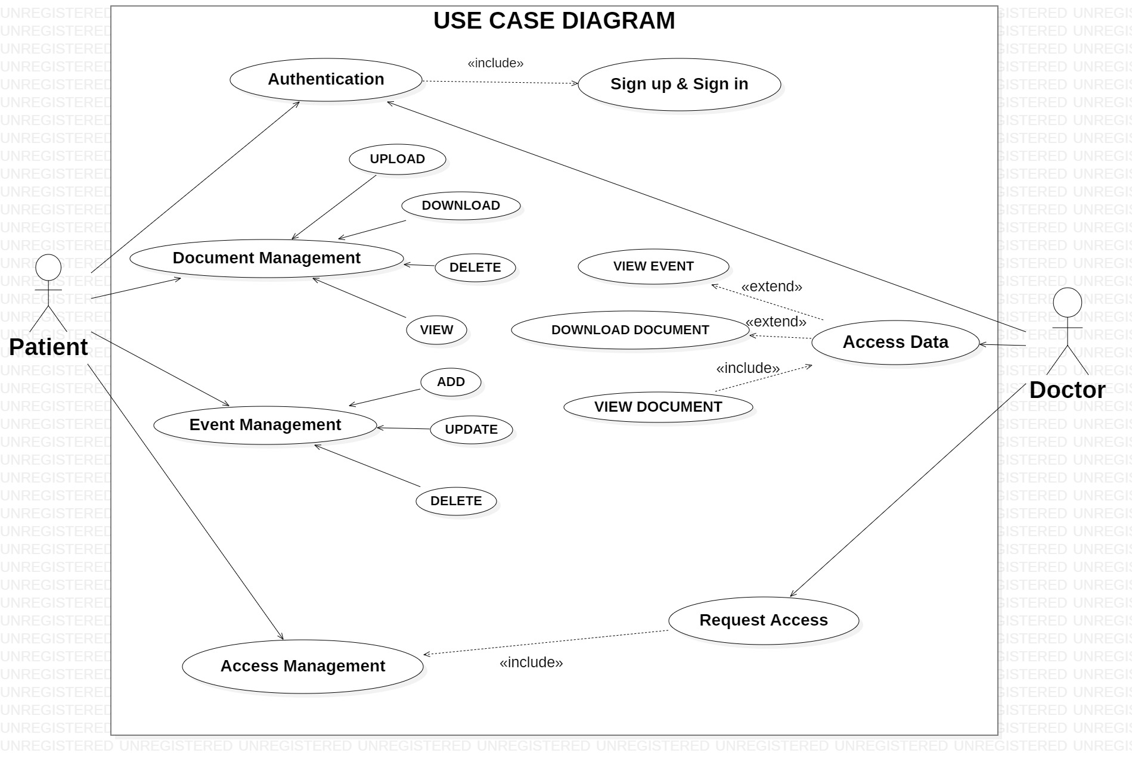

Slide 4
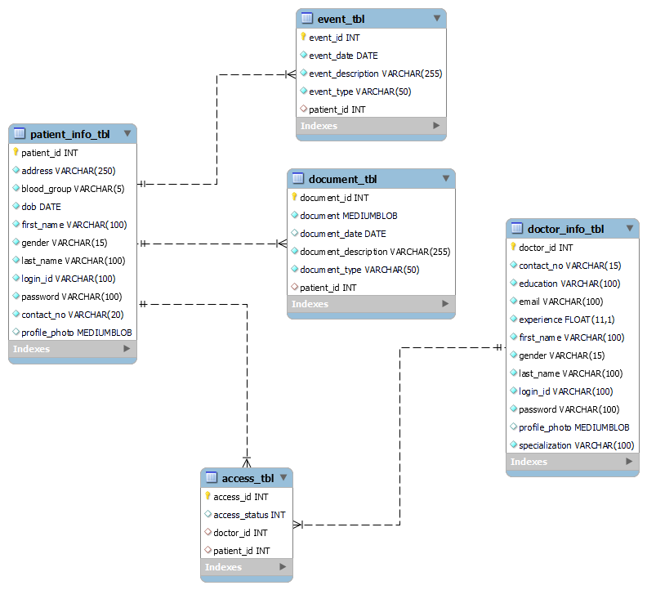
E-R Diagram

