Slide 1
TestOps task-l2 Presentation
By Hardik Gupta (XS/IN/0890)

Slide 2
Agenda
Introduction to Software Testing
Software Development and Testing Life Cycles
Testing Strategies and Frameworks
Testing Methodologies
Specific Testing types and Techniques
Types of Testing
Performance Testing
User Acceptance Testing and Development Models
Defect and Bug Lifecycle Management
Test Planning and Documentation

Slide 3

Introduction to software testing
What is Software Testing
Integral part of SDLC
Involves verifying and validating that a software application is free of bugs, meets the technical requirements and satisfy the user needs efficiently.
Aim is not only finding faults in the application but also finding measures to improve software experience and performance.
Example:
A banking application is rigorously tested to ensure transactions are secure and accurate.
Two main ways of testing:
Manual testing: Tester takes up the role of the end user and tests the software to identify flaws and errors. Different stages for manual testing include unit testing, integration testing, system testing and so on.
Automation Testing: It is also known as Test Automation and here the tester writes scripts and users software to test product. It can essentially be referred as Automation for a manual process.
Examples:
Manual testing of a mobile app's user interface vs. automated testing of its backend APIs using tools like Selenium.

Slide 4
Software testing and testing life cycles
SDLC (Software Development Life Cycle) | STLC (Software Testing Life Cycle)
It is a process followed for software building within a software organization. | It is a systematic approach to testing a software application to ensure that it meets the requirements and is free of defects.
SDLC consist of 6 Phases: Requirement Analysis Software Design Software Build Testing Deployment Maintenance | STLC consists of 5 Phases: Test Planning Test Case Development Test Environment Setup Test Execution Test Closure
QA (Quality Assurance) | QC (Quality Control)
The continuous and consistent improvement and maintenance of process that gives us the confidence the product will meet the needs of the customers. | A process through which a business seeks to ensure that product quality is maintained or improved, and errors are reduced or eliminated.
Aims to improve end-to-end product development lifecycle and plays a crucial role in early identification and prevention in product defects. | Part of the quality management that verifies the products compliance with the standards set by Quality Assurance.
Verification: It is the process of checking that the software achieves its goal without any bugs. Verification is static testing. (Are we building the product right? )
Validation: It is the process of checking whether the software product is up to the mark. Validation is dynamic testing. (Are we building the right product?)

Slide 5
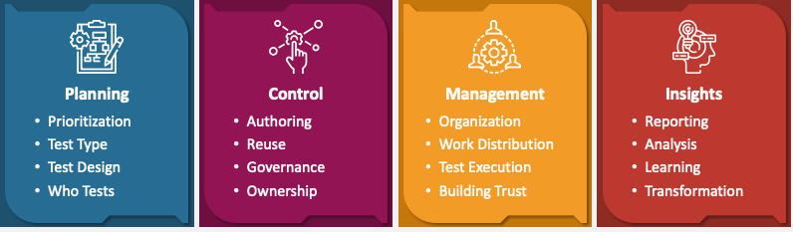
Testing strategies and frameworks
TestOps
It is the process of using automation to centralize and streamline the planning, monitoring and testing of your software development.
4 main components of TestOps:

Slide 6
Future Trends in Testing:
AI and Machine Learning: AI algorithms now have a crucial role in generating test cases, and ML techniques are instrumental in identifying patterns and anomalies in test data.
Rising significance of QAOps: QAOps, blending QA and ITOps revolutionizes software development by integrating QA into the DevOps cycle. This fusion ensures high-quality software standards, as QA is a vital checkpoint before software release.
Test Automation at Scale: Low-code/no-code platforms enable testers to create automation scripts with minimal coding skills.
Role of Test Automation:
Test automation uses tools to execute test cases, improving efficiency and reliability. Automation test engineers identify which tests to automate, develop strategies, and ensure maximum benefits from automation
Quality Assurance: Quality Assurance (QA) ensures products meet quality standards through proactive processes. QA involves usability, feature, system, and integration testing, creating test plans, and developing standards to ensure quality software code.
QAOps: QAOps integrates QA into software delivery pipelines, enhancing collaboration between QA, operations and development teams. It ensures QA processes are part of CI/CD pipelines, improving product quality and delivery speed.
Quality Engineering: It focuses on optimizing product quality by integrating quality checks at every stage of development. It involves management, development, operation and maintenance of IT systems with high-quality standards.
Performance Engineering: It is a proactive approach to building software that meets performance objectives. It involves optimizing performance from the earliest design stages, reducing the need for last-minute tuning.

Slide 7
Testing methodologies
Domain-Driven Testing | Keyword-Driven Testing
Aligns with Domain-Driven Design (DDD) principles. | Use predefined keywords to create test cases.
Tests are based on the domain model and business logic | Keywords represent actions or operations in test scripts
Business-aligned and better coverage of critical functionality | Reusable keywords and easier for non-technical testers
Example: Healthcare software companies use DDT to ensure compliance with medical regulations. | Example: E-commerce platforms use KDT for resusable test scripts.
Test-Driven Development | Behavior-Driven Development
Testing individual units of code before implementation | Specifying and validating the behavior of an application from the user’s perspective
Write tests first, then implement code to pass those tests | Write behavior specifications using natural language to ensure understanding among all stakeholders
Unit tests for individual components | High-level functional tests based on user stories
Example: Microsoft uses TDD to develop robust and error free cloud services. | Example: Walmart uses BDD to create tests that describe the desired behavior of their online shopping system

Slide 8
Testing types and techniques
Aspect | CX Testing | Smoke Testing | Microservices Testing | API Testing | Mobile Testing
Concept | Evaluates the end-to-end experience of users interacting with the product. | Ensures the basic functionalities of an application work as expected. | Focuses on testing individual microservices. | Verifies the functionality, reliability and performance of APIs | Assesses the performance, usability and functionality of mobile apps
Scope | End-to-End user journey and interactions across various touchpoints. | Basic functions and critical paths of the application. | Individual microservices and their interactions with other services | API endpoints, data handling and responses. | Mobile-specific features, performance and usability.
Tools | Usability testing tools, analytics platforms, and user feedback tools. | Basic test scripts and automation frameworks | Service virtualization, containerization, and microservices testing | API testing tools like Postman, RestAssured. | Mobile testing frameworks like Appium, XCTest
Frequency | Continuous or periodic, especially after major updates. | Early in development cycle, typically before more rigorous testing | Throughout development and deployment cycles. | During development and after changes to APIs | Throughout development especially before release and after updates
Examples | Adobe conducts CX testing to enhance the customer experience platform. | Startups perform smoke testing to ensure basic functionalities | Uber tests its microservices architecture to ensure seamless communication between different services. | PayPal rigorously tests APIs to ensure secure and reliable payment processing. | Instagram performs extensive mobile testing to ensure app stability across different devices and OS versions.

Slide 9
Types of testing
Aspect | Functional Testing | Non-Functional Testing | Alpha Testing | Beta Testing
Concept | Validates that software functions according to requirements. | Validates non-functional aspects like performance, usability and security. | Conducted internally to identify bugs before public release | Conducted by end-users in a real environment before the final release.
Scope | Covers functional requirements like features, operations and behavior | Covers non-functional aspects like performance, usability, and other standards. | Comprehensive testing of the entire application by internal testers. | Limited testing by real users in a real-world environment.
Tools | Selenium, QTP, TestComplete | LoadRunner, AppDynamics, Grafana K6 | Internal testing framework and tools | Surveys, feedback tools, bug reporting tools.
Challenges | Identifying all functional requirements ensuring complete code coverage. | Handling complex performance metrics, ensuring security and compliance. | Limited to internal testers, might miss real-world issues | Dependency on external users for thorough feedback and isuse reporting
Example | Login Functionality, Data Input, Validation business processes. | Load testing, stress testing, security testing, usability testing. | Internal testing phases before releasing the software to a wider audience. | Testing by selected external users in real-world scenarios.

Slide 10
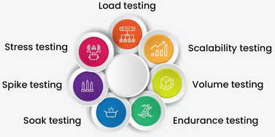
PERFORMANCE TESTING
Aspect | White Box Testing | Black Box Testing
Concept | Involves looking into the internal structure of application. | Evaluates software based on functionality
Scope | Focus on code logic, internal paths | Focus on input-output behavior
Approach | Involves code analysis, control flow testing, path testing | Involves testing functional requirements, end-user scenarios
Examples | Unit tests, integration tests | Functional testing, system testing
Advantages | Early detection of errors, ensures code quality | No need for internal knowledge, the tester can be non-technical.
Performance testing is a type of software testing that focuses on evaluating the performance and scalability of a system or application. Performance testing aims to identify bottlenecks, measure system performance under various loads and conditions, and ensure that the system can handle the expected number of users or transactions.
Types of Performance testing:

Slide 11
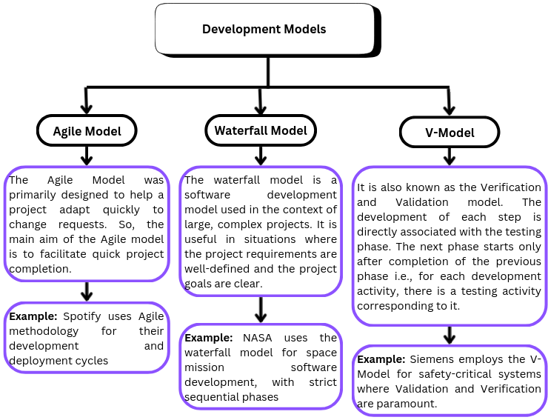
User Acceptance Testing and Development Models
User Acceptance Testing (UAT), or application testing, is the final stage of any software development or change request lifecycle before go-live.
Actual users test the software to determine if it does what it was designed to do in real-world situations, validating changes made and assessing adherence to their organization’s business requirements.
The main purpose of acceptance testing is to validate end-to-end business flow.

Slide 12
DEFECT AND BUG LIFECYCLE MANAGEMENT
A bug/defect is an error or bug in an application that is created during the building or designing of software due to which software starts to show abnormal behavior during its use.
Defect Tracking
Defect Tracking is the process of identifying, documenting and managing defects in software during its development or maintenance.
It involves systematically recording information about a Defect define, prioritize, analyze, and track its status from discovery through resolution to ensure a more reliable and high-quality end product.
Different phases of defect tracking include New, Assigned, Open, Fixed, Verified, Closed, Deferred.
Defect Life Cycle: The defect life cycle is the life cycle of a defect or bug that goes through covering a specific set of states in its entire life. Mainly it refers to the entire state starting from a new defect detected to the closing off that defect by the tester.
Severity: Severity is defined as the extent to which a particular defect can create an impact on the software. Severity is a parameter to denote the implication and the impact of the defect on the functionality of the software. Types of Severity includes Critical, Major, Medium, Low.
Priority: Priority is defined as a parameter that decides the order in which a defect should be fixed. Defect with a higher priority should be fixed first. Types of priority includes Low, Medium, High.

Slide 13
TEST PLANNING AND DOCUMENTATION
Test Plan
A test plan is a document that consists of all future testing-related activites. It is prepared at the project level ad in general, it defines all the work product ot be tested. The test plan serves as a blueprint that changes according to the progressions in the project and stays current at all times.
Test Case
A test case is a set of actions that verify whether the software application is working per the client's requirements. It outlines the steps to follow, the input values to use and the expected outcomes in order to determine whether the application behaves correctly under various conditions.
Test Scenario
A test scenario is a document that covers the end-to-end functionality of the software very briefly, mostly in one line from an end-user perspective. The scenario is intended to simulate a real-life situation the user will face while using the software.
How to Create a Test Plan ?
Define the release Scope
Schedule timelines
Define test objectives
Determine test Deliverables
Design the test strategy
Plan the test environment and test data

Slide 14
Practical task

Slide 15
Thank you

